Slide 1
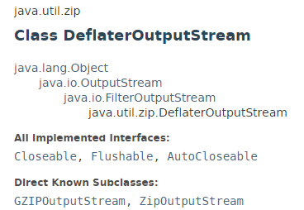
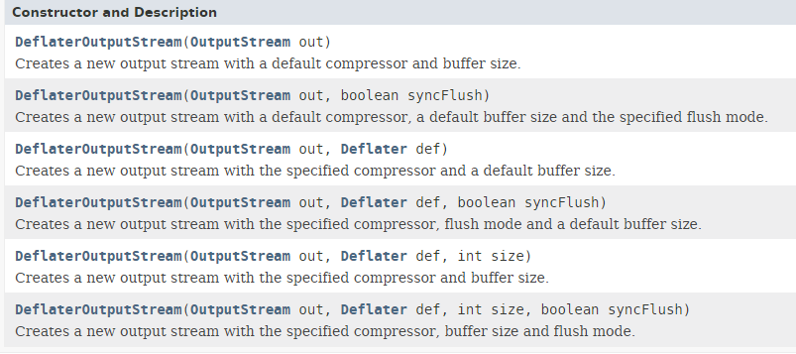
Compressing and Decompressing File
The DeflaterOutputStream class provide mechanism to compress the data in the deflate compression format. It provides facility to the other compression filters, such as GZIPOutputStream.

Slide 2
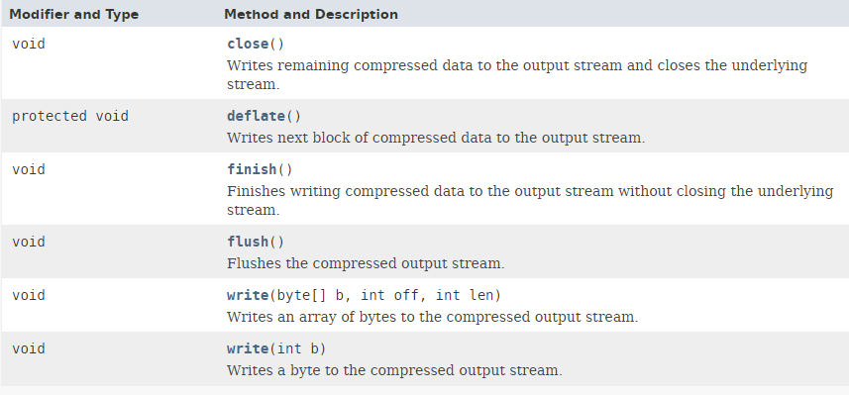
Compressing and Decompressing File

Slide 3
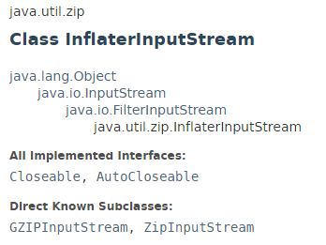
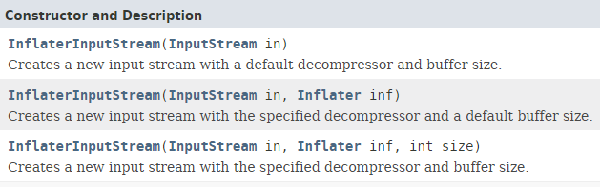
Compressing and Decompressing File
The InflaterInputStream class is used to decompress the file in the deflate compression format. It provides facility to the other decompression filters, such as GZIPInputStream class.

Slide 4
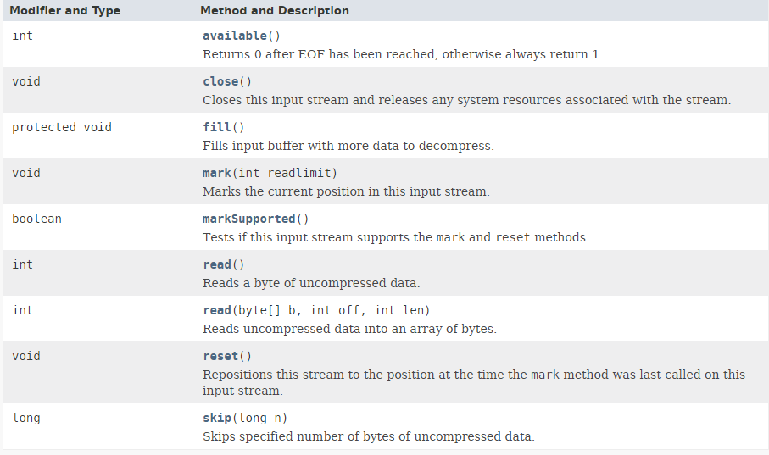
Compressing and Decompressing File

Slide 5
Compressing and Decompressing File
https://en.wikipedia.org/wiki/DEFLATE
https://docs.oracle.com/javase/8/docs/api/index.html?java/util/zip/DeflaterOutputStream.html
https://docs.oracle.com/javase/8/docs/api/index.html?java/util/zip/InflaterInputStream.html

