Slide 1
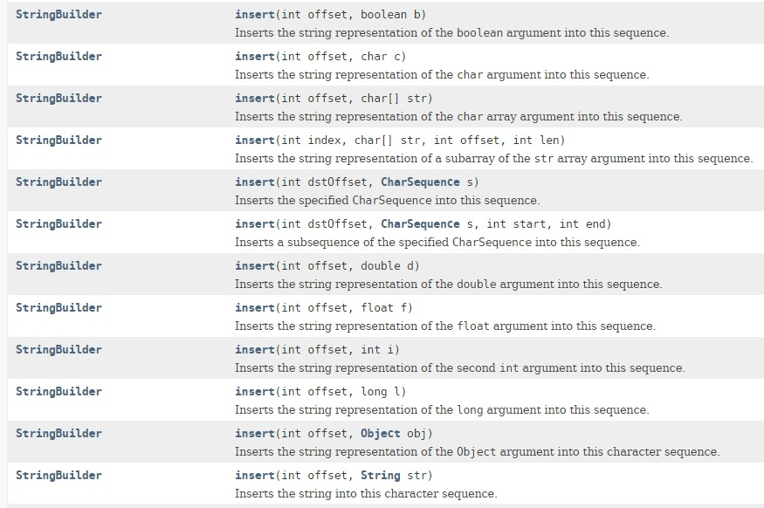
StringBuilder – insert methods

