Slide 1
RandomAccessFile
The RandomAccessFile class in the Java IO API allows you to move around a file and read from it or write to it as you please. You can replace existing parts of a file too. This is not possible with the FileInputStream or FileOutputStream.
Random access files permit nonsequential, or random, access to a file's contents. To access a file randomly, you open the file, seek a particular location, and read from or write to that file.
The United States of America (USA), commonly referred to as the United States (U.S.) or America, is a country composed of 50 states, a federal district, five major self-governing territories, and various possessions.[fn 1] The 48 contiguous states and federal district are in central North America between Canada and Mexico, with the state of Alaska in the northwestern part of North America and the state of Hawaii comprising an archipelago in the mid-Pacific. The territories are scattered about the Pacific Ocean and the Caribbean Sea. At 3.8 million square miles (9.8 million km2)[17] and with over 324 million people, the United States is the world's third largest country by total area (and fourth largest by land area)[fn 2] and the third most populous. It is one of the world's most ethnically diverse and multicultural nations, the product of large-scale immigration from many other countries.[23] The country's capital is Washington, D.C. and its largest city is New York City; other major metropolitan areas include Los Angeles, Chicago, Dallas, San Francisco, Boston, Philadelphia, Houston, Atlanta and Miami. The geography, climate and wildlife of the country are extremely diverse.[24]
myfile.txt

Slide 2
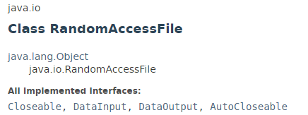
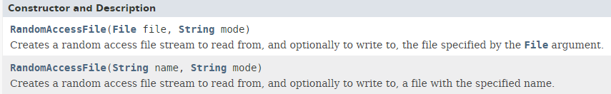
RandomAccessFile

Slide 3
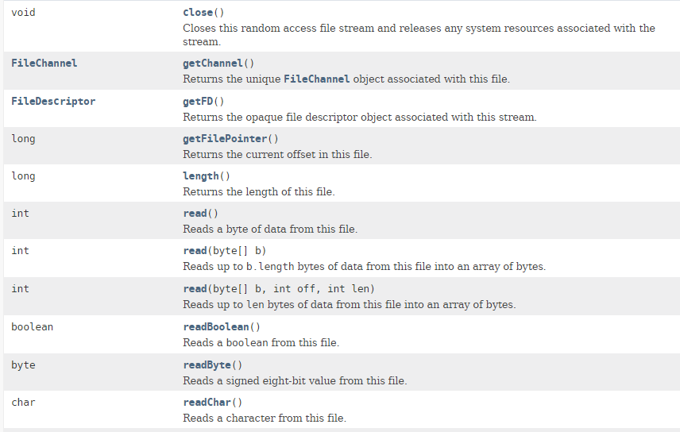
RandomAccessFile

Slide 4
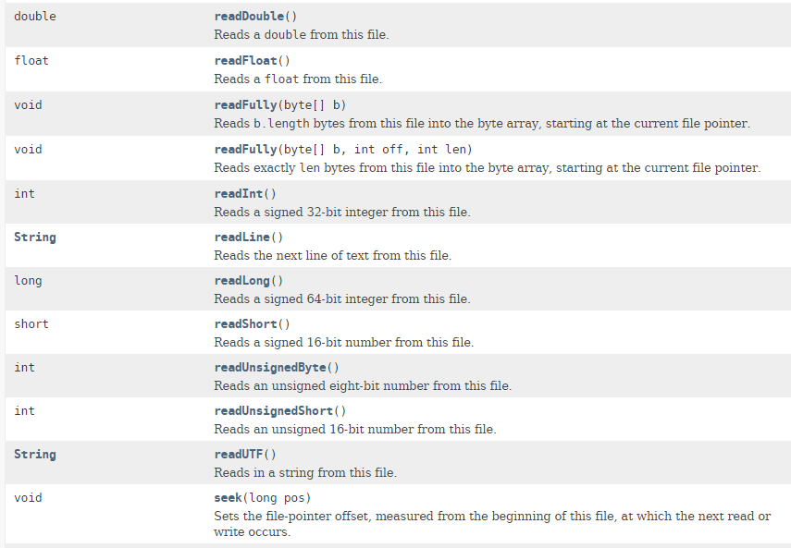
RandomAccessFile

Slide 5
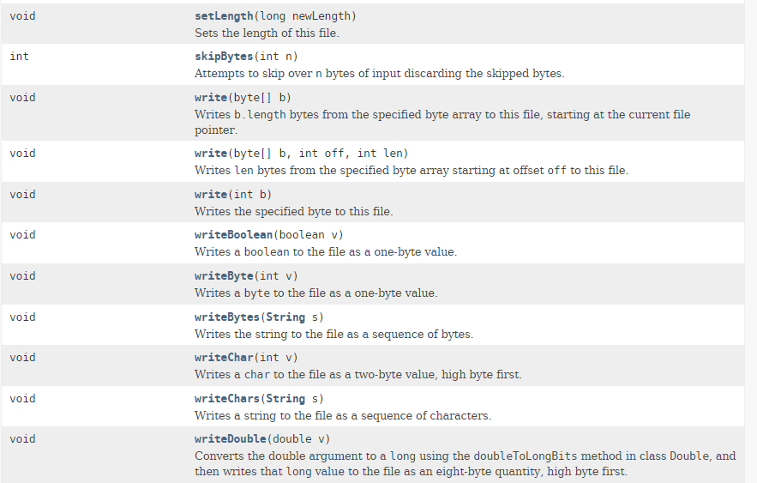
RandomAccessFile

Slide 6
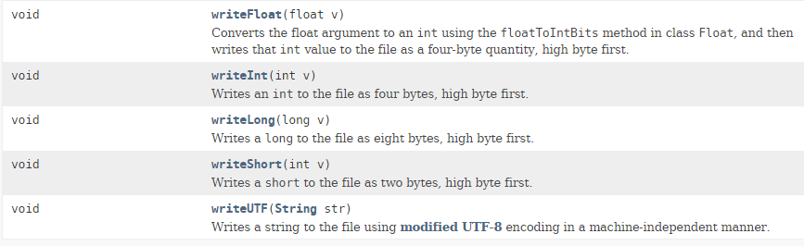
RandomAccessFile

Slide 7
RandomAccessFile
https://docs.oracle.com/javase/8/docs/api/index.html?java/io/RandomAccessFile.html

