Slide 1
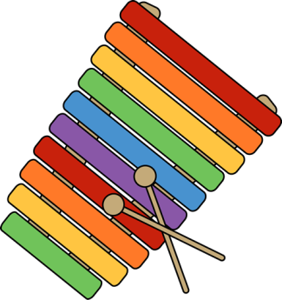
Xx
Xylophone

