Slide 1
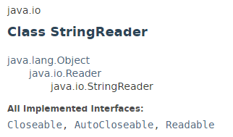

StringReader
A character stream whose source is a string.
The Java StringReader class enables you to turn an ordinary String into a Reader. This is useful if you have data as a String but need to pass that String to a component that only accepts a Reader.

Slide 2
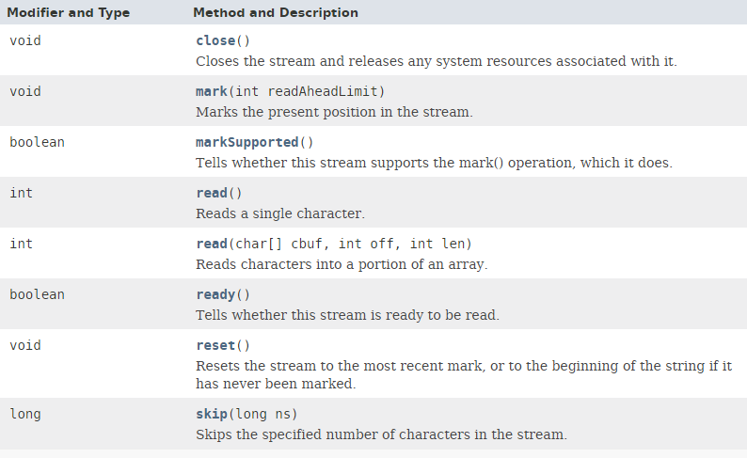
StringReader

Slide 3
StringReader
https://docs.oracle.com/javase/8/docs/api/index.html?java/io/StringReader.html

