Slide 1
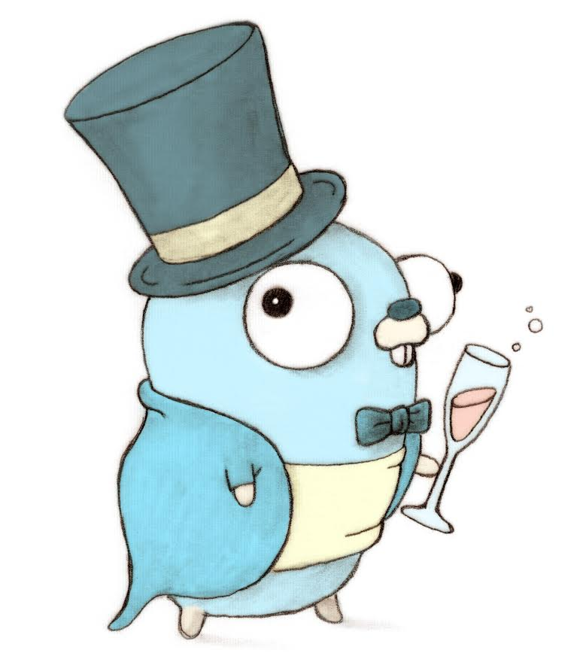
GO P0
15440 Fall 2021
Session 1: 7pm - 7:50pm
Session 2: 8pm - 8:50pm
Stolen from Fall’18 slides made by Samuel Kim and Chelsea Chen

Slide 2
Outline
Overview
Brief syntax overview
Go Concurrency Examples
P0
Tips/Tricks
Questions

Slide 3
Overview
Purpose of this recitation:
Teach important GO concurrent models.
Will be crucial in p0 and p1.
Mutexes not allowed until p2.
Briefly go over p0.
Answer GO related questions.
Strengthen basic knowledge of GO and its syntax.
Brief syntax overview.
Please read and understand all of “A Tour of GO” before you start the project.

Slide 4
How not to write Go
Know another language,
Think in terms of the other language,
“Translate” statement by statement.
If you want to enjoy the power of Go…
...you need to embrace its idiosyncrasies
We kind of force you to do this anyway.

Slide 5
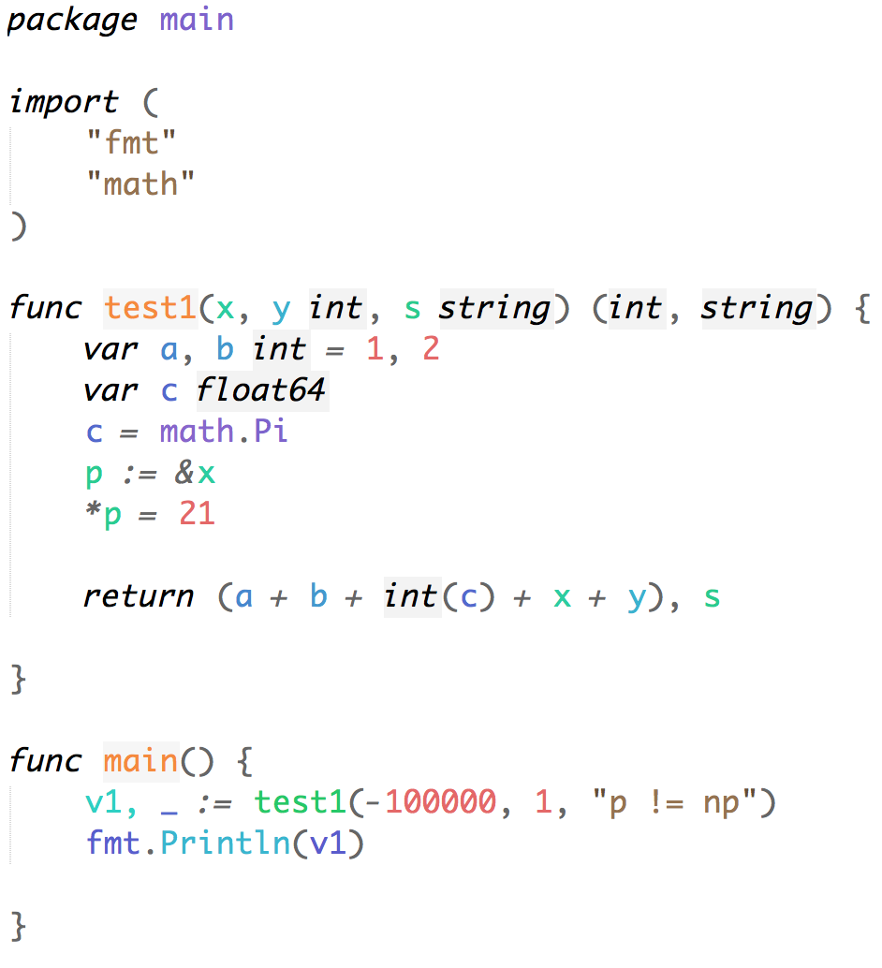
Brief Syntax Overview (1/5)
Always a part of a package
Library imports
Return types specified here
Implicit int pointer type
Type casting
Basics
Notes:
Points to cover:
package name at top
imports (single line vs multiple)
function declaration (parameters and return)
two types of variables declarations
explicit (var foo int)
implicit (foo := 0)
type casting
main is like C’s main (but returns void instead of int)
printing (fmt.Println, fmt.Printf, fmt.Sprintf) - formatting is similar to C’s
Code:
package main
import (
"fmt"
"math"
)
func test1(x, y int, s string) (int, string) {
var a, b int = 1, 2
var c float64
c = math.Pi
p := &x
*p = 21
return (a + b + int(c) + x + y), s
}
func main() {
v1, _ := test1(-100000, 1, "p != np")
fmt.Println(v1)
}

Slide 6
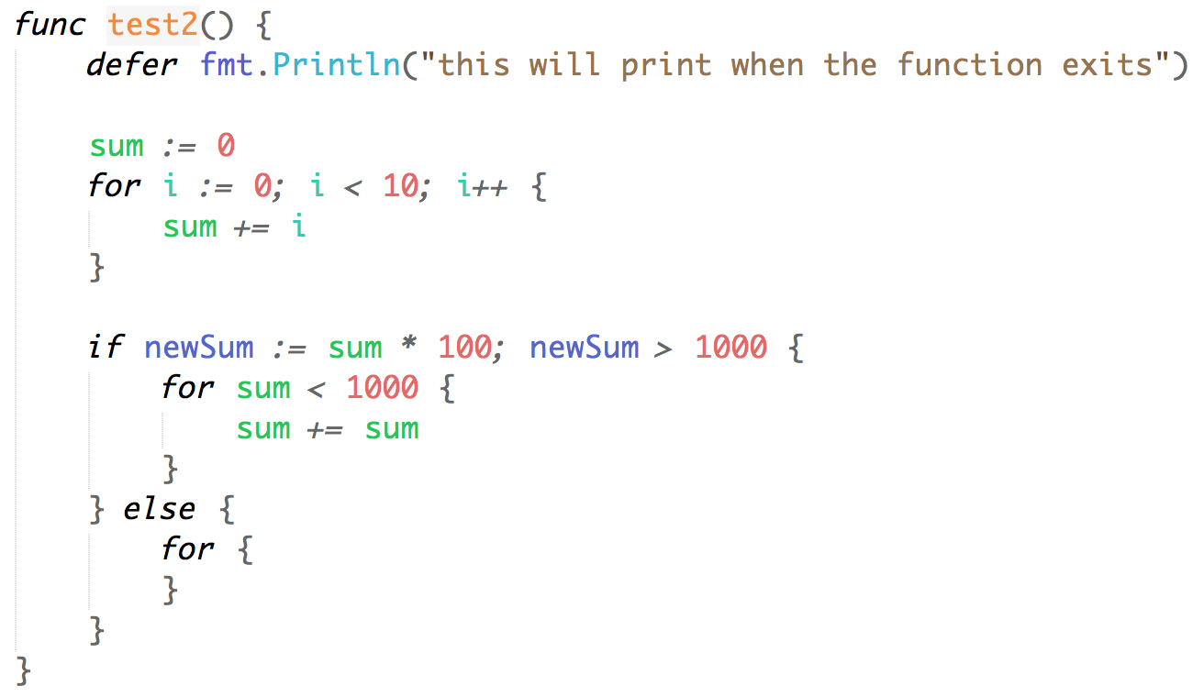
Brief Syntax Overview (2/5)
One way to write a for loop
One-line declaration/conditional
Another way to write a for loop
Infinite for loop
Conditionals & For loops
Notes:
Points to cover:
defer statement (useful for closing files/connections)
for loops - the only keyword to iterate in go
traditional for loop
‘while’ loop
infinite loop
conditionals
if, else if, else
in-line statement/declaration
Code:
func test2() {
defer fmt.Println("this will print when the function exits")
sum := 0
for i := 0; i < 10; i++ {
sum += i
}
if newSum := sum * 100; newSum > 1000 {
for sum < 1000 {
sum += sum
}
} else {
for {
}
}
}

Slide 7
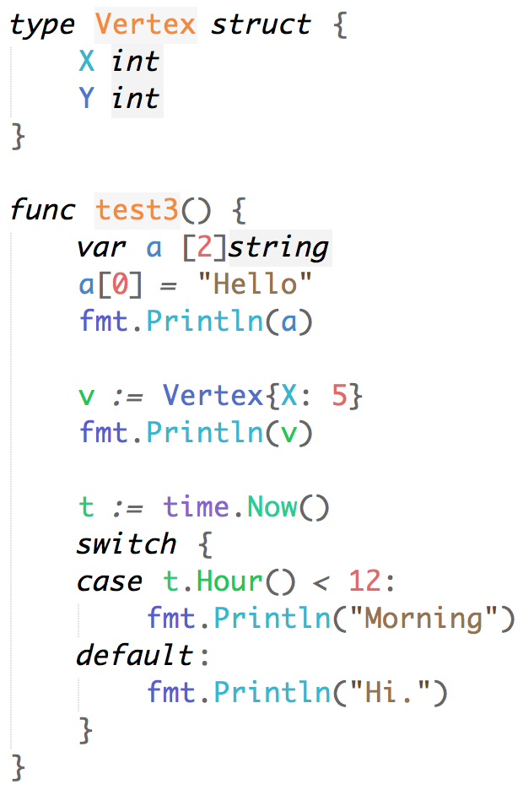
Brief Syntax Overview (3/5)
Definition of struct
(Note: methods/structs starting with capital letters are public)
Instantiation of array.
Instantiation of struct. Unspecified struct fields will have default values.
Switch statements & Structs
Notes:
Points to cover:
structs are similar to C structs
capital letters mean ‘public’ access in Go
array instantiation, value assignments
struct instantiation, field values
time is just another package, docs are online
switch statement
can do conditional cases
but does not fall through (no need for ‘break’)
Pause to go over pass-by-reference/by-value
Code:
type Vertex struct {
X int
Y int
}
func test3() {
var a [2]string
a[0] = "Hello"
fmt.Println(a)
v := Vertex{X: 5}
fmt.Println(v)
t := time.Now()
switch {
case t.Hour() < 12:
fmt.Println("Morning")
default:
fmt.Println("Hi.")
}
}

Slide 8
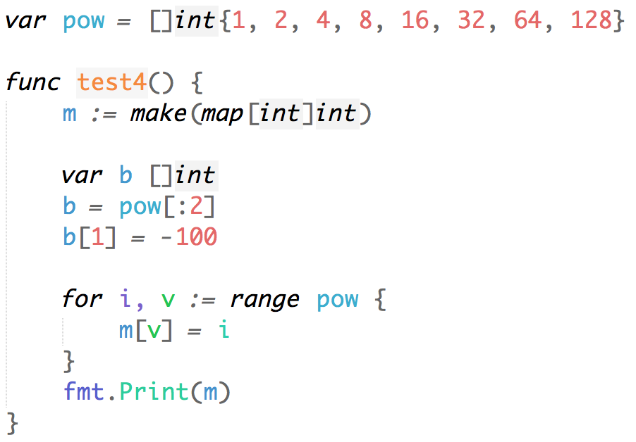
Brief Syntax Overview (4/5)
Use the make built-in function to allocate dynamic data structures
Arrays/Slices and Maps
Notes:
Points to cover:
array instantation with values
‘make’ keyword similar to ‘malloc/calloc’
make(map[key-type]value-type)
make([]array-type, init-capacity)
slices
range
for index, value := range array {}
for key, value := range map {}
for chanValue := range chan {}
‘append’ to array - write on board?
b = append(b, 1)
b = append(b, []int{1,2,3}...}
Code:
var pow = []int{1, 2, 4, 8, 16, 32, 64, 128}
func test4() {
m := make(map[int]int)
var b []int
b = pow[:2]
b[1] = -100
for i, v := range pow {
m[v] = i
}
fmt.Print(m)
}

Slide 9
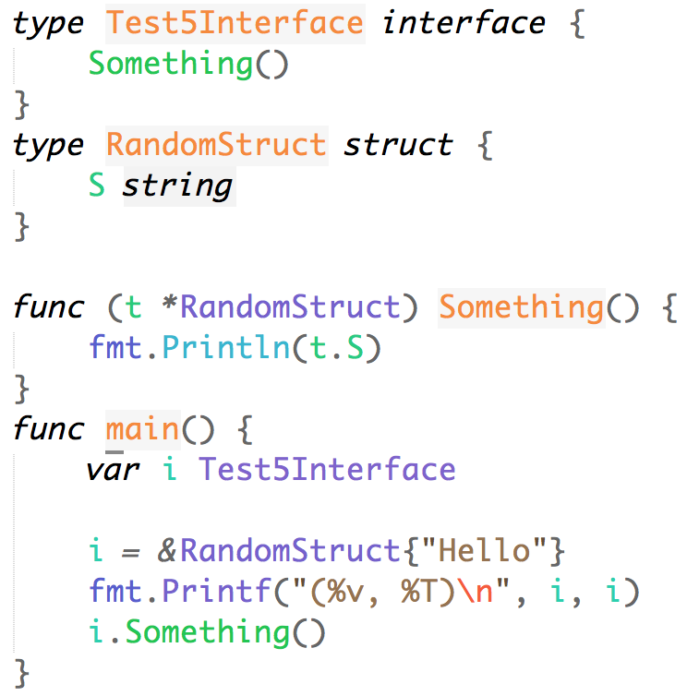
Brief Syntax Overview (5/5)
Interface just contains method signatures (method name, input/output types).
RandomStruct implicitly implements Test5Interface (by implementing all methods)
‘i’ is of type Test5Interface
Interfaces
Notes:
Points to cover:
interface
interfaces just contain method signatures (name, input/output types)
implicit interface implementation in go = just implement interface methods
the print statement will print:
(&{Hello}, *main.RandomStruct)
Hello
type Test5Interface interface {
Something()
}
type RandomStruct struct {
S string
}
func (t *RandomStruct) Something() {
fmt.Println(t.S)
}
func main() {
var i Test5Interface
i = &RandomStruct{"Hello"}
fmt.Printf("(%v, %T)\n", i, i)
i.Something()
}

Slide 10
Go Concurrency Example #1
Problem: Consider the producer/consumer problem.
Producer generates data => puts into a buffer.
Consumer consumes data => removes from buffer.
Ensure producer won’t add data into the buffer if buffer is full.
Ensure consumer won’t remove data from an empty buffer.

Slide 11
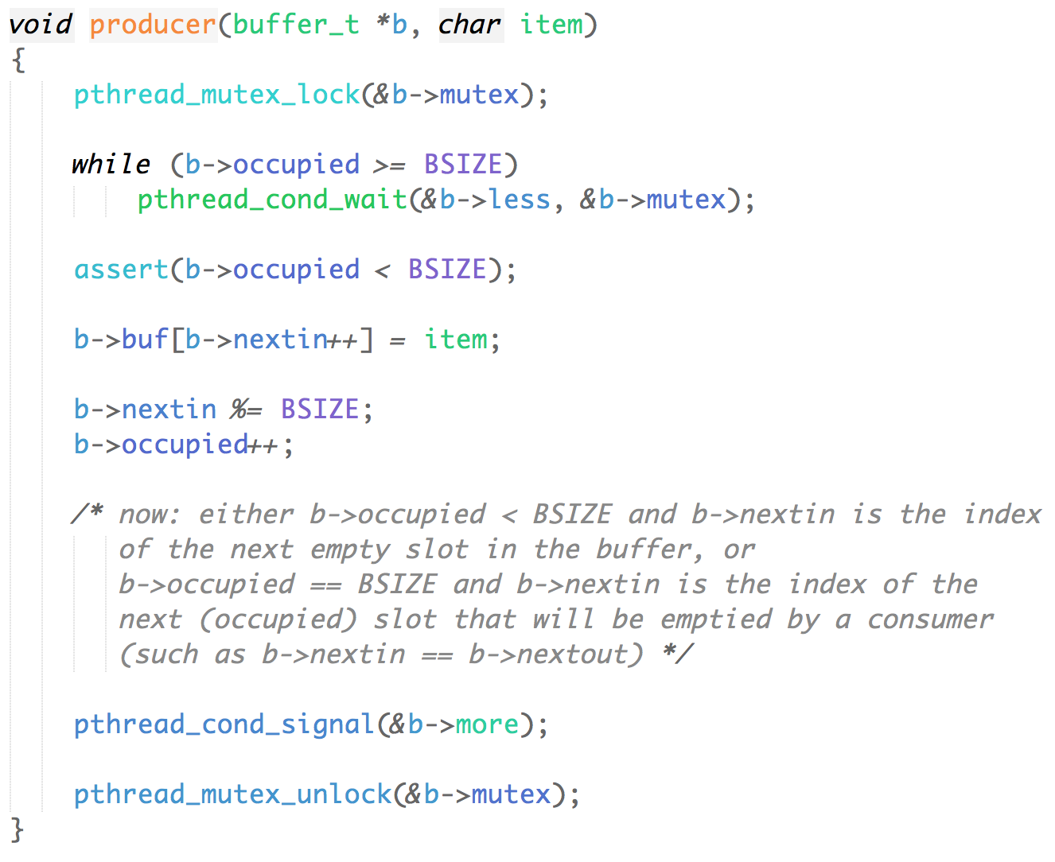
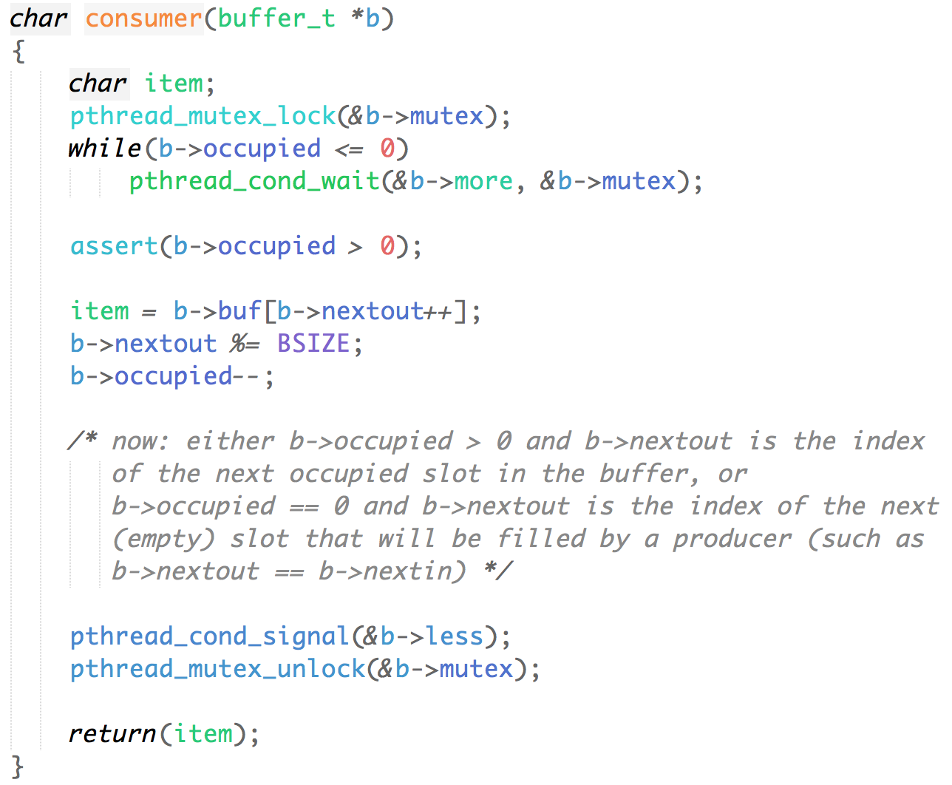
Go Concurrency Example #1
A Solution in C (docs.oracle)
Notes:
Points to cover:
this is a solution in C
:(
Code:
void producer(buffer_t *b, char item)
{
pthread_mutex_lock(&b->mutex);
while (b->occupied >= BSIZE)
pthread_cond_wait(&b->less, &b->mutex);
assert(b->occupied < BSIZE);
b->buf[b->nextin++] = item;
b->nextin %= BSIZE;
b->occupied++;
/* now: either b->occupied < BSIZE and b->nextin is the index
of the next empty slot in the buffer, or
b->occupied == BSIZE and b->nextin is the index of the
next (occupied) slot that will be emptied by a consumer
(such as b->nextin == b->nextout) */
pthread_cond_signal(&b->more);
pthread_mutex_unlock(&b->mutex);
}
char consumer(buffer_t *b)
{
char item;
pthread_mutex_lock(&b->mutex);
while(b->occupied <= 0)
pthread_cond_wait(&b->more, &b->mutex);
assert(b->occupied > 0);
item = b->buf[b->nextout++];
b->nextout %= BSIZE;
b->occupied--;
/* now: either b->occupied > 0 and b->nextout is the index
of the next occupied slot in the buffer, or
b->occupied == 0 and b->nextout is the index of the next
(empty) slot that will be filled by a producer (such as
b->nextout == b->nextin) */
pthread_cond_signal(&b->less);
pthread_mutex_unlock(&b->mutex);
return(item);
}

Slide 12
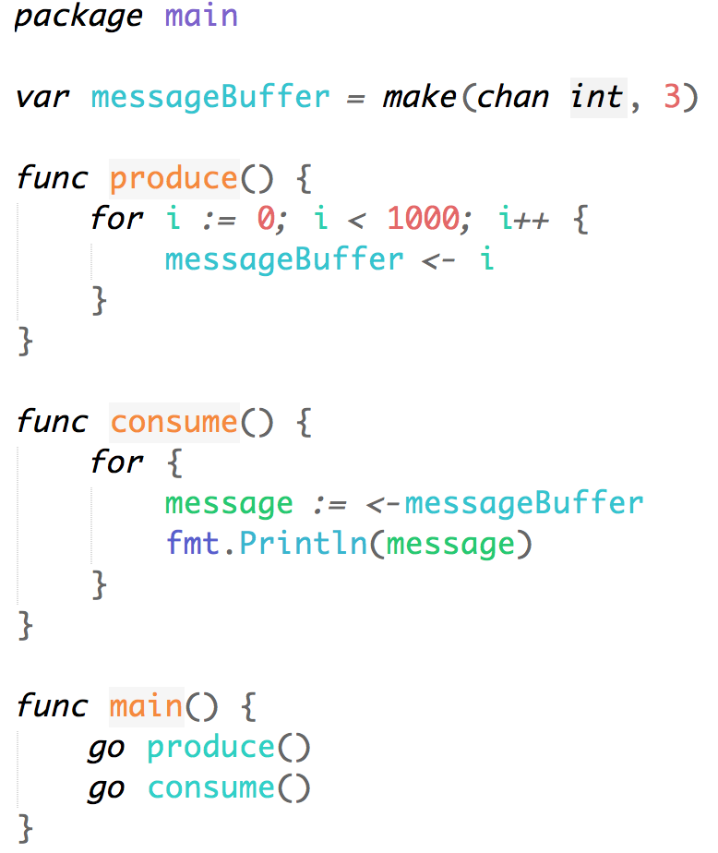
Go Concurrency Example #1
A Solution in Go
A lot shorter and simpler!
It even achieves more than the C code by spawning its own “threads”
Is there a problem with the code?
Notes:
Points to cover:
‘go’ keyword starts a new goroutine (thread)
rule of thumb: if method accesses a channel, start goroutine
channels
make(chan channel-type, capacity)
unbuffered vs buffered channels
unbuffered: need a getter and a putter (otherwise, putter will block forever)
buffered: putter can put until capacity is full (won’t block putter)
what’s wrong?
main will return quickly
could do ‘time.sleep’ but not elegant solution

Slide 13
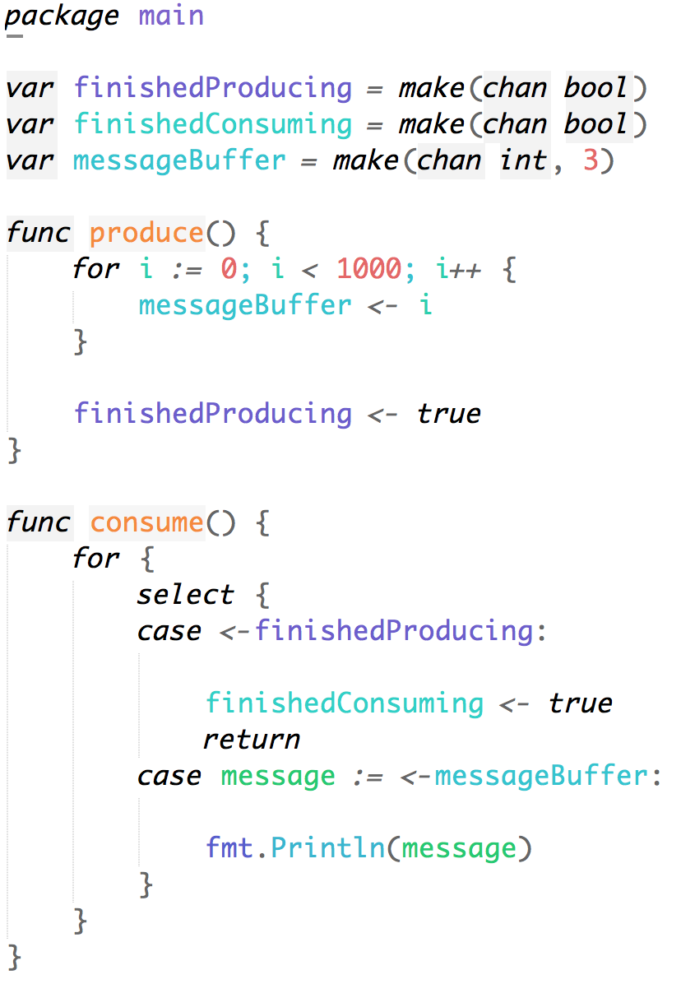
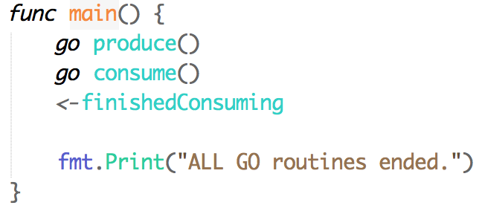
Go Concurrency Example #1
Proper termination
use channels to communicate between go channels that they are done
Notes:
Points to cover:
create ‘done’ signal with go channel
for-select (important!)
go will randomly select a case when the channel is ready
we will see this again in next example
another problem?
style!

Slide 14
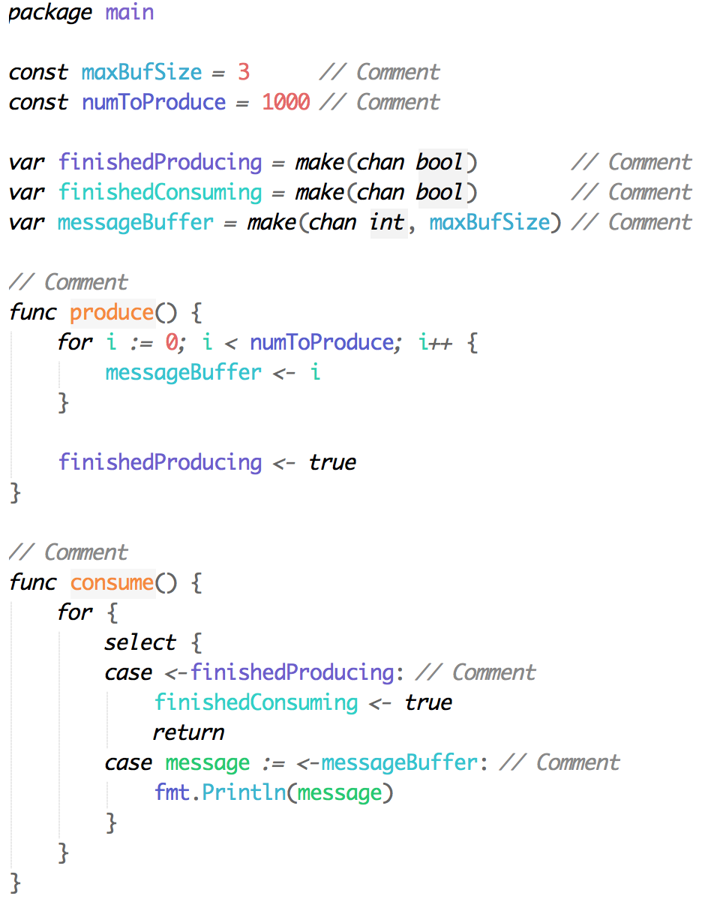
Go Concurrency Example #1
Proper style
‘go fmt’ command is your friend
no magic numbers
comment constants, functions, cases
Anyone see one last bug?
Notes:
Points to cover:
pull out magic numbers into constants
comment ambiguous variables and each method
one final bug?
something in consume()
answer: finishedProducing could cause early termination

Slide 15
Go Concurrency Example #2
Problem: Sharing a data structure across many threads

Slide 16
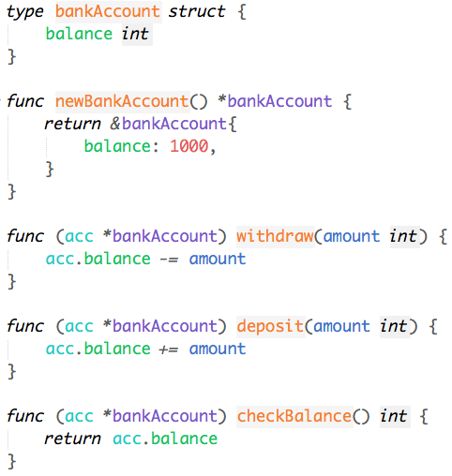
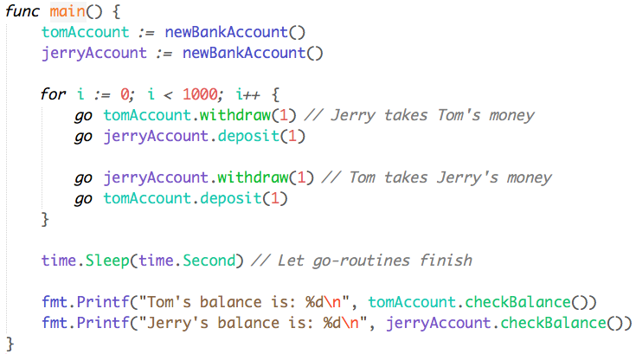
Go Concurrency Example #2
Can you see the problem?
Notes:
Points to cover:
expected to be 1000, 1000
classic race condition
LIVE DEMO
‘go run’ few times
‘go run -race’ to show race condition
STUDENTS
Take a moment to let students read code and discuss with neighbor(s) what you think is wrong with the code.
Take suggestions to fix in go, WITHOUT mutexes.

Slide 17
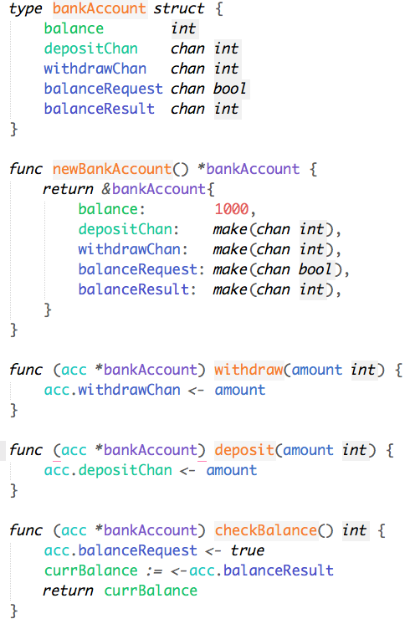
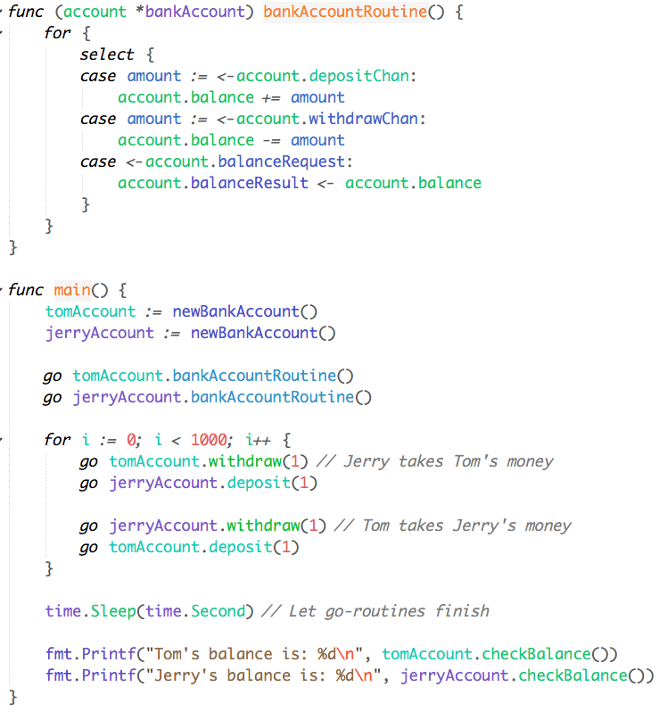
Go Concurrency Example #2
bankAccountRoutine manages data.
Use channels to communicate requests/results.
Notes:
Points to cover:
one main goroutine that handles any reads/writes to the single data structure
other goroutines send ‘requests’ through *channels*
no mutexes!

Slide 18
P0: Introduction to Go Concurrency
Released yesterday (September 7th, 2021)
Due on September 16th, 2021, 11:59 PM
No grace days, -10% penalty for each day late
No submissions will be accepted after September 18th, 2021, 11:59 PM
Please make sure you have checked out “A Tour of Go” https://tour.golang.org/welcome/1

Slide 19
P0 Part A: Concurrency
A key value store.
Given an abstracted database, implement simple operations.
Multiple, concurrent clients.
Supports Put, Get, Delete, and Update.
No mutexes (cannot use go’s ‘sync’ package).
Also can’t use channels as mutexes!
You can only use ‘bufio’, ‘io’, ‘bytes’, ‘fmt’, ‘net’, and ‘strconv’.
All tests available to you.
This will not be true in future projects.
Notes:
Points to cover:
simple kv store
get put delete, update
NO MUTEXES (or using channels as mutexes)
no grace days

Slide 20
P0 Part B: Testing
A Squarer: simple concurrent data structure.
Well-defined API and requirements.
We provide you with a working implementation.
We have 2 secret buggy implementations.
Can you write a (valid) test that catches the bug?
Unlimited Gradescope submissions.
Hint: read the code carefully + use your Go knowledge.
Notes:
Points to cover:
simple kv store
get put delete
NO MUTEXES (or using channels as mutexes)
no grace days

Slide 21
Good to know - GO
for-select loop:
select will wait until a single case is ready.
Know which calls are blocking.
unbuffered vs buffered channels.
TCP/UDP calls (e.g. Listen, Read, Write).
Run ’go fmt‘ before submitting to autolab!
GoLand is an IDE by JetBrains (creators of IntelliJ).
Students can get for free: https://www.jetbrains.com/student/
atom plugin go-plus is great.
vsc has a Go extension.
Make sure GOPATH/GOROOT is set properly.
Notes:
Note: More parallelism on autolab (run with -race flag)
Submitting on day of deadline = :(
INSTALLING GO: https://golang.org/doc/install
Points to cover:
for-select loop
commonly used throughout projects
be careful of default case (rare case, but good to know)
blocking calls
unbuffered vs buffered channels
TCP/UDP calls (read go.net package)
run ‘go fmt’
just do it
IDEs
GOPATH/GOROOT
on AFS, only need to modify bashrc once with GOROOT
every new project, need to modify GOPATH

Slide 22
Good to know - Miscellaneous
Gradescope Issues.
No submission limits on P0, but there will be for future projects.
Many cores on autolab = more parallelism than your machine (run with -race).
Note many students will be submitting on deadline date.
Run code on AFS clusters before submitting.
Installing GO.
Version 1.17!
https://golang.org/doc/install
Notes:
Points to cover
submission limits
autolab has more cores than your machine, probably
deadline, many students
Installing Go
make sure to have go installed before leaving recitation
we can help now

Slide 23
Questions?

