Slide 1
Web-based Systems Project 2 – Google Analytics
Wykonali: Jakub Kamiński 273107 Adam Ćwikliński 273055

Slide 2
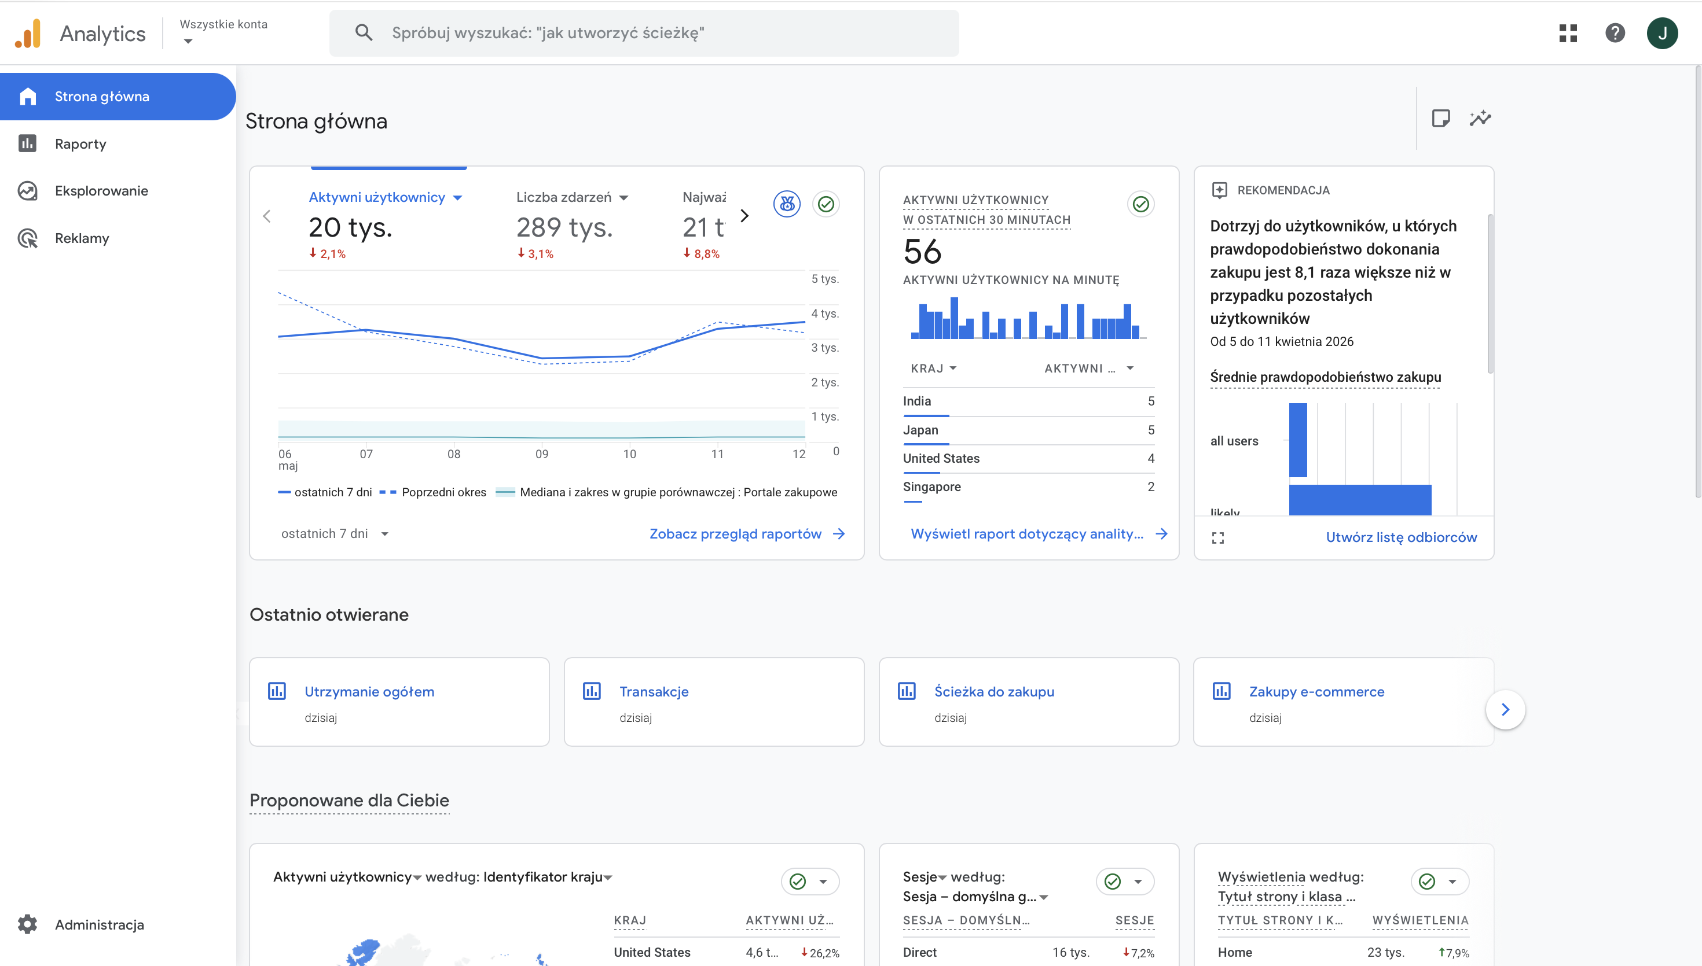
Goals of the project
Google Merchandise Store analysis using Google Analytics 4 Demo Account
Understand:
Customer acquisition
Customer engagement
Revenue generation
Purchase funnel behavior
Compare:
Full-day analysis (17.04)
One-hour analysis (16:00 - 16:59)

Slide 3
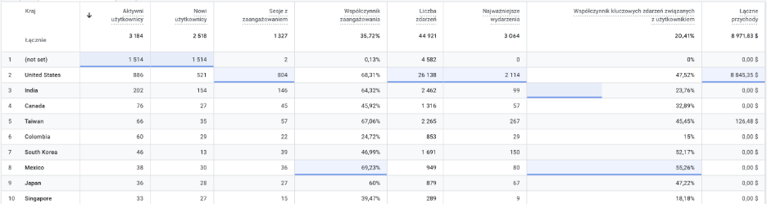
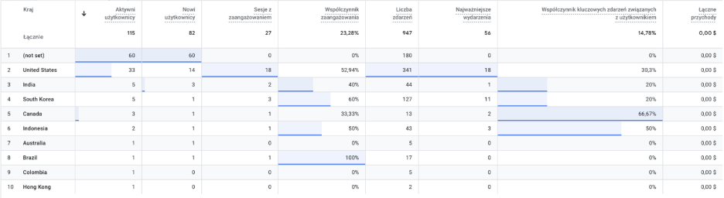
Customer Acquisition Analysis
Data from whole day
Data from 16 PM

Slide 4
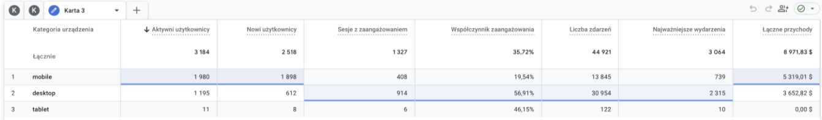
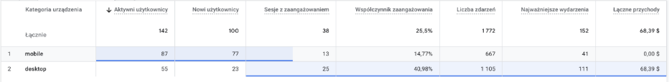
Technology Performance Analysis
Data from whole day
Traffic Volume: Mobile is the leading device category in terms of reach, attracting 1,980 active users and 1,898 new users.
Data from 16 PM​
The data suggests that while the store attracts more users via mobile, the actual purchasing power and deep engagement are driven almost exclusively by desktop users.

Slide 5
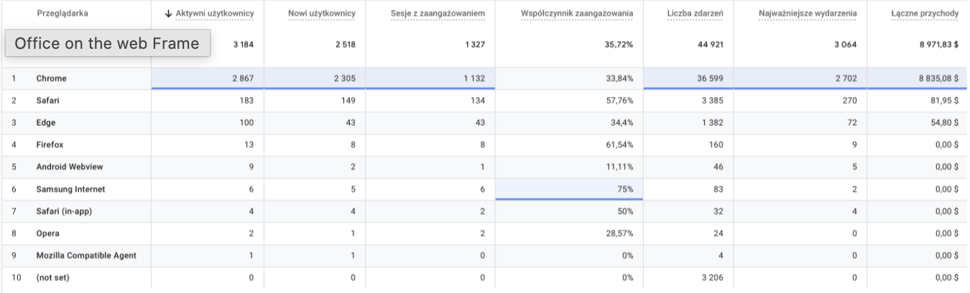
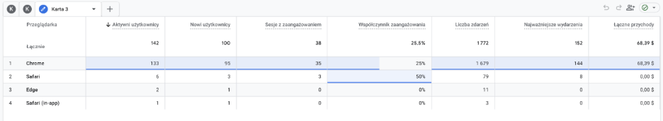
Browsers: Analysis of the most popular Browsers used by customers.
Data from whole day
Data from 16 PM

Slide 6
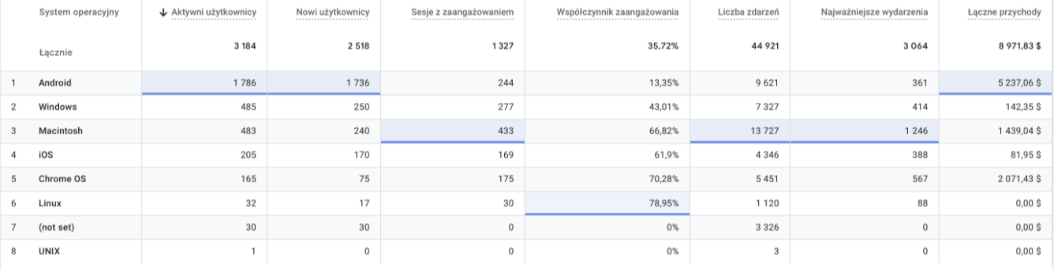
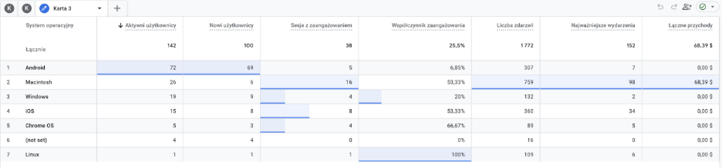
Operating Systems
Data from whole day
Data from 16 PM

Slide 7
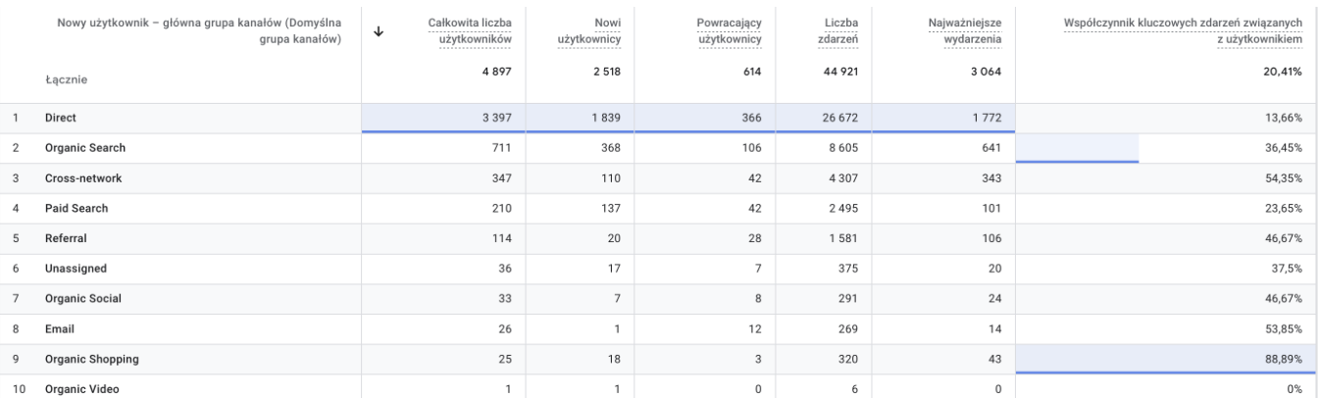
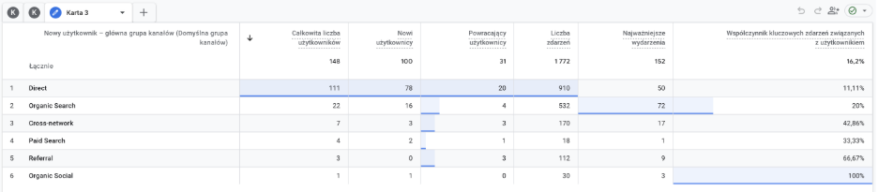
Traffic Acquisition Analysis
Data from whole day
Data from 16 PM

Slide 8
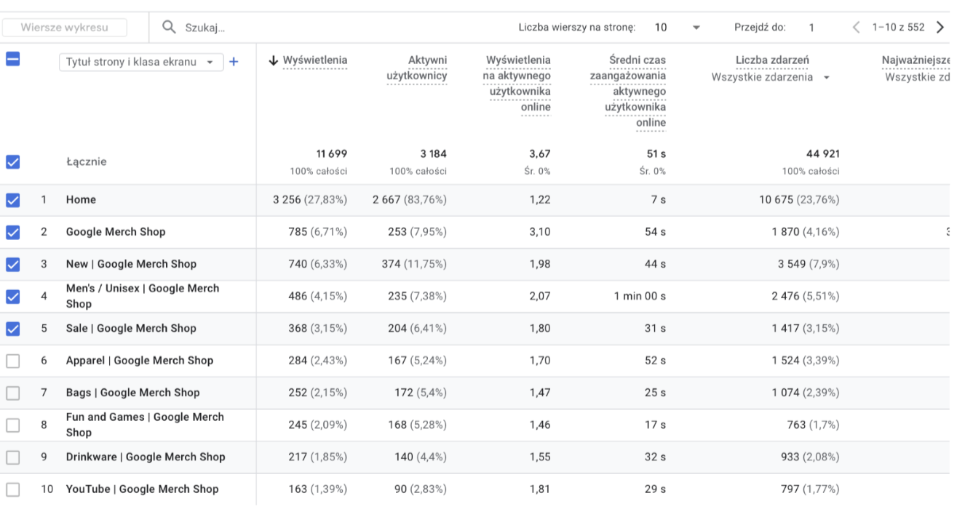
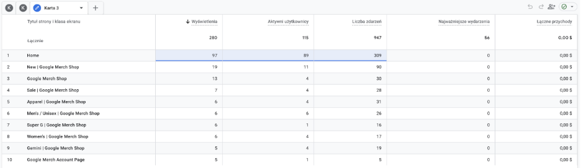
Customer Engagement Analysis & Site structure
Data from whole day
Data from 16 PM

Slide 9
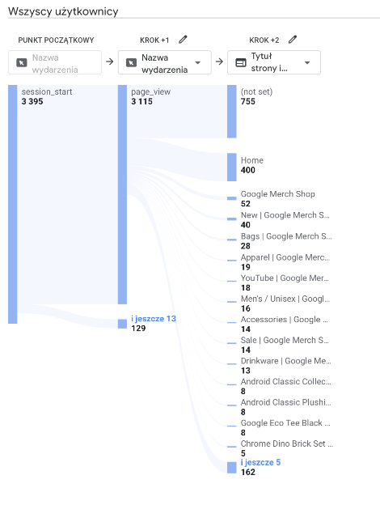
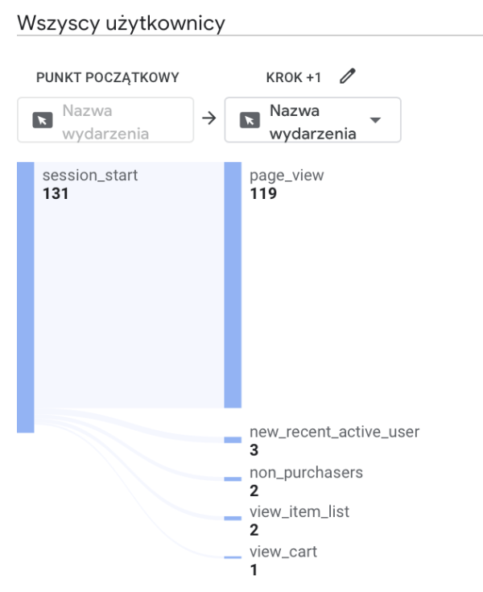
User Path Exploration Analysis
Data from whole day
Data from 16 PM

Slide 10
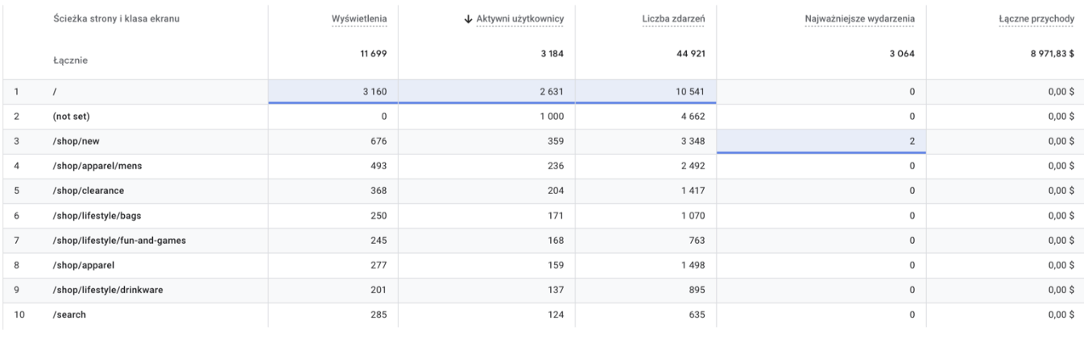
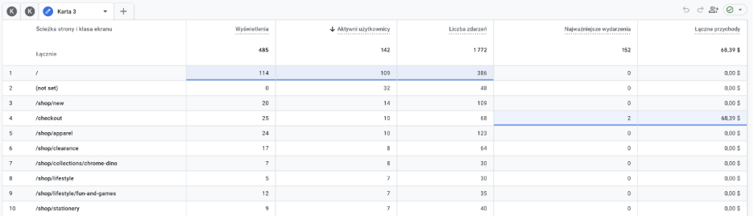
Active Users
Data from whole day
Data from 16 PM

Slide 11
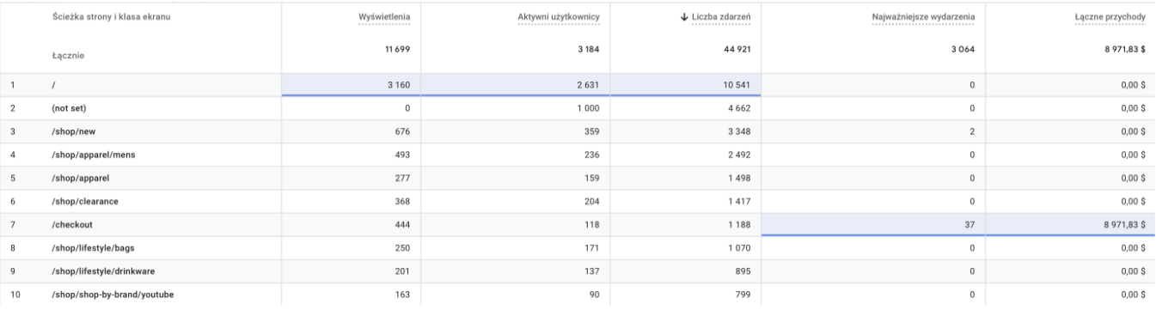
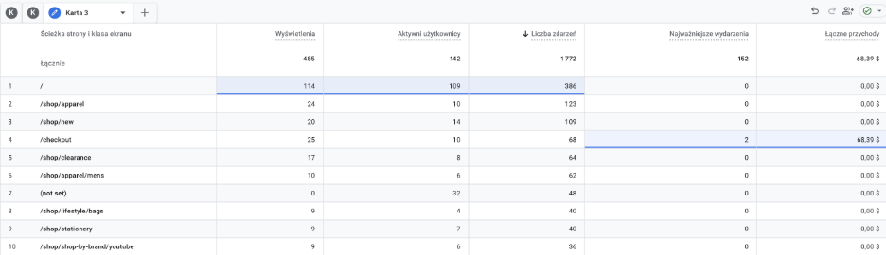
Number of events
Data from whole day
Data from 16 PM

Slide 12
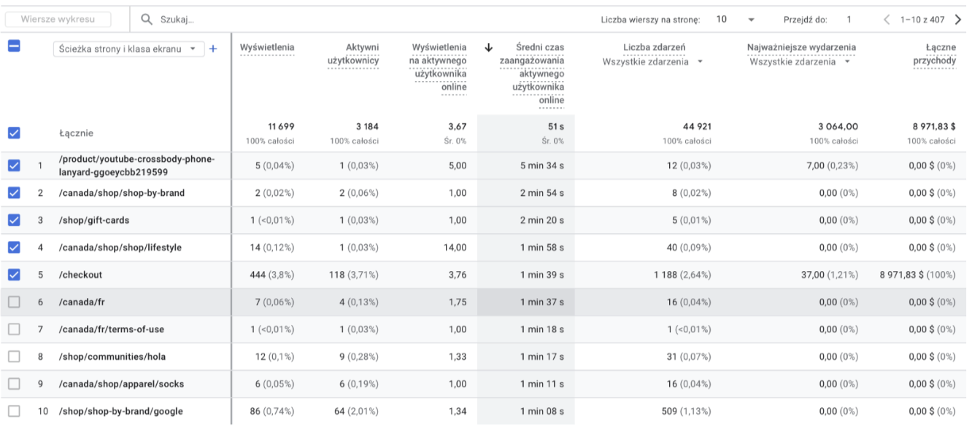
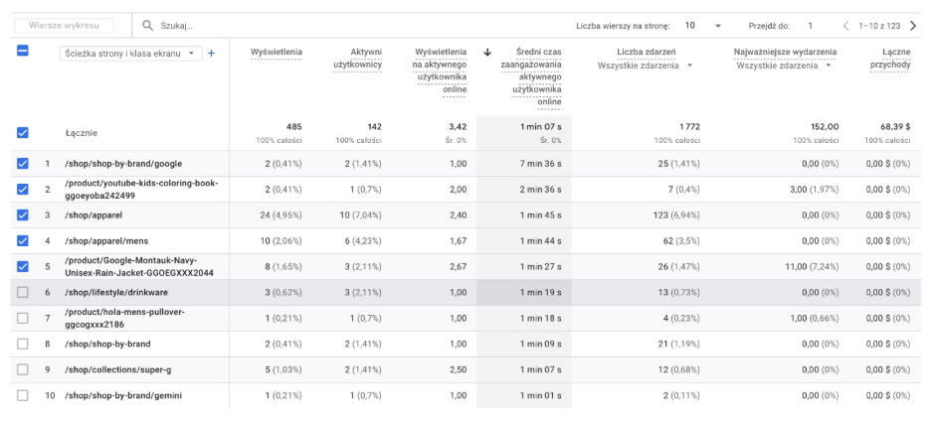
Engagement Time
Data from whole day
Data from 16 PM

Slide 13
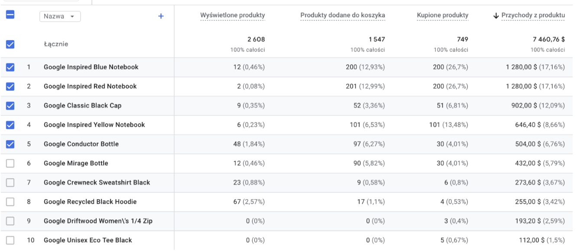
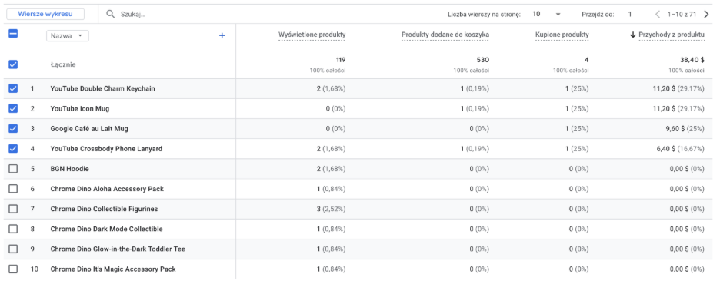
Revenue for the whole day:
Data from whole day
Data from 16 PM

Slide 14
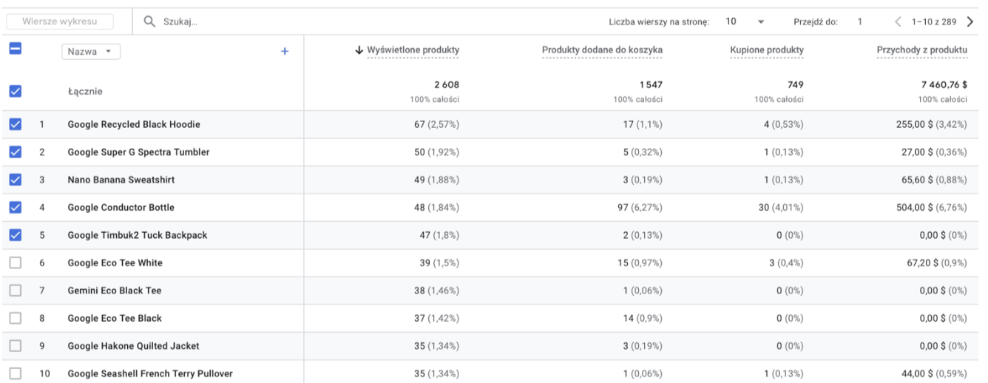
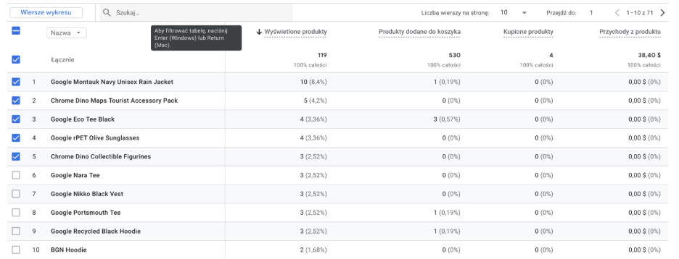
Product Interest & Visibility
Data from whole day
Data from 16 PM

Slide 15
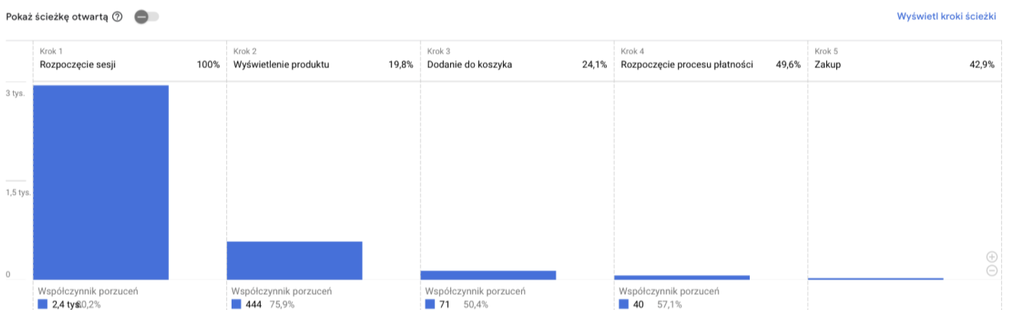
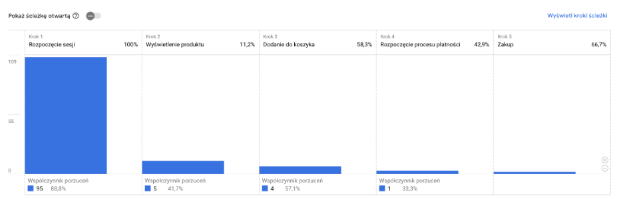
Purchase funnel
Data from whole day
Data from 16 PM

Slide 16
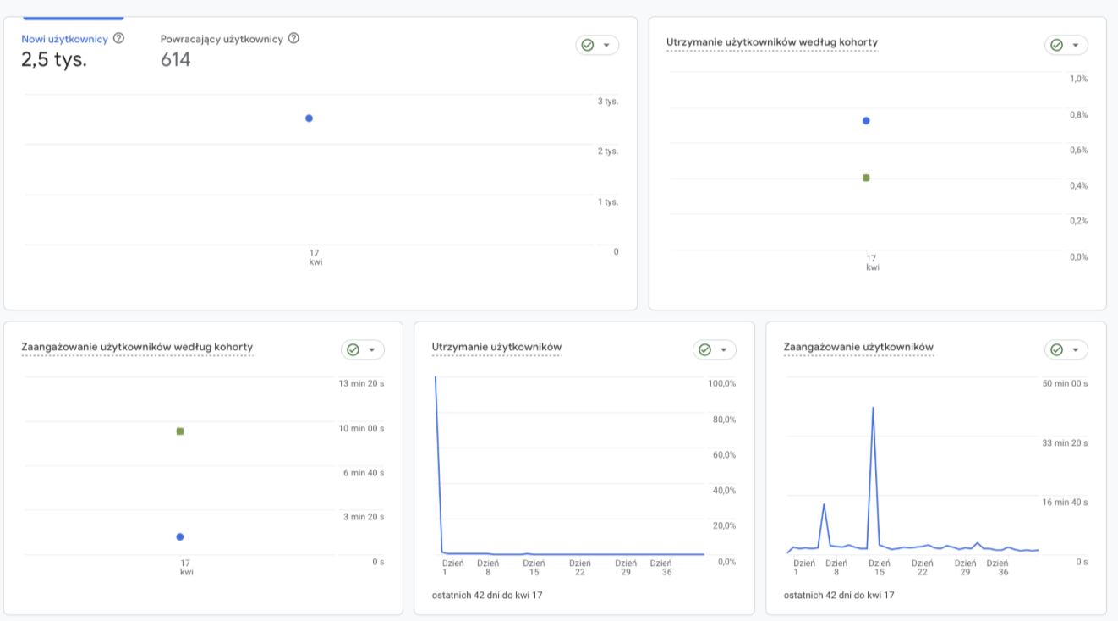
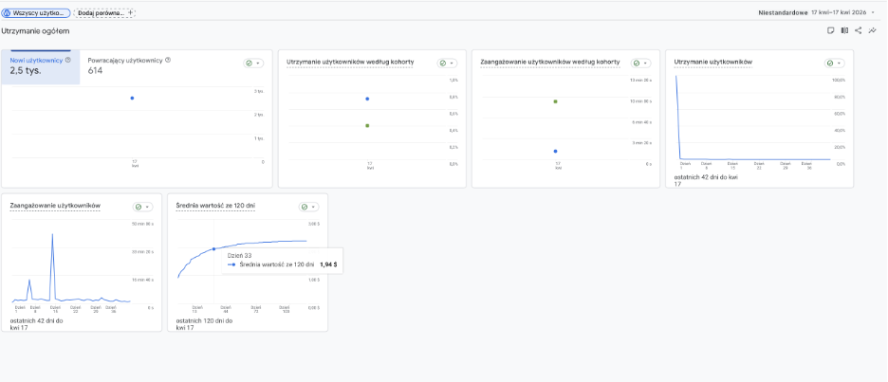
Customer retention
Data from whole day
Data Limitation:
Due to the analysis being focused on a single-hour snapshot,
long-term retention trends and cohort behaviors
cannot be fully established.
Data from 16 PM

Slide 17
Conclusions
Daily Performance (April 17, 2026)
Revenue: Total daily revenue of $8,971.83, with 98.5% generated by the United States.
Browser: Chrome dominates the ecosystem, accounting for 88.4% of users and 98.5% of total revenue.
Device Gap: Mobile drives the highest traffic volume , but Desktop delivers superior engagement (56.91%) and higher conversion power.
Funnel Weakness: A critical drop-off occurs at the start, with over 80% of users leaving before viewing a product.
Hourly Insights (4:00 PM – 5:00 PM UTC)
Short-term Activity: 142 active users generated $68.39 in revenue, driven exclusively by Macintosh users.
Acquisition: Direct traffic provides the most volume , while Referral and Organic Search yield the highest conversion quality.
Top Items: High interest in New Arrivals and Apparel , though hourly sales were limited to small accessories like mugs and keychains.
Key Recommendations
Mobile Optimization: High mobile traffic fails to convert effectively; urgent need to streamline the mobile checkout path.

