Slide 1

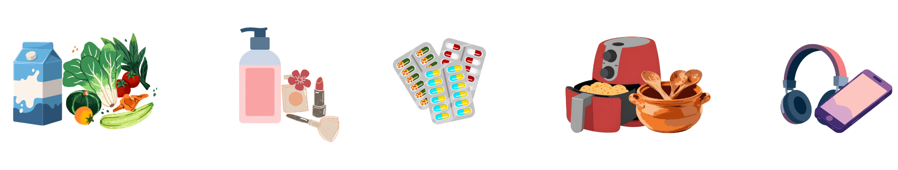
Increasing AOV for Blinkit Through Better Discovery & User Experience
Adamya Varshney
Ankita Chatterjee

Slide 2
MARKET POTENTIAL & PRODUCT OVERVIEW
Indian Q-Commerce
Industry Analysis
Dark Stores
Speed Promise
AI-Powered
🏪
⚡
🤖
📦
15,000+ SKUs
Micro-fulfillment centers 2,500–4,000 sq ft within 1.5–3km of customers
Orders picked in <120 sec; delivered in 10–30 min via AI-optimized routes
Deep learning for SKU-level demand forecasting & dynamic routing
From groceries to electronics, beauty and fashion — one super-app
$3.5B
$35B
10x
45%
Market Size
2024
Projected Size
2030
Growth
CAGR
Blinkit
Market Share

Slide 3
MARKET POTENTIAL & PRODUCT OVERVIEW
Market GMV Growth
Category Evolution — The Super-App Pivot
$0.3B
$6.5B
Groceries & FMCG
80%
2022 — Nascent Phase
2024 — Rapid Scaling
Beauty & Personal Care
15%
$8.8B
$35B
Electronics
2025P — Non-Grocery Pivot
2030P — Structural Dominance
12%
Market at a Glance
Fashion (emerging)
8%
🛒 ~65% of all online grocery orders in India
📈 ~10% of total e-retail spending today
Unit Economics Snapshot
🏙️ 60% new shoppers from Tier 3+ cities since 2020
Avg Order Value
₹450 – ₹709
Gross Margin
20% – 25%
📱 4.5 orders/month average per household
Delivery Cost / Order
₹35 – ₹55
Dark Store Break-even
>800 orders/day
Source: Bain & Company · RedSeer · Industry Reports 2024–2025

Slide 4
COMPETITOR BENCHMARKING
★ #1
BLINKIT
ZEPTO
SWIGGY INSTAMART
JIOMART
Zomato
Zepto
Swiggy
Reliance
Market Share: 45–50%
Market Share: 21–29%
Market Share: 23–27%
Market Share: #2 by orders
AOV
AOV
AOV
AOV
₹460-500
₹607-650
₹487–619
Variable
Delivery
Delivery
Delivery
Delivery
10–15 min
~11 min
15–30 min
30 min / Sched.
Reach
Reach
Reach
Reach
30+ metros
10+ metros
580+ cities
1,000+ cities
UX
UX
UX
UX
Premium / Organized
Minimalist / Lightning
Integrated / Cluttered
Functional / Omni
Loyalty
Loyalty
Loyalty
Loyalty
Zomato Gold
Zepto Pass
Swiggy One
Reliance One
KEY EDGE
KEY EDGE
KEY EDGE
KEY EDGE
Widest SKUs (15,000+), electronics, contextual UX triggers
Highest rating (4.7/5), Zepto Café, density-first model
Largest rider fleet (500K+), Swiggy Bolt 10-min tier
Widest reach, WhatsApp ordering, 19,000+ stores
Market share estimates: RedSeer, CIIM, Bain & Company (2025) · AOV and delivery benchmarks: Industry reports

Slide 5
USER PERSONAS
05
💼
Rahul, 27
🏠
Priya, 34
The Rushed Professional
The Household Manager
Daily user
Low AOV
Weekly planner
High AOV potential
Single-item orders
High churn risk
Multi-item shopper
Medium retention
Pain Points
Pain Points
▸ Opens app for one item — never browses
▸ Re-searches the same 20 items every single week
▸ Switches apps instantly if item is out of stock
▸ Coupon fails silently at checkout after filling cart
▸ Search fails on minor typos → gives up
▸ Homepage isn't personalised to her family
▸ No feature pulls him back between orders
▸ No list-building or 'save favourites' feature
"I just need my oat milk. Just let me find it and pay."
"Why do I search 'Aashirvaad atta 5kg' every week? I've ordered it 40 times."
💸 AOV Impact
🔄 Retention Risk
💸 AOV Impact
🔄 Retention Risk
Rarely crosses ₹300 per order
Very High risk. Zero emotional attachment to any app.
Would jump from ₹800 → ₹1,500+ with a prompt discovery of 'My Weekly or Periodic’ needs
Medium. Loyal if app saves time. Churns if it wastes it.
Based on primary user research · Usability testing sessions

Slide 6
USER PERSONAS
🏷️
Arjun, 22
Suresh, 33
The Offer Hunter
The Responsible Son
Price-driven
Multi-app switcher
Intermediate User
Tech-savvy
Impulse buyer
Very high churn
Trust barrier
Untapped AOV Lift
Pain Points
Pain Points
▸ Opens 2–3 apps to compare deals before every order
▸ Gets interrupted mid-work every time his father tries to place an order
▸ Offer terms hidden — discount disappears at checkout
▸ Has to walk his father through every step over call
▸ Adds random items just to hit the free-delivery threshold
▸ Doesn't know if the parent successfully placed the tight order
▸ No loyalty benefit keeps him on one platform
"I checked Blinkit, Zepto and Instamart before ordering chips. Zepto had 30% off. So I went there."
“My father calls me every time he wants to order something. Every. Single. Time. I'll be in a meeting and get a WhatsApp — 'beta, did I press the right button?' If I could just set up his grocery list once, and he taps what he needs, and I get one notification to approve and pay — that's it.”
💸 AOV Impact
🔄 Retention Risk
💸 AOV Impact
🔄 Retention Risk
Spends more when bundle deals are clearly visible upfront
Very High risk. A ₹30 saving will send him to a competitor.
Would order essentials in bulk repeatedly consistently if the process is easy
Never acquired in the first place — completely untapped pain point
Based on primary user research · Usability testing sessions

Slide 7




PERSONA PRIORITIZATION
1
Would order essentials in bulk repeatedly if the process is easy
2
Spends more when bundled deals are clearly visible upfront
3
Would jump from ₹800 → ₹1,500+ with a prompt discovery of 'My Weekly or Periodic’ needs
4
Very High risk. Zero emotional attachment to any app.
Based on primary user research · Usability testing sessions

Slide 8
PRIMARY & SECONDARY RESEARCH
PRIMARY RESEARCH
SECONDARY RESEARCH
User Survey · n=12 respondents
Industry analysis · Expert benchmarking
Why users open the app
🔍
Product Discovery
🛒
Low Cart Value (AOV)
Reactive triggers — 'ran out of milk' dominates over planned buying
First action on search
Users abandon when search results don't match typed queries
Single urgent item triggers — open, buy one, leave
Most users type directly into search; browse/category is secondary
Discovery friction
🔄
Retention & Habits
💳
Checkout Friction
Majority reported difficulty finding products when results don't match
Reactive, not proactive usage. No loyalty loop built in
Coupon failures & opaque T&C = key drop-off point
Cart abandonment drivers
Price sensitivity & delivery fees are top cart-blockers
AOV boosters
👴
Older Proxy Users Ignored
📱
Multi-App Switching
Free delivery threshold & bundle deals most likely to increase spend
55+ users rely on family to order — untapped segment
Zero switching cost — users flip for best stock or price
Older user pain points
Small text, complex navigation & payment flow are key barriers
Primary: User Survey (n=12) · Secondary: Industry reports, competitive teardowns

Slide 9
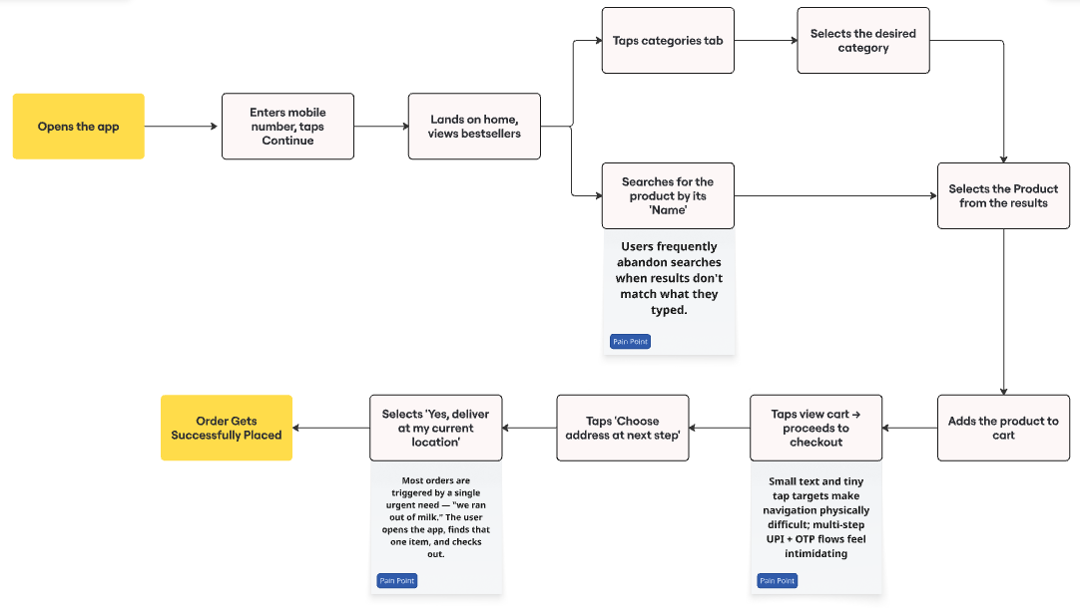
USER FLOW (Placing an Order on Blinkit)
Based on existing App journey

Slide 10
OBSERVED USER PAIN POINTS
Product Discovery & Search
Very High Priority
Browsing categories isn't much helpful — the taxonomy is built around warehouse logic, no thought a person thinks when they're cooking or shopping.
The barriers are layered: small text and tiny tap targets make navigation Physically difficult;
Multi-step UPI + OTP flows feel intimidating;
🔍︎
🔍︎
Checkout & Payment Friction
💳︎
High Priority
Homepage Relevance
Multi-App Switching
Personalization is shallow — "top picks" and "trending near you" feel like filler rather than genuine curation. This directly suppresses both engagement because users who don't see relevant content on the homepage stop scrolling
There's no deep loyalty, no feature or experience that's differentiated enough to keep someone committed.
⌂
⇄
Based on primary user research · Usability testing sessions

Slide 11
PROPOSED SOLUTIONS WITH PRIORITISATION
1
Smart Bundles
EFFORT
IMPACT
AOV LIFT
Horizontally scrollable bundle cards on the home screen (below Frequently Ordered), filterable by category (Breakfast, Snacks, etc). Bundle items group in cart as a single line item with a "Bundle" badge.
MEDIUM
HIGH
HIGH
2
Blinkit Buddy Mode
A linked-account system where a "buddy" sets up a simplified Easy Shop UI for a non-tech user. Users select frequent items in a large, accessible format & submit the list for the buddy to complete payment
HIGH
HIGH
HIGH
Cart Nudge (Save More, Add More)
3
A dynamic savings nudge bar at the checkout section whenever the cart total is below a threshold. "Add items worth ₹XX more to save ₹YY" with animated fill bar to show how close user is to unlock the discount
LOW
MEDIUM
MEDIUM
4
Recipe Discovery from Cart
Once food items are in the cart, a "🍳 Recipes You Can Make" card appears in the cart screen which is auto matched to the ingredients, also asking to add more items to complete the recipe preparation
HIGH
MEDIUM
MEDIUM

Slide 12
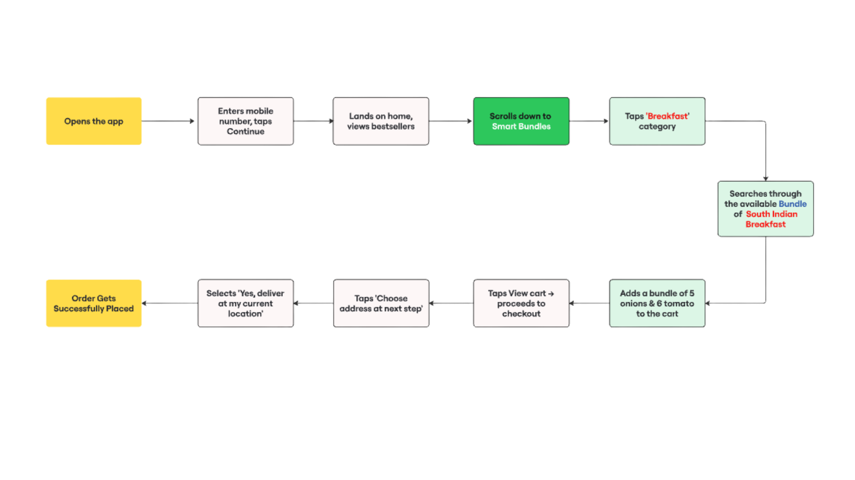
REVISED USER FLOW
1
Smart Bundles Solution
Placing an Order for a Bundle

Slide 13
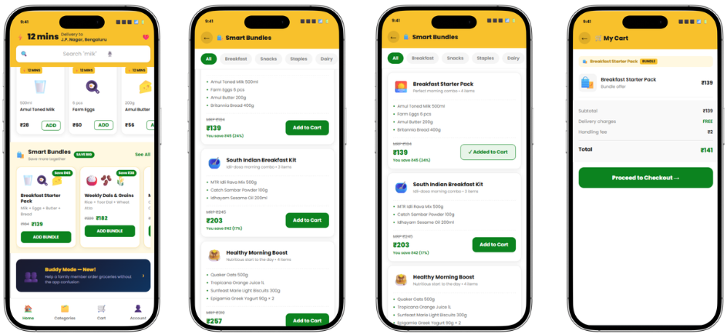
REVISED USER JOURNEYS
1
Smart Bundles Solution
Placing an Order for a Bundle

Slide 14
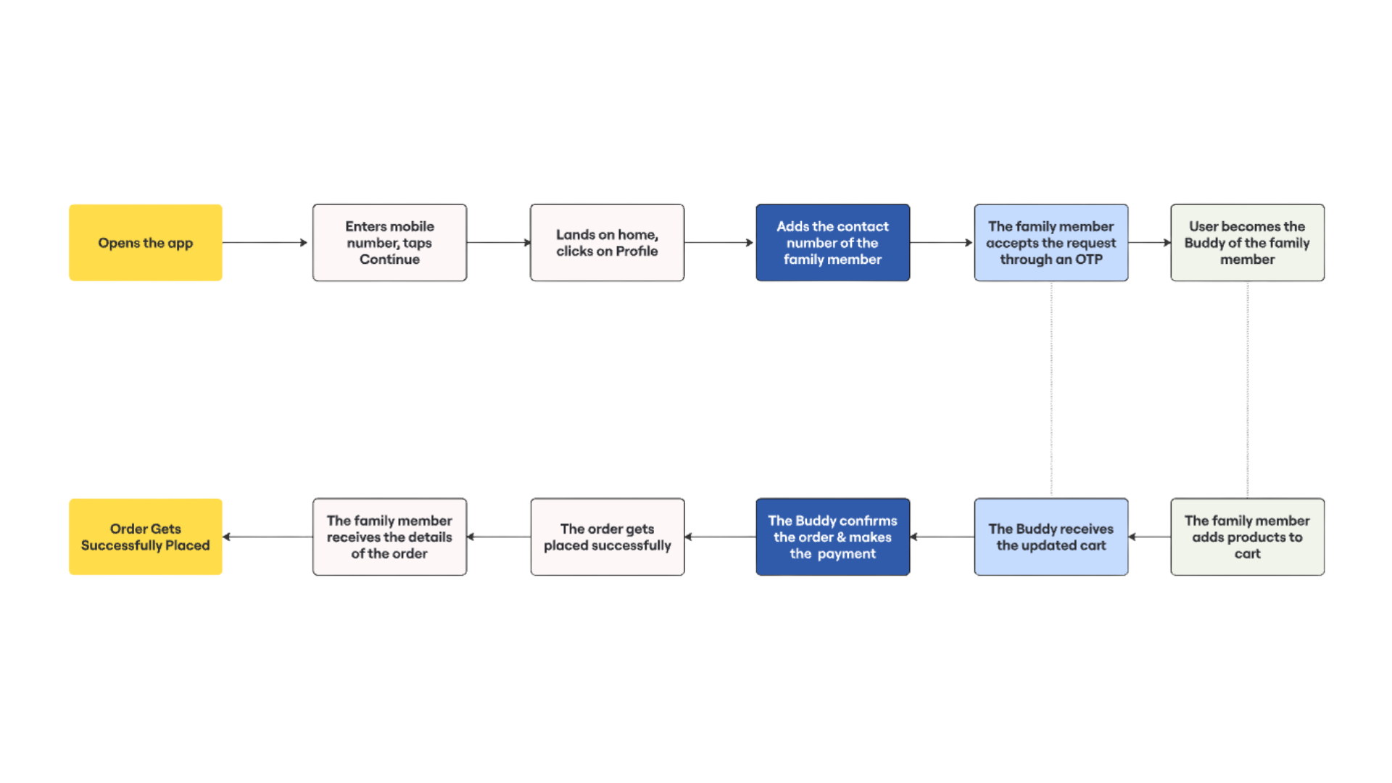
REVISED USER FLOW
2
Buddy Mode
Adding A Member to the Buddy
Placing the Order through the Buddy

Slide 15
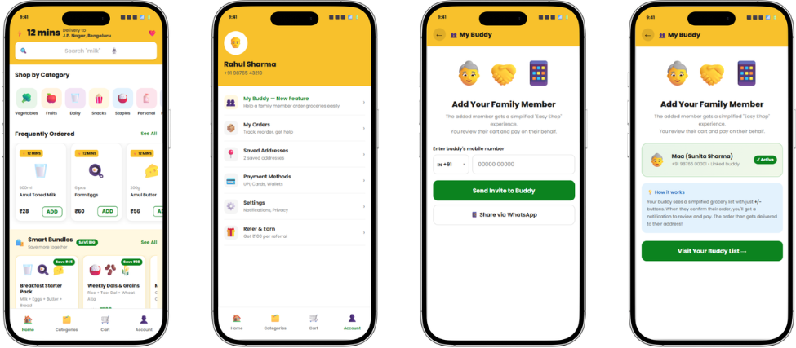
REVISED USER JOURNEYS
2
Buddy Mode
Adding A Member to the Buddy

Slide 16
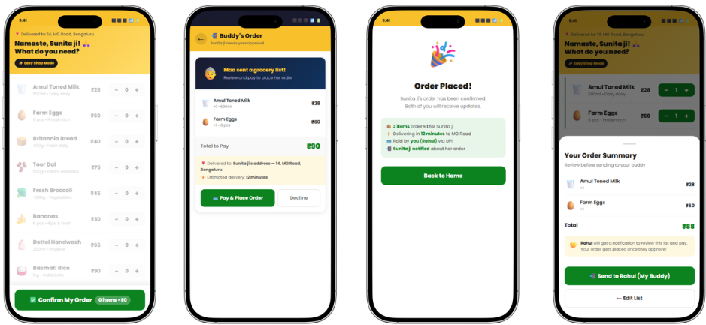
REVISED USER JOURNEYS
2
Buddy Mode
Placing the Order through the Buddy
Source: Bain & Company · RedSeer · Industry Reports 2024–2025

Slide 17
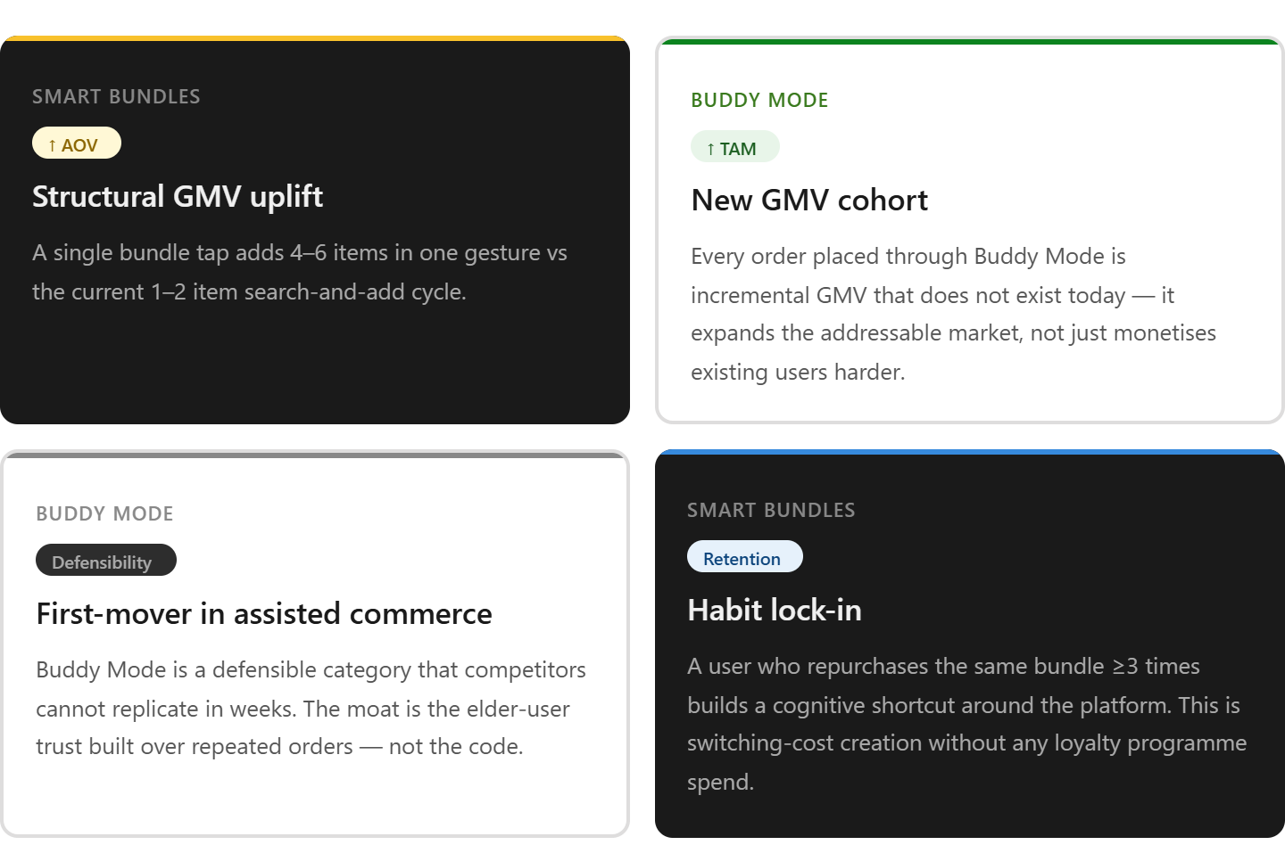
BUSINESS IMPLICATIONS

Slide 18
FEATURE METRICS TO BE MONITORED
Smart Bundles Solution
Buddy Mode
Adoption
Bundle card CTR% of home-screen sessions that tap any bundle card. Baseline readiness signal — low CTR = poor placement or irrelevant curation, not a conversion problem.
Acquisition & Setup
Buddy invite sent rate% of users visiting the "Add a Buddy" screen who complete the invite flow (phone number entered + invite sent). Top-of-funnel health check.
Conversion & AOV
Bundle add-to-cart rate% of bundle card taps that result in "Add Bundle" being pressed. Validates that bundle contents and discount depth are compelling enough to convert intent.
Usage & Experience
Shop session completion rate% of Buddy Mode sessions that result in a "Send to Buddy" submission. Core usability metric — Suresh must be able to complete the flow unaided.
RETENTION
Same-bundle repurchase rate (D30)% of bundle buyers who reorder the same bundle within 30 days. The habit formation signal — indicates bundles are becoming a reorder shortcut, not a novelty.
CHURN RATE
Buddy account D30 churn rate% share of linked buddy accounts that place zero orders in the 30 days following their first order.
Since this cohort has never been acquired before, any churn reading sets the baseline.

