Slide 1

ZOMATO · FOOD DELIVERY PLATFORM
Improving Farm-to-Table Discovery of Restaurants
Product Case Study
Notes:
Product case study: improving farm-to-table discovery inside the Zomato ordering experience.

Slide 2
PROBLEM STATEMENT
Urban food consumers in India are increasingly health-conscious and values-driven, yet the Zomato ordering experience offers no mechanism to discover, verify, or prefer meals made with locally sourced ingredients.
At the same time, small-scale farmers and farm-to-table restaurants that invest in sustainable sourcing have no way to signal this differentiation within the platform — making their premium positioning invisible and economically unjustifiable to end consumers.
The result is a broken value chain: consumers order blind to ingredient origin, restaurants cannot monetise their sourcing story, and local farmers remain locked out of urban demand despite sitting geographically close to it.
Notes:
The value chain is broken at three points: consumer, restaurant, farmer.

Slide 3
01
Background and Context
Market trends · External factors · Current scenario · Limitations
Notes:
Section one: market and external context.

Slide 4
1 · BACKGROUND AND CONTEXT
Market Trends
68%
10,000+
3–4
20–40%
of urban Indian consumers are willing to pay a premium for sustainably sourced food (Nielsen, 2023)
registered FPOs hold high-quality local produce with no efficient urban distribution channel — supply exists but is disconnected from demand
food delivery orders per week per urban Indian, making food-tech the highest-frequency lever to shift food consumption behaviour at scale
higher ASPs at farm-to-table restaurants in Mumbai, Bengaluru, Delhi, and Pune — yet their differentiation is entirely invisible on the platform
Post-COVID health consciousness has structurally shifted food priorities — immunity, ingredient quality, and gut health are now mainstream concerns, not niche ones
The conscious consumer cohort — millennials and Gen Z — represents Zomato's highest-LTV users by order frequency and AOV
Notes:
Demand, supply, and frequency all point the same way.

Slide 5
2 · BACKGROUND AND CONTEXT
External Factors
Regulatory pressure
Competitive pressure
FSSAI's Eat Right India initiative is moving toward ingredient traceability mandates; building a voluntary sourcing layer now means compliance readiness later, not reactive scrambling
Swiggy has a shallow self-declared "Healthy" filter; Deliveroo launched a "Sustainable Restaurants" badge in the UK; DoorDash has tested local-first discovery in the US — the first mover to build a verified, credible layer sets the trust standard others are measured against
Consumer behaviour shift
Infrastructure readiness
Post-pandemic India saw a sustained rise in food provenance interest; CSA subscriptions, farm-to-fork restaurant growth, and brands like Organic India entering mainstream households confirm the consumer has shifted ahead of the platform
Cold chain improvements, GPS-enabled farm-to-warehouse tracking, and QR-based provenance labelling have significantly lowered the technical and cost barrier to building a sourcing layer compared to 2019
Climate and macro risk
Erratic monsoons, crop losses, and supply chain disruptions have made local sourcing a resilience argument for consumers
Notes:
Regulation, competition, behaviour, infrastructure, and climate risk.

Slide 6
CURRENT SCENARIO
How Consumers Solve It Today
Users resort to high-effort, low-reliability workarounds outside the platform
01
Google search before ordering — looking up whether a specific restaurant sources locally or has farm-to-table credentials, adding significant friction to the decision
02
Instagram and food blogs — conscious consumers follow food influencers and farm-to-fork content creators to discover restaurants, then cross-reference on Zomato to order
03
Word of mouth — recommendations from friends or community groups (WhatsApp, Reddit, housing society groups) for trusted farm-fresh or organic restaurants
04
Direct ordering from farm brands — Country Delight, Two Brothers Organic Farms, and similar D2C brands are capturing demand that could otherwise flow through Zomato, because they offer provenance that Zomato cannot
05
Restaurant websites and menus — some farm-to-table restaurants publish sourcing information on their own websites; users visit these before placing orders on aggregators
Notes:
Every workaround happens off-platform.

Slide 7
CURRENT SCENARIO
How Farmers and Producers Solve It Today
Farmers have no direct consumer channel at all — they are entirely B2B
FPO aggregators
D2C subscription boxes
Government schemes
Ninjacart and Waycool connect farmers to restaurants and cloud kitchens in bulk, but the farmer remains invisible to the end consumer
Two Brothers, Organic India, and Country Delight are the only model where farmers have direct consumer visibility — but this is a separate product category from restaurant ordering
e-NAM (National Agriculture Market) focuses on wholesale price discovery, not consumer-facing branding
Notes:
Farmers have no consumer-facing channel inside restaurant ordering.

Slide 8
CURRENT SCENARIO
Limitations of Available Solutions
High discovery friction
Low trust and verification
Users lack a centralized, reliable source of truth for identifying farm-to-table restaurants, forcing them to rely on fragmented, often outdated information from multiple off-platform channels before making a decision.
There is no credible mechanism to validate restaurant claims (e.g. "farm fresh"), and relevant quality signals are buried in unstructured reviews — making it difficult for users to distinguish authentic offerings from marketing noise.
Discovery is not systematic
Platform abandonment
Current discovery is driven by incomplete and biased channels (influencers, media, word-of-mouth), resulting in inconsistent and non-exhaustive coverage of relevant restaurant options.
Users frequently leave the platform to verify information externally, creating drop-offs in the conversion funnel and leading to loss of both transactions and valuable behavioural data.
No reinforcement loop
The platform fails to learn from or persist user preferences (e.g. interest in farm-to-table dining), resulting in repeated effort for users and no cumulative improvement in personalisation over time.
Notes:
Five shortcomings of the status quo — the last two are platform costs.

Slide 9
02
Goals, Personas, and Stories
Business and user objectives · Three personas · Prioritisation · User stories
Notes:
Section two: what success means, and who we build for first.

Slide 10
GOAL
Business Objectives
01
Make Zomato relevant to globally emerging consumer trends shaped by the idea of Sustainability.
02
Grow the health-conscious user segment — acquire new users who currently bypass Zomato in favour of D2C farm brands or direct restaurant ordering, by offering them a discovery utility they cannot find elsewhere
03
Expand restaurant partner supply — onboard farm-to-table and sustainably-sourced restaurants that are currently under-indexed on the platform or prefer dine-in over delivery due to lack of differentiation
STRATEGIC BUSINESS ADVANTAGE
Solving both simultaneously is what makes this a compelling platform play for Zomato — it creates a network effect where more farmer-linked restaurants attract more values-driven consumers, which in turn incentivises more restaurants to source locally.
Notes:
Two-sided objective, and why solving both together compounds.

Slide 11
GOAL
User Objectives
Discover with confidence
Make values-aligned choices effortlessly
Users want to identify restaurants and dishes that use locally sourced, seasonal, or sustainably grown ingredients — without leaving the platform or doing independent research to verify the claim.
Users want their health, ethical, and sustainability preferences to be understood and reflected back by the platform recommendations.
Trust what they're paying a premium for
Feel the impact of their choice
Users who are willing to pay more for farm-fresh or locally sourced food want a credible signal — a verified badge, a producer name, a distance-to-farm indicator.
Users want acknowledgement that their order made a difference — supporting a local farmer, reducing food miles, choosing seasonal produce.
Notes:
Four user objectives, from discovery through to felt impact.

Slide 12
USERS
User Personas
HEALTH-CONSCIOUS YOUTH
PARENTS
CORPORATE BUYERS
Arjun Kapoor
Priya Sharma
Roshni Nair
26 · UX Designer · Bengaluru Solo, weekday orderer Fitness-conscious · High frequency · Early adopter
38 · Housemaker · Mumbai Family, weekend orderer Parent of two · High trust threshold · Low experimentation
34 · HR Business Partner · Gurugram Bulk, institutional buyer Approval-gated · Employer-brand driven · B2B context
Find locally sourced meals without leaving Zomato to research
Trust the sourcing claim without independently verifying it
Have health preferences remembered and surfaced automatically
Find restaurants trusted to serve clean, traceable food to her children
Justify premium order pricing with a credible sourcing signal
Expand trusted restaurant shortlist without relying on word of mouth
Source farm-to-table catering that reflects the company's wellness values
Reduce manual effort of vetting sourcing credentials before each bulk order
Generate a reportable sustainability impact summary for HR dashboards
Notes:
Three candidate personas: solo youth, parent, corporate buyer.

Slide 13
USERS
Behaviour and Motivation
Arjun
Priya
Roshni
Googles sourcing credentials before every order — adds 10–15 min friction to a 3-min decision
Willing to pay more for verified fresh and locally grown food
Trusts platform-verified signals over self-declared restaurant claims
Discovers restaurants via food Instagram — orders on Zomato but validates off-platform
Rotates through a shortlist of 2–4 trusted restaurants; reluctant to try new ones without a strong recommendation
Reads reviews specifically for mentions of freshness and hygiene — time-consuming and unreliable
Influenced heavily by peer parent recommendations in school and housing society groups
Already pays a premium for organic groceries — the willingness exists, the discovery tool does not
Farm-to-table is an employer-brand and wellness narrative — a strategic statement, not just a meal choice
Calls restaurants directly to vet sourcing credentials before committing to large orders
Manages an approved vendor list — new additions require internal justification and a trial order
Sustainability metrics are increasingly required in HR reporting — impact data has direct internal utility
Notes:
All three already pay a premium; none has a discovery tool.

Slide 14
USERS
In Their Words
“
“
“
I try to eat clean but I spend more time researching where my food comes from than actually ordering it. Zomato just shows me ratings — it doesn't tell me anything about the food itself.
I don't mind spending more if I know it's actually good for my kids. But how do I know? The app tells me nothing about where the food actually comes from.
When I order for the team, it reflects on the company. I need to show that we care about what we feed our employees — not just that we ordered lunch.
Priya · 38 · Mumbai
Arjun · 26 · Bengaluru
Roshni · 34 · Gurugram
Notes:
Three verbatims — the same gap stated three ways.

Slide 15
USERS
Prioritised Persona
RATIONALE FOR PRIORITISATION
PERSONA 1
Highest frequency, highest data yield
Urban Health-Conscious Youth
This order frequency means faster feedback loops, richer behavioural data
Lowest friction to convert
Arjun Kapoor · 26 · UX Designer · Bengaluru
That is a significantly easier conversion than the other two personas
Strongest AOV growth signal
Building for him directly tests and validates the premium pricing hypothesis
Largest and most accessible segment
Designing for Arjun captures the widest slice of the target market in the first release
Early adopter amplifier
He is the acquisition funnel for the other two segments
Notes:
Arjun first: frequency, conversion ease, AOV signal, reach, and amplification.

Slide 16
USERS
User Stories
Farm-to-table filter
Sourcing badge on listing card
Curated farm-fresh collection
Given Arjun opens Zomato and wants to order a locally sourced meal, when he applies the farm-to-table filter on the restaurant search screen, then he sees only restaurants with at least one platform-verified sourced dish, updated in under 1 second.
Given Arjun is browsing the restaurant listing page, when a restaurant has one or more verified farm-to-table dishes on its menu, then a sourcing badge is displayed on its listing card, visible without opening the restaurant.
Given Arjun opens the Zomato homepage on a weekday, when he has previously ordered from or browsed farm-tagged restaurants, then a personalised "Farm Fresh" collection is surfaced on his homepage as a direct entry point.
Farmer profile card on dish detail
Platform-verified sourcing signal
Personalised recommendations
Given Arjun taps on a farm-tagged dish to view its detail page, when the dish has a linked producer profile, then he sees the farmer's name, farm location, distance from the city, and produce type within the dish detail view.
Given Arjun sees a sourcing label on a dish or restaurant, when he wants to assess the credibility of the claim, then the label displays a "Verified by Zomato" indicator distinguishing it from self-declared restaurant descriptions.
Given Arjun has a history of ordering from and rating farm-tagged dishes, when he opens his Zomato home or discovery feed, then the platform surfaces personalised farm-fresh dish and restaurant recommendations ranked by his past sourcing preferences and ratings.
Notes:
Six stories in GIVEN / WHEN / THEN form.

Slide 17
03
Proposed Solution
Improved user flow · Four solution pillars
Notes:
Section three: the flow and the four solution pillars.

Slide 18
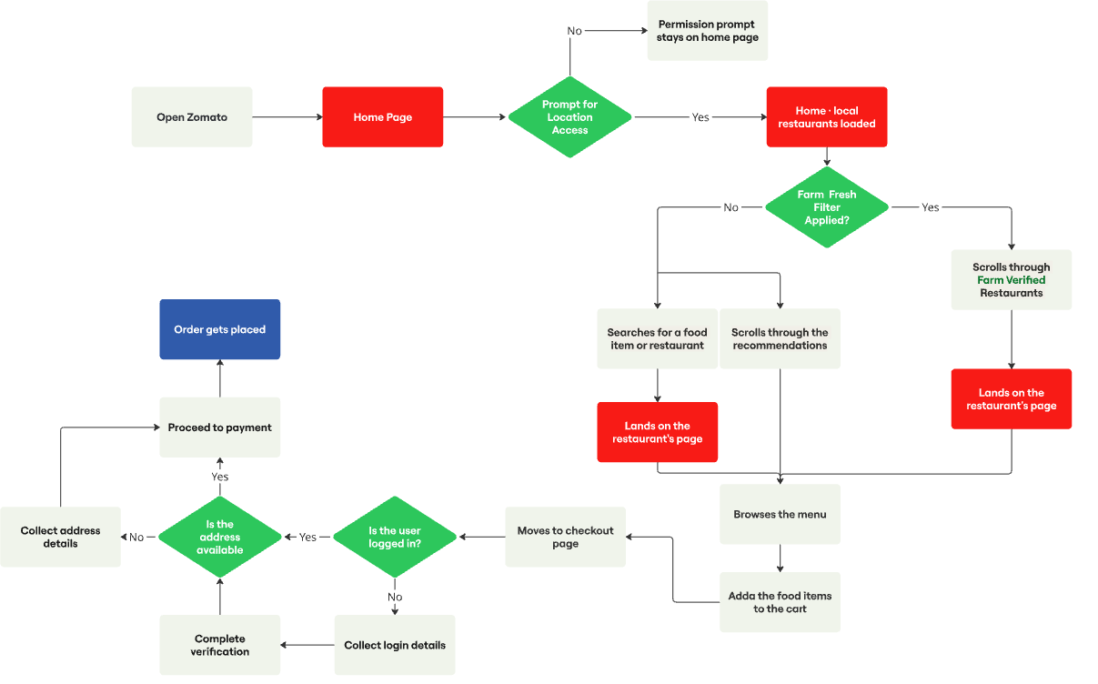
Improved User Flow
ORDER PLACEMENT ON ZOMATO
Notes:
Order placement on Zomato, with Farm Fresh filter and Farm Verified surfaces inserted into the existing path.

Slide 19
PROPOSED SOLUTION
Four Building Blocks
01
02
03
Farm Fresh Discovery
Verified Sourcing Signal
Personalisation Flywheel
Brings farm-to-table restaurant discovery entirely inside Zomato — replacing Google and Instagram as the user's sourcing research channel.
Replaces unverifiable "farm fresh" marketing copy with a platform-controlled verification layer — named producer, real distance, and a Zomato-audited badge.
Makes Zomato progressively smarter about each user's sourcing preferences — so the research effort required reduces with every order, not resets.
04
The operational and data foundation that makes every consumer-facing feature credible — producer registry, verification workflow, anti-gaming rules, and a two-tier badge system.
Sourcing Trust Infrastructure
Notes:
Three consumer-facing pillars sitting on one operational foundation.

Slide 20
04
Requirements
Functional · Technical · Design · Non-functional
Notes:
Section four: requirements across functional, technical, design, and non-functional.

Slide 21
FUNCTIONAL REQUIREMENTS · 1 OF 3
Discovery and Restaurant Page
Home and location
Restaurant header and menu
Dish detail and farmer card
If user denies location access — permission prompt remains on home page; no restaurant listings are shown; Farm Fresh rail and filter chip are not rendered.
If user grants location access — home page loads with local restaurants, Farm Fresh rail, and Farm Fresh filter chip all rendered in the same page load.
Two sub-paths available: user searches for a food item or restaurant, or user scrolls through standard recommendations.
In both sub-paths, Farm Verified restaurants display a "Farm Verified" badge on their listing card — a sourcing signal without requiring the filter to be active.
Restaurant header displays "Farm Verified ✓" badge alongside existing trust signals (e.g. "Frequently reordered") — badge is tappable and opens the Farm Verified bottom sheet.
Badge shown only when restaurant has at least one dish with verification_status = verified.
Badge removed automatically within 15 minutes if the restaurant's last verified dish lapses or is revoked.
A "Farm Fresh" filter chip is available in the dish filter row — tapping it floats farm-tagged dishes to the top of the menu.
No dish-level Farm Fresh label is displayed on dish cards — sourcing signal is carried at restaurant level only.
Dish detail expands inline — farmer profile card renders below the dish description showing farm name, village and district, computed distance from the user's delivery address, produce types, and a "Verified by Zomato" link.
If dish is linked to multiple producers, all are shown as scrollable cards — one per producer.
Distance computed server-side using the user's saved default delivery address; district-level proximity used as fallback if no saved address.
If producer API is slow, dish detail renders without the farmer card — page does not block.
Notes:
Home, listing, and restaurant page behaviour.

Slide 22
FUNCTIONAL REQUIREMENTS · 2 OF 3
Cart, Checkout, and Address
Cart impact card
Checkout and login
Address and distance
System displays a "You're ordering from a Farm Verified restaurant" impact card on the cart page whenever the restaurant holds an active Farm Verified status — regardless of which specific dishes are in the cart.
Secondary line names the producer(s) linked to the restaurant and their distance: "[Producer Name] · X km from your location".
Impact card suppressed if Farm Verified status has lapsed or been revoked — consistent with the 15-minute cache invalidation applied to all other surfaces.
No dish-level label or badge displayed on cart item rows — all rows are visually identical regardless of sourcing status.
If logged in, system proceeds directly to address availability check — no login step shown.
Farm Verified impact card remains visible on the checkout screen — impact message persists through the checkout flow.
If not logged in, system redirects to login — collects login details and completes verification (OTP or password).
Cart state must be preserved through the login flow — items added before login must not be lost after authentication.
After successful login, system proceeds to address availability check.
If address is available, system proceeds to payment — pre-fills saved address on the checkout summary.
Farmer profile card distance recomputes reactively if the user switches delivery address mid-session — distance label updates on next farmer card view.
If recomputed distance exceeds 150 km, the label switches to "Sourced locally in [District Name]" — no specific km figure shown, to prevent a misleading number.
If no address, system prompts the user to enter and save one, then loops back to payment — cart state preserved throughout.
New address is used to recompute farmer card distance for all farm-tagged dishes in the current session.
Notes:
Impact card behaviour, login and address branches.

Slide 23
FUNCTIONAL REQUIREMENTS · 3 OF 3
Post-Order and Personalisation
Order and tracking
Freshness rating
Personalisation
Order placed successfully — system records which dishes were farm-tagged and which restaurant was Farm Verified at the time of order.
Farm sourcing summary card rendered on the order tracking screen: "You're ordering from a Farm Verified restaurant · [Producer Name] · X km from your location".
Post-delivery rating prompt includes an optional "Rate freshness" dimension — framed as "How fresh did the ingredients taste?" with a 1–5 leaf-scale and optional structured tags.
Dimension is suppressed for failed, cancelled, or refunded orders — only shown after a successfully delivered order from a Farm Verified restaurant.
Ratings stored against the restaurant's producer record — contributing to the producer's aggregate freshness score.
Producer freshness score computed using a trimmed mean — top and bottom 10% of ratings removed per rolling 30-day window to reduce outlier influence.
System computes farm_preference_score nightly: farm-tagged orders (weight 0.5) + browse events (weight 0.3) + freshness ratings (weight 0.2).
Users with score above threshold receive a personalised Farm Fresh rail on the homepage — ranked by individual preference affinity rather than city-level popularity.
Personalised rail copy shifts to "Based on your past orders" — restaurants previously ordered from are deprioritised to surface new discovery options.
Users can toggle farm preference on or off from profile settings — toggling off halts score computation entirely, not just hides the rail (DPDPA 2023 compliant).
Notes:
Tracking, freshness rating, and the nightly preference score.

Slide 24
REQUIREMENTS
Technical and Design Requirements
TECHNICAL
DESIGN
API extension with farm_to_table parameter; indexed verification data
Server-driven badge logic; cache invalidation (~15 min)
Batch-processed cached collections; preference-based API exposure
Producer entity model; dish-producer linkage; distance computation
Audit workflow; write-protected verification; expiry + re-audit
Preference scoring model; recommendation integration
Scalable architecture for large datasets
Visible filter chip with intuitive UI; graceful empty states
Prominent badge; consistent visual identity
Homepage carousel; optimised info density
Dish-level labels; farmer profile cards
Verified badge with explainer; credibility hierarchy
Context-aware UI; user toggle control
Accessible UI (WCAG compliant)
Notes:
Each capability paired with its technical and design requirement.

Slide 25
REQUIREMENTS
Non-functional Requirements
Scalability
Accessibility
Schema supports 50K producers and 500K tagged dishes without architectural changes in Phase 1–3
WCAG 2.1 AA — all Farm Fresh UI elements include aria-labels; colour never the sole differentiator. iOS VoiceOver and Android TalkBack compatibility required for the bottom sheet and all new interactive components
Reliability
Security
Sourcing data service target uptime 99.9%; all surfaces degrade gracefully on failure
verification_status write-protected; farm location data returned at district level only to consumers
Privacy
DPDPA 2023 compliant; preference toggle = full data processing opt-out, not a UI preference only
Notes:
Scale, accessibility, reliability, security, privacy.

Slide 26
05
Mockups
Discovery · Restaurant · Cart · Order tracking
Notes:
Section five: the screens.

Slide 27
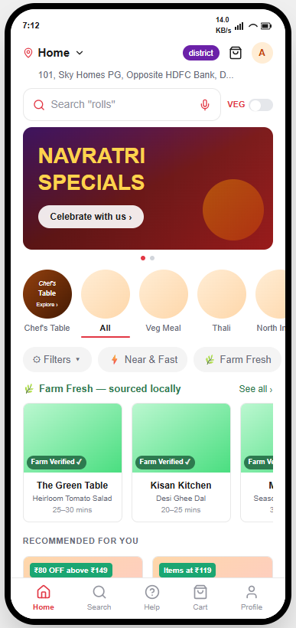
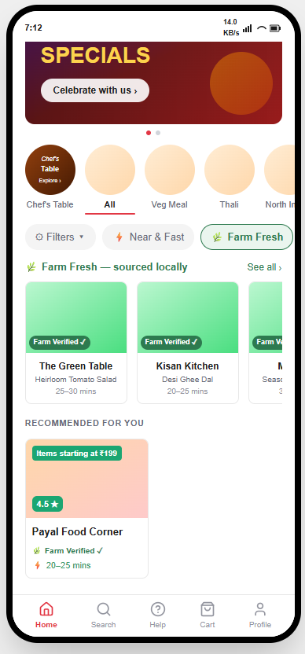
Home and Discovery
FARM FRESH FILTER CHIP · FARM FRESH RAIL
Farm Fresh rail
"Farm Fresh — sourced locally" rail renders on the same page load as local restaurants, with Farm Verified badges on each card.
Filter chip
Farm Fresh sits in the existing filter row beside Near & Fast — active state floats verified restaurants into the recommendations feed.
Badge in the feed
Recommended-for-you cards carry the badge inline, so the sourcing signal is visible without the filter being active.
Notes:
Farm Fresh chip and rail land on the existing home page without displacing anything.

Slide 28
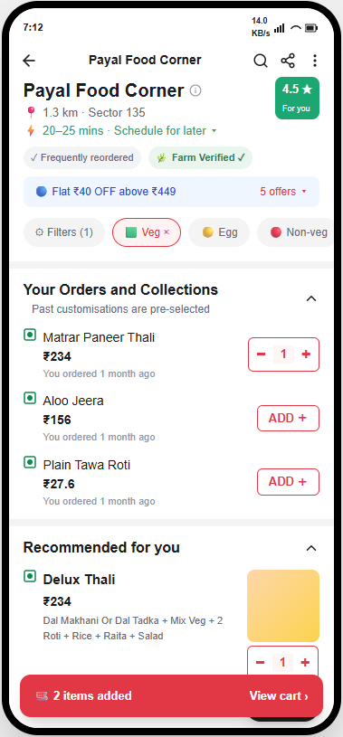
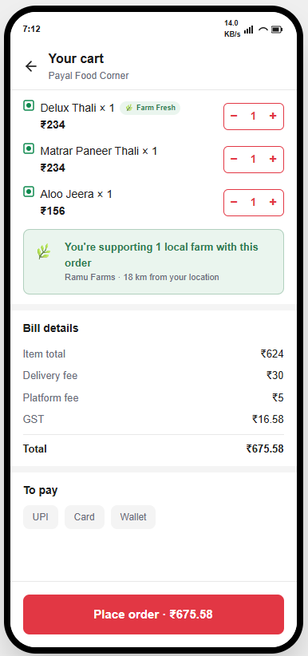
Restaurant Page and Cart
HEADER BADGE · IMPACT CARD
Header badge
"Farm Verified ✓" sits alongside existing trust signals such as "Frequently reordered", and is tappable to open the verification bottom sheet.
Impact card
"You're supporting 1 local farm with this order" names the producer and the distance — Ramu Farms · 18 km from your location.
Unchanged cart rows
Item rows stay visually identical regardless of sourcing status; the signal is carried once, at restaurant level.
Notes:
Badge in the restaurant header; impact card in the cart naming the producer and distance.

Slide 29
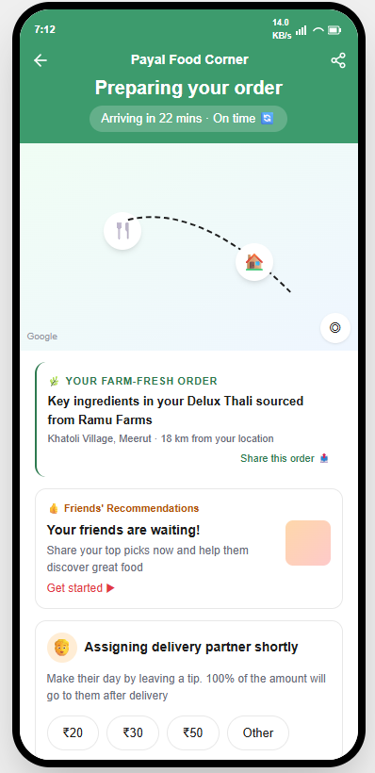
Order Tracking
FARM SOURCING SUMMARY CARD
Sourcing summary
"Key ingredients in your Delux Thali sourced from Ramu Farms" — Khatoli Village, Meerut · 18 km from your location, with a share action.
Freshness rating
After a successful delivery, the rating prompt adds "How fresh did the ingredients taste?" on a 1–5 leaf scale, feeding the producer's freshness score.
FUNCTIONAL PROTOTYPE
Farm-to-Fresh by Zomato ↗
Notes:
Tracking screen carries the sourcing summary; prototype link for the live walkthrough.

Slide 30
06
Verification, Edge Cases, Metrics
SOP for Farm-Fresh Verified status · Edge cases · Success metrics
Notes:
Section six: how verification is earned, where it breaks, and how success is measured.

Slide 31
SOP · TIER 1 — DECLARATION REQUIREMENTS
What the Restaurant Must Declare
Producer identity
Full legal name and registration number of the producer or FPO. Must be a registered entity — FPO, Kisan Credit Card holder, or APMC-registered trader. Unregistered intermediaries not accepted.
Ingredient scope
Specific ingredient(s) declared, not the whole dish. Declared ingredient must appear in the dish name or contribute more than 30% of the dish's raw ingredient weight. Garnishes, condiments, and finishing herbs explicitly excluded.
Geography
Farm must be within 150 km straight-line distance of the restaurant's registered address. Supply chain must be direct — maximum one intermediary between farm and restaurant.
Supply frequency
Minimum weekly or more frequent supply. Seasonal or one-time sourcing does not qualify. Three consecutive purchase invoices from the declared producer within the last 90 days required.
Produce eligibility
Eligible: fresh vegetables, fruits, dairy, pulses, grains, herbs, eggs. Processed or packaged goods explicitly excluded — no packaged spice mixes, bottled sauces, or manufactured ingredients.
Notes:
What the restaurant must submit before an audit begins.

Slide 32
SOP · TIER 2 — AUDIT CHECKS
What Zomato Verifies
Document verification
Physical verification
Renewal cadence
Producer GSTIN must be live on the GST portal
Invoice amounts must appear in the restaurant's own GST input credit filings for that period
Producer's GSTIN must appear directly on restaurant purchase invoices — not an intermediary's
Timestamped photo or video of fresh produce received from the declared producer — showing the delivery challan or producer packaging label alongside the produce
Invoices submitted on a rolling 90-day basis throughout a 6-month badge cycle — at months 1, 3, and 5
Badge displays the "last verified" date on the consumer-facing verification bottom sheet
Notes:
What Zomato verifies after the declaration is submitted.

Slide 33
EDGE CASES · CONSUMER-FACING
Where Trust Can Break
01
A user orders a farm-tagged dish but the restaurant substitutes the sourced ingredient on a specific day due to stock shortage — the consumer receives a non-farm-sourced version of a dish they believed was farm-sourced, with no disclosure.
02
A user gives a low freshness rating not because the sourcing was compromised but because the dish was prepared poorly — the rating unfairly penalises the producer's freshness score.
03
The farmer profile card shows a distance of "18 km from your location" but the user changes their delivery address mid-session to a different city — the distance becomes stale and misleading.
Notes:
Three consumer-facing failure modes the design has to answer for.

Slide 34
SUCCESS METRICS
How We Measure It
DEMAND SIDE
SUPPLY SIDE
No. of orders containing at least one Farm-Verified dish
Cart-to-order conversion rate on farm-tagged carts
Farm Fresh filter usage rate
AOV for orders with ≥ 1 Farm-Verified dish
Restaurant sourcing declaration rate
Verification approval rate
Verified dish count per restaurant
Notes:
Four demand metrics, three supply metrics.

