Slide 1
Spring 2024 COMP 3511 Review

Slide 2
Coverages
Multi-threaded process
fork() examples

Slide 3
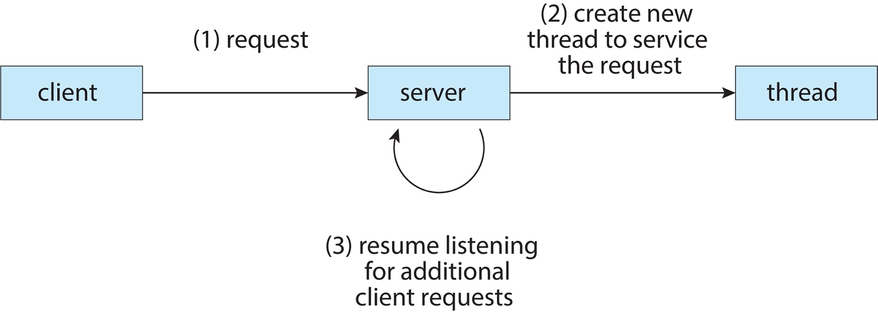
Multithreaded Process
Many modern applications are multithreaded - an application may be required to perform several similar tasks – for instance, a web server accepts client requests for retrieving web pages, which may have many (perhaps thousands of) clients concurrently accessing it
Creating a separate process to service each request is time-consuming and resource-intensive, and each process essentially performs the same task - It is generally much more efficient to create one process containing multiple threads, and each thread listens and serves requests.

Slide 4
Why Multithreaded
A single-threaded program or process runs sequentially, performing one operation followed by another
There are two major reasons for multi-threaded process
Parallelism: to take advantage of multicores or multi-processors - speed up process execution considerably by using each of the processors to perform a portion of the work
Overlap I/O with other activities within a single program
It is feasible to create multiple processes instead of a multi-threaded process. However, threads within a process share the address space and thus make it easy to share data naturally.
Processes are natural choices for logically separate tasks where little sharing of data structures in memory is needed.

Slide 5
Threads within a Process
If a process has a single or multiple thread(s) of execution – the execution context fully describes the state, i.e., the current activity of the thread
A thread is represented by
Program counter, registers, execution flags, and stack
A thread is executing on a processor (CPU) when it is resident in the processor registers. PC register holds the address of executing instruction in the thread
Threads within a process share code, data, I/O and files
On multicore systems, multiple threads of a process can run in parallel on different CPU cores
Each Thread has a Thread Control Block (TCB) containing execution state (CPU registers, program counter, pointer to stack), scheduling info, accounting info, various pointers including the pointer to the process PCB that the thread belongs to

Slide 6
Shared vs. Per-Thread State
Shared State
Per-Thread State
Per-Thread State

Slide 7
Thread Address Space
Single-threaded and multi-threaded address spaces
Here, we assume the virtual memory address space is 16KB
In practice, the address space is much larger than 16KB

Slide 8
Thread Libraries
Thread library provides programmers with API for creating and managing threads. Three main thread libraries are in use today :
POSIX Pthreads - either a user-level or a kernel-level library
Windows - kernel-level library available on Windows systems
Java - Since JVM is running on top of a host operating system, the Java thread API is generally implemented using a thread library available on the host system, i.e., Pthreads or Windows threads
There are two primary ways of implementing a thread library
Library entirely in user space - invoking a function in the library results in a local function call in user space and not a system call
Kernel-level library supported by the OS - invoking a function in the API for the library typically results in a system call to the kernel
For POSIX and Windows thread, data declared globally (outside of any function) - are shared among all threads belonging to the same process
Java has no equivalent notion of global data, access to shared data must be explicitly arranged between threads

Slide 9
Process Creation
fork() creates a new process, perhaps the strangest routine you have seen so far - the newly created process (child process) is an (almost) exact copy of the calling process (parent process). That means that it looks like there are two copies of the same program running, and both are about to return from the fork()system call
The child isn’t an exact copy. Specifically, although it has its own copy of the address space (i.e., its own private memory), its own registers, its own PC, and so forth, the value it returns to the caller of fork() is different - the parent receives the PID of the newly-created child, the child receives a return code of zero. This is essential to distinguish which process (parent or child) is executing the code after fork()
When the child process is created, there are now two active processes in the system along with other processes – either the child or the parent might run before the other. The execution sequences are now non-deterministic, which is determined by CPU scheduling (to be discussed in Chapter 5). In another word, any process can not determine when it will be executed by CPU and for how long.

Slide 10
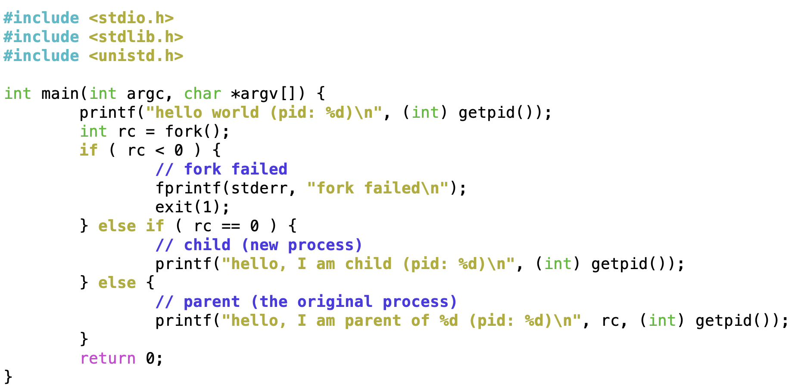
Process Creation with Error Handling
http://pages.cs.wisc.edu/~remzi/OSTEP/cpu-api.pdf
Figure 5.1 (p1.c) the simple fork example (with error handling)

Slide 11
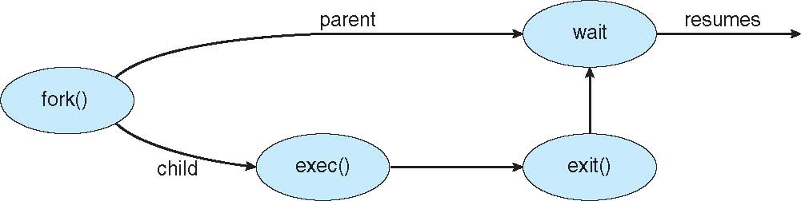
Concurrent Execution
fork() creates a new process, which duplicates entire address space of the parent, but with its own process ID and state
Both processes continue execution at the next instruction after fork()
exec() system call can be used after a fork() to replace the process’s memory space with a new program (load a new program to execute)
Parent process can call wait() system call to wait for a child to finish

Slide 12
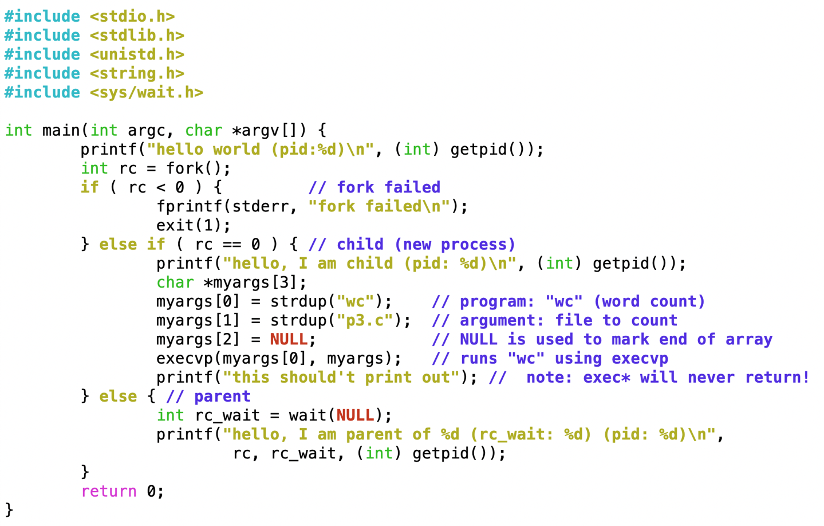
fork() Example with Error Handling
http://pages.cs.wisc.edu/~remzi/OSTEP/cpu-api.pdf
Figure 5.3 (p3.c), example with fork(), wait() and exec*()…
In the child process, this example demonstrates the usage of execvp to run a command to count number of words in a text file (i.e. p3.c)
Note: exec*() are special functions. They will never return!

Slide 13
fork() Example 1
Assume that necessary header files are included
Consider the following code segments, what is the total number of processes? Please elaborate
int main() {
int i=0;
for (i=0;i<3;i++)
fork();
return 0;
}
int main() {
fork();
fork();
fork();
return 0;
}
equivalent
Answer:
8 processes
There are 2 processes after each fork() and we have 3 consecutive fork(), so the answer is 2³ = 8

Slide 14
fork() Example 2
Assume that necessary header files are included
Consider the following code segments, what is the total number of processes? Please elaborate
256 processes
Each fork() will create 2 processes, and we have 8 consecutive fork() function calls, thus the total number of processes is 2⁸ = 256
int main() {
int i,j;
for (i=0; i<2; i++) {
fork();
for (j=0; j<3; j++)
if (!fork()) {
// do nothing
}
}
return 0;
}
int main()
{
fork();
if (!fork()); // do nothing
if (!fork()); // do nothing
if (!fork()); // do nothing
fork();
if (!fork()); // do nothing
if (!fork()); // do nothing
if (!fork()); // do nothing
return 0;
}
equivalent

Slide 15
fork() Example 3
Assume that necessary header files are included
Consider the following code segments, what is the total number of processes? Please elaborate (Hint: You can write your answer in terms of x^{y} processes)
6¹⁰ processes
In each loop, there are 6 processes from the initial one. Since there are 10 loops, the program will have 6¹⁰ processes
int main() {
int i=0;
for(i=0; i<10; i++) {
if(fork()) {
fork();
fork();
}
else
fork();
}
return 0;
}

Slide 16
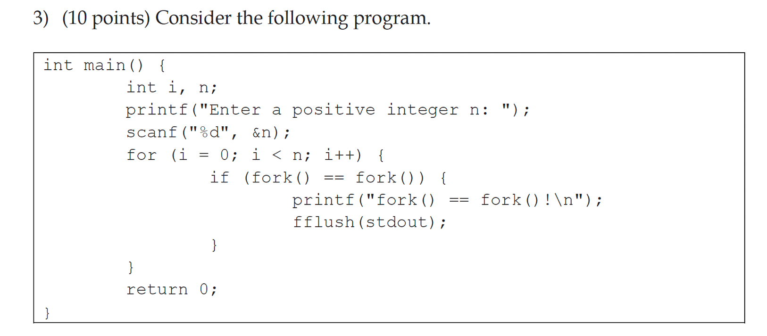
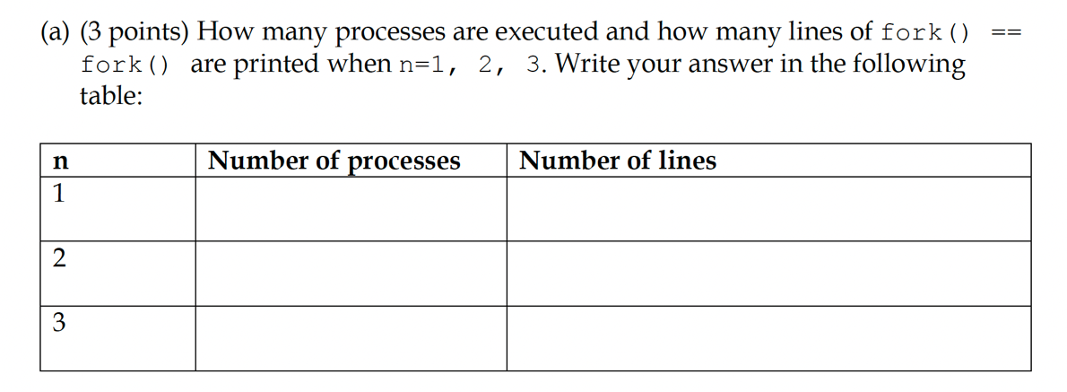
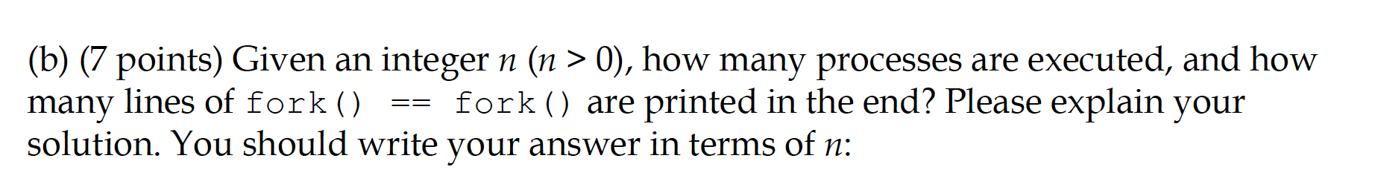
Fall 2022 Past Paper

Slide 17
Fall 2022 Past Paper
The for-loop can be rewritten like this
You can see 2 consecutive fork() function calls inside a loop of n iteration
for (i = 0; i < n; i++) {
int left_fork = fork();
int right_fork = fork();
if (left_fork == right_fork) {
printf("fork() == fork()!\n");
fflush(stdout);
}
}

Slide 18
Fall 2022 Past Paper
When n = 1, the whole program is:
The number of processes is relatively easy
Count the number (m) of consecutive fork() and the total is 2^m
When n = 1:
fork();
fork();
The total number of process is:
2^2 = 4
left_fork = fork();
right_fork = fork();
if (left_fork == right_fork) {
printf("fork() == fork()!\n");
fflush(stdout);
}

Slide 19
Fall 2022 Past Paper
When n = 2, the whole program is:
When n = 2:
fork();
fork();
fork();
fork();
So, the total number of process is:
2^4 = 16
left_fork = fork();
right_fork = fork();
if (left_fork == right_fork) {
printf("fork() == fork()!\n");
fflush(stdout);
}
left_fork = fork();
right_fork = fork();
if (left_fork == right_fork) {
printf("fork() == fork()!\n");
fflush(stdout);
}

Slide 20
Fall 2022 Past Paper
When n = 3, the whole program is:
left_fork = fork();
right_fork = fork();
if (left_fork == right_fork) {
printf("fork() == fork()!\n");
fflush(stdout);
}
left_fork = fork();
right_fork = fork();
if (left_fork == right_fork) {
printf("fork() == fork()!\n");
fflush(stdout);
}
left_fork = fork();
right_fork = fork();
if (left_fork == right_fork) {
printf("fork() == fork()!\n");
fflush(stdout);
}
When n = 3:
fork();
fork();
fork();
fork();
fork();
fork();
So, the total number of process is:
2^6 = 64

Slide 21
Fall 2022 Past Paper
The number of lines printed on the screen is a little bit tricky
When n = 1, the whole program is:
left_fork = fork();
right_fork = fork();
// 1 out of 4 processes print this
if (left_fork == right_fork) {
printf("fork() == fork()!\n");
fflush(stdout);
}
Total Number of Lines:
1

Slide 22
Fall 2022 Past Paper
It becomes a bit tricky when n = 2
When n = 2, the whole program is:
left_fork = fork();
right_fork = fork();
// 1 out of 4 processes print this line
if (left_fork == right_fork) {
printf("fork() == fork()!\n");
fflush(stdout);
}
left_fork = fork();
right_fork = fork();
// 4 out of 16 processes print this line
if (left_fork == right_fork) {
printf("fork() == fork()!\n");
fflush(stdout);
}
Total Number of Lines:
1+4

Slide 23
Fall 2022 Past Paper
It is even more tricky when n = 3
When n = 3, the whole program is:
left_fork = fork();
right_fork = fork();
// 1 out of 4 processes print this line
if (left_fork == right_fork) {
printf("fork() == fork()!\n");
fflush(stdout);
}
left_fork = fork();
right_fork = fork();
// 4 out of 16 processes print this line
if (left_fork == right_fork) {
printf("fork() == fork()!\n");
fflush(stdout);
}
// 16 out of 64 processes print this line
left_fork = fork();
right_fork = fork();
if (left_fork == right_fork) {
printf("fork() == fork()!\n");
fflush(stdout);
}
Total Number of Lines:
1+4+16

Slide 24
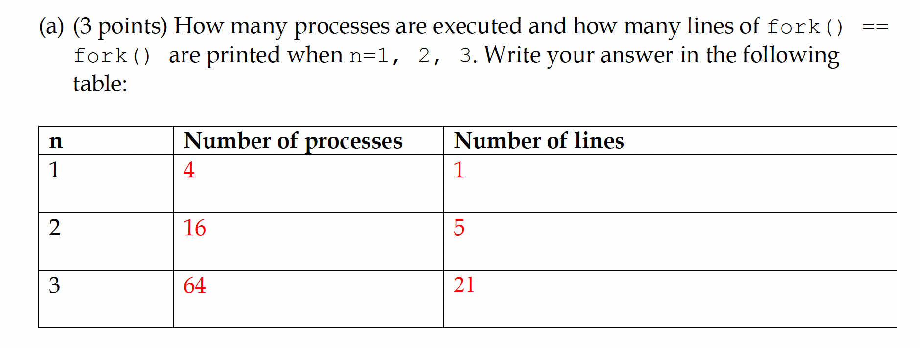
Fall 2022 Past Paper (Part A Answer)

Slide 25
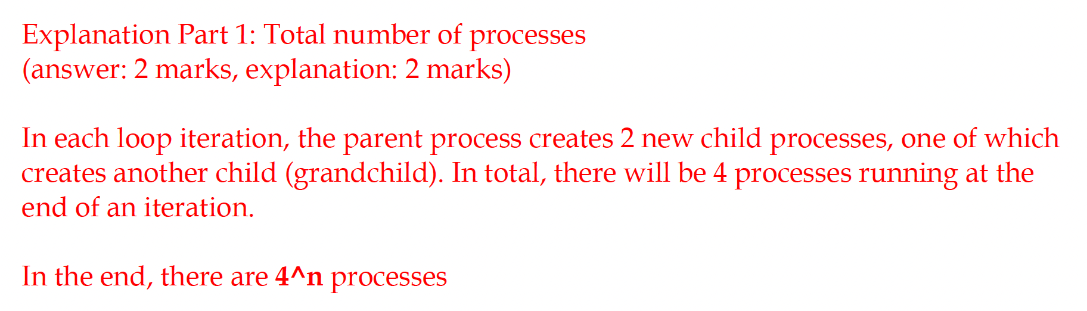

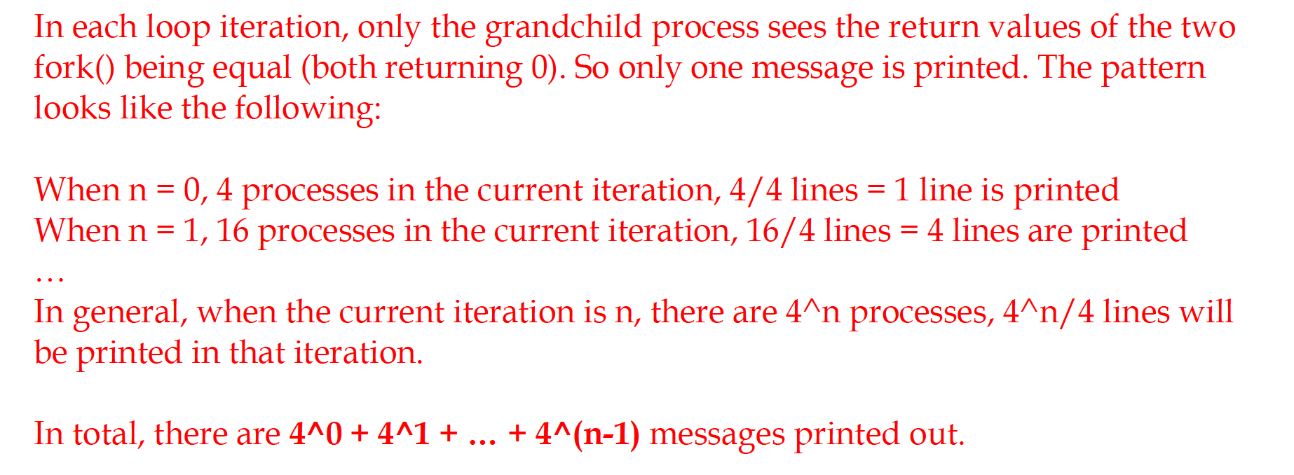
Fall 2022 Past Paper (Part B Answer)

Slide 26
Tips: fork() related questions
General tips
If you see loops, try to expand the loops to equivalent statements without loops
If you see nested loops, try to expand the inner loops, and then the outer loops
If you see fork() inside an if statement: e.g., if ( fork() )
Think carefully what will happens on the parent (i.e., the original) process, and the child process
For Homework
You can always write a program to verify your result

