Slide 1
COMP3511
Project Assignment 1 Introduction (Spring 2024)
Peter CHUNG (cspeter@cse.ust.hk)

Slide 2
Project Introduction
Simplified Linux Shell

Slide 3
Why Implementing a Shell Program?
Unlike a normal C/C++ programming course, an operating system course CANNOT easily create new programming topics that are related to operating systems
The first Unix shell was implemented in year 1971, and shell programs are still being used in Windows / Mac / Linux and various operating system nowadays
It is a very good practice to implement a simplified shell program using system calls in C programming language
Every semester, I make changes on the skeleton code, requirements, test cases, and documentations

Slide 4

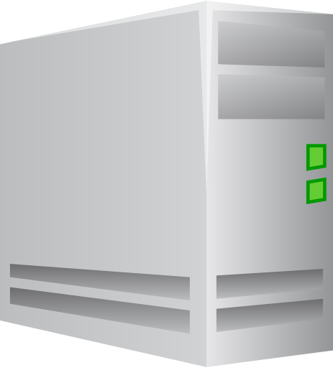


Why I need to do the programming in a CS Lab 2 machine?
Uploading and downloading code between the CS Lab2 Linux server and my local desktop or laptop computer, and subsequently compiling and debugging the program in a CS Lab 2 machine, poses significant challenges and inconveniences

Slide 5
TA’s Perspective: We need to consistently grade 100+ submissions!
It is impossible to fairly grade 100+ submissions with different environments:
Mac OS: 10+ different versions, 10+ different compiler versions…
Windows: 10+ different versions, 10+ different compiler versions…
Linux: 100+ different distributions, 10+ different compiler versions…
We need to grade everything in a consistent lab environment
CS Lab 2 Linux environment: all machines sharing the same environment
A single compiler (gcc) with consistent compiler options
The sample Linux executable is also compiled in a CS Lab 2 machine

Slide 6
Overview: The sample Linux executable
In this assignment, you need to implement an interactive shell program
Here is a sample usage using the exit command
$> ./myshell
COMP3511 PA1 Myshell (Spring 2024)
Myshell (pid=4609) starts
ITSC FULL_PATH_TO_CURRENT_DIR> exit
Myshell (pid=4609) ends
$>

Slide 7
Implement the cd command
cd command is a special command that needs to implement separately (i.e., it cannot be handled using exec* functions)
You need to invoke a special system call that is not covered in the lab notes. For details, please check the problem description and the examples:
int chdir(const char *path);

Slide 8
Restrictions
You CANNOT use these functions defined in <stdlib.h> and <stdio.h>
system function creates a default shell and then process the input command. The parent process will be blocked.
popen is similar, but both the parent and child processes will be executed independently. The return file pointer can be used for a one-way communication between the parent and the child process
They are too powerful! The purpose of the project assignment is to help students understand process management and inter-process communication.
It is meaningless to directly use these functions to process the whole command
CANNOT be used in this course project
int system(const char *command);
FILE *popen(const char *command, const char *mode);

Slide 9
Assumptions of the input test cases
You can assume that the input format is valid
Before running the command, you should first identify the pattern of the command
Here are the possible patterns in PA1:
Case 1: command
Case 2: command < input
Case 3: command > output
Case 4: command < input > output
Case 5: command > output < input
Case 6: command1 | command2 | …

Slide 10
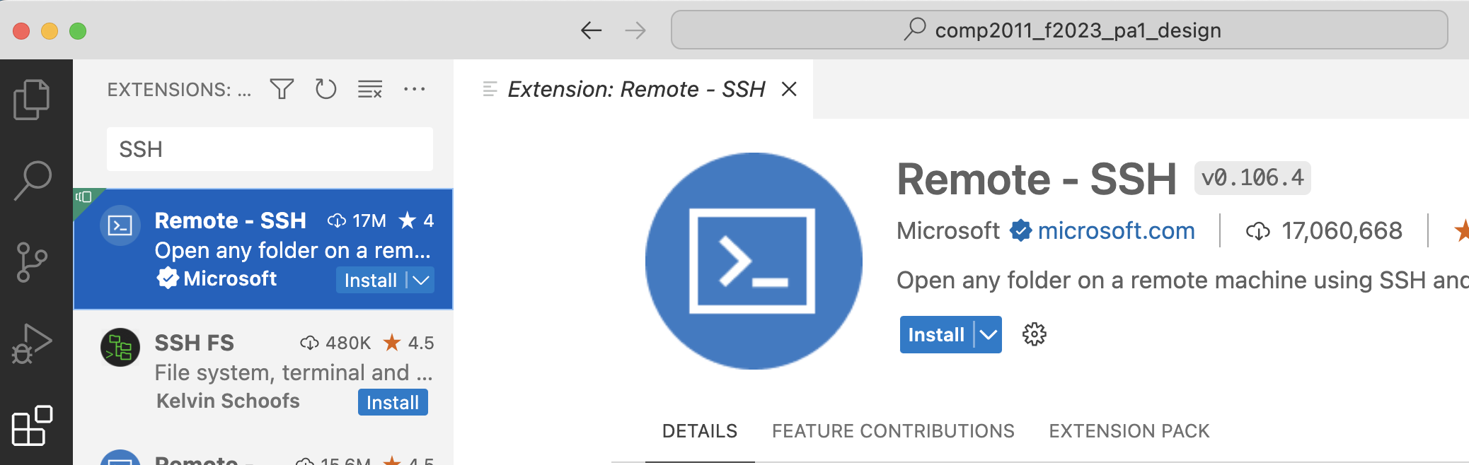
Tip 1: Do not use Remote-SSH extension
Use putty/terminal (for commands) + Filezilla FTP Client (for files)
Do not use VSCode Remote-SSH extension to remote login a CS lab computer unless you clean up the remote config files everytime
cssystem has very limited disk quota (~100MB)
Strange errors will be shown if you are running out of disk quota
Please read the next slide if you are out of disk quota

Slide 11
Tip 2: Checking your disk quota
# means the Linux system shell prompt
Unfortunately, CS Lab 2 users only have 100MB of disk quota
Here are the commands to check the disk quota:
The first command goes to your home directory
The second command shows your disk usage
If you disk usage exceeds 100MB, you may need to delete files in your CS Lab 2 machine
# cd ~
# du -ah | sort -rh | less

Slide 12
Tip 3: File Redirection
A file output redirection example using dup system call
Can you extend it to handle file redirections?
#include <stdio.h> /* For print and fflush */
#include <unistd.h> /* For dup */
#include <sys/types.h>
#include <fcntl.h> /* For open syscall, flags, and user permissions */
int main() {
int fd;
fd = open("output.txt", /* output file name */
O_CREAT | O_WRONLY , /* flags */
S_IRUSR | S_IWUSR ); /* user permission: 600 */
close(1); /* Close stdout */
dup(fd); /* Replace stdout using the new file descriptor ID */
printf("Hello World!\n"); /* call printf in C standard library */
fflush(stdout); /* ensure all characters are output from the buffer */
return 0;
}

Slide 13
Tip 4: How to extend to a multi-level pipe?
In the lab, we discussed a 2-level pipe example
Hint: Can you rewrite the 2-level pipe example to a for-loop like this?
Once the loop is correctly implemented, you can easily extend it from a 2-level pipe to a multi-level pipe
for (i=0; i<2; i++) {
// Rewrite the 2-level pipe here
}

Slide 14
Given Test Cases V.S. Hidden Test Cases
To make the project assignment more challenging, we have given test cases and hidden test cases
For given test cases,
We give students the exact commands to be tested
If needed, we will check the source code to avoid students hard-coding the test cases
For hidden test cases
We don’t give students the exact commands
We only give students the general descriptions about the hidden test cases
The hidden test cases avoid the hard-coding issues

Slide 15
Plagiarism
DON’T do any cheating!
Both parties (i.e., students providing the codes and students copying the codes) will receive 0 marks
Near the end of the semester, a plagiarism detection software (JPlag) will be used to identify cheating cases
The system is quite robust to detect simple refactoring tricks (e.g., renaming variables, inserting dummy variables, refactoring if-statements /loops, etc.)

