Slide 1
Spring 2024 COMP 3511 Review #4

Slide 2
Coverages
CPU Scheduling

Slide 3
CPU Scheduler
The CPU scheduling is the task of selecting a waiting process from the ready queue (one or multiple queues) and allocating the CPU to it. The CPU is allocated to the selected process by the dispatcher.
The non-preemptive scheduling is invoked when the process running on the CPU gives up the CPU voluntarily
Switches from running to waiting state, e.g., I/O request, or wait()
Terminates
The preemptive scheduling - where the CPU can be taken away from a process involuntarily can further be invoked when
Switches from running to ready state, e.g., quantum (timer) expires in RR scheduling
Switches from waiting to ready (e.g., completion of I/O) or from new to ready (new process with higher priority) - in SRTF or MLFQ scheduling

Slide 4
Scheduling Criteria
Waiting time – amount of time a process waiting in the ready queue
Turnaround time – defined as the time at which the process completes minus the time at which the process arrived in the system
Considering single CPU burst, turnaround time = waiting time + CPU burst time
Response time – the amount of time it takes from when a request was submitted until the first response is produced
This is relevant to interactive programs (typically using RR scheduling)
Fairness
Resources such as CPU are utilized in some “fair” manner
Performance (such as turn-around time) and fairness are often at odds, in which optimizing performance often sacrifice fairness

Slide 5
First-Come, First-Served (FCFS) Scheduling
First-Come, First-Served （FCFS） means the firstly arrived process can be firstly served.
FCFS is also known as First-In, First-Out (FIFO).
Although FCFS is simple, it also has many good properties, eg
easy to implement
works pretty well under specific assumptions

Slide 6
FCFS Scheduling: Example
Process | Burst Time
P1 | 7
P2 | 4
P3 | 1
P4 | 4
We assume the
arrival order is
P1, P2, P3, P4
P1
P2
P3
P4
0
7
11
12
16
We assume the processes arrive in this order: P1, P2, P3, P4
Waiting time for P1=0, P2=7, P3=11, P4=12
Average waiting time: (0+7+11+12)/4=7.5

Slide 7
Round Robin (RR) Scheduling
Each process gets a small unit of CPU time (time quantum), usually 10-100 milliseconds. After quantum expires, the process is preempted (OS timer interrupt) and added to the end of the ready queue.
Suppose n processes in the ready queue and the time quantum is q
In chunks of at most q time units at once.
No process waits more than (n-1)q time units
Performance
q large ⟹ FCFS
q small ⟹ Interleaved (resemble process sharing)
q must be large with respect to context switch, otherwise overhead is too high

Slide 8
RR Scheduling: Example 1
Process | Burst Time
P1 | 7
P2 | 4
P3 | 1
P4 | 4
We assume the
arrival order is
P1, P2, P3, P4
P1
P2
P3
P4
0
7
11
12
16
When time quantum q is 8, which is larger than the longest burst time among the process.
The Gantt chart is the same as that of FCFS.
Waiting time for P1=0, P2=7, P3=11, P4=12
Average waiting time: (0+7+11+12)/4=7.5

Slide 9
RR Scheduling: Example 2
Process | Burst Time
P1 | 7
P2 | 4
P3 | 1
P4 | 4
We assume the
arrival order is
P1, P2, P3, P4
P1
P2
P3
P4
P1
0
4
8
9
13
16
When time quantum q is 4
Waiting time for P1=(13-4)=9, P2=4, P3=8, P4=9
Average waiting time: (9+4+8+9)/4=7.5

Slide 10
RR Scheduling: Example 3
Process | Burst Time
P1 | 7
P2 | 4
P3 | 1
P4 | 4
We assume the
arrival order is
P1, P2, P3, P4
P1
P2
P3
P4
P1
P2
P4
P1
P1
0
2
4
5
7
9
11
13
15
16
When time quantum q is 2
Waiting time for P1=5+4=9

Slide 11
RR Scheduling: Example 3
Process | Burst Time
P1 | 7
P2 | 4
P3 | 1
P4 | 4
We assume the
arrival order is
P1, P2, P3, P4
P1
P2
P3
P4
P1
P2
P4
P1
P1
0
2
4
5
7
9
11
13
15
16
When time quantum q is 2
Waiting time for P1=9, P2=2+5=7

Slide 12
RR Scheduling: Example 3
Process | Burst Time
P1 | 7
P2 | 4
P3 | 1
P4 | 4
We assume the
arrival order is
P1, P2, P3, P4
P1
P2
P3
P4
P1
P2
P4
P1
P1
0
2
4
5
7
9
11
13
15
16
When time quantum q is 2
Waiting time for P1=9, P2=7, P3=4

Slide 13
RR Scheduling: Example 3
Process | Burst Time
P1 | 7
P2 | 4
P3 | 1
P4 | 4
We assume the
arrival order is
P1, P2, P3, P4
P1
P2
P3
P4
P1
P2
P4
P1
P1
0
2
4
5
7
9
11
13
15
16
When time quantum q is 2
Waiting time for P1=9, P2=7, P3=4, P4=5+4=9

Slide 14
RR Scheduling: Example 3
Process | Burst Time
P1 | 7
P2 | 4
P3 | 1
P4 | 4
We assume the
arrival order is
P1, P2, P3, P4
P1
P2
P3
P4
P1
P2
P4
P1
P1
0
2
4
5
7
9
11
13
15
16
When time quantum q is 2
Waiting time for P1=9, P2=7, P3=4, P4=9
Average waiting time: (9+7+4+9)/4=7.25 (better than FCFS, 7.5)

Slide 15
Shortest-Job-First (SJF) Scheduling
Associate with each process the length of its next CPU burst. Use these lengths to schedule the process with the shortest time
Two schemes:
Non-preemptive – once the CPU is allocated to a process, it cannot be preempted until the completion of its current CPU burst
Long
Short
SJF is optimal – yields the minimum average waiting time for a given set of processes
Short
Long

Slide 16
SJF Scheduling: Example
Process | Burst Time | Arrival Time
P1 | 7 | 0
P2 | 4 | 0
P3 | 1 | 0
P4 | 4 | 0
P3
P2
P4
P1
0
1
5
9
16
Since P2 and P4 have the same burst time, we first schedule P2, then P4
Waiting time for P1=9, P2=1, P3=0, P4=5
Average waiting time: (9+1+0+5)/4=3.75 (better than FCFS and RR)

Slide 17
Shortest-Job-First (SJF) Scheduling
Associate with each process the length of its next CPU burst. Use these lengths to schedule the process with the shortest time
Two schemes:
Non-preemptive – once the CPU is allocated to a process, it cannot be preempted until the completion of its current CPU burst
Preemptive – if a new process arrives with CPU burst length less than remaining time of current executing process, preempt. This scheme is also know as the Shortest-Remaining-Time-First (SRTF)

Slide 18
SRTF Scheduling: Example
Process | Burst Time | Arrival Time | Remaining Time
P1 | 7 | 0 | 7
P2 | 4 | 2
P3 | 1 | 4
P4 | 4 | 5
P1
0
2

Slide 19
SRTF Scheduling: Example
Process | Burst Time | Arrival Time | Remaining Time
P1 | 7 | 0 | 5
P2 | 4 | 2 | 4
P3 | 1 | 4
P4 | 4 | 5
P1
P2
0
2
4
P1 gets preempted at time 2

Slide 20
SRTF Scheduling: Example
Process | Burst Time | Arrival Time | Remaining Time
P1 | 7 | 0 | 5
P2 | 4 | 2 | 2
P3 | 1 | 4 | 1
P4 | 4 | 5
P1
P2
P3
0
2
4
5
P1 gets preempted at time 2
P2 gets preempted at time 4

Slide 21
SRTF Scheduling: Example
Process | Burst Time | Arrival Time | Remaining Time
P1 | 7 | 0 | 5
P2 | 4 | 2 | 2
P3 | 1 | 4 | 0
P4 | 4 | 5 | 4
P1
P2
P3
P2
0
2
4
5
7
P1 gets preempted at time 2
P2 gets preempted at time 4

Slide 22
SRTF Scheduling: Example
Process | Burst Time | Arrival Time | Remaining Time
P1 | 7 | 0 | 5
P2 | 4 | 2 | 0
P3 | 1 | 4 | 0
P4 | 4 | 5 | 4
P1
P2
P3
P2
P4
0
2
4
5
7
11
P1 gets preempted at time 2
P2 gets preempted at time 4

Slide 23
SRTF Scheduling: Example
Process | Burst Time | Arrival Time | Remaining Time
P1 | 7 | 0 | 0
P2 | 4 | 2 | 0
P3 | 1 | 4 | 0
P4 | 4 | 5 | 0
P1
P2
P3
P2
P4
P1
0
2
4
5
7
11
16
P1 gets preempted at time 2
P2 gets preempted at time 4

Slide 24
SRTF Scheduling: Example
Process | Burst Time | Arrival Time | Remaining Time
P1 | 7 | 0 | 0
P2 | 4 | 2 | 0
P3 | 1 | 4 | 0
P4 | 4 | 5 | 0
P1
P2
P3
P2
P4
P1
0
2
4
5
7
11
16
Waiting time for P1=(11-2)=9, P2=1, P3=0, P4=(7-5)=2
Average waiting time: (9+1+0+2)/4=3 (better than SJF, 3.75)

Slide 25
Priority Scheduling
A priority number (integer) is associated with each process
The CPU is allocated to the process with the highest priority (smallest integer ≡ highest priority), it can be
Preemptive （upon new arrival of a higher priority process)
Non-preemptive
Equal-priority processes are scheduled in FCFS order
SJF is a special case of the general priority-scheduling algorithm, where priority is the inverse of predicted next CPU burst time
Problem ≡ Starvation – low priority processes may never execute
Solution ≡ Aging – as time progresses increase the priority of the process

Slide 26
Priority Scheduling: Example
Process | Burst Time | Arrival Time | Priority
P1 | 7 | 0 | 4
P2 | 4 | 0 | 1
P3 | 1 | 0 | 2
P4 | 4 | 0 | 3
P2
P3
P4
P1
0
4
5
9
16
Waiting time for P1=9, P2=0, P3=4, P4=5
Average waiting time: (9+0+4+5)/4=4.5

Slide 27
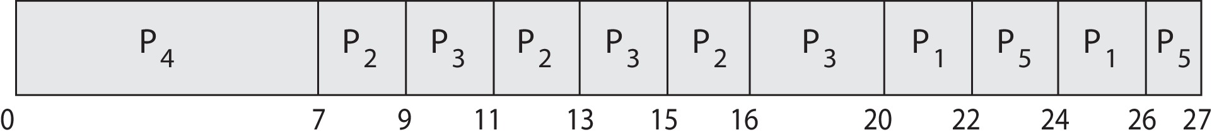
Priority Scheduling w/ Round-Robin
ProcessA arri Burst TimeT Priority
P₁ 4 3
P₂ 5 2
P₃ 8 2
P₄ 7 1
P₅ 3 3
Run the process with the highest priority. Processes with the same priority are scheduled to run in a round-robin or RR manner
Gantt Chart with 2 ms time quantum
Average waiting time = [(26-4)+(16-5)+(20-8)+(7-7)+(27-3)]=69/5=13.8

Slide 28
Priority Scheduling with Round-Robin in HW/Exam
In the previous lecture example, all processes arrive at t = 0
In HW/Exam, you may see more challenging questions of Priority Scheduling w/ Round-Robin with different arrival times
If the arrival times are different, you need to consider the pre-emptive issues, and keep track of the remaining time of the pre-empted processes (if any)
A common mistake is to reset the time quantum of the pre-empted processes, without keeping track of the remaining time

Slide 29
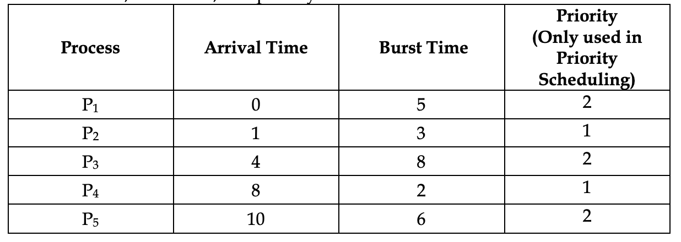
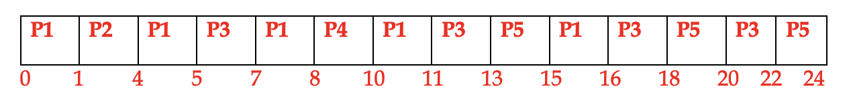
S2023 Midterm Question/Solution (Priority Scheduling w/ Round-Robin – different arrival time)
Draw the Gantt Chart of
Preemptive priority scheduling with RR
(with quantum of 2 milliseconds)

Slide 30
Multilevel Feedback Queue (MLFQ) Scheduling
Multilevel-feedback-queue or MLFQ scheduler defined by
The number of queues
scheduling algorithms for each queue
method used to determine when to upgrade a process
method used to determine when to demote a process
method used to determine which queue a process will enter when that process needs service
MLFQ is commonly used in many systems such as BSD Unix, Solaris, Window NT and subsequent Window operating systems
MLFQ has several distinctive advantages:
It does not require prior knowledge on CPU burst time
It handles interactive jobs well by delivering similar performance as that of SJF or SRTF
It is also “fair” by making progress on CPU-bound jobs

Slide 31
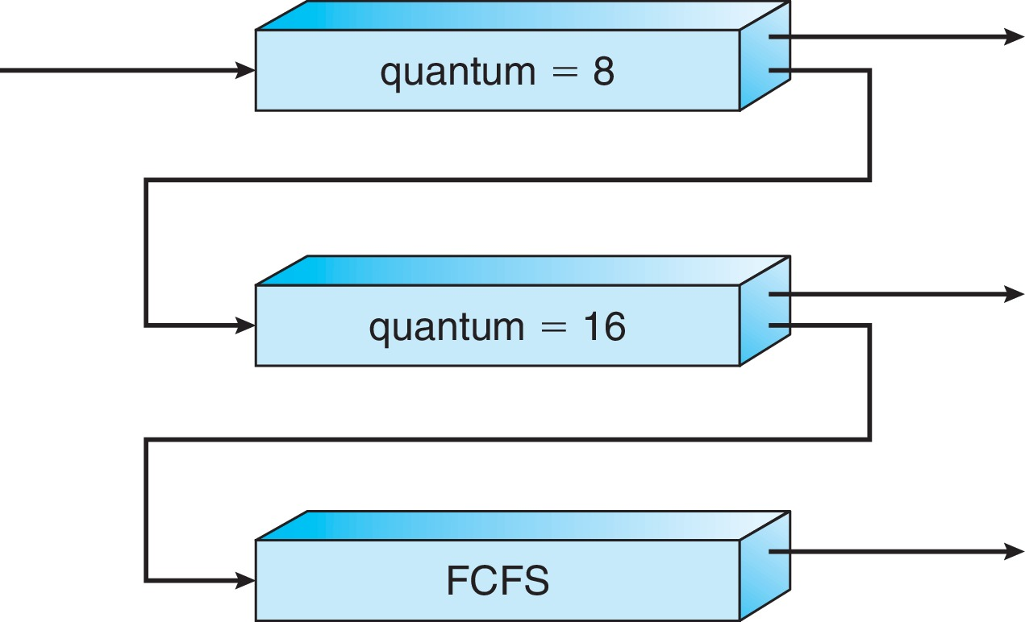
Example of Multilevel Feedback Queue
Three queues:
Q₀ – RR with time quantum 8 milliseconds
Q₁ – RR time quantum 16 milliseconds
Q₂ – FCFS
Scheduling
A new job enters queue Q₀ which is served FCFS, also preempts jobs from Q1 or Q2 if currently running on CPU
When it gains CPU, job receives 8 ms
If it does not finish in 8 milliseconds, job is moved to the queue Q₁
At Q₁ job is again served FCFS and receives 16 additional milliseconds
If it still does not complete, it is preempted and moved to queue Q₂
If a job from Q₁ or Q₂ is preempted by a new job from Q₀, it joins the head of the queue Q₁ or Q₂ , respectively
This approximates SRTF:
CPU bound jobs drop like a rock
Short-running I/O bound jobs stay near top

Slide 32
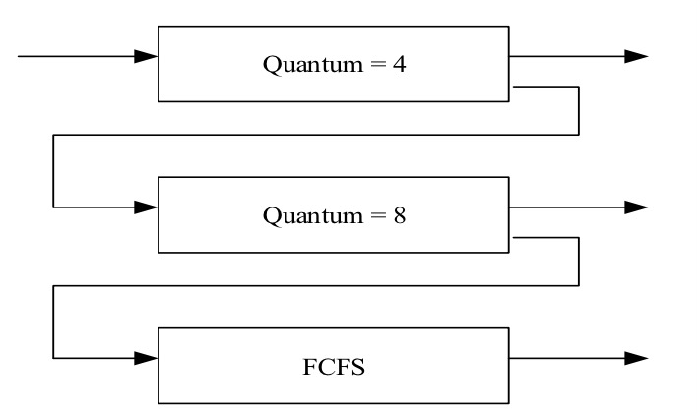
MLFQ: The lecture example with animation
Process | Arrival Time (ms) | Burst Time (ms)
P1 | 0 | 10
P2 | 2 | 15
P3 | 5 | 2
P4 | 12 | 14
P5 | 18 | 6

Slide 33
MLFQ Scheduling: Example
Process | Burst Time | Arrival Time | Remaining Time
P1 | 10 | 0
6
10
6
8
0
2
2
4
√
4
P2
2
P2
15
15
2
3
15
15
14
3
11
11
√
0
P3
√
P3
2
2
5
5
2
2
0
14
14
12
12
10
10
0
2
P4
2
√
P4
14
P5
P5
6
18
6
18
0
2
6
√
2
P1
P2
P3
P1
P4
P1
P5
P1
P2
P4
P5
P2
P4
0
4
8
10
12
16
18
22
24
32
40
42
45
47
P2
Q0
P3
P2
P1
P3
P5
P4
at time 47: P4 finishes
at time 22: P5 gets preempted and waits in Q1; P1 gets service in Q1
at time 32: P2 gets preempted and waits in Q2; P4 gets service in Q1
at time 45: P2 finishes; P4 gets service in Q2
at time 40: P4 gets preempted and waits in Q2; P5 gets service in Q1
at time 16: P4 gets preempted and waits in Q1; P1 gets service in Q1
at time 42: P5 finishes; P2 gets service in Q2
at time 24: P1 finishes; P2 gets service in Q1
at time 18: P5 arrives and gets service in Q0; P1 gets preempted in Q1
at time 12: P4 arrives and gets service in Q0; P1 gets preempted in Q1
at time 10: P3 finishes; P1 gets service in Q1
at time 8: P2 gets preempted and waits in Q1; P3 gets service in Q0
at time 2: P2 arrives and waits in Q0
at time 4: P1 gets preempted and waits in Q1; P2 gets service in Q0
at time 0: P1 arrives and gets service in Q0
at time 5: P3 arrives and waits in Q0
P2
P1
P1
P5
P5
P1
P2
P1
P5
P1
P4
P4
P4
P1
Q1
P5
P4
P4
P2
P2
Q2

Slide 34
MLFQ Scheduling: Example
Process | Burst Time | Arrival Time | Remaining Time
P1 | 10 | 0
0
P2
15
2
0
P3
2
5
0
P4
14
12
0
P5
6
18
0
P1
P2
P3
P1
P4
P1
P5
P1
P2
P4
P5
P2
P4
0
4
8
10
12
16
18
22
24
32
40
42
45
47
2
5
Waiting time for
P1=14, P2=2+16+10=28
P1=6+4+4=14
P1=14, P2=28, P3=3
P1=14, P2=28, P3=3, P4=16+5=21
P1=14, P2=28, P3=3, P4=21, P5=18
P1=14, P2=28, P3=3, P4=21, P5=18
Average waiting time: (14+28+3+21+18)/5=16.8

Slide 35
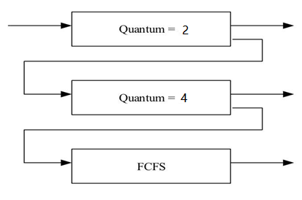
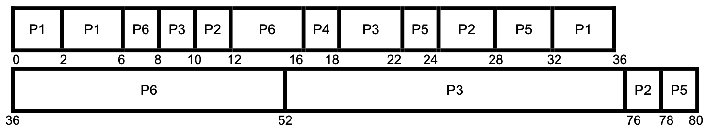
MLFQ Scheduling: Another Example
Process | Arrival Time | Burst Time
P1 | 0 | 10
P2 | 10 | 8
P3 | 8 | 30
P4 | 16 | 2
P5 | 22 | 8
P6 | 6 | 22

Slide 36
MLFQ Scheduling: Example
Averaging waiting time = turn-around time - CPU burst time
P1: 36-0-10 = 26
P2: 78-10-8 = 60
P3: 76-8-30 = 38
P4: 18-16-2 = 0
P5: 80-22-8 = 50
P6: 52-6-22 = 24
Average waiting time: (26+60+38+0+50+24)/6 =33

Slide 37
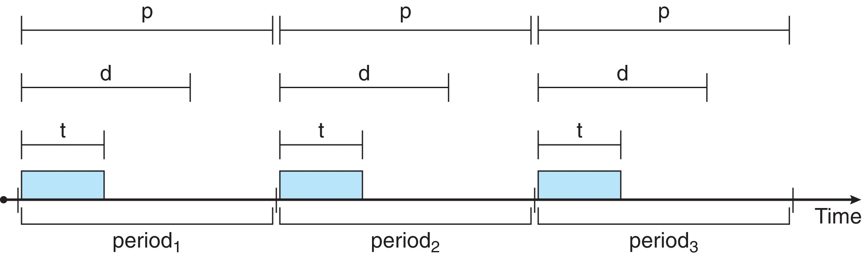
Priority-based Scheduling
Note that providing a preemptive, priority-based scheduler only guarantees soft real-time functionality. Processes have the characteristics: periodic ones require CPU at constant intervals (periods)
Has processing time t, deadline d, period p , in which 0 ≤ t ≤ d ≤ p
The rate of a periodic task is 1/p
A process may have to announce its deadline requirements to the scheduler. The scheduler decides whether to admit the process or not depending on whether it can guarantee that the process will complete on time (by its deadline)

Slide 38
Rate Monotonic Scheduling
A static priority is assigned based on the inverse of its period
Shorter (longer) period = higher (lower) priority;
The rationale is to assign a higher priority to tasks requiring CPU more often

Slide 39
RM Scheduling: Example
Process | Processing Time | Deadline | Period
P1 | 1 | 2 | 4
P2 | 2 | 5 | 6
P3 | 3 | 7 | 9
P1
P2
P3
P1
P3
P2
P1
P3
P3
P1
P2
P3
0
1
4
6
10
12
16
3
5
8
9
13
15
Miss one deadline: P3 arrives at time 0 misses the deadline (7) by finishing at time 10

Slide 40
Earliest Deadline First Scheduling (EDF)
Earliest-deadline-first (EDF) scheduling assigns priorities dynamically according to the deadline
the earlier (later) the deadline, the higher (lower) the priority

Slide 41
EDF Scheduling: Example
Process | Processing Time | Deadline | Period
P1 | 1 | 2 | 4
P2 | 2 | 5 | 6
P3 | 3 | 7 | 9
P1
P1
P2
P3
P1
P3
P2
P2
P1
P3
P3
P2
4
8
10
12
0
1
3
5
7
9
13
14
16
Misses no deadlines

Slide 42


