Slide 1
Spring 2024 COMP 3511
Review 6

Slide 2
Coverages
Deadlock - Banker’s Algorithm
Memory Management - Contiguous Memory Allocation
Memory Management - Segmentation

Slide 3
Deadlock

Slide 4
Methods for Handling Deadlocks
Ensure that the system will never enter a deadlock state:
  Deadlock prevention: it provides a set of methods to ensure at least one of the necessary conditions (i.e., mutual exclusion, hold and wait, no preemption, and circular wait) cannot hold
  Deadlock avoidance: this requires additional information given in advance concerning which resources a process will request and use during its lifetime. Within such knowledge, the OS can decide for each resource request whether or not a process should wait
Deadlock detection - allow the system to enter a deadlock state, periodically detect deadlock and then recover from it
Many OSes just ignore the deadlock problem because of the overhead and pretend that deadlocks never occur in the system

Slide 5
Avoidance Algorithms
Single instance of a resource type
  Use a resource-allocation graph (discussed in Lab06)
Multiple instances of a resource type
  Use the Banker’s algorithm

Slide 6
Banker’s Algorithm
Multiple instances for each resource type
Each process must declare a priori maximum usage
When a process requests a resource, it may have to wait - check to see if this allocation results in a safe state or not
When a process gets all its resources it must return them in a finite amount of time after use
This is analogous to banking loan system, which has a maximum amount in total, that can be loaned at one time to a set of businesses each with a credit line

Slide 7
Data Structures
Let n = number of processes, and m = number of resources types
Available: Vector of length m. If available [j] = k, there are k instances of resource type R_{j} available
Max: n x m matrix. If Max [i,j] = k, then process P_{i} may request at most k instances of resource type R_{j}
Allocation: n x m matrix. If Allocation[i,j] = k then P_{i} is currently allocated k instances of R_{j}
Need: n x m matrix. If Need[i,j] = k, then P_{i} may need k more instances of R_{j} to complete its task
    Need [i,j] = Max[i,j] – Allocation [i,j]

Slide 8
Usage of Banker’s Algorithm
Safety algorithm (core)
  To find out whether a system is in a safe state
Resource-Request algorithm
  Determine whether a request can be safely granted
  Please note that resource-request algorithm will invoke safety algorithm
  Nearly the SAME as Safety, except extra initialization and error checking
Detection algorithm
  Very similar to banker’s algorithm
  Initialization conditions are different, no need to compute the Need matrix…

Slide 9
Safety Algorithm
1. Let Work and Finish be vectors of length m and n, respectively
Initialize:
  (a) Work = Available
  (b) for i = 0, 1, …, n- 1
  if Allocation_{i} = 0 or Need_{i} = 0: Finish[i] = true; Work = Work + Allocation_{i}
  else: Finish[i] = false
2. Find an index i such that both:
  (a) Finish[i] == false
  (b) Need_{i} ≤ Work
  If no such i exists, go to step 4.
3. Work = Work + Allocation_{i}
Finish[i] = true
go to step 2.
4. If Finish [i] == true for all i, then the system is in a safe state, otherwise, it is unsafe

Slide 10
Safety Algorithm - Example
Consider the following snapshot of a system, is this system safe?
 | Allocation |  |  |  |  | Max |  |  |  |  | Available
 | A | B | C | D |  | A | B | C | D |  | A | B | C | D
P0 | 0 | 0 | 1 | 2 |  | 0 | 0 | 3 | 2 |  | 2 | 1 | 2 | 0
P1 | 2 | 0 | 0 | 0 |  | 2 | 7 | 5 | 0
P2 | 0 | 0 | 3 | 4 |  | 6 | 6 | 5 | 6
P3 | 2 | 3 | 5 | 4 |  | 4 | 3 | 5 | 6
P4 | 0 | 3 | 3 | 2 |  | 0 | 6 | 5 | 2

Slide 11
Safety Algorithm - Example
What is the content of the matrix Need denoting the number of resources needed by each process?
  Max – Allocation = Need
 | Need
 | A | B | C | D
P0 | 0 | 0 | 2 | 0
P1 | 0 | 7 | 5 | 0
P2 | 6 | 6 | 2 | 2
P3 | 2 | 0 | 0 | 2
P4 | 0 | 3 | 2 | 0

Slide 12
Safety Algorithm - Step 1
Sequence = <>
Initialize Finish and Work mentioned in the algorithm
 | Allocation |  |  |  |  | Need |  |  |  | Finish | Work
 | A | B | C | D |  | A | B | C | D |  | (2,1,2,0)
P0 | 0 | 0 | 1 | 2 |  | 0 | 0 | 2 | 0 | false
P1 | 2 | 0 | 0 | 0 |  | 0 | 7 | 5 | 0 | false
P2 | 0 | 0 | 3 | 4 |  | 6 | 6 | 2 | 2 | false
P3 | 2 | 3 | 5 | 4 |  | 2 | 0 | 0 | 2 | false
P4 | 0 | 3 | 3 | 2 |  | 0 | 3 | 2 | 0 | false

Slide 13
Safety Algorithm - Step 2
Sequence = <P0>
Find an index i such that both:
Finish[i] == false
Need_{i} ≤ Work
i=0 satisfies the two conditions
Work = Work + Allocation_{i}
Finish[i] = true
 | Allocation |  |  |  |  | Need |  |  |  | Finish | Work
 | A | B | C | D |  | A | B | C | D |  | (2,1,2,0) (2,1,3,2)
P0 | 0 | 0 | 1 | 2 |  | 0 | 0 | 2 | 0 | false true
P1 | 2 | 0 | 0 | 0 |  | 0 | 7 | 5 | 0 | false
P2 | 0 | 0 | 3 | 4 |  | 6 | 6 | 2 | 2 | false
P3 | 2 | 3 | 5 | 4 |  | 2 | 0 | 0 | 2 | false
P4 | 0 | 3 | 3 | 2 |  | 0 | 3 | 2 | 0 | false

Slide 14
Safety Algorithm - Step 2
Sequence = <P0,P3>
Find an index i such that both:
Finish[i] == false
Need_{i} ≤ Work
i=3 satisfies the two conditions
Work = Work + Allocation_{i}
Finish[i] = true
 | Allocation |  |  |  |  | Need |  |  |  | Finish | Work
 | A | B | C | D |  | A | B | C | D |  | (2,1,2,0) (2,1,3,2) (4,4,8,6)
P0 | 0 | 0 | 1 | 2 |  | 0 | 0 | 2 | 0 | true
P1 | 2 | 0 | 0 | 0 |  | 0 | 7 | 5 | 0 | false
P2 | 0 | 0 | 3 | 4 |  | 6 | 6 | 2 | 2 | false
P3 | 2 | 3 | 5 | 4 |  | 2 | 0 | 0 | 2 | false true
P4 | 0 | 3 | 3 | 2 |  | 0 | 3 | 2 | 0 | false

Slide 15
Safety Algorithm - Step 2
Sequence = <P0,P3,P4>
Find an index i such that both:
Finish[i] == false
Need_{i} ≤ Work
i=4 satisfies the two conditions
Work = Work + Allocation_{i}
Finish[i] = true
 | Allocation |  |  |  |  | Need |  |  |  | Finish | Work
 | A | B | C | D |  | A | B | C | D |  | (2,1,2,0) (2,1,3,2) (4,4,8,6) (4,7,11,8)
P0 | 0 | 0 | 1 | 2 |  | 0 | 0 | 2 | 0 | true
P1 | 2 | 0 | 0 | 0 |  | 0 | 7 | 5 | 0 | false
P2 | 0 | 0 | 3 | 4 |  | 6 | 6 | 2 | 2 | false
P3 | 2 | 3 | 5 | 4 |  | 2 | 0 | 0 | 2 | true
P4 | 0 | 3 | 3 | 2 |  | 0 | 3 | 2 | 0 | false true

Slide 16
Safety Algorithm - Step 2
Sequence = <P0,P3,P4,P1>
Find an index i such that both:
Finish[i] == false
Need_{i} ≤ Work
i=1 satisfies the two conditions
Work = Work + Allocation_{i}
Finish[i] = true
 | Allocation |  |  |  |  | Need |  |  |  | Finish | Work
 | A | B | C | D |  | A | B | C | D |  | (2,1,2,0) (2,1,3,2) (4,4,8,6) (4,7,11,8) (6,7,11,8)
P0 | 0 | 0 | 1 | 2 |  | 0 | 0 | 2 | 0 | true
P1 | 2 | 0 | 0 | 0 |  | 0 | 7 | 5 | 0 | false true
P2 | 0 | 0 | 3 | 4 |  | 6 | 6 | 2 | 2 | false
P3 | 2 | 3 | 5 | 4 |  | 2 | 0 | 0 | 2 | true
P4 | 0 | 3 | 3 | 2 |  | 0 | 3 | 2 | 0 | true

Slide 17
Safety Algorithm - Step 2
Sequence = <P0,P3,P4,P1,P2>
Find an index i such that both:
Finish[i] == false
Need_{i} ≤ Work
i=2 satisfies the two conditions
Work = Work + Allocation_{i}
Finish[i] = true
 | Allocation |  |  |  |  | Need |  |  |  | Finish | Work
 | A | B | C | D |  | A | B | C | D |  | (2,1,2,0) (2,1,3,2) (4,4,8,6) (4,7,11,8) (6,7,11,8) (6,7,14,12)
P0 | 0 | 0 | 1 | 2 |  | 0 | 0 | 2 | 0 | true
P1 | 2 | 0 | 0 | 0 |  | 0 | 7 | 5 | 0 | true
P2 | 0 | 0 | 3 | 4 |  | 6 | 6 | 2 | 2 | false true
P3 | 2 | 3 | 5 | 4 |  | 2 | 0 | 0 | 2 | true
P4 | 0 | 3 | 3 | 2 |  | 0 | 3 | 2 | 0 | true

Slide 18
Safety Algorithm - Step 4
Is the system in a safe state? Why?
  From the previous step, all Finish[i] become true
  The allocation should be safe right now, with a sequence of process execution: <P0, P3, P4, P1, P2>
  Note: There may be more than one possible sequence of process execution in particular cases. It is because in Step 2 of the safety algorithm, we may have more than one possible choices
 | Resources available after each process finished
 | A | B | C | D
P0 | 2 | 1 | 3 | 2
P3 | 4 | 4 | 8 | 6
P4 | 4 | 7 | 11 | 8
P1 | 6 | 7 | 11 | 8
P2 | 6 | 7 | 14 | 12

Slide 19
Banker’s Algorithm - New Request Example 1
If a request from process P0 arrives for (0, 1, 2, 0), can it be granted?
 | Allocation |  |  |  |  | Max |  |  |  |  | Available
 | A | B | C | D |  | A | B | C | D |  | A | B | C | D
P0 | 0 | 0 | 1 | 2 |  | 0 | 0 | 3 | 2 |  | 2 | 1 | 2 | 0
P1 | 2 | 0 | 0 | 0 |  | 2 | 7 | 5 | 0
P2 | 0 | 0 | 3 | 4 |  | 6 | 6 | 5 | 6
P3 | 2 | 3 | 5 | 4 |  | 4 | 3 | 5 | 6
P4 | 0 | 3 | 3 | 2 |  | 0 | 6 | 5 | 2

Slide 20
Resource-Request Algorithm - Step 1
Request[i] <= Need[i] must hold.
The answer is No in this case:
Request[0] = (0, 1, 2, 0) > Need[0] = (0, 0, 2, 0), which is not allowed.
 | Allocation |  |  |  |  | Need |  |  |  | Finish | Work
 | A | B | C | D |  | A | B | C | D |  | (2,1,2,0)
P0 | 0 | 0 | 1 | 2 |  | 0 | 0 | 2 | 0 | false
P1 | 2 | 0 | 0 | 0 |  | 0 | 7 | 5 | 0 | false
P2 | 0 | 0 | 3 | 4 |  | 6 | 6 | 2 | 2 | false
P3 | 2 | 3 | 5 | 4 |  | 2 | 0 | 0 | 2 | false
P4 | 0 | 3 | 3 | 2 |  | 0 | 3 | 2 | 0 | false

Slide 21
Banker’s Algorithm - New Request Example 2
If a request from process P2 arrives for (0, 1, 2, 0), can it be granted?
 | Allocation |  |  |  |  | Max |  |  |  |  | Available
 | A | B | C | D |  | A | B | C | D |  | A | B | C | D
P0 | 0 | 0 | 1 | 2 |  | 0 | 0 | 3 | 2 |  | 2 | 1 | 2 | 0
P1 | 2 | 0 | 0 | 0 |  | 2 | 7 | 5 | 0
P2 | 0 | 0 | 3 | 4 |  | 6 | 6 | 5 | 6
P3 | 2 | 3 | 5 | 4 |  | 4 | 3 | 5 | 6
P4 | 0 | 3 | 3 | 2 |  | 0 | 6 | 5 | 2

Slide 22
Resource-Request Algorithm - Step 1
Request[i] <= Need[i] condition holds:
Request[2] = (0, 1, 2, 0) < Need[2] = (6, 6, 2, 2)
Then go to step 2.
 | Allocation |  |  |  |  | Need |  |  |  | Finish | Available
 | A | B | C | D |  | A | B | C | D |  | (2,1,2,0)
P0 | 0 | 0 | 1 | 2 |  | 0 | 0 | 2 | 0 | false
P1 | 2 | 0 | 0 | 0 |  | 0 | 7 | 5 | 0 | false
P2 | 0 | 0 | 3 | 4 |  | 6 | 6 | 2 | 2 | false
P3 | 2 | 3 | 5 | 4 |  | 2 | 0 | 0 | 2 | false
P4 | 0 | 3 | 3 | 2 |  | 0 | 3 | 2 | 0 | false

Slide 23
Resource-Request Algorithm - Step 2
Request[i] <= Available condition holds:
Request[2] = (0, 1, 2, 0) < Available = (2, 1, 2, 0)
Then go to step 3.
 | Allocation |  |  |  |  | Need |  |  |  | Finish | Available
 | A | B | C | D |  | A | B | C | D |  | (2,1,2,0)
P0 | 0 | 0 | 1 | 2 |  | 0 | 0 | 2 | 0 | false
P1 | 2 | 0 | 0 | 0 |  | 0 | 7 | 5 | 0 | false
P2 | 0 | 0 | 3 | 4 |  | 6 | 6 | 2 | 2 | false
P3 | 2 | 3 | 5 | 4 |  | 2 | 0 | 0 | 2 | false
P4 | 0 | 3 | 3 | 2 |  | 0 | 3 | 2 | 0 | false

Slide 24
Resource-Request Algorithm - Step 3
Sequence = <>
Pretend to have allocated requested resources and modify the status.
 | Allocation |  |  |  |  | Need |  |  |  | Finish | Available
 | A | B | C | D |  | A | B | C | D |  | (2,0,0,0)
P0 | 0 | 0 | 1 | 2 |  | 0 | 0 | 2 | 0 | false
P1 | 2 | 0 | 0 | 0 |  | 0 | 7 | 5 | 0 | false
P2 | 0 | 1 | 5 | 4 |  | 6 | 5 | 0 | 2 | false
P3 | 2 | 3 | 5 | 4 |  | 2 | 0 | 0 | 2 | false
P4 | 0 | 3 | 3 | 2 |  | 0 | 3 | 2 | 0 | false

Slide 25
Resource-Request Algorithm - Step 3
Sequence = N/A
Find an index i such that both:
Finish[i] == false
Need_{i} ≤ Work
No i satisfies the two conditions
If Finish [i] == true for all i, then the system is in a safe state, otherwise, it is unsafe
 | Allocation |  |  |  |  | Need |  |  |  | Finish | Work
 | A | B | C | D |  | A | B | C | D |  | (2,0,0,0)
P0 | 0 | 0 | 1 | 2 |  | 0 | 0 | 2 | 0 | false
P1 | 2 | 0 | 0 | 0 |  | 0 | 7 | 5 | 0 | false
P2 | 0 | 1 | 5 | 4 |  | 6 | 5 | 0 | 2 | false
P3 | 2 | 3 | 5 | 4 |  | 2 | 0 | 0 | 2 | false
P4 | 0 | 3 | 3 | 2 |  | 0 | 3 | 2 | 0 | false

Slide 26
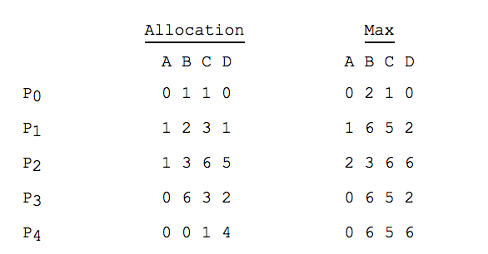
Another Example of Banker’s Algorithm
Consider the following snapshot of a system:
Using the Banker’s algorithm, determine whether each of the following states is safe or not. If the system is safe, specify one execution sequence in that all the processes may complete. Otherwise, briefly justify why the state is unsafe.

Slide 27
Another Example of Banker’s Algorithm
(a) Available = (0, 3, 0, 1).

Slide 28
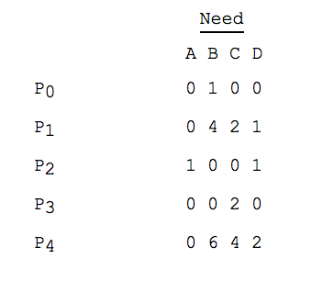
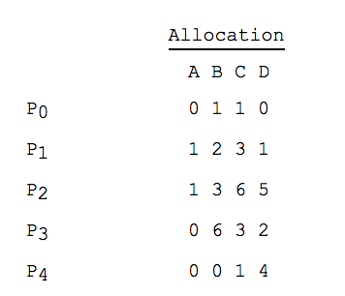
Another Example of Banker’s Algorithm
(a) Available = (0, 3, 0, 1).
Answer: It is unsafe.
Only P0 can be finished. Then available vector becomes (0, 4, 1, 1), which cannot satisfy remaining processes’ needs.

Slide 29
Another Example of Banker’s Algorithm
(b) Available = (1, 0, 0, 3)

Slide 30
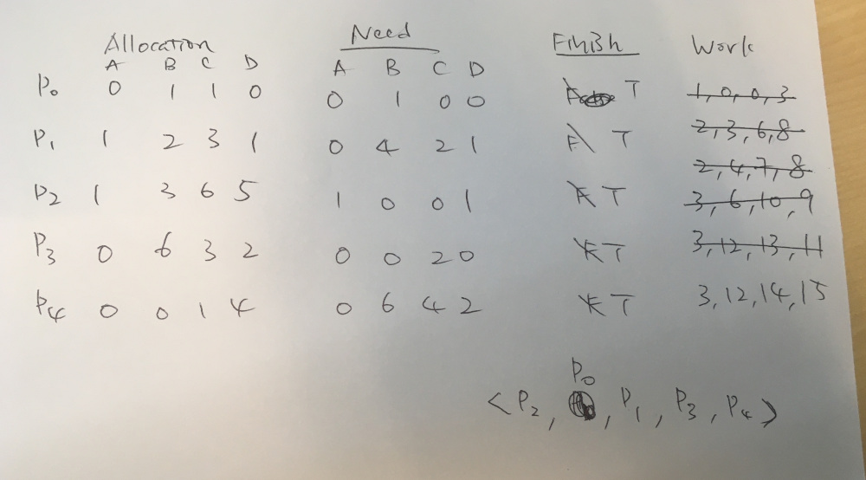
Another Example of Banker’s Algorithm
(b) Available = (1, 0, 0, 3)
In this example, we pick the smallest index if we have >1 choices
Answer: Yes. The order is P2, P0, P1, P3, P4

Slide 31
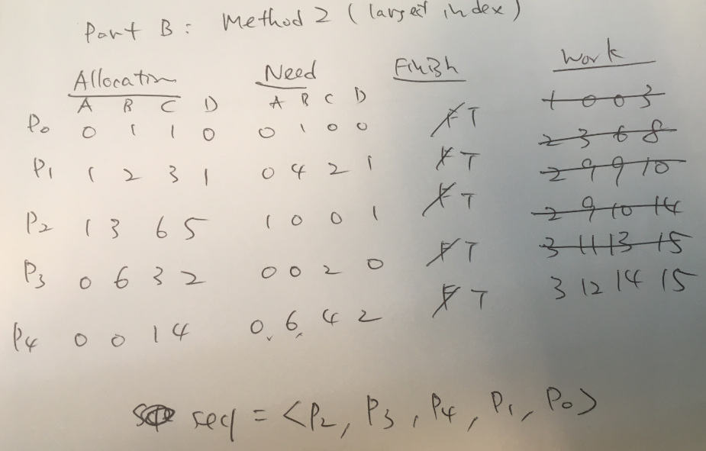
Another Example of Banker’s Algorithm
(b) Available = (1, 0, 0, 3).
In this example, we pick the largest index if we have >1 choices
Answer: An alternative solution: The order is P2, P3, P4, P1, P0
Banker’s algorithm may have more than one possible solutions.

Slide 32
Contiguous Memory Allocation
Memory Management Part 1

Slide 33
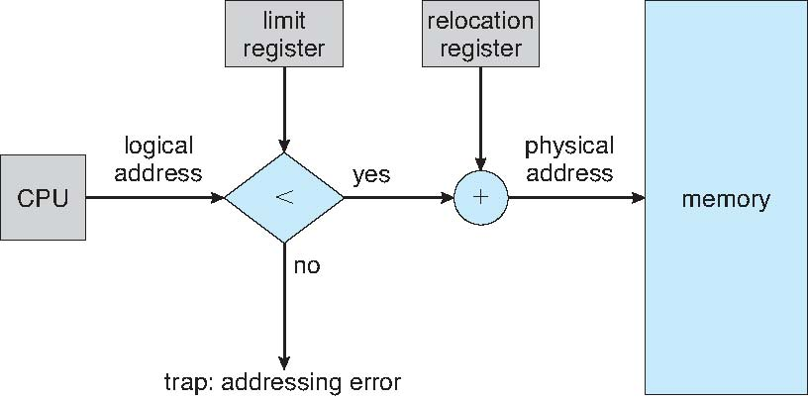
Contiguous Memory Allocation
In a multi-programmed OS, several user processes reside in memory at the same time.
In contiguous memory allocation, each process contained in a single section of memory that is contiguous to the section containing the next process.
Relocation register and limit register are used to protect user processes from each other and from OS
  Relocation register contains value of the smallest physical address
  Limit register contains range of logical addresses – each logical address must be less than the limit register
MMU maps logical address dynamically

Slide 34
Memory Hole
Hole - block of available memory; holes of various size are scattered throughout memory
Memory
Memory
Memory
Memory
Request
memory
#1 (200KB)
Release
memory #2
#1 (200KB)
Release
memory #4
#1 (200KB)
#2 (100KB)
100KB
100KB
#3 (500KB)
#3 (500KB)
#3 (500KB)
#4 (300KB)
#4 (300KB)
300KB
#5 (200KB)
#5 (200KB)
#5 (200KB)
Hole list:
100 KB
Hole list:
100 KB
300 KB

Slide 35
Dynamic Storage-Allocation Problem
How to satisfy a request of (variable) size n from a list of free holes?
First-fit: Allocate the first hole that is big enough
  No need to searching the entire list
Best-fit: Allocate the smallest hole that is big enough
  Must search entire list, unless ordered by size
  Produces the smallest leftover hole - intended not use it
Worst-fit: Allocate the largest hole
  Must also search entire list
  Produces the largest leftover hole - intended to reuse the remaining hole

Slide 36
Example Question
Given five memory partitions of 200 KB, 600 KB, 500 KB, 100 KB, and 400 KB (in order)
How would each of the first-fit, best-fit, and worst-fit algorithms place processes of 150 KB, 350 KB, 450 KB, and 550 KB (in order)?
Which algorithm makes the most efficient use of memory?

Slide 37
First-Fit Example
 | 200KB | 600KB | 500KB | 100KB | 400KB
150KB
350KB
450KB
550KB
√
√
√
wait

Slide 38
Best-Fit Example
 | 200KB | 600KB | 500KB | 100KB | 400KB
150KB
350KB
450KB
550KB
√
√
√
√

Slide 39
Worst-Fit Example
Best-Fit turns out to be the best in this case
 | 200KB | 600KB | 500KB | 100KB | 400KB
150KB
350KB
450KB
550KB
√
√
wait
wait

Slide 40
Segmentation
Memory Management Part 2

Slide 41
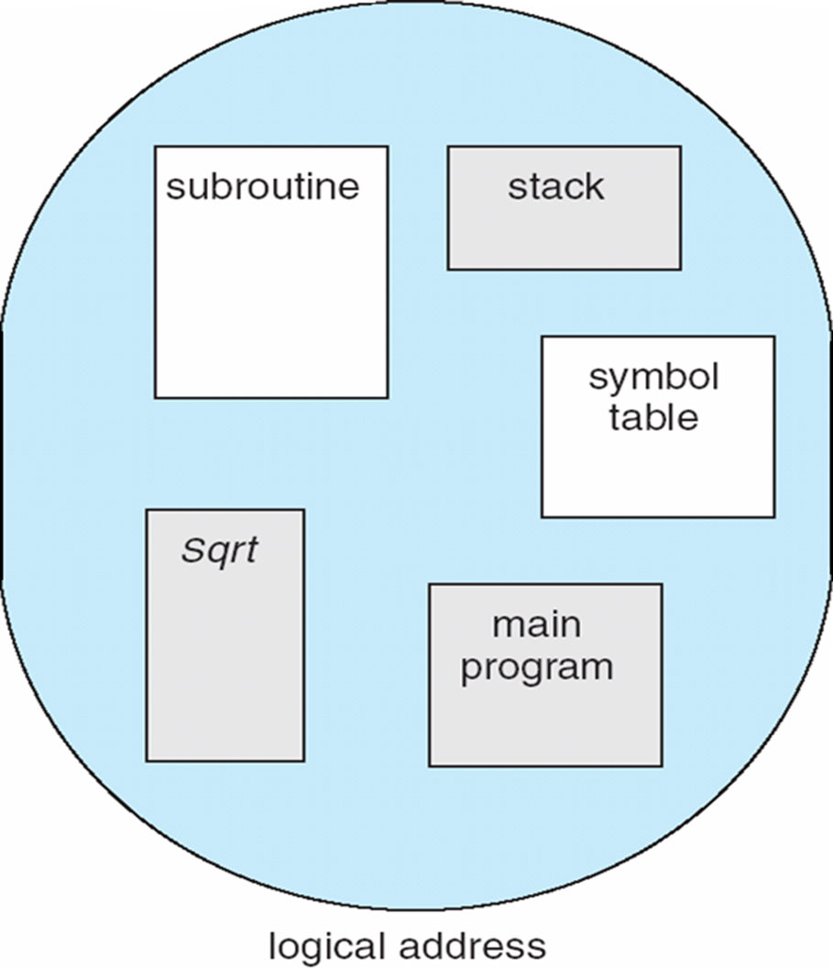
Segmentation - User View
Memory-management scheme that supports user view of memory
A program is a collection of segments. A segment is a logical unit such as:
main program
procedure
function
method
object
local variables, global variables
common block
stack
symbol table
arrays

Slide 42
Segmentation: Logical vs. Physical
1
1
4
2
3
4
2
3
user space
physical memory space

Slide 43
Segmentation Architecture
The Logical address now consists of a two-tuple:
<segment-number, offset>,
Segment table – maps two-dimensional programmer-defined addresses (virtual address) into one-dimensional physical addresses; each table entry has:
  base – contains the starting physical address where the segments reside in memory
  limit – specifies the length of the segment
Both STBR and STLR stored in the PCB of a process
Segment-table base register (STBR) points to the segment table’s location in memory
Segment-table length register (STLR) indicates the number of segments used by a program;
segment number s is legal if s < STLR

Slide 44
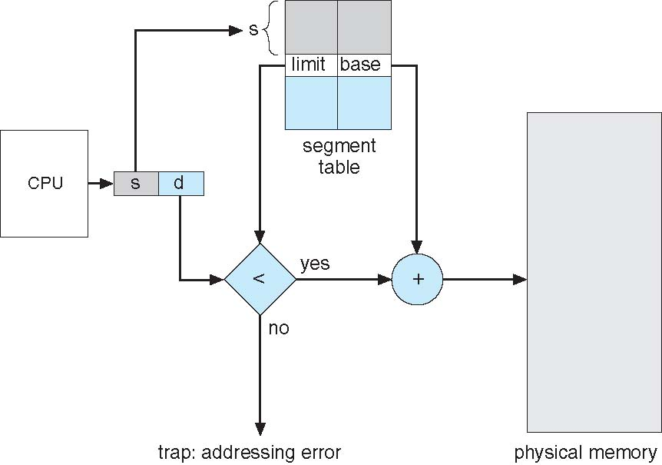
Segmentation Architecture (Cont.)
Protection. each entry in segment table associates with:
  validation bit = 0 ⇒ illegal segment
  read/write/execute privileges
A protection bit is associated with each segment; code sharing occurs at segment level
Since segments vary in length, memory allocation for a segment is a dynamic storage-allocation problem
External fragmentation still exists, but is much less severe than that in a contiguous allocation –since each segment is considerably smaller than the total memory space of a process

Slide 45
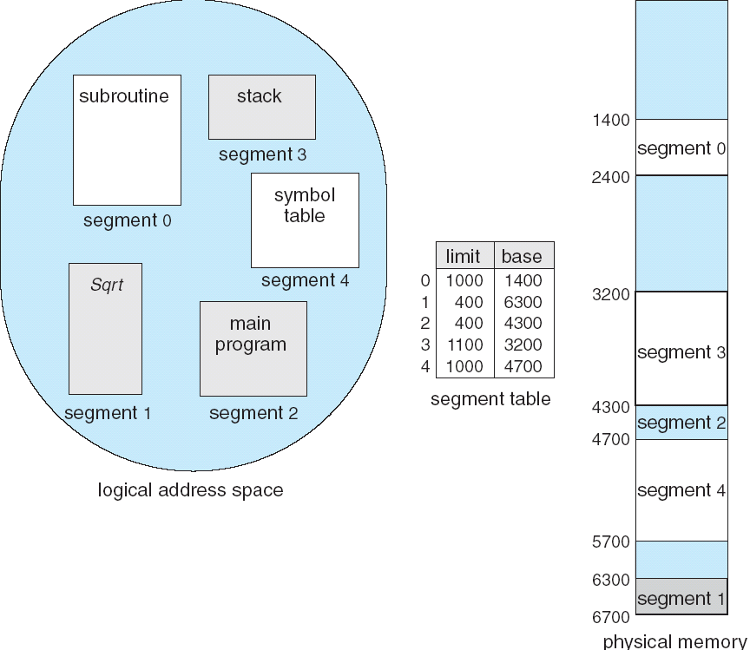
Example of Segmentation

Slide 46
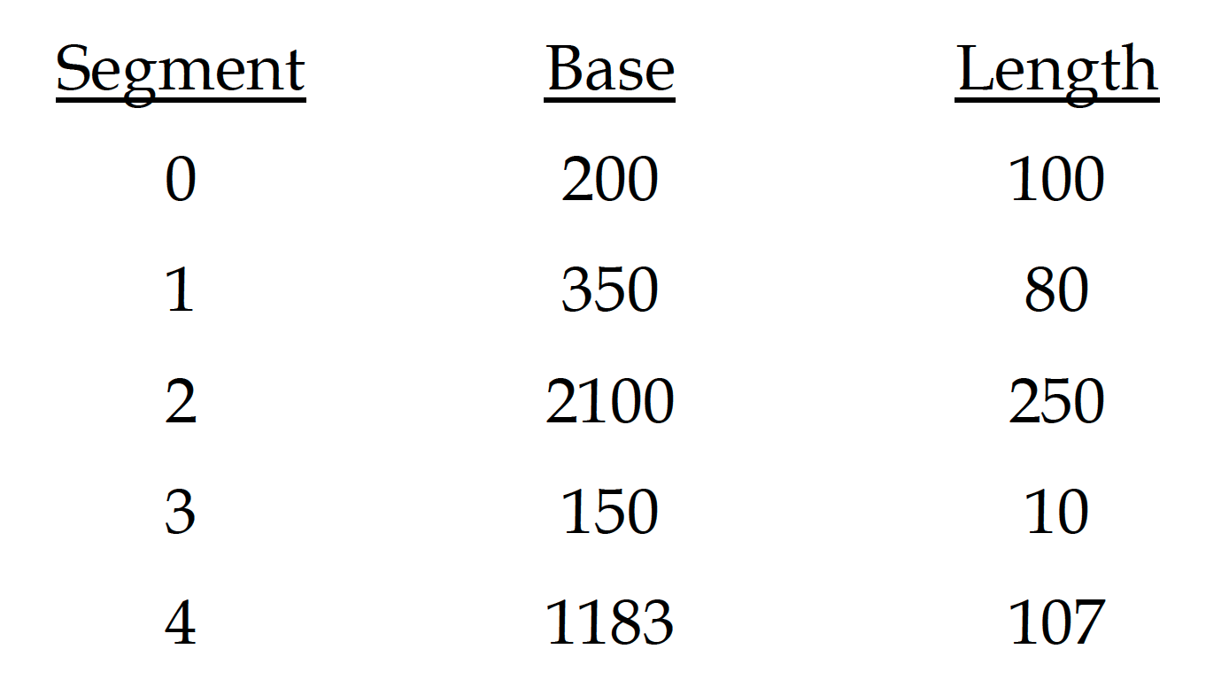
Example: Address Translation
Logical Addresses:
0, 91
1, 93
2, 56
3, 70
4, 93
Physical Addresses:
200 + 91 = 291
trap (93 > 80)
2100 +56 = 2156
trap (70 > 10)
1183 + 93 = 1276

Slide 47
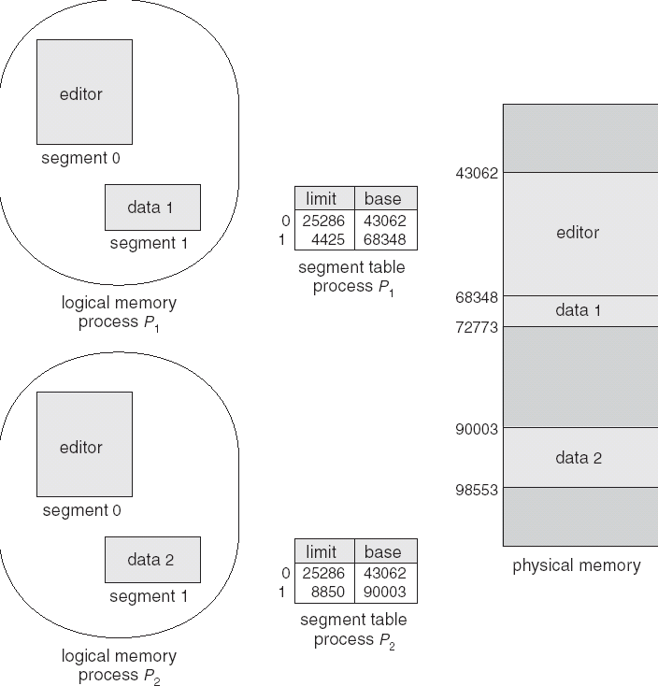
Sharing of Segments

Slide 48
Summary - Segmentation
Protection is easy in segmentation scheme – in segment table
  Code segment would be read-only, data and stack would be read-write (stores allowed), shared segment could be read-only or read-write
Can address be outside the valid range?
  Yes, this is how stack and heap are allowed to grow. For instance, stack takes fault, system automatically increases the size of stack
The main problem with segmentation
  It must fit variable-sized chunks into physical memory – classical dynamic storage allocation problem
  It may move processes multiple times to fit everything
  External fragmentation

