Slide 1
Spring 2024 COMP 3511 Review #7

Slide 2
Coverages
Memory Management
Paging
Address translation examples
Translation look-aside buffer (TLB)
2-level paging

Slide 3
PAGING

Slide 4
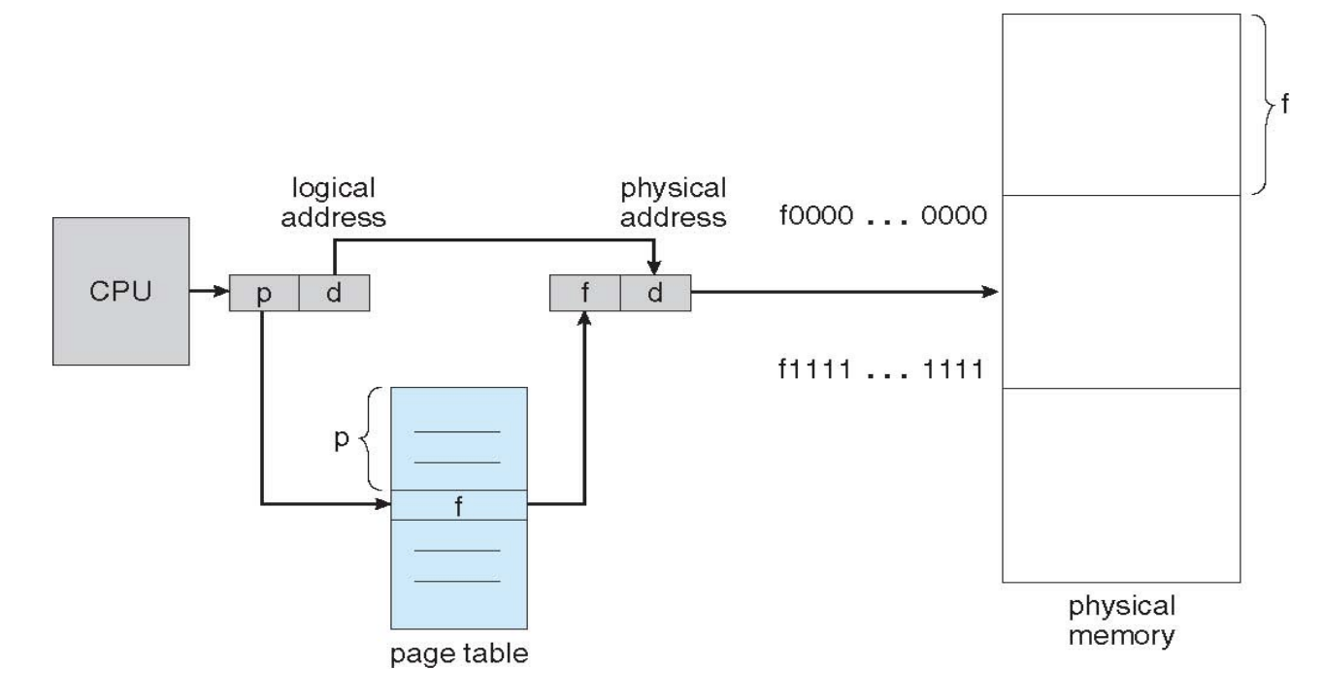
Paging Scheme (1-level)
A logical address has n bits
Typical values: 32, 64
Some questions may use other values, such as 36, 48, …
A logical address is divided into 2 parts
d = page offset
p = n - d = page number
Paging hardware
Number of bits of a logical address: n
page number
page offset
p = n-d
d

Slide 5
Common Questions on 1-level paging
What is the page size?
What is the total number of pages?
If the size of each page table entry is M bytes, what is the total size of the page table?
… and many more related questions
Paging hardware
Number of bits of a logical address: n
page number
page offset
p = n-d
d

Slide 6
Q1: Page Size
What is the page size?
The size of the page / frame (i.e., page size = frame size)
The page size can be calculated using the page offset
Page size = 2^{d} bytes
Paging hardware
Number of bits of a logical address: n
page number
page offset
p = n-d
d

Slide 7
Q2: Total Number of Pages
What is the total number of pages?
The total number of pages can be calculated using the page number
Total number of pages = 2^{P} pages
Paging hardware
Number of bits of a logical address: n
page number
page offset
p = n-d
d

Slide 8
Q3: Total size of the Page Table
If the size of each page table entry (PTE) is M bytes, what is the total size of the page table?
We know that the total number of pages = 2^{P} pages
Each PTE has M bytes
So, the total page table size is 2^{P} * M bytes
Paging hardware
Number of bits of a logical address: n
page number
page offset
p = n-d
d

Slide 9
Useful Shortcuts for Memory-related Computations
In most questions, you don’t need to calculate the exact values, and it is very easy to make mistakes if you deal with the exact values
The exact terms should be Ki, Mi, Gi, … (for power of 2 notations),
The power of 10 notations should be K, M, G
In this course, we mainly use the power of 2 notations and don’t use power of 10 notations, so we can simply use K, M, G (because we are lazy)
Here are some useful shortcuts for memory related computations
Symbol | Power of 2 | Exact value
K | 2¹⁰ | 1 024
M | 2²⁰ | 1 048 576
G | 2³⁰ | 1 073 741 824
T | 2⁴⁰ | 1 099 511 627 776

Slide 10
Useful Digit Mappings
Hex (16) | Dec (10) | Bin (2)
0 | 0 | 0000
1 | 1 | 0001
2 | 2 | 0010
3 | 3 | 0011
4 | 4 | 0100
5 | 5 | 0101
6 | 6 | 0110
7 | 7 | 0111
8 | 8 | 1000
9 | 9 | 1001
A | 10 | 1010
B | 11 | 1011
C | 12 | 1100
D | 13 | 1101
E | 14 | 1110
F | 15 | 1111
Binary (2), Decimal (10), and Hexadecimal (16) notations are commonly used in memory-related computations

Slide 11
Examples with actual numbers
What is the page size?
What is the total number of pages?
If the size of each page table entry is 8 bytes, what is the total size of the page table?
Paging hardware
Number of bits of a logical address: 32
page number
page offset
20
12

Slide 12
Answers
Page size = 2¹² = 4 * 2¹⁰ = 4KB
Total number of pages = 2²⁰ pages
If the size of each page table entry is 8 bytes:
The total page table size is 2²⁰ * 8 = 8MB
Paging hardware
Number of bits of a logical address: 32
page number
page offset
20
12

Slide 13
Why 1-level paging is not good?
Page size = 2¹² = 4 * 2¹⁰ = 4KB
Total number of pages = 2²⁰ pages
If the size of each page table entry is 8 bytes:
The total page table size is 2²⁰ * 8 = 8MB
The above example is for a 32-bit OS, and the overhead may be much larger for a 64-bit OS
The overhead on the page table size is too large
Based on the above example, even the OS would like to load a very tiny executable program (e.g., ~1KB in size), the OS wastes 8MB only for the page table of that tiny executable program
Solution: (all of them were discussed in lectures)
2-level paging, 3-level paging, hashed page tables, segmentation + paging, …
and all real-world examples (e.g., Intel IA-32, x86-64, ARM…)

Slide 14
Address translation examples

Slide 15
Example of page address translation
Suppose that the physical memory size is 4096 bytes. And there is 16 frames in physical memory.
The page table is listed as follows:
Please work out physical address of following logical addresses
717
508
Page No. | Frame No.
0 | 5
1 | 2
2 | 7
3 | 0

Slide 16
Example of page address translation
Suppose that the physical memory size is 4096 bytes. And there is 16 frames in physical memory.
The page table is listed as follows:
Please work out physical address of following logical addresses
Each page has 256 bytes (4096/16)
Page No. | Frame No.
0 | 5
1 | 2
2 | 7
3 | 0

Slide 17
Example of page address translation
Suppose that the physical memory size is 4096 bytes. And there is 16 frames in physical memory.
The page table is listed as follows:
Please work out physical address of following logical addresses
717 → 717 = 256*2+ 205 → 7*256 + 205 = 1997
508
Page No. | Frame No.
0 | 5
1 | 2
2 | 7
3 | 0

Slide 18
Example of page address translation
Suppose that the physical memory size is 4096 bytes. And there is 16 frames in physical memory.
The page table is listed as follows:
Please work out physical address of following logical addresses
717 → 717 = 256*2 + 205 → 7*256 + 205 = 1997
508 → 508 = 256*1 + 252 → 2*256 + 252 = 764
Page No. | Frame No.
0 | 5
1 | 2
2 | 7
3 | 0

Slide 19
Example of page address translation
Suppose that the physical memory size is 4096 bytes. And there is 16 frames in physical memory.
The page table is listed as follows:
Please work out logical address of following physical addresses
444
700
Page No. | Frame No.
0 | 5
1 | 2
2 | 7
3 | 0

Slide 20
Example of page address translation
Suppose that the physical memory size is 4096 bytes. And there is 16 frames in physical memory.
The page table is listed as follows:
Please work out logical address of following physical addresses
444 → 256*1 + 188 → illegal
700
Page No. | Frame No.
0 | 5
1 | 2
2 | 7
3 | 0

Slide 21
Example of page address translation
Suppose that the physical memory size is 4096 bytes. And there is 16 frames in physical memory.
The page table is listed as follows:
Please work out logical address of following physical addresses
444 → 256*1 + 188 → illegal
700 → 256*2 + 188 → 256*1 + 188 = 444
Page No. | Frame No.
0 | 5
1 | 2
2 | 7
3 | 0

Slide 22
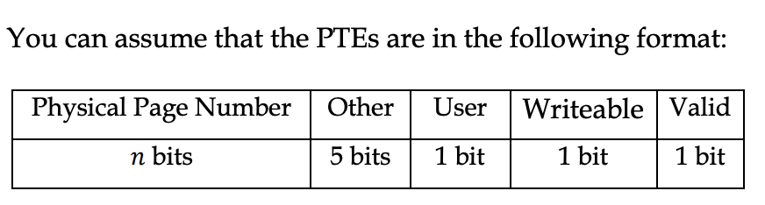
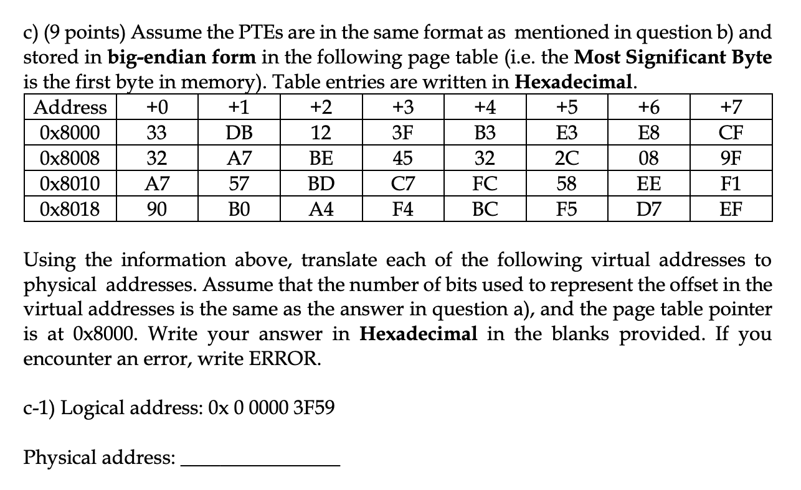
S2023 Past Paper on Page Address Translation
Exam questions are usually more complicated
I will explain the one of the most difficult questions (i.e., part c-i)
Here are the relevant information provided on the question text:

Slide 23
Step1: Understand the Paging Hardware
From the question text
The virtual address space is 36-bit
The page size is 4KB, so we need 12 bits for the page offset
Note: Don’t mess up between the logical address and PTE
Each PTE is 4 bytes (i.e., 32 bits), physical page number (n) has 32 - (5+1+1+1) = 32 – 8 = 24 bits
Paging hardware
Number of bits of a logical address: 36
page number
page offset
24
12

Slide 24
Step 2: Understand the logical address
Logical address: 0x 0 0000 3F59
Each hexadecimal digit = 4 bits
It is a 36-bit logical address, so there are 9 hexadecimal digits
page number (24 bits)
page offset (12 bits)
Hex | 0 | 0 | 0 | 0 | 0 | 3 | F | 5 | 9
Bits | 0000 | 0000 | 0000 | 0000 | 0000 | 0011 | 1111 | 0101 | 1001
The page number is 3
We need to extract the 4th entry from the page table:
0 = 1st entry
1 = 2nd entry
2 = 3rd entry
…
N = (N+1)^{th} entry

Slide 25
Step 3: Understand the Page Table Entries
We know that each page table entry is 4 bytes = 32 bits
The designer tried to confuse students by putting 2 PTEs on each row
A normal page table:
The 4th PTE entry is: 0x 322C089F
A tricky page table made by the designer:
(Note: 2 PTEs on each row)

Slide 26
Step 4: Find out the Physical Page Number
The 4th PTE entry is: 0x 322C089F
Physical page number (24 bits)
Hex | 3 | 2 | 2 | C | 0 | 8 | 9 | F
Bits | 0011 | 0010 | 0010 | 1100 | 0000 | 1000 | 1001 | 1111
PTE (32-bit)

Slide 27
Step 5: Physical Address (Answer)
From the logical address, we can extract the page offset
From the PTE entry, we can extract the physical page number
Combining the physical page number with the page offset, we have the answer: Physical Address
page number (24 bits)
page offset (12 bits)
Logical address:
36-bit
Hex | 0 | 0 | 0 | 0 | 0 | 3 | F | 5 | 9
Bits | 0000 | 0000 | 0000 | 0000 | 0000 | 0011 | 1111 | 0101 | 1001
Physical page number (24 bits)
Hex | 3 | 2 | 2 | C | 0 | 8 | 9 | F
Bits | 0011 | 0010 | 0010 | 1100 | 0000 | 1000 | 1001 | 1111
PTE (32-bit)
Physical address:
36-bit
Hex | 3 | 2 | 2 | C | 0 | 8 | F | 5 | 9
Bits | 0011 | 0010 | 0010 | 1100 | 0000 | 1000 | 1111 | 0101 | 1001

Slide 28
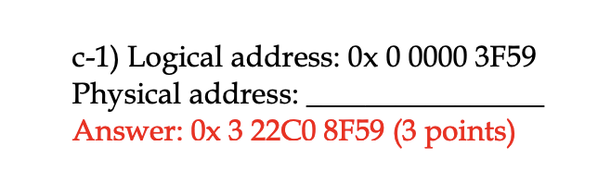
Result of s2023 Page Address Translation (Part C-i)
C-2 and C-3 are similar
I leave them as your exercises
Hex | 0 | 0 | 0 | 0 | 0 | 3 | F | 5 | 9
Bits | 0000 | 0000 | 0000 | 0000 | 0000 | 0011 | 1111 | 0101 | 1001
Steps based on the previous few slides!!
Hex | 3 | 2 | 2 | C | 0 | 8 | F | 5 | 9
Bits | 0011 | 0010 | 0010 | 1100 | 0000 | 1000 | 1111 | 0101 | 1001
So, printing the exam solution paper is useless
if you don’t know the steps

Slide 29
Summary
This question is tricky because the designer tried to confuse students by putting 2 PTEs on each row
We have many tricky variations such as:
A HUGE page table (I remember one past exam paper has a whole page of the exam booklet for the page table, and many students complained about the difficulty after the exam)
Multiple PTEs on each row
One PTE spanning in 2 rows
Cutting points are in the middle of the hexadecimal digits
Cutting in the middle can be tricky because you need to calculate the binary patterns for every hex digits carefully, for example:
Hex | 3 | 2 | 2 | C | 0 | 8 | 9 | F
Bits | 0011 | 0010 | 0010 | 1100 | 0000 | 1000 | 1001 | 1111

Slide 30
translation look-aside buffer (TLB)

Slide 31
TLB
The two memory access problem can be solved by using TLB (translation look-aside buffer) – caching
a special, small, fast-lookup hardware cache
each entry in the TLB consists of a key (or tag) and a value
The page number is presented to the TLB, if found, its frame number is immediately available to access memory
fast but expensive – done in hardware
Typical size of a TLB 64 – 1,024 entries

Slide 32
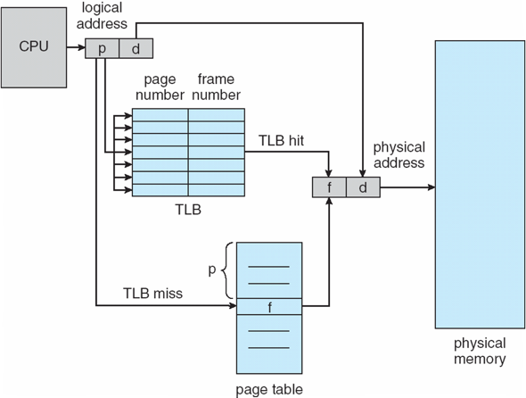
Paging Hardware With TLB
This table is small, e.g., 64 to 1,024 entries
Can be very large,
e.g., 1M entries

Slide 33
Effective Access Time (EAT): Question
Suppose that a system has a TLB hit ratio of 85%. It requires 10 nanoseconds to access the TLB, and 100 nanoseconds to access main memory. What is the effective memory access time in nanoseconds for this system?

Slide 34
Effective Access Time (EAT): Example
Suppose that a system has a TLB hit ratio of 85%. It requires 10 nanoseconds to access the TLB, and 100 nanoseconds to access main memory. What is the effective memory access time in nanoseconds for this system?
Answer: If the hit ratio is 85%
EAT = (10 + 100) * 0.85 + // Hit: 1 TLB access + 1 memory access
(10 + 200) * 0.15 // Miss: 1 TLB access + 2 memory accesses
= 93.5 + 31.5 = 125
Note: EAT will also be used in Chapter 10: Virtual Memory to evaluate the performance of demand paging. Their calculations are different. Don’t mess them up!

Slide 35
Two-level page table

Slide 36
Two-Level Page Table
In a 32-bit machine we subdivide the virtual address into 3 parts as follows:
First 10 bits of an address is an index into the first level page table.
The next 10 bits are an index into a second level page table.
Assume that each page table entry is 64 bits (8 bytes) in size.
page number |  | page offset
10 | 10 | 12

Slide 37
Two-Level Page Table
Q1: What is the advantage of using two-level paging scheme?
Two-level paging scheme can divide the large page table into many smaller pieces.
Therefore, there is no need to allocate the whole page table contiguously in main memory.

Slide 38

Two-Level Page Table
Q2: How much space is occupied in memory by the page tables for a process that has 128MB of actual virtual address space allocated?
Show your work with a detailed explanation.
Page size: $2^{12}=4KB$

Slide 39
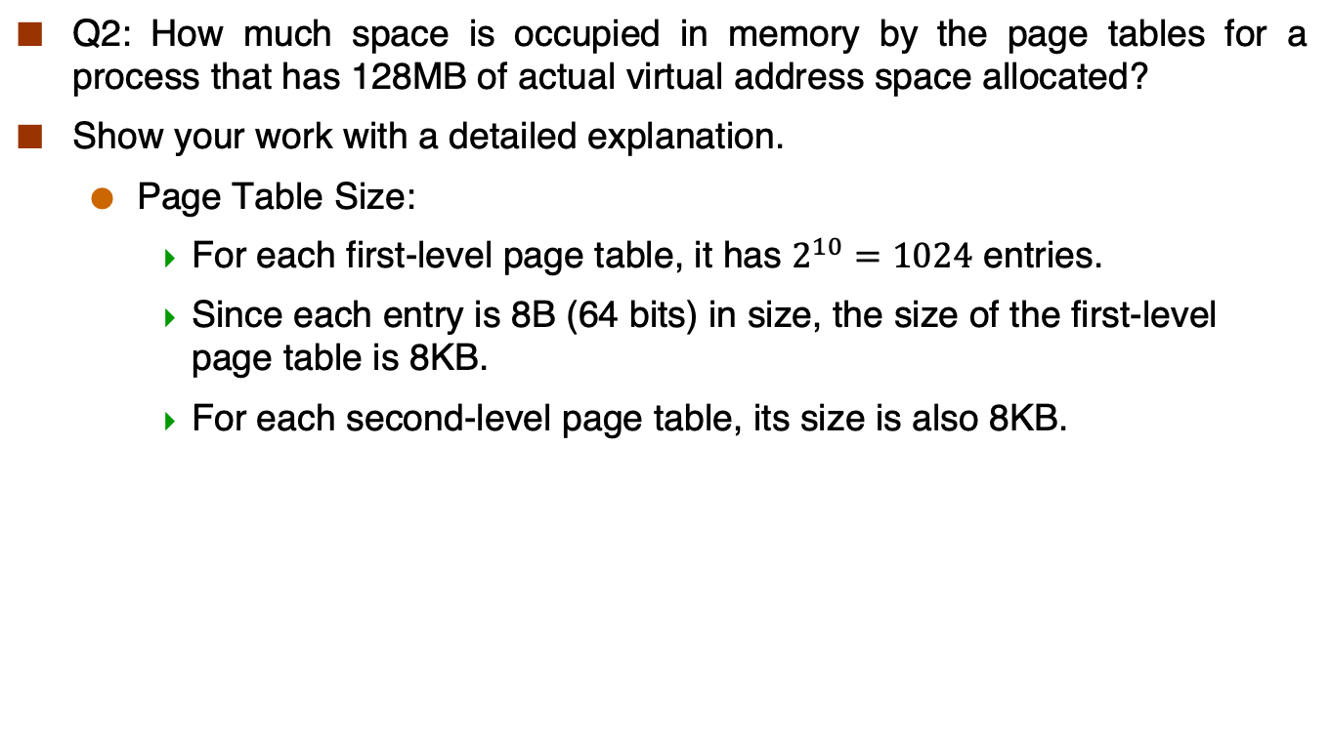
Two-Level Page Table
Q2: How much space is occupied in memory by the page tables for a process that has 128MB of actual virtual address space allocated?
Show your work with a detailed explanation.
Page Table Size:
For each first-level page table, it has $2^{10}=1024$ entries.
Since each entry is 8B (64 bits) in size, the size of the first-level page table is 8KB.
For each second-level page table, its size is also 8KB.

Slide 40
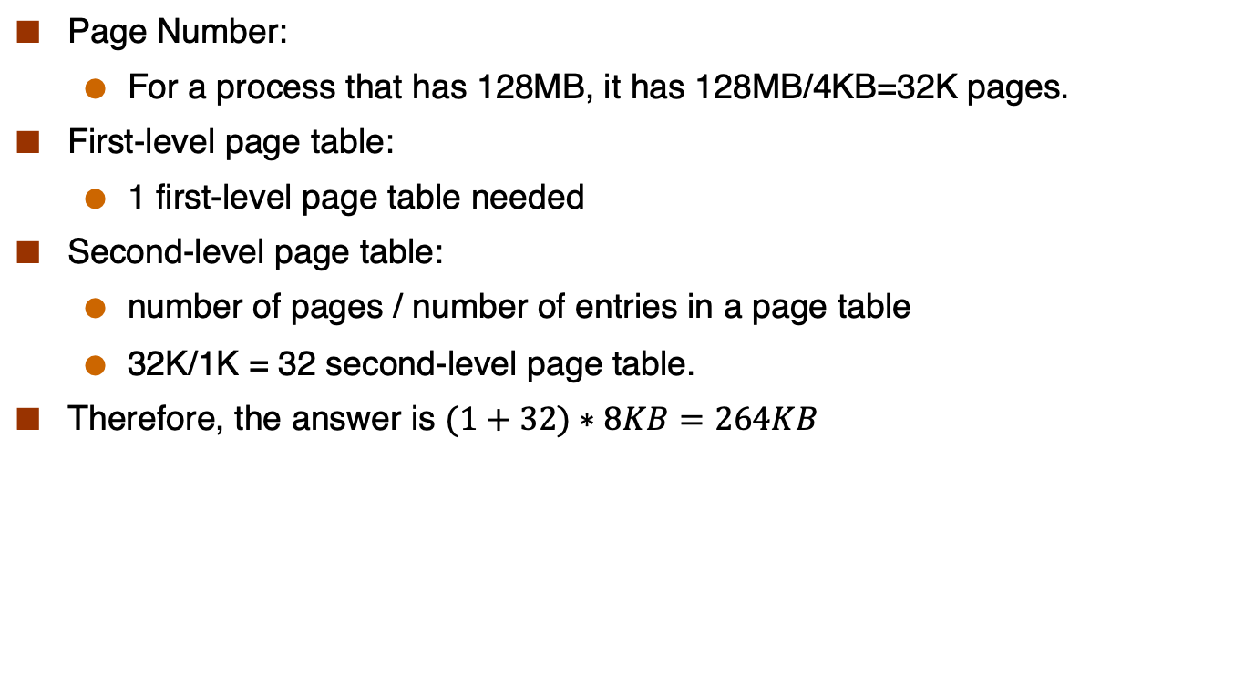
Two-Level Page Table
Page Number:
For a process that has 128MB, it has 128MB/4KB=32K pages.
First-level page table:
1 first-level page table needed
Second-level page table:
number of pages / number of entries in a page table
32K/1K = 32 second-level page table.
Therefore, the answer is $(1+32)∗8KB=264KB$

Slide 41
Q and A

