Slide 1
COMP3511
Project Assignment 3 Introduction

Slide 2
Page-Replacement Algorithms
A page-replacement algorithm is used to decide which frames to replace
Several algorithms are discussed during the virtual memory lecture
In this project assignment, we require students to implement page-replacement algorithms:
First-In-First-Out (FIFO)
Optimal (OPT)
Least Recently Used (LRU)

Slide 3
How to run the program?
Here is a sample usage:
$> ./page_replacement < input.txt > output.txt
$> represents the shell prompt
< means input redirection
> means output redirection
Thus, you can easily replace input.txt with different test cases and then use the diff command to compare with the sample output files

Slide 4
Skeleton code
The input parsing is given in the skeleton code
You can add new constants, variables, and helper functions
Necessary header files are included
You should not add extra header files
Some constants and helper functions are provided
Please read the skeleton code carefully

Slide 5
Assumptions
There are at most 10 different frame numbers (i.e., frame 0-9)
The number of available frames ranges from a minimum of 2 to a maximum of 10
The maximum size of the queue data structure (used in FIFO) is 10
The maximum length of the reference string is 30 (defined in the starter code)

Slide 6
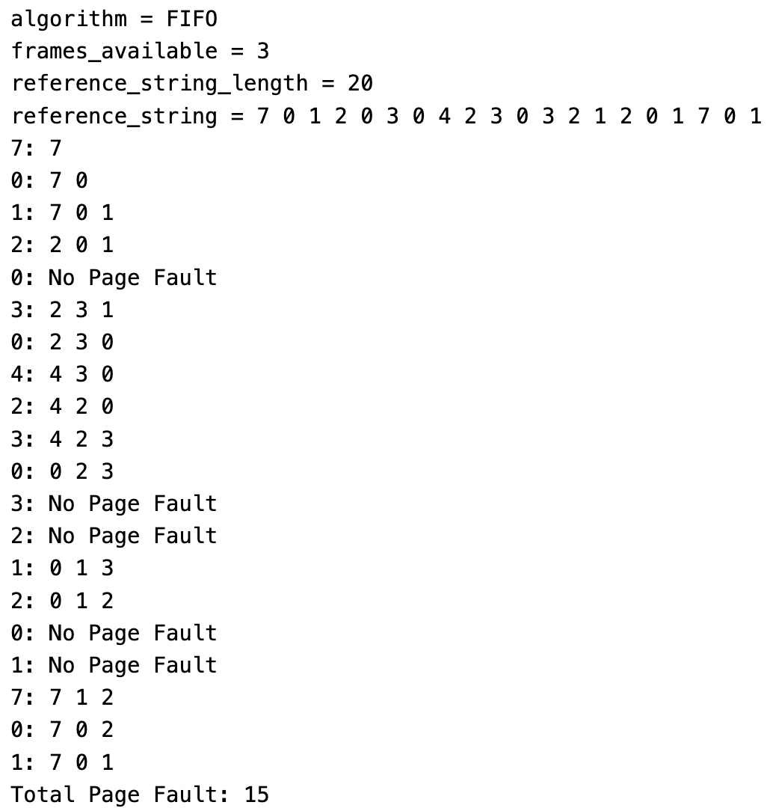
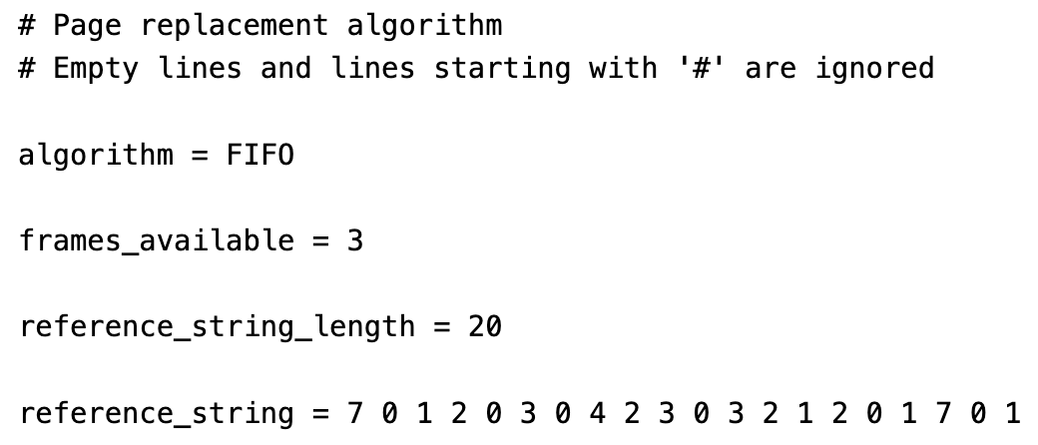
Sample input and output
Sample Output
Sample Input

Slide 7
Input format
The input parsing is given in the skeleton code
Empty lines and lines starting with # are ignored

Slide 8
Output format
The output consists of 2 regions:
Display the parsed values (given in the starter code)
Displaying the steps of the algorithm and the total page fault

Slide 9
First-In-First-Out (FIFO) Page Replacement Algorithm
A queue can be implemented using a simple 1D array
You should use a queue to implement the FIFO page-replacement algorithm
You should refer to the lecture notes for the details of FIFO page-replacement algorithm

Slide 10
A step-by-step FIFO example (3 available frames)
7 | 0 | 1 | 2 | 0 | 3 | 0 | 4 | 2 | 3 | 0 | 3 | 2 | 1 | 2 | 0 | 1 | 7 | 0 | 1
The Current Queue: (empty)

Slide 11
Step 1
7 | 0 | 1 | 2 | 0 | 3 | 0 | 4 | 2 | 3 | 0 | 3 | 2 | 1 | 2 | 0 | 1 | 7 | 0 | 1
7
F
The Current Queue: 7

Slide 12
Step 2
7 | 0 | 1 | 2 | 0 | 3 | 0 | 4 | 2 | 3 | 0 | 3 | 2 | 1 | 2 | 0 | 1 | 7 | 0 | 1
7
7
0
F
F
The Current Queue: 7 0

Slide 13
Step 3
7 | 0 | 1 | 2 | 0 | 3 | 0 | 4 | 2 | 3 | 0 | 3 | 2 | 1 | 2 | 0 | 1 | 7 | 0 | 1
7
7
0
7
0
1
F
F
F
The Current Queue: 7 0 1

Slide 14
Step 4
7 | 0 | 1 | 2 | 0 | 3 | 0 | 4 | 2 | 3 | 0 | 3 | 2 | 1 | 2 | 0 | 1 | 7 | 0 | 1
7
7
0
7
0
1
2
0
1
F
F
F
F
Frame 7 is removed from the queue
The Current Queue: 7 0 1 2
Frame 2 is inserted to the queue

Slide 15

Step 5
7 | 0 | 1 | 2 | 0 | 3 | 0 | 4 | 2 | 3 | 0 | 3 | 2 | 1 | 2 | 0 | 1 | 7 | 0 | 1
7
7
0
7
0
1
2
0
1
F
F
F
F
There is no page fault in this step, so the queue is not updated
The Current Queue: 0 1 2

Slide 16
Step 6
7 | 0 | 1 | 2 | 0 | 3 | 0 | 4 | 2 | 3 | 0 | 3 | 2 | 1 | 2 | 0 | 1 | 7 | 0 | 1
7
7
0
7
0
1
2
0
1
2
3
1
F
F
F
F
F
The Current Queue: 1 2 3

Slide 17
Step 7
7 | 0 | 1 | 2 | 0 | 3 | 0 | 4 | 2 | 3 | 0 | 3 | 2 | 1 | 2 | 0 | 1 | 7 | 0 | 1
7
7
0
7
0
1
2
0
1
2
3
1
2
3
0
F
F
F
F
F
F
The Current Queue: 2 3 0

Slide 18
Step 8
7 | 0 | 1 | 2 | 0 | 3 | 0 | 4 | 2 | 3 | 0 | 3 | 2 | 1 | 2 | 0 | 1 | 7 | 0 | 1
7
7
0
7
0
1
2
0
1
2
3
1
2
3
0
4
3
0
F
F
F
F
F
F
F
The Current Queue: 3 0 4

Slide 19
Step 9
7 | 0 | 1 | 2 | 0 | 3 | 0 | 4 | 2 | 3 | 0 | 3 | 2 | 1 | 2 | 0 | 1 | 7 | 0 | 1
7
7
0
7
0
1
2
0
1
2
3
1
2
3
0
4
3
0
4
2
0
F
F
F
F
F
F
F
F
The Current Queue: 0 4 2

Slide 20
Step 10
7 | 0 | 1 | 2 | 0 | 3 | 0 | 4 | 2 | 3 | 0 | 3 | 2 | 1 | 2 | 0 | 1 | 7 | 0 | 1
7
7
0
7
0
1
2
0
1
2
3
1
2
3
0
4
3
0
4
2
0
4
2
3
F
F
F
F
F
F
F
F
F
The Current Queue: 4 2 3

Slide 21
Step 11
7 | 0 | 1 | 2 | 0 | 3 | 0 | 4 | 2 | 3 | 0 | 3 | 2 | 1 | 2 | 0 | 1 | 7 | 0 | 1
7
7
0
7
0
1
2
0
1
2
3
1
2
3
0
4
3
0
4
2
0
4
2
3
0
2
3
F
F
F
F
F
F
F
F
F
The Current Queue: 2 3 0

Slide 22
Step 12
7 | 0 | 1 | 2 | 0 | 3 | 0 | 4 | 2 | 3 | 0 | 3 | 2 | 1 | 2 | 0 | 1 | 7 | 0 | 1
7
7
0
7
0
1
2
0
1
2
3
1
2
3
0
4
3
0
4
2
0
4
2
3
0
2
3
F
F
F
F
F
F
F
F
F
F
The Current Queue: 2 3 0

Slide 23
Step 13
7 | 0 | 1 | 2 | 0 | 3 | 0 | 4 | 2 | 3 | 0 | 3 | 2 | 1 | 2 | 0 | 1 | 7 | 0 | 1
7
7
0
7
0
1
2
0
1
2
3
1
2
3
0
4
3
0
4
2
0
4
2
3
0
2
3
F
F
F
F
F
F
F
F
F
F
The Current Queue: 2 3 0

Slide 24
Step 14
7 | 0 | 1 | 2 | 0 | 3 | 0 | 4 | 2 | 3 | 0 | 3 | 2 | 1 | 2 | 0 | 1 | 7 | 0 | 1
7
7
0
7
0
1
2
0
1
2
3
1
2
3
0
4
3
0
4
2
0
4
2
3
0
2
3
0
1
3
F
F
F
F
F
F
F
F
F
F
F
The Current Queue: 3 0 1

Slide 25
Step 15
7 | 0 | 1 | 2 | 0 | 3 | 0 | 4 | 2 | 3 | 0 | 3 | 2 | 1 | 2 | 0 | 1 | 7 | 0 | 1
7
7
0
7
0
1
2
0
1
2
3
1
2
3
0
4
3
0
4
2
0
4
2
3
0
2
3
0
1
3
0
1
2
F
F
F
F
F
F
F
F
F
F
F
F
The Current Queue: 0 1 2

Slide 26
Step 16
7 | 0 | 1 | 2 | 0 | 3 | 0 | 4 | 2 | 3 | 0 | 3 | 2 | 1 | 2 | 0 | 1 | 7 | 0 | 1
7
7
0
7
0
1
2
0
1
2
3
1
2
3
0
4
3
0
4
2
0
4
2
3
0
2
3
0
1
3
0
1
2
F
F
F
F
F
F
F
F
F
F
F
F
The Current Queue: 0 1 2

Slide 27
Step 17
7 | 0 | 1 | 2 | 0 | 3 | 0 | 4 | 2 | 3 | 0 | 3 | 2 | 1 | 2 | 0 | 1 | 7 | 0 | 1
7
7
0
7
0
1
2
0
1
2
3
1
2
3
0
4
3
0
4
2
0
4
2
3
0
2
3
0
1
3
0
1
2
F
F
F
F
F
F
F
F
F
F
F
F
The Current Queue: 0 1 2

Slide 28
Step 18
7 | 0 | 1 | 2 | 0 | 3 | 0 | 4 | 2 | 3 | 0 | 3 | 2 | 1 | 2 | 0 | 1 | 7 | 0 | 1
7
7
0
7
0
1
2
0
1
2
3
1
2
3
0
4
3
0
4
2
0
4
2
3
0
2
3
0
1
3
0
1
2
7
1
2
F
F
F
F
F
F
F
F
F
F
F
F
F
The Current Queue: 1 2 7

Slide 29
Step 19
7 | 0 | 1 | 2 | 0 | 3 | 0 | 4 | 2 | 3 | 0 | 3 | 2 | 1 | 2 | 0 | 1 | 7 | 0 | 1
7
7
0
7
0
1
2
0
1
2
3
1
2
3
0
4
3
0
4
2
0
4
2
3
0
2
3
0
1
3
0
1
2
7
1
2
7
0
2
F
F
F
F
F
F
F
F
F
F
F
F
F
F
The Current Queue: 2 7 0

Slide 30
Step 20
7 | 0 | 1 | 2 | 0 | 3 | 0 | 4 | 2 | 3 | 0 | 3 | 2 | 1 | 2 | 0 | 1 | 7 | 0 | 1
7
7
0
7
0
1
2
0
1
2
3
1
2
3
0
4
3
0
4
2
0
4
2
3
0
2
3
0
1
3
0
1
2
7
1
2
7
0
2
7
0
1
F
F
F
F
F
F
F
F
F
F
F
F
F
F
F
The Current Queue: 7 0 1

Slide 31
Total Page Faults
7 | 0 | 1 | 2 | 0 | 3 | 0 | 4 | 2 | 3 | 0 | 3 | 2 | 1 | 2 | 0 | 1 | 7 | 0 | 1
7
7
0
7
0
1
2
0
1
2
3
1
2
3
0
4
3
0
4
2
0
4
2
3
0
2
3
0
1
3
0
1
2
7
1
2
7
0
2
7
0
1
F
F
F
F
F
F
F
F
F
F
F
F
F
F
F
The Current Queue: 7 0 1
Total Page Faults: 15

Slide 32
Optimal (OPT) Page Replacement Algorithm
There is no specific data structure for the OPT page-replacement algorithm
However, the standard OPT may not give a unique solution (which is bad for grading programming assignment)
i.e., more than one possible solution giving the same number of page faults
It happens if there are page faults near the end of the algorithm
In this assignment, if there are more than one choice of the victim frame, we should choose a frame with the smallest frame number
For example, if frame 0 and frame 1 are victim frames, you should choose frame 0
You should refer to the lecture notes for the details of OPT page-replacement algorithm

Slide 33
OPT Example - more than one choice (2 available frames)
0 | 1 | 0 | 0 | 1 | 1 | 2 | 3
0
0
1
2
1
In this step, both frame 0 and frame 1 are suitable victim frames
We should pick frame 0 because it has the smallest frame numbers among the suitable victim frames

Slide 34
OPT Example - more than one choice (2 available frames)
0 | 1 | 0 | 0 | 1 | 1 | 2 | 3
0
0
1
2
1
2
3
In this step, both frame 2 and frame 1 are suitable victim frames
We should pick frame 1 because it has the smallest frame numbers among the suitable victim frames

Slide 35
Least Recently Used (LRU) Page Replacement Algorithm
There are 2 possible implementations of LRU page-replacement algorithm:
Counters implementation
Stack implementation
In this project, we have a small number of frames (i.e., frame 0-9), so the counters implementation is more suitable.
You can create an array of integers to store the current count of the frames
So, there is no specific data structure for the LRU page-replacement algorithm if you use the counters implementation
Example: int counter[MAX_FRAMES_AVAILABLE];
You should refer to the lecture notes for the details of LRU page-replacement algorithm

Slide 36
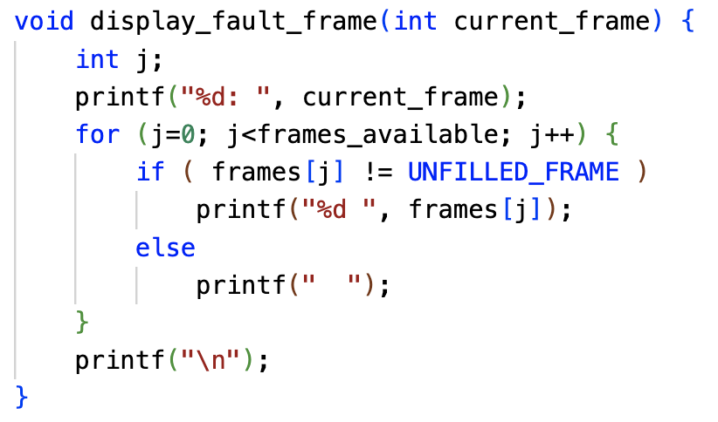
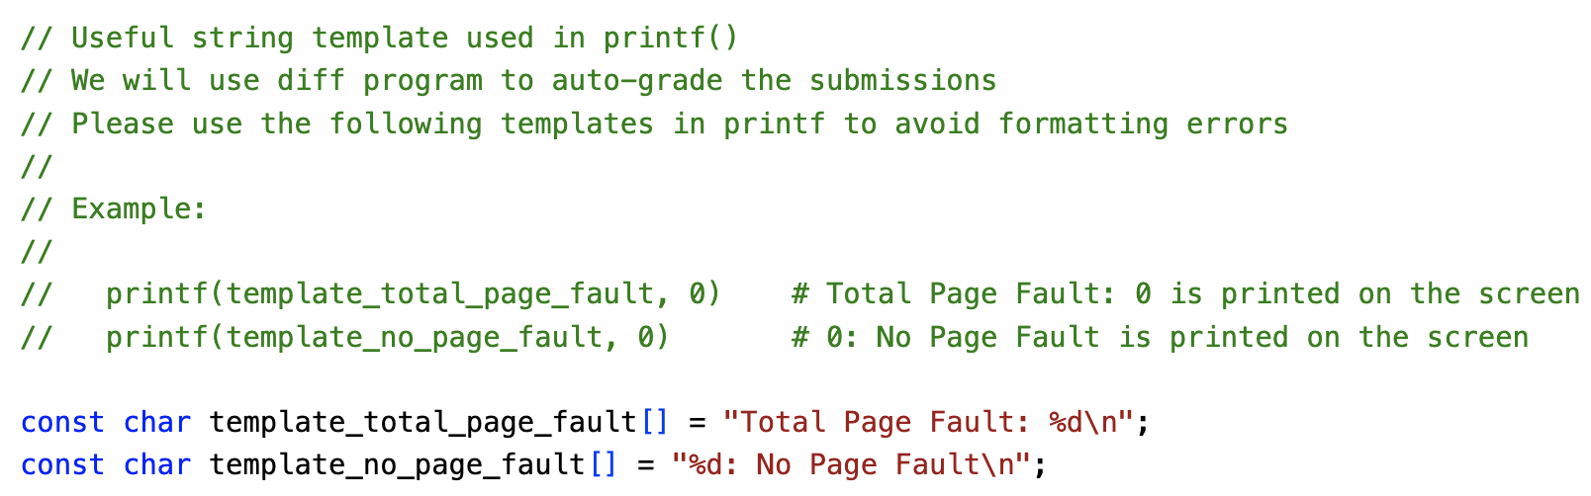
Output-related constants/functions
In the skeleton code, you can find the following output-related constants/functions that can help you get the expected output:

Slide 37
Given Test Cases
Some test cases are provided
The grader will probably write a grading script to mark the test cases
Please use the Linux diff command to compare your output with the sample output
$> diff --side-by-side outX.txt sampleX.txt
An extra option --suppress-common-lines can be added if you are not interested in the common lines. If both text files are the same, adding --suppress-common-lines will print nothing on the screen.

Slide 38
Hidden Test Cases
The hidden test cases are like the given test cases.
Different input values will be used.
The main purpose of the hidden test cases is to avoid students hard coding all test cases in their code.
For example, if the grader finds out that a student passes all given test cases but fails all hidden test cases, the grader may further investigate the code and check whether hard coding occurs.

Slide 39
Summary
Think carefully before you type ANY line of code
Good C programmers never do trial-and-error
A program that can compile does not mean that it can execute correctly
Check carefully to avoid runtime errors (i.e., Segmentation fault)
Read carefully the provided base code
Compare your output files with the sample output files using the Linux diff command

Slide 40
Live Demo
The skeleton code
The sample Linux executable program

