Slide 1
Spring 2024 COMP 3511 Review #8

Slide 2
Coverages
Virtual Memory Management
Mass-Storage System & File System
Examples & Some hints on homework 4

Slide 3
VIRTUAL MEMORY MANAGEMENT

Slide 4
Motivation of Virtual Memory
Programmers don’t want to care about physical memory.
Virtual memory benefits both the system and the user
Logical address space can be larger than physical address space
A program would no longer be constrained by physical memory
More programs run concurrently, increasing CPU utilization
Allow processes to share files easily and to implement shared memory

Slide 5
Motivation of Virtual Memory
A Program
Arrays, lists, and tables are often allocated more memory than actual need, e.g., maybe only 10×10 elements are used.
Initialization
…
Array M[100][100]
…
…
Code to handle unusual error conditions
…
Since these errors seldom, if ever, occur in practice, this code is almost never executed.

Slide 6
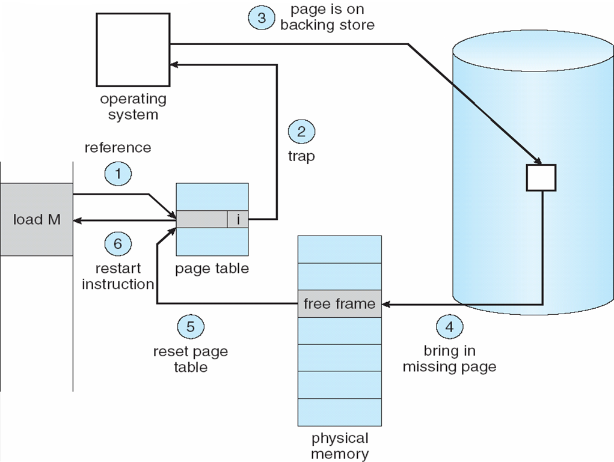
Demand Paging - Page Fault
If there is a reference to a page, the first reference to that page will trap to operating system: page fault

Slide 7
Demand Paging - Example
Suppose demand-paging is used. Memory-access time is 100 nanoseconds. It takes 8 milliseconds to service a page fault if an empty frame is available and if the replaced page is not modified, or it takes 20 milliseconds if the replaced page is modified. Assume that the page to be replaced is modified 70 percent of the time. What is the effective access time (EAT) if the page-fault rate is 0.0000025?
Solution:
EAT = (1-p_{page-fault}) x t_{memory access}
+ p_{page-fault} x t_{page service}
= (1-p_{page-fault}) x t_{memory access}
+ p_{page-fault} x (p_{w/o. modification} x t_{w/o modification}+ p_{w. modification} x t_{w. modification})
EAT = (1-0.0000025) x 100 ns + 0.0000025 x (0.3 x 8 x 10⁶ ns + 0.7 x 20 x 10⁶ ns)
EAT = 140 ns

Slide 8
Page Replacement
If there is no free frame within the number of pages assigned (fixed) to a process – local replacement
Page replacement – find a page in memory, but not really in use, swap it out
Replacement algorithm – how to select a “victim” frame
Performance – the minimum number of page faults (long-term)
Same page may be brought into and out of memory several times

Slide 9
Page Replacement Algorithms
OPT (Optimal) algorithm
Replace page that will not be used for longest period of time in the future – practically not feasible (no future knowledge)
FIFO algorithm
Replace page according to the order of entering the memory. Easy to implement, suffers from Belady’s anomaly
LRU (Least Recently Used) algorithm
Use the recent past as an approximation of the near future
Replace the page that has not been used for the longest period of time
Difficult to implement, often requires hardware support and updates (clock or stack pointers) for each and every memory reference.
LRU-approximation: Reference bits, Second chance
Notes:
Belady’s anomaly : the phenomenon where increasing the number of page frames results in an increase in the number of page faults for a given memory access pattern.
First in first out (FIFO)
Second chance algorithm
Random page replacement algorithm

Slide 10
Example
Consider the following page reference string:
2, 1, 3, 7, 1, 4, 3, 5, 6, 2, 2, 7, 0, 4, 5, 6, 1
Illustrate each step for:
Optimal (OPT) Replacement
FIFO replacement
LRU replacement

Slide 11
Optimal Replacement
2 | 1 | 3 | 7 | 1 | 4 | 3 | 5 | 6 | 2 | 2 | 7 | 0 | 4 | 5 | 6 | 1
∞
This is an array to illustrate that some frame numbers won’t be appeared in future
This array will be dynamically updated

Slide 12
Optimal Replacement
2 | 1 | 3 | 7 | 1 | 4 | 3 | 5 | 6 | 2 | 2 | 7 | 0 | 4 | 5 | 6 | 1
2 | 2 | 2 | 7 |  | 7 |  | 7 | 7 | 7 |  |  | 0 |  | 0 | 0 | 0
 | 1 | 1 | 1 |  | 4 |  | 4 | 4 | 4 |  |  | 4 |  | 5 | 6 | 1
 |  | 3 | 3 |  | 3 |  | 5 | 6 | 2 |  |  | 2 |  | 2 | 2 | 2
∞

Slide 13
Optimal Replacement
2 | 1 | 3 | 7 | 1 | 4 | 3 | 5 | 6 | 2 | 2 | 7 | 0 | 4 | 5 | 6 | 1
2 | 2 | 2 | 7 |  | 7 |  | 7 | 7 | 7 |  |  | 0 |  | 0 | 0 | 0
 | 1 | 1 | 1 |  | 4 |  | 4 | 4 | 4 |  |  | 4 |  | 5 | 6 | 1
 |  | 3 | 3 |  | 3 |  | 5 | 6 | 2 |  |  | 2 |  | 2 | 2 | 2
∞

Slide 14
Optimal Replacement
2 | 1 | 3 | 7 | 1 | 4 | 3 | 5 | 6 | 2 | 2 | 7 | 0 | 4 | 5 | 6 | 1
2 | 2 | 2 | 7 |  | 7 |  | 7 | 7 | 7 |  |  | 0 |  | 0 | 0 | 0
 | 1 | 1 | 1 |  | 4 |  | 4 | 4 | 4 |  |  | 4 |  | 5 | 6 | 1
 |  | 3 | 3 |  | 3 |  | 5 | 6 | 2 |  |  | 2 |  | 2 | 2 | 2
∞

Slide 15
Optimal Replacement
2 | 1 | 3 | 7 | 1 | 4 | 3 | 5 | 6 | 2 | 2 | 7 | 0 | 4 | 5 | 6 | 1
2 | 2 | 2 | 7 |  | 7 |  | 7 | 7 | 7 |  |  | 0 |  | 0 | 0 | 0
 | 1 | 1 | 1 |  | 4 |  | 4 | 4 | 4 |  |  | 4 |  | 5 | 6 | 1
 |  | 3 | 3 |  | 3 |  | 5 | 6 | 2 |  |  | 2 |  | 2 | 2 | 2
∞

Slide 16
Optimal Replacement
2 | 1 | 3 | 7 | 1 | 4 | 3 | 5 | 6 | 2 | 2 | 7 | 0 | 4 | 5 | 6 | 1
2 | 2 | 2 | 7 |  | 7 |  | 7 | 7 | 7 |  |  | 0 |  | 0 | 0 | 0
 | 1 | 1 | 1 |  | 4 |  | 4 | 4 | 4 |  |  | 4 |  | 5 | 6 | 1
 |  | 3 | 3 |  | 3 |  | 5 | 6 | 2 |  |  | 2 |  | 2 | 2 | 2
∞

Slide 17
Optimal Replacement
2 | 1 | 3 | 7 | 1 | 4 | 3 | 5 | 6 | 2 | 2 | 7 | 0 | 4 | 5 | 6 | 1
2 | 2 | 2 | 7 |  | 7 |  | 7 | 7 | 7 |  |  | 0 |  | 0 | 0 | 0
 | 1 | 1 | 1 |  | 4 |  | 4 | 4 | 4 |  |  | 4 |  | 5 | 6 | 1
 |  | 3 | 3 |  | 3 |  | 5 | 6 | 2 |  |  | 2 |  | 2 | 2 | 2
∞

Slide 18
Optimal Replacement
2 | 1 | 3 | 7 | 1 | 4 | 3 | 5 | 6 | 2 | 2 | 7 | 0 | 4 | 5 | 6 | 1
2 | 2 | 2 | 7 |  | 7 |  | 7 | 7 | 7 |  |  | 0 |  | 0 | 0 | 0
 | 1 | 1 | 1 |  | 4 |  | 4 | 4 | 4 |  |  | 4 |  | 5 | 6 | 1
 |  | 3 | 3 |  | 3 |  | 5 | 6 | 2 |  |  | 2 |  | 2 | 2 | 2
∞
 |  |  | 3
After this step, frame 3 won’t be appeared in future. We marked it in the infinite array. Frame 3 won’t be appeared, so frame 3 will be the next victim

Slide 19
Optimal Replacement
2 | 1 | 3 | 7 | 1 | 4 | 3 | 5 | 6 | 2 | 2 | 7 | 0 | 4 | 5 | 6 | 1
2 | 2 | 2 | 7 |  | 7 |  | 7 | 7 | 7 |  |  | 0 |  | 0 | 0 | 0
 | 1 | 1 | 1 |  | 4 |  | 4 | 4 | 4 |  |  | 4 |  | 5 | 6 | 1
 |  | 3 | 3 |  | 3 |  | 5 | 6 | 2 |  |  | 2 |  | 2 | 2 | 2
∞
 |  |  | 3

Slide 20
Optimal Replacement
2 | 1 | 3 | 7 | 1 | 4 | 3 | 5 | 6 | 2 | 2 | 7 | 0 | 4 | 5 | 6 | 1
2 | 2 | 2 | 7 |  | 7 |  | 7 | 7 | 7 |  |  | 0 |  | 0 | 0 | 0
 | 1 | 1 | 1 |  | 4 |  | 4 | 4 | 4 |  |  | 4 |  | 5 | 6 | 1
 |  | 3 | 3 |  | 3 |  | 5 | 6 | 2 |  |  | 2 |  | 2 | 2 | 2
∞
 |  |  | 3

Slide 21
Optimal Replacement
2 | 1 | 3 | 7 | 1 | 4 | 3 | 5 | 6 | 2 | 2 | 7 | 0 | 4 | 5 | 6 | 1
2 | 2 | 2 | 7 |  | 7 |  | 7 | 7 | 7 |  |  | 0 |  | 0 | 0 | 0
 | 1 | 1 | 1 |  | 4 |  | 4 | 4 | 4 |  |  | 4 |  | 5 | 6 | 1
 |  | 3 | 3 |  | 3 |  | 5 | 6 | 2 |  |  | 2 |  | 2 | 2 | 2
∞
 |  |  | 3

Slide 22
Optimal Replacement
2 | 1 | 3 | 7 | 1 | 4 | 3 | 5 | 6 | 2 | 2 | 7 | 0 | 4 | 5 | 6 | 1
2 | 2 | 2 | 7 |  | 7 |  | 7 | 7 | 7 |  |  | 0 |  | 0 | 0 | 0
 | 1 | 1 | 1 |  | 4 |  | 4 | 4 | 4 |  |  | 4 |  | 5 | 6 | 1
 |  | 3 | 3 |  | 3 |  | 5 | 6 | 2 |  |  | 2 |  | 2 | 2 | 2
∞
 |  | 2 | 3

Slide 23
Optimal Replacement
In this step, 2 frames: 2, 7 cannot be found in future
What strategy we should apply?
If the question does not specify, you can pick any one of them
So, OPT replacement may not give a unique solution (but the total number of page faults should be the same among the possible solutions), especially if there are many page faults near the end.
2 | 1 | 3 | 7 | 1 | 4 | 3 | 5 | 6 | 2 | 2 | 7 | 0 | 4 | 5 | 6 | 1
2 | 2 | 2 | 7 |  | 7 |  | 7 | 7 | 7 |  |  | 0 |  | 0 | 0 | 0
 | 1 | 1 | 1 |  | 4 |  | 4 | 4 | 4 |  |  | 4 |  | 5 | 6 | 1
 |  | 3 | 3 |  | 3 |  | 5 | 6 | 2 |  |  | 2 |  | 2 | 2 | 2
∞
 |  | 2 | 3 |  |  |  | 7

Slide 24
Optimal Replacement
2 | 1 | 3 | 7 | 1 | 4 | 3 | 5 | 6 | 2 | 2 | 7 | 0 | 4 | 5 | 6 | 1
2 | 2 | 2 | 7 |  | 7 |  | 7 | 7 | 7 |  |  | 0 |  | 0 | 0 | 0
 | 1 | 1 | 1 |  | 4 |  | 4 | 4 | 4 |  |  | 4 |  | 5 | 6 | 1
 |  | 3 | 3 |  | 3 |  | 5 | 6 | 2 |  |  | 2 |  | 2 | 2 | 2
∞
0 |  | 2 | 3 |  |  |  | 7

Slide 25
Optimal Replacement
2 | 1 | 3 | 7 | 1 | 4 | 3 | 5 | 6 | 2 | 2 | 7 | 0 | 4 | 5 | 6 | 1
2 | 2 | 2 | 7 |  | 7 |  | 7 | 7 | 7 |  |  | 0 |  | 0 | 0 | 0
 | 1 | 1 | 1 |  | 4 |  | 4 | 4 | 4 |  |  | 4 |  | 5 | 6 | 1
 |  | 3 | 3 |  | 3 |  | 5 | 6 | 2 |  |  | 2 |  | 2 | 2 | 2
∞
0 |  | 2 | 3 | 4 |  |  | 7

Slide 26
Optimal Replacement
In this step, all 3 frames: 0, 2, 5 cannot be found in future
What strategy we should apply?
If the question does not specify, you can pick any one of them
So, OPT replacement may not give a unique solution (but the total number of page faults should be the same among the possible solutions), especially if there are many page faults near the end.
2 | 1 | 3 | 7 | 1 | 4 | 3 | 5 | 6 | 2 | 2 | 7 | 0 | 4 | 5 | 6 | 1
2 | 2 | 2 | 7 |  | 7 |  | 7 | 7 | 7 |  |  | 0 |  | 0 | 0 | 0
 | 1 | 1 | 1 |  | 4 |  | 4 | 4 | 4 |  |  | 4 |  | 5 | 6 | 1
 |  | 3 | 3 |  | 3 |  | 5 | 6 | 2 |  |  | 2 |  | 2 | 2 | 2
∞
0 |  | 2 | 3 | 4 | 5 |  | 7

Slide 27
Optimal Replacement
2 | 1 | 3 | 7 | 1 | 4 | 3 | 5 | 6 | 2 | 2 | 7 | 0 | 4 | 5 | 6 | 1
2 | 2 | 2 | 7 |  | 7 |  | 7 | 7 | 7 |  |  | 0 |  | 0 | 0 | 0
 | 1 | 1 | 1 |  | 4 |  | 4 | 4 | 4 |  |  | 4 |  | 5 | 6 | 1
 |  | 3 | 3 |  | 3 |  | 5 | 6 | 2 |  |  | 2 |  | 2 | 2 | 2
∞
0 |  | 2 | 3 | 4 | 5 | 6 | 7

Slide 28
Optimal Replacement
2 | 1 | 3 | 7 | 1 | 4 | 3 | 5 | 6 | 2 | 2 | 7 | 0 | 4 | 5 | 6 | 1
2 | 2 | 2 | 7 |  | 7 |  | 7 | 7 | 7 |  |  | 0 |  | 0 | 0 | 0
 | 1 | 1 | 1 |  | 4 |  | 4 | 4 | 4 |  |  | 4 |  | 5 | 6 | 1
 |  | 3 | 3 |  | 3 |  | 5 | 6 | 2 |  |  | 2 |  | 2 | 2 | 2
∞
0 | 1 | 2 | 3 | 4 | 5 | 6 | 7
Page Faults: 12

Slide 29
FIFO Replacement
2 | 1 | 3 | 7 | 4 | 5 | 6 | 2 | 7 | 0 | 4 | 5 | 6 | 1
2 | 1 | 3 | 7 | 1 | 4 | 3 | 5 | 6 | 2 | 2 | 7 | 0 | 4 | 5 | 6 | 1
2 | 2 | 2 | 7 |  | 7 |  | 7 | 6 | 6 |  | 6 | 0 | 0 | 0 | 6 | 6
 | 1 | 1 | 1 |  | 4 |  | 4 | 4 | 2 |  | 2 | 2 | 4 | 4 | 4 | 1
 |  | 3 | 3 |  | 3 |  | 5 | 5 | 5 |  | 7 | 7 | 7 | 5 | 5 | 5

Slide 30
FIFO Replacement
In FIFO, we can use a queue to illustrate the idea
The queue size is bounded by the available frames (i.e., 3 in this example)
The queue will be dynamically updated in this animation
2 | 1 | 3 | 7 | 4 | 5 | 6 | 2 | 7 | 0 | 4 | 5 | 6 | 1
2 | 1 | 3 | 7 | 1 | 4 | 3 | 5 | 6 | 2 | 2 | 7 | 0 | 4 | 5 | 6 | 1
2 | 2 | 2 | 7 |  | 7 |  | 7 | 6 | 6 |  | 6 | 0 | 0 | 0 | 6 | 6
 | 1 | 1 | 1 |  | 4 |  | 4 | 4 | 2 |  | 2 | 2 | 4 | 4 | 4 | 1
 |  | 3 | 3 |  | 3 |  | 5 | 5 | 5 |  | 7 | 7 | 7 | 5 | 5 | 5

Slide 31
FIFO Replacement
2 | 1 | 3 | 7 | 4 | 5 | 6 | 2 | 7 | 0 | 4 | 5 | 6 | 1
2 | 1 | 3 | 7 | 1 | 4 | 3 | 5 | 6 | 2 | 2 | 7 | 0 | 4 | 5 | 6 | 1
2 | 2 | 2 | 7 |  | 7 |  | 7 | 6 | 6 |  | 6 | 0 | 0 | 0 | 6 | 6
 | 1 | 1 | 1 |  | 4 |  | 4 | 4 | 2 |  | 2 | 2 | 4 | 4 | 4 | 1
 |  | 3 | 3 |  | 3 |  | 5 | 5 | 5 |  | 7 | 7 | 7 | 5 | 5 | 5

Slide 32
FIFO Replacement
Which one is the victim frame in this step?
Remember, queue is a first-in-first-out data structure.
Thus, frame 2 will be the victim frame, and then we update the queue
2 | 1 | 3 | 7 | 4 | 5 | 6 | 2 | 7 | 0 | 4 | 5 | 6 | 1
2 | 1 | 3 | 7 | 1 | 4 | 3 | 5 | 6 | 2 | 2 | 7 | 0 | 4 | 5 | 6 | 1
2 | 2 | 2 | 7 |  | 7 |  | 7 | 6 | 6 |  | 6 | 0 | 0 | 0 | 6 | 6
 | 1 | 1 | 1 |  | 4 |  | 4 | 4 | 2 |  | 2 | 2 | 4 | 4 | 4 | 1
 |  | 3 | 3 |  | 3 |  | 5 | 5 | 5 |  | 7 | 7 | 7 | 5 | 5 | 5

Slide 33
FIFO Replacement
2 | 1 | 3 | 7 | 4 | 5 | 6 | 2 | 7 | 0 | 4 | 5 | 6 | 1
2 | 1 | 3 | 7 | 1 | 4 | 3 | 5 | 6 | 2 | 2 | 7 | 0 | 4 | 5 | 6 | 1
2 | 2 | 2 | 7 |  | 7 |  | 7 | 6 | 6 |  | 6 | 0 | 0 | 0 | 6 | 6
 | 1 | 1 | 1 |  | 4 |  | 4 | 4 | 2 |  | 2 | 2 | 4 | 4 | 4 | 1
 |  | 3 | 3 |  | 3 |  | 5 | 5 | 5 |  | 7 | 7 | 7 | 5 | 5 | 5

Slide 34
FIFO Replacement
2 | 1 | 3 | 7 | 4 | 5 | 6 | 2 | 7 | 0 | 4 | 5 | 6 | 1
2 | 1 | 3 | 7 | 1 | 4 | 3 | 5 | 6 | 2 | 2 | 7 | 0 | 4 | 5 | 6 | 1
2 | 2 | 2 | 7 |  | 7 |  | 7 | 6 | 6 |  | 6 | 0 | 0 | 0 | 6 | 6
 | 1 | 1 | 1 |  | 4 |  | 4 | 4 | 2 |  | 2 | 2 | 4 | 4 | 4 | 1
 |  | 3 | 3 |  | 3 |  | 5 | 5 | 5 |  | 7 | 7 | 7 | 5 | 5 | 5

Slide 35
FIFO Replacement
2 | 1 | 3 | 7 | 4 | 5 | 6 | 2 | 7 | 0 | 4 | 5 | 6 | 1
2 | 1 | 3 | 7 | 1 | 4 | 3 | 5 | 6 | 2 | 2 | 7 | 0 | 4 | 5 | 6 | 1
2 | 2 | 2 | 7 |  | 7 |  | 7 | 6 | 6 |  | 6 | 0 | 0 | 0 | 6 | 6
 | 1 | 1 | 1 |  | 4 |  | 4 | 4 | 2 |  | 2 | 2 | 4 | 4 | 4 | 1
 |  | 3 | 3 |  | 3 |  | 5 | 5 | 5 |  | 7 | 7 | 7 | 5 | 5 | 5

Slide 36
FIFO Replacement
2 | 1 | 3 | 7 | 4 | 5 | 6 | 2 | 7 | 0 | 4 | 5 | 6 | 1
2 | 1 | 3 | 7 | 1 | 4 | 3 | 5 | 6 | 2 | 2 | 7 | 0 | 4 | 5 | 6 | 1
2 | 2 | 2 | 7 |  | 7 |  | 7 | 6 | 6 |  | 6 | 0 | 0 | 0 | 6 | 6
 | 1 | 1 | 1 |  | 4 |  | 4 | 4 | 2 |  | 2 | 2 | 4 | 4 | 4 | 1
 |  | 3 | 3 |  | 3 |  | 5 | 5 | 5 |  | 7 | 7 | 7 | 5 | 5 | 5

Slide 37
FIFO Replacement
2 | 1 | 3 | 7 | 4 | 5 | 6 | 2 | 7 | 0 | 4 | 5 | 6 | 1
2 | 1 | 3 | 7 | 1 | 4 | 3 | 5 | 6 | 2 | 2 | 7 | 0 | 4 | 5 | 6 | 1
2 | 2 | 2 | 7 |  | 7 |  | 7 | 6 | 6 |  | 6 | 0 | 0 | 0 | 6 | 6
 | 1 | 1 | 1 |  | 4 |  | 4 | 4 | 2 |  | 2 | 2 | 4 | 4 | 4 | 1
 |  | 3 | 3 |  | 3 |  | 5 | 5 | 5 |  | 7 | 7 | 7 | 5 | 5 | 5

Slide 38
FIFO Replacement
2 | 1 | 3 | 7 | 4 | 5 | 6 | 2 | 7 | 0 | 4 | 5 | 6 | 1
2 | 1 | 3 | 7 | 1 | 4 | 3 | 5 | 6 | 2 | 2 | 7 | 0 | 4 | 5 | 6 | 1
2 | 2 | 2 | 7 |  | 7 |  | 7 | 6 | 6 |  | 6 | 0 | 0 | 0 | 6 | 6
 | 1 | 1 | 1 |  | 4 |  | 4 | 4 | 2 |  | 2 | 2 | 4 | 4 | 4 | 1
 |  | 3 | 3 |  | 3 |  | 5 | 5 | 5 |  | 7 | 7 | 7 | 5 | 5 | 5

Slide 39
FIFO Replacement
2 | 1 | 3 | 7 | 4 | 5 | 6 | 2 | 7 | 0 | 4 | 5 | 6 | 1
2 | 1 | 3 | 7 | 1 | 4 | 3 | 5 | 6 | 2 | 2 | 7 | 0 | 4 | 5 | 6 | 1
2 | 2 | 2 | 7 |  | 7 |  | 7 | 6 | 6 |  | 6 | 0 | 0 | 0 | 6 | 6
 | 1 | 1 | 1 |  | 4 |  | 4 | 4 | 2 |  | 2 | 2 | 4 | 4 | 4 | 1
 |  | 3 | 3 |  | 3 |  | 5 | 5 | 5 |  | 7 | 7 | 7 | 5 | 5 | 5

Slide 40
FIFO Replacement
2 | 1 | 3 | 7 | 4 | 5 | 6 | 2 | 7 | 0 | 4 | 5 | 6 | 1
2 | 1 | 3 | 7 | 4 | 5 | 6 | 2 | 7 | 0 | 4 | 5 | 6 | 1
2 | 1 | 3 | 7 | 1 | 4 | 3 | 5 | 6 | 2 | 2 | 7 | 0 | 4 | 5 | 6 | 1
2 | 2 | 2 | 7 |  | 7 |  | 7 | 6 | 6 |  | 6 | 0 | 0 | 0 | 6 | 6
 | 1 | 1 | 1 |  | 4 |  | 4 | 4 | 2 |  | 2 | 2 | 4 | 4 | 4 | 1
 |  | 3 | 3 |  | 3 |  | 5 | 5 | 5 |  | 7 | 7 | 7 | 5 | 5 | 5

Slide 41
FIFO Replacement
2 | 1 | 3 | 7 | 4 | 5 | 6 | 2 | 7 | 0 | 4 | 5 | 6 | 1
2 | 1 | 3 | 7 | 1 | 4 | 3 | 5 | 6 | 2 | 2 | 7 | 0 | 4 | 5 | 6 | 1
2 | 2 | 2 | 7 |  | 7 |  | 7 | 6 | 6 |  | 6 | 0 | 0 | 0 | 6 | 6
 | 1 | 1 | 1 |  | 4 |  | 4 | 4 | 2 |  | 2 | 2 | 4 | 4 | 4 | 1
 |  | 3 | 3 |  | 3 |  | 5 | 5 | 5 |  | 7 | 7 | 7 | 5 | 5 | 5

Slide 42
FIFO Replacement
2 | 1 | 3 | 7 | 4 | 5 | 6 | 2 | 7 | 0 | 4 | 5 | 6 | 1
2 | 1 | 3 | 7 | 1 | 4 | 3 | 5 | 6 | 2 | 2 | 7 | 0 | 4 | 5 | 6 | 1
2 | 2 | 2 | 7 |  | 7 |  | 7 | 6 | 6 |  | 6 | 0 | 0 | 0 | 6 | 6
 | 1 | 1 | 1 |  | 4 |  | 4 | 4 | 2 |  | 2 | 2 | 4 | 4 | 4 | 1
 |  | 3 | 3 |  | 3 |  | 5 | 5 | 5 |  | 7 | 7 | 7 | 5 | 5 | 5

Slide 43
FIFO Replacement
2 | 1 | 3 | 7 | 4 | 5 | 6 | 2 | 7 | 0 | 4 | 5 | 6 | 1
2 | 1 | 3 | 7 | 1 | 4 | 3 | 5 | 6 | 2 | 2 | 7 | 0 | 4 | 5 | 6 | 1
2 | 2 | 2 | 7 |  | 7 |  | 7 | 6 | 6 |  | 6 | 0 | 0 | 0 | 6 | 6
 | 1 | 1 | 1 |  | 4 |  | 4 | 4 | 2 |  | 2 | 2 | 4 | 4 | 4 | 1
 |  | 3 | 3 |  | 3 |  | 5 | 5 | 5 |  | 7 | 7 | 7 | 5 | 5 | 5

Slide 44
FIFO Replacement
2 | 1 | 3 | 7 | 4 | 5 | 6 | 2 | 7 | 0 | 4 | 5 | 6 | 1
2 | 1 | 3 | 7 | 1 | 4 | 3 | 5 | 6 | 2 | 2 | 7 | 0 | 4 | 5 | 6 | 1
2 | 2 | 2 | 7 |  | 7 |  | 7 | 6 | 6 |  | 6 | 0 | 0 | 0 | 6 | 6
 | 1 | 1 | 1 |  | 4 |  | 4 | 4 | 2 |  | 2 | 2 | 4 | 4 | 4 | 1
 |  | 3 | 3 |  | 3 |  | 5 | 5 | 5 |  | 7 | 7 | 7 | 5 | 5 | 5

Slide 45
FIFO Replacement
2 | 1 | 3 | 7 | 4 | 5 | 6 | 2 | 7 | 0 | 4 | 5 | 6 | 1
2 | 1 | 3 | 7 | 4 | 5 | 6 | 2 | 7 | 0 | 4 | 5 | 6 | 1
2 | 1 | 3 | 7 | 1 | 4 | 3 | 5 | 6 | 2 | 2 | 7 | 0 | 4 | 5 | 6 | 1
2 | 2 | 2 | 7 |  | 7 |  | 7 | 6 | 6 |  | 6 | 0 | 0 | 0 | 6 | 6
 | 1 | 1 | 1 |  | 4 |  | 4 | 4 | 2 |  | 2 | 2 | 4 | 4 | 4 | 1
 |  | 3 | 3 |  | 3 |  | 5 | 5 | 5 |  | 7 | 7 | 7 | 5 | 5 | 5

Slide 46
FIFO Replacement
2 | 1 | 3 | 7 | 4 | 5 | 6 | 2 | 7 | 0 | 4 | 5 | 6 | 1
2 | 1 | 3 | 7 | 1 | 4 | 3 | 5 | 6 | 2 | 2 | 7 | 0 | 4 | 5 | 6 | 1
2 | 2 | 2 | 7 |  | 7 |  | 7 | 6 | 6 |  | 6 | 0 | 0 | 0 | 6 | 6
 | 1 | 1 | 1 |  | 4 |  | 4 | 4 | 2 |  | 2 | 2 | 4 | 4 | 4 | 1
 |  | 3 | 3 |  | 3 |  | 5 | 5 | 5 |  | 7 | 7 | 7 | 5 | 5 | 5
Page Faults: 14

Slide 47
LRU Replacement
2 | 1 | 3 | 7 | 1 | 4 | 3 | 5 | 6 | 2 | 2 | 7 | 0 | 4 | 5 | 6 | 1
2 | 2 | 2 | 7 |  | 7 | 3 | 3 | 3 | 2 |  | 2 | 2 | 4 | 4 | 4 | 1
 | 1 | 1 | 1 |  | 1 | 1 | 5 | 5 | 5 |  | 7 | 7 | 7 | 5 | 5 | 5
 |  | 3 | 3 |  | 4 | 4 | 4 | 6 | 6 |  | 6 | 0 | 0 | 0 | 6 | 6
LRU can be implemented using 2 methods: (1) Counters (2) Stack
In this example, we observe that the frame numbers are 0-7
So, counters approach is easier to implement and understand
0 | 1 | 2 | 3 | 4 | 5 | 6 | 7
Notes:
Bi direction link lisk.

Slide 48
LRU Replacement
2 | 1 | 3 | 7 | 1 | 4 | 3 | 5 | 6 | 2 | 2 | 7 | 0 | 4 | 5 | 6 | 1
2 | 1 | 3 | 7 | 1 | 4 | 3 | 5 | 6 | 2 | 2 | 7 | 0 | 4 | 5 | 6 | 1
2 | 2 | 2 | 7 |  | 7 | 3 | 3 | 3 | 2 |  | 2 | 2 | 4 | 4 | 4 | 1
 | 1 | 1 | 1 |  | 1 | 1 | 5 | 5 | 5 |  | 7 | 7 | 7 | 5 | 5 | 5
 |  | 3 | 3 |  | 4 | 4 | 4 | 6 | 6 |  | 6 | 0 | 0 | 0 | 6 | 6
0 | 1 | 2 | 3 | 4 | 5 | 6 | 7
 |  | 1

Slide 49
LRU Replacement
2 | 1
2 | 1 | 3 | 7 | 1 | 4 | 3 | 5 | 6 | 2 | 2 | 7 | 0 | 4 | 5 | 6 | 1
2 | 1 | 3 | 7 | 1 | 4 | 3 | 5 | 6 | 2 | 2 | 7 | 0 | 4 | 5 | 6 | 1
2 | 2 | 2 | 7 |  | 7 | 3 | 3 | 3 | 2 |  | 2 | 2 | 4 | 4 | 4 | 1
 | 1 | 1 | 1 |  | 1 | 1 | 5 | 5 | 5 |  | 7 | 7 | 7 | 5 | 5 | 5
 |  | 3 | 3 |  | 4 | 4 | 4 | 6 | 6 |  | 6 | 0 | 0 | 0 | 6 | 6
0 | 1 | 2 | 3 | 4 | 5 | 6 | 7
 | 2 | 1
Notes:
timestamp

Slide 50
LRU Replacement
2 | 1 | 3
2 | 1 | 3 | 7 | 1 | 4 | 3 | 5 | 6 | 2 | 2 | 7 | 0 | 4 | 5 | 6 | 1
2 | 1 | 3 | 7 | 1 | 4 | 3 | 5 | 6 | 2 | 2 | 7 | 0 | 4 | 5 | 6 | 1
2 | 2 | 2 | 7 |  | 7 | 3 | 3 | 3 | 2 |  | 2 | 2 | 4 | 4 | 4 | 1
 | 1 | 1 | 1 |  | 1 | 1 | 5 | 5 | 5 |  | 7 | 7 | 7 | 5 | 5 | 5
 |  | 3 | 3 |  | 4 | 4 | 4 | 6 | 6 |  | 6 | 0 | 0 | 0 | 6 | 6
0 | 1 | 2 | 3 | 4 | 5 | 6 | 7
 | 2 | 1 | 3
Note: For frame 2, 1, 3, the frame 2 has the smallest number

Slide 51
LRU Replacement
2 | 1 | 3
1 | 3 | 7
2 | 1 | 3 | 7 | 1 | 4 | 3 | 5 | 6 | 2 | 2 | 7 | 0 | 4 | 5 | 6 | 1
2 | 1 | 3 | 7 | 1 | 4 | 3 | 5 | 6 | 2 | 2 | 7 | 0 | 4 | 5 | 6 | 1
2 | 2 | 2 | 7 |  | 7 | 3 | 3 | 3 | 2 |  | 2 | 2 | 4 | 4 | 4 | 1
 | 1 | 1 | 1 |  | 1 | 1 | 5 | 5 | 5 |  | 7 | 7 | 7 | 5 | 5 | 5
 |  | 3 | 3 |  | 4 | 4 | 4 | 6 | 6 |  | 6 | 0 | 0 | 0 | 6 | 6
0 | 1 | 2 | 3 | 4 | 5 | 6 | 7
 | 2 | 1 | 3 |  |  |  | 4

Slide 52
LRU Replacement
2 | 1 | 3
2 |  | 3 | 7 | 1 | 4 | 3 | 5 | 6 | 2 | 2 | 7 | 0 | 4 | 5 | 6 | 1
2 | 1 | 3 | 7 | 1 | 4 | 3 | 5 | 6 | 2 | 2 | 7 | 0 | 4 | 5 | 6 | 1
2 | 2 | 2 | 7 |  | 7 | 3 | 3 | 3 | 2 |  | 2 | 2 | 4 | 4 | 4 | 1
 | 1 | 1 | 1 |  | 1 | 1 | 5 | 5 | 5 |  | 7 | 7 | 7 | 5 | 5 | 5
 |  | 3 | 3 |  | 4 | 4 | 4 | 6 | 6 |  | 6 | 0 | 0 | 0 | 6 | 6
0 | 1 | 2 | 3 | 4 | 5 | 6 | 7
 | 5 | 1 | 3 |  |  |  | 4

Slide 53
LRU Replacement
2 | 1 | 3
2 |  | 3 | 7 | 1 | 4 | 3 | 5 | 6 | 2 | 2 | 7 | 0 | 4 | 5 | 6 | 1
2 | 1 | 3 | 7 | 1 | 4 | 3 | 5 | 6 | 2 | 2 | 7 | 0 | 4 | 5 | 6 | 1
2 | 2 | 2 | 7 |  | 7 | 3 | 3 | 3 | 2 |  | 2 | 2 | 4 | 4 | 4 | 1
 | 1 | 1 | 1 |  | 1 | 1 | 5 | 5 | 5 |  | 7 | 7 | 7 | 5 | 5 | 5
 |  | 3 | 3 |  | 4 | 4 | 4 | 6 | 6 |  | 6 | 0 | 0 | 0 | 6 | 6
0 | 1 | 2 | 3 | 4 | 5 | 6 | 7
 | 5 | 1 | 3 | 6 |  |  | 4
Note: For frame 7, 1, 3, the frame 3 has the smallest number

Slide 54
LRU Replacement
2 | 1 | 3
2 |  |  | 7 | 1 | 4 | 3 | 5 | 6 | 2 | 2 | 7 | 0 | 4 | 5 | 6 | 1
2 | 1 | 3 | 7 | 1 | 4 | 3 | 5 | 6 | 2 | 2 | 7 | 0 | 4 | 5 | 6 | 1
2 | 2 | 2 | 7 |  | 7 | 3 | 3 | 3 | 2 |  | 2 | 2 | 4 | 4 | 4 | 1
 | 1 | 1 | 1 |  | 1 | 1 | 5 | 5 | 5 |  | 7 | 7 | 7 | 5 | 5 | 5
 |  | 3 | 3 |  | 4 | 4 | 4 | 6 | 6 |  | 6 | 0 | 0 | 0 | 6 | 6
0 | 1 | 2 | 3 | 4 | 5 | 6 | 7
 | 5 | 1 | 7 | 6 |  |  | 4

Slide 55
LRU Replacement
2 | 1 | 3
2 |  |  | 7 | 1 | 4 | 3 | 5 | 6 | 2 | 2 | 7 | 0 | 4 | 5 | 6 | 1
2 | 1 | 3 | 7 | 1 | 4 | 3 | 5 | 6 | 2 | 2 | 7 | 0 | 4 | 5 | 6 | 1
2 | 2 | 2 | 7 |  | 7 | 3 | 3 | 3 | 2 |  | 2 | 2 | 4 | 4 | 4 | 1
 | 1 | 1 | 1 |  | 1 | 1 | 5 | 5 | 5 |  | 7 | 7 | 7 | 5 | 5 | 5
 |  | 3 | 3 |  | 4 | 4 | 4 | 6 | 6 |  | 6 | 0 | 0 | 0 | 6 | 6
0 | 1 | 2 | 3 | 4 | 5 | 6 | 7
 | 5 | 1 | 7 | 6 | 8 |  | 4

Slide 56
LRU Replacement
2 | 1 | 3
2 |  |  | 7 | 1 | 4 | 3 | 5 | 6 | 2 | 2 | 7 | 0 | 4 | 5 | 6 | 1
2 | 1 | 3 | 7 | 1 | 4 | 3 | 5 | 6 | 2 | 2 | 7 | 0 | 4 | 5 | 6 | 1
2 | 2 | 2 | 7 |  | 7 | 3 | 3 | 3 | 2 |  | 2 | 2 | 4 | 4 | 4 | 1
 | 1 | 1 | 1 |  | 1 | 1 | 5 | 5 | 5 |  | 7 | 7 | 7 | 5 | 5 | 5
 |  | 3 | 3 |  | 4 | 4 | 4 | 6 | 6 |  | 6 | 0 | 0 | 0 | 6 | 6
0 | 1 | 2 | 3 | 4 | 5 | 6 | 7
 | 5 | 1 | 7 | 6 | 8 | 9 | 4

Slide 57
LRU Replacement
2 | 1 | 3
 |  |  | 7 | 1 | 4 | 3 | 5 | 6 | 2 | 2 | 7 | 0 | 4 | 5 | 6 | 1
2 | 1 | 3 | 7 | 1 | 4 | 3 | 5 | 6 | 2 | 2 | 7 | 0 | 4 | 5 | 6 | 1
2 | 2 | 2 | 7 |  | 7 | 3 | 3 | 3 | 2 |  | 2 | 2 | 4 | 4 | 4 | 1
 | 1 | 1 | 1 |  | 1 | 1 | 5 | 5 | 5 |  | 7 | 7 | 7 | 5 | 5 | 5
 |  | 3 | 3 |  | 4 | 4 | 4 | 6 | 6 |  | 6 | 0 | 0 | 0 | 6 | 6
0 | 1 | 2 | 3 | 4 | 5 | 6 | 7
 | 5 | 10 | 7 | 6 | 8 | 9 | 4

Slide 58
LRU Replacement
2 | 1 | 3
 |  |  | 7 | 1 | 4 | 3 | 5 | 6 |  | 2 | 7 | 0 | 4 | 5 | 6 | 1
2 | 1 | 3 | 7 | 1 | 4 | 3 | 5 | 6 | 2 | 2 | 7 | 0 | 4 | 5 | 6 | 1
2 | 2 | 2 | 7 |  | 7 | 3 | 3 | 3 | 2 |  | 2 | 2 | 4 | 4 | 4 | 1
 | 1 | 1 | 1 |  | 1 | 1 | 5 | 5 | 5 |  | 7 | 7 | 7 | 5 | 5 | 5
 |  | 3 | 3 |  | 4 | 4 | 4 | 6 | 6 |  | 6 | 0 | 0 | 0 | 6 | 6
0 | 1 | 2 | 3 | 4 | 5 | 6 | 7
 | 5 | 11 | 7 | 6 | 8 | 9 | 4

Slide 59
LRU Replacement
2 | 1 | 3
 |  |  |  | 1 | 4 | 3 | 5 | 6 |  | 2 | 7 | 0 | 4 | 5 | 6 | 1
2 | 1 | 3 | 7 | 1 | 4 | 3 | 5 | 6 | 2 | 2 | 7 | 0 | 4 | 5 | 6 | 1
2 | 2 | 2 | 7 |  | 7 | 3 | 3 | 3 | 2 |  | 2 | 2 | 4 | 4 | 4 | 1
 | 1 | 1 | 1 |  | 1 | 1 | 5 | 5 | 5 |  | 7 | 7 | 7 | 5 | 5 | 5
 |  | 3 | 3 |  | 4 | 4 | 4 | 6 | 6 |  | 6 | 0 | 0 | 0 | 6 | 6
0 | 1 | 2 | 3 | 4 | 5 | 6 | 7
 | 5 | 11 | 7 | 6 | 8 | 9 | 12

Slide 60
LRU Replacement
2 | 1 | 3
 |  |  |  | 1 | 4 | 3 | 5 | 6 |  | 2 | 7 | 0 | 4 | 5 | 6 | 1
2 | 1 | 3 | 7 | 1 | 4 | 3 | 5 | 6 | 2 | 2 | 7 | 0 | 4 | 5 | 6 | 1
2 | 2 | 2 | 7 |  | 7 | 3 | 3 | 3 | 2 |  | 2 | 2 | 4 | 4 | 4 | 1
 | 1 | 1 | 1 |  | 1 | 1 | 5 | 5 | 5 |  | 7 | 7 | 7 | 5 | 5 | 5
 |  | 3 | 3 |  | 4 | 4 | 4 | 6 | 6 |  | 6 | 0 | 0 | 0 | 6 | 6
0 | 1 | 2 | 3 | 4 | 5 | 6 | 7
13 | 5 | 11 | 7 | 6 | 8 | 9 | 12

Slide 61
LRU Replacement
2 | 1 | 3
 |  |  |  | 1 |  | 3 | 5 | 6 |  | 2 | 7 | 0 | 4 | 5 | 6 | 1
2 | 1 | 3 | 7 | 1 | 4 | 3 | 5 | 6 | 2 | 2 | 7 | 0 | 4 | 5 | 6 | 1
2 | 2 | 2 | 7 |  | 7 | 3 | 3 | 3 | 2 |  | 2 | 2 | 4 | 4 | 4 | 1
 | 1 | 1 | 1 |  | 1 | 1 | 5 | 5 | 5 |  | 7 | 7 | 7 | 5 | 5 | 5
 |  | 3 | 3 |  | 4 | 4 | 4 | 6 | 6 |  | 6 | 0 | 0 | 0 | 6 | 6
0 | 1 | 2 | 3 | 4 | 5 | 6 | 7
13 | 5 | 11 | 7 | 14 | 8 | 9 | 12

Slide 62
LRU Replacement
2 | 1 | 3
 |  |  |  | 1 |  | 3 |  | 6 |  | 2 | 7 | 0 | 4 | 5 | 6 | 1
2 | 1 | 3 | 7 | 1 | 4 | 3 | 5 | 6 | 2 | 2 | 7 | 0 | 4 | 5 | 6 | 1
2 | 2 | 2 | 7 |  | 7 | 3 | 3 | 3 | 2 |  | 2 | 2 | 4 | 4 | 4 | 1
 | 1 | 1 | 1 |  | 1 | 1 | 5 | 5 | 5 |  | 7 | 7 | 7 | 5 | 5 | 5
 |  | 3 | 3 |  | 4 | 4 | 4 | 6 | 6 |  | 6 | 0 | 0 | 0 | 6 | 6
0 | 1 | 2 | 3 | 4 | 5 | 6 | 7
13 | 5 | 11 | 7 | 14 | 15 | 9 | 12

Slide 63
LRU Replacement
2 | 1 | 3
 |  |  |  | 1 |  | 3 |  |  |  | 2 | 7 | 0 | 4 | 5 | 6 | 1
2 | 1 | 3 | 7 | 1 | 4 | 3 | 5 | 6 | 2 | 2 | 7 | 0 | 4 | 5 | 6 | 1
2 | 2 | 2 | 7 |  | 7 | 3 | 3 | 3 | 2 |  | 2 | 2 | 4 | 4 | 4 | 1
 | 1 | 1 | 1 |  | 1 | 1 | 5 | 5 | 5 |  | 7 | 7 | 7 | 5 | 5 | 5
 |  | 3 | 3 |  | 4 | 4 | 4 | 6 | 6 |  | 6 | 0 | 0 | 0 | 6 | 6
0 | 1 | 2 | 3 | 4 | 5 | 6 | 7
13 | 5 | 11 | 7 | 14 | 15 | 16 | 12

Slide 64
LRU Replacement
2 | 1 | 3
 |  |  |  |  |  | 3 |  |  |  | 2 | 7 | 0 | 4 | 5 | 6 | 1
2 | 1 | 3 | 7 | 1 | 4 | 3 | 5 | 6 | 2 | 2 | 7 | 0 | 4 | 5 | 6 | 1
2 | 2 | 2 | 7 |  | 7 | 3 | 3 | 3 | 2 |  | 2 | 2 | 4 | 4 | 4 | 1
 | 1 | 1 | 1 |  | 1 | 1 | 5 | 5 | 5 |  | 7 | 7 | 7 | 5 | 5 | 5
 |  | 3 | 3 |  | 4 | 4 | 4 | 6 | 6 |  | 6 | 0 | 0 | 0 | 6 | 6
0 | 1 | 2 | 3 | 4 | 5 | 6 | 7
13 | 17 | 11 | 7 | 14 | 15 | 16 | 12
Page Faults: 15

Slide 65
Belady’s Anomaly
FIFO algorithm can cause Belady’s Anomaly: Adding more frames can cause more page faults.
Second chance algorithm
Random page replacement algorithm
LRU and OPT are cases of stack algorithms that don’t suffer from Belady’s Anomaly
A stack algorithm can be shown that the set of pages in memory for n frames is always a subset of the set of pages that would be in memory with n+1 frames allocated -> if not having page fault in the subset, no page fault in the superset
For LRU replacement, the set of pages in memory would be the n most recently referenced pages. If the number of frames allocated is increased to (n+1), these n pages will still be the most recently referenced and so will still be in memory

Slide 66
Second-Chance Algorithm
Reference bit
Initially = 0, associated with each entry in the page table
When page is referenced (read/write), the reference bit is set to 1
Replace any with reference bit = 0 (if one exists)
Corse-grained approximation, but do not know the order of use
Second-chance algorithm
Generally, FIFO, plus hardware-provided reference bit - clock replacement
If page to be replaced has
reference bit = 0 -> replace it (select it as the victim)
reference bit = 1 then:
set reference bit 0, leave page in memory (second chance)
replace next page, subject to same rules (FIFO and clock)

Slide 67
Second-Chance Algorithm
A | B | C | D | A | B | D | C | B | A
A | A | A | D | D | D |  | D |  | A
 | B | B | B | A | A |  | C |  | C
 |  | C | C | C | B |  | B |  | B
0 | 0 | 0 | 0 | 0 | 0 | 1 | 0 | 0 | 0
 | 0 | 0 | 0 | 0 | 0 | 0 | 0 | 0 | 0
 |  | 0 | 0 | 0 | 0 | 0 | 0 | 1 | 1
Reference bit
Page faults: 8

Slide 68
Second-Chance Algorithm
Note: Same as FIFO
A | B | C | D | A | B | D | C | B | A
A | A | A | D | D | D |  | D |  | A
 | B | B | B | A | A |  | C |  | C
 |  | C | C | C | B |  | B |  | B
0 | 0 | 0 | 0 | 0 | 0 | 1 | 0 | 0 | 0
 | 0 | 0 | 0 | 0 | 0 | 0 | 0 | 0 | 0
 |  | 0 | 0 | 0 | 0 | 0 | 0 | 1 | 1
Reference bit
Page faults: 8

Slide 69
Second-Chance Algorithm
Note: Change the reference bit of the first entry
A | B | C | D | A | B | D | C | B | A
A | A | A | D | D | D |  | D |  | A
 | B | B | B | A | A |  | C |  | C
 |  | C | C | C | B |  | B |  | B
0 | 0 | 0 | 0 | 0 | 0 | 1 | 0 | 0 | 0
 | 0 | 0 | 0 | 0 | 0 | 0 | 0 | 0 | 0
 |  | 0 | 0 | 0 | 0 | 0 | 0 | 1 | 1
Reference bit
Page faults: 8

Slide 70
Second-Chance Algorithm
Note: D should be replaced considering FIFO, but here we just change the reference bit and give it a 2nd chance. Then continue to search the victim page using FIFO.
A | B | C | D | A | B | D | C | B | A
A | A | A | D | D | D |  | D |  | A
 | B | B | B | A | A |  | C |  | C
 |  | C | C | C | B |  | B |  | B
0 | 0 | 0 | 0 | 0 | 0 | 1 | 0 | 0 | 0
 | 0 | 0 | 0 | 0 | 0 | 0 | 0 | 0 | 0
 |  | 0 | 0 | 0 | 0 | 0 | 0 | 1 | 1
Reference bit
Page faults: 8

Slide 71
Second-Chance Algorithm
Note: Change the reference bit of the third entry
A | B | C | D | A | B | D | C | B | A
A | A | A | D | D | D |  | D |  | A
 | B | B | B | A | A |  | C |  | C
 |  | C | C | C | B |  | B |  | B
0 | 0 | 0 | 0 | 0 | 0 | 1 | 0 | 0 | 0
 | 0 | 0 | 0 | 0 | 0 | 0 | 0 | 0 | 0
 |  | 0 | 0 | 0 | 0 | 0 | 0 | 1 | 1
Reference bit
Page faults: 8

Slide 72
Second-Chance Algorithm
Note: D should be the victim and reference bit is 0, replace it.
A | B | C | D | A | B | D | C | B | A
A | A | A | D | D | D |  | D |  | A
 | B | B | B | A | A |  | C |  | C
 |  | C | C | C | B |  | B |  | B
0 | 0 | 0 | 0 | 0 | 0 | 1 | 0 | 0 | 0
 | 0 | 0 | 0 | 0 | 0 | 0 | 0 | 0 | 0
 |  | 0 | 0 | 0 | 0 | 0 | 0 | 1 | 1
Reference bit
Page faults: 8

Slide 73
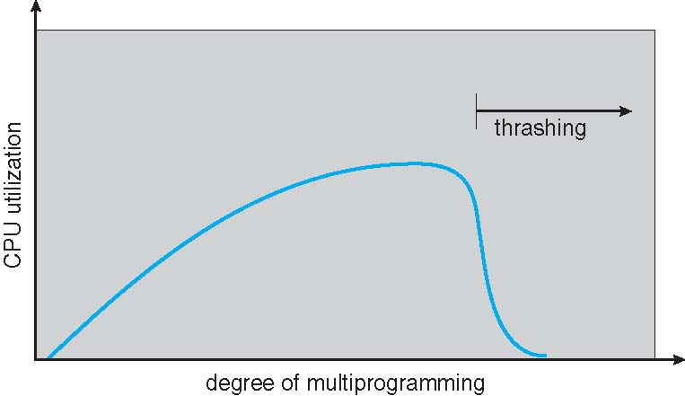
Thrashing
Thrashing ≡ a process or a set of processes is busy swapping pages in and out
This implies that the number of frames (pages) allocated to the process is insufficient to capture the current locality

Slide 74
Demand Paging and Thrashing
Why does demand paging work? – Locality model
A locality is a set of pages that are actively used together. A running program is generally composed of several different localities, which may overlap
Memory access or subsequent memory access tends to stay in the same set of page(s)
Process migrates from one locality to another, e.g., operating on a different set of data or call a function (different code segment)
Why does thrashing occur?
total size of locality (of all processes) > total memory size
If we do not allocate enough frames to accommodate the size of the current locality, the process will thrash, since it cannot keep in memory all the pages that it is actively using

Slide 75
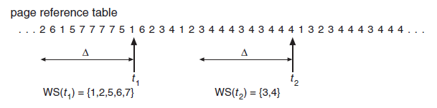
Working-Set Window
A working set is the set of pages in the most recent Δ referenced pages..
The working-set window is a moving window. Δ is the window size
A page is in the working set if it is referenced anywhere in the working-set window
For example, in the following working-set model:
if Δ = 10 memory references, then the working set at time t1 is {1,2,5,6,7}, and at time t2, the working set is {3,4}.

Slide 76
Working-Set Window
If the total demand frames is larger than the total number of frames => Thrashing – at least one process is short of memory
Policy: suspend or swap out one of the processes -> do it later
The working-set strategy prevents thrashing while keeping the degree of multiprogramming as high as possible, thus optimizes CPU utilization

Slide 77
Mass-storage system & File system

Slide 78
Disk Mechanism
A platter has a flat circular shape, with both surfaces covered with a magnetic materials for storing data
The surface of a platter is logically divided into circular tracks, further divided into hundreds of sectors.
The set of tracks that are at one arm position makes up a cylinder.
Disk drives rotate at 60 to 250 times per second, or specified in rotations per minute (RPM)
Positioning time is time to move disk arm to desired cylinder (seek time) and time for desired sector to rotate under the disk head (rotational latency)
Transfer rate is rate at which data flow between drive and computer
Notes:
The structure of the disk is like this
Pay attention to the concpet

Slide 79
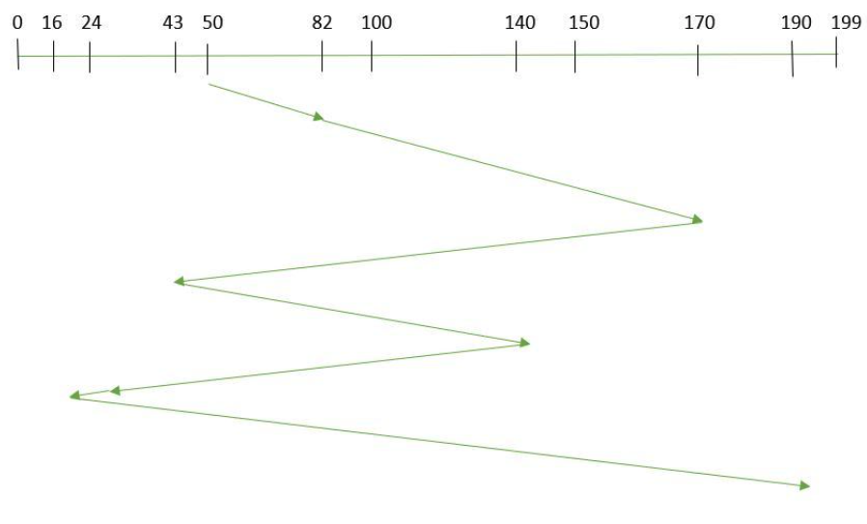
Disk Scheduling
Device controllers is responsible for disk drive head scheduling
FCFS – serves according the request order. FCFS is intrinsically fair, but it generally does not provide the fastest service
Suppose the order of request is - (82,170,43,140,24,16,190). And current position of Read/Write head is 50
Seek distance/time =(82-50)+(170-82)+(170-43)+(140-43)+(140-24)+(24-16)+(190-16) =642

Slide 80
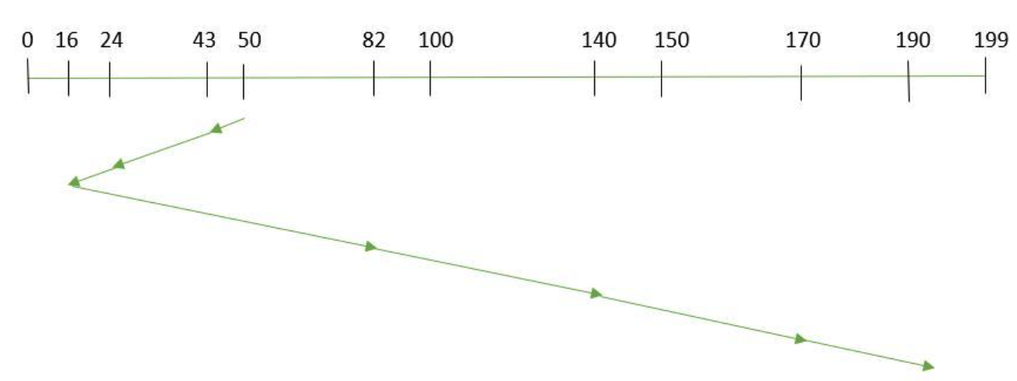
Disk Scheduling
The Shortest Seek Time First (SSTF) selects a request with the least seek time from the current head position, may cause starvation
Suppose the order of request is - (82,170,43,140,24,16,190). And current position of Read/Write head is 50
Seek distance/time = (50-43)+(43-24)+(24-16)+(82-16)+(140-82)+(170-140)+(190-170) =208

Slide 81
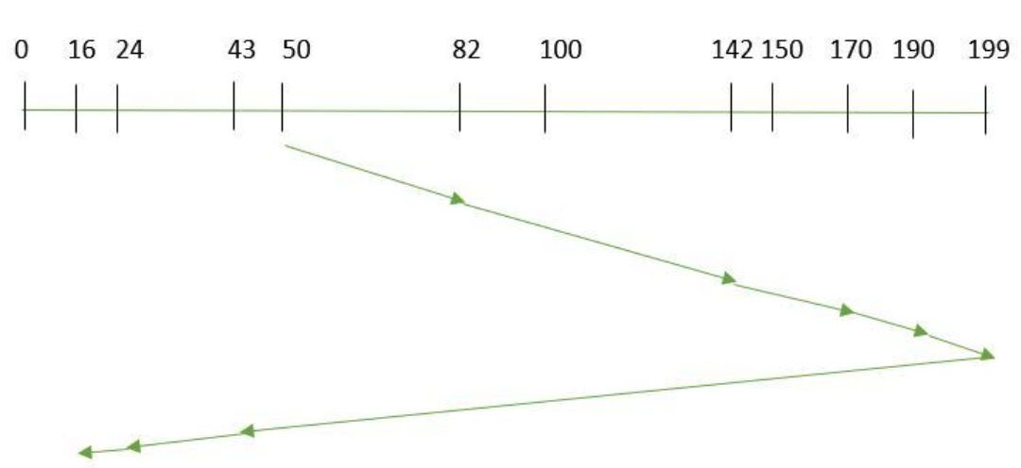
Disk Scheduling
SCAN - the disk arm starts at one end of the disk, and moves toward the other end, servicing requests as it reaches each cylinder.
Suppose the order of request is - (82,170,43,140,24,16,190). And current position of Read/Write head is 50 (direction: from left to right)
Seek distance/time =(199-50)+(199-16) =332

Slide 82
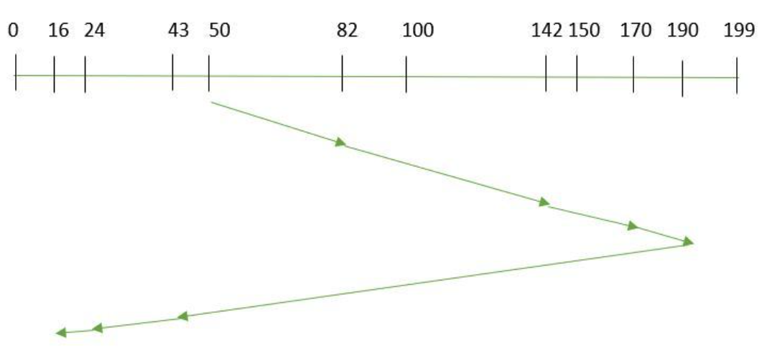
Disk Scheduling
LOOK，It is similar to the SCAN disk scheduling algorithm
in spite of going to the end of the disk, it goes only to the last request to be serviced in front of the head and then reverses its direction from there only.
Thus it prevents the extra delay which occurred due to unnecessary traversal to the end of the disk.
Suppose the order of request is - (82,170,43,140,24,16,190). And current position of Read/Write head is 50 (direction: from left to right)
Seek distance/time = (190-50)+(190-16) =314

Slide 83
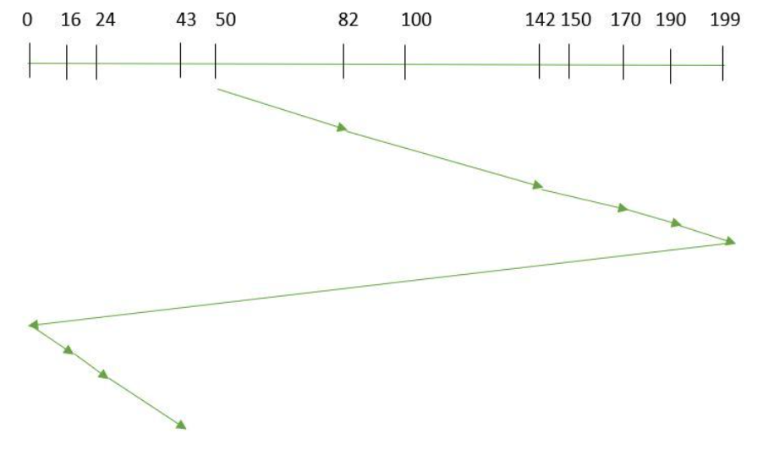
Disk Scheduling
C-SCAN, Circular-SCAN, - the head moves from one end of the disk to the other, servicing requests. When it reaches the other end, it immediately returns to the beginning of the disk, without servicing any requests on the return trip.
Suppose the order of request is - (82,170,43,140,24,16,190). And current position of Read/Write head is : 50 (direction: from left to right)
Seek distance/time =(199-50)+(199-0)+(43-0) =391

Slide 84
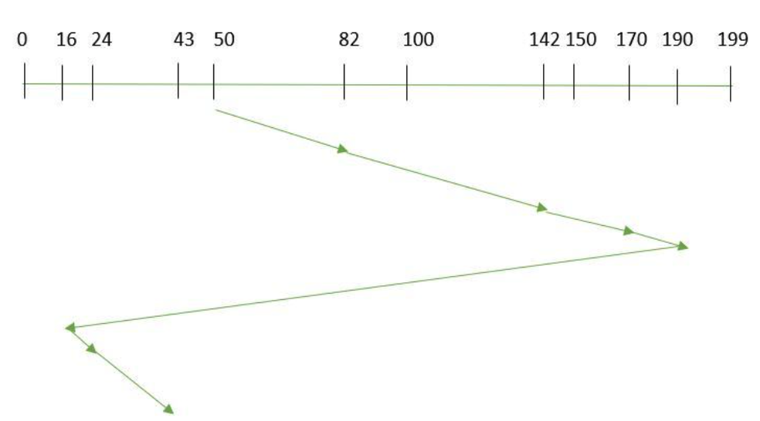
Disk Scheduling
C-LOOK returns with the last request without going to the end of the disk. the disk arm in spite of going to the end goes only to the last request to be serviced in front of the head and then from there goes to the other end’s last request. Thus, it also prevents the extra delay which occurred due to unnecessary traversal to the end of the disk.
Suppose the order of request is - (82,170,43,140,24,16,190). And current position of Read/Write head is 50 (direction: from left to right)
Seek distance/time =(190-50)+(190-16)+(43-16) =341

Slide 85
Disk Scheduling
SSTF is commonly used as it increases performance over FCFS
SCAN and C-SCAN perform better for systems that place a heavy load on the disk, because they are less likely to cause starvation problem

Slide 86
Disk-Scheduling Example
Suppose that a disk drive has 5,000 cylinders, numbered 0 to 4999. The drive is currently serving a request at cylinder 2150, and the previous request was at cylinder 1280. The queue of pending requests, in FIFO order, is:
2069, 1212, 2296, 2800, 544, 1618, 356, 1523, 4965, 3681
Starting from the current head position (cylinder 2150), what is the total distance (in cylinders) that the disk arm moves to satisfy all the pending requests for each of the following disk-scheduling algorithms?
a) FCFS
b) SSTF
c) SCAN
d) C-SCAN
e) LOOK
f) C-LOOK

Slide 87
Disk-Scheduling Example
Suppose that a disk drive has 5,000 cylinders, numbered 0 to 4999. The drive is currently serving a request at cylinder 2150, and the previous request was at cylinder 1280. The queue of pending requests, in FIFO order, is:
2069, 1212, 2296, 2800, 544, 1618, 356, 1523, 4965, 3681
Answer:
a) The FCFS schedule is 2150, 2069, 1212, 2296, 2800, 544, 1618, 356, 1523, 4965, 3681. The total seek distance is：
（2150-1212）+（2800-1212）+（2800-544）+（1618-544）+（1618-356）+（4965-356）+（4935-3681）=13011
b) The SSTF schedule is 2150, 2069, 2296, 2800, 3681, 4965, 1618, 1523, 1212, 544, 356. The total seek distance is：
（2150-2069）+（4965-2069）+（4965-356）=81+2896+4609=7586

Slide 88
Disk-Scheduling Example
Suppose that a disk drive has 5,000 cylinders, numbered 0 to 4999. The drive is currently serving a request at cylinder 2150, and the previous request was at cylinder 1280. The queue of pending requests, in FIFO order, is:
2069, 1212, 2296, 2800, 544, 1618, 356, 1523, 4965, 3681
Answer:
c) The SCAN schedule is 2150, 2296, 2800, 3681, 4965, (4999), 2069, 1618, 1523, 1212, 544, 356. The total seek distance is.
（4999-2150）+（4999-356）= 7492
d) The C-SCAN schedule is 2150, 2296, 2800, 3681, 4965, (4999, 0), 356, 544, 1212, 1523, 1618, 2069. The total seek distance is.
（4999-2150）+（4999-0）+（2069-0）=2849+4999+2069=9917
Notes:
Pay attention to the end of the disk

Slide 89
Disk-Scheduling Example
Suppose that a disk drive has 5,000 cylinders, numbered 0 to 4999. The drive is currently serving a request at cylinder 2150, and the previous request was at cylinder 1280. The queue of pending requests, in FIFO order, is:
2069, 1212, 2296, 2800, 544, 1618, 356, 1523, 4965, 3681
Answer:
e) The LOOK schedule is 2150, 2296, 2800, 3681, 4965, 2069, 1618, 1523, 1212, 544, 356. The total seek distance is
（4965-2150）+（4965-356）= 7424
f) The C-LOOK schedule is 2150, 2296, 2800, 3681, 4965, 356, 544, 1212, 1523, 1618, 2069. The total seek distance is
（4965-2150）+（4965-356）+（2069-356）=2815+4609+1713=9137

Slide 90
Block Allocation Methods
Block allocation refers to how disk blocks are allocated for files, so the disk space is utilized effectively and files can be accessed quickly
There are three major methods of allocating disk space that are widely in use, contiguous, linked and indexed
Contiguous allocation – each file occupies a set of contiguous blocks of the disk. Simple and efficient, support sequential and direct access easily. Poor disk space utilization (both internal and external fragmentation), and difficulty when file size grows

Slide 91
Block Allocation Methods
There are three major methods of allocating disk space that are widely in use, contiguous, linked and indexed
Linked allocation - each file consists of a linked-list of blocks. Inefficient to support direct access, only good for sequential access. Reasonable disk space utilization (low overhead in pointers)
Indexed allocation - Each file has its own index block containing an array of pointers to its data blocks, or disk-block addresses. It supports direct access, with no external fragmentation. Disk space utilization worse than linked allocation (high overhead in pointers),

Slide 92
Examples

Slide 93
Q. 1
Explain the distinction between a demand-paging system and a paging system with swapping
Answer:
A demand-paging system is similar to a paging system with swapping where processes reside in secondary memory
With swapping, when a process is executed, it is swapped into memory. Rather than swapping the entire process into memory, with demand-paging, a lazy swapper is used. A lazy swapper never swaps a page into memory unless that the page is needed or referenced
Thus, a paging system with swapping manipulates entire processes, whereas a demand pager is concerned with the individual pages of a process

Slide 94
Q. 2
Explain how working set model works.
Answer:
The working set model uses an integer parameter working-set window ∆
The set of pages in the most recent ∆ references is the working set of a process
A process is allowed to run only if its entire working set can be accommodated in memory
Otherwise, the process is swapped out. If there are enough extra frames in memory, another process can be initiated

Slide 95
Q. 3
Describe the in-memory structures that may be used to implement a file system.
Answer:
An in-memory mount table contains information about each mounted volume
An in-memory directory-structure cache holds the directory information of recently accessed directories
The system-wide open-file table contains a copy of the FCB of each open file
The per-process open-file table contains a pointer to the appropriate entry in the system-wide open-file table
Buffers hold file-system blocks when they are being read from disk or written to disk

Slide 96
Q. 4
What is a disadvantage of the FCFS disk scheduling algorithm?
Answer: FCFS can cause the disk head to move wildly over large distance skipping some of the cylinders in between even there are requests waiting to be serviced. As a result, average performance of FCFS is poor.

Slide 97
Q. 5
None of the disk-scheduling disciplines, except FCFS, is intrinsically fair, why? Under what circumstances are fairness or unfairness (priority-based) necessary?
Answer:
All scheduling algorithms, except FCFS, are relevant to the current head position rather than the coming order.
In a time-sharing system, fairness is important to prevent unusually long response times starvation
Memory Paging and swapping should take priority over user requests. It is desirable for kernel-initiated I/O, or I/O request from real-time processes to have priority

Slide 98
Q. 6
How many disk accesses are necessary for direct access to 20680 bytes using linked allocation and assuming each disk block is 4 KB in size?
Answer: Each block is 4KB, 5 blocks have 20480 bytes, so 20680 bytes are spread into 6 blocks, with linked allocation, it needs to have 6 disk accesses

Slide 99
Q. 7
Consider a file system that uses inodes to represent files. Disk blocks are 8-KB in size and a pointer to a disk block (or disk address) requires 4 bytes. This file system has 12 direct disk blocks, plus single, double, and triple indirect disk blocks. What is the maximum size of a file that can be stored in this file system?
Answer:
Each index block has 2048 pointers (8KB/4B=2K or 2048)
(12 * 8 KB) + (2048 * 8 KB) + (2048 * 2048 * 8 KB) + (2048 * 2048 * 2048 * 8 KB) = 64 terabytes

Slide 100
Hints on homework 4

Slide 101
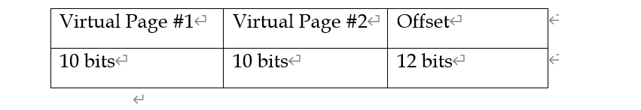
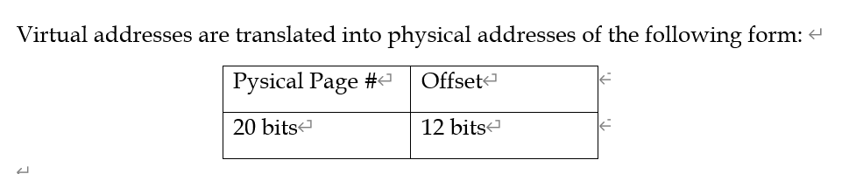
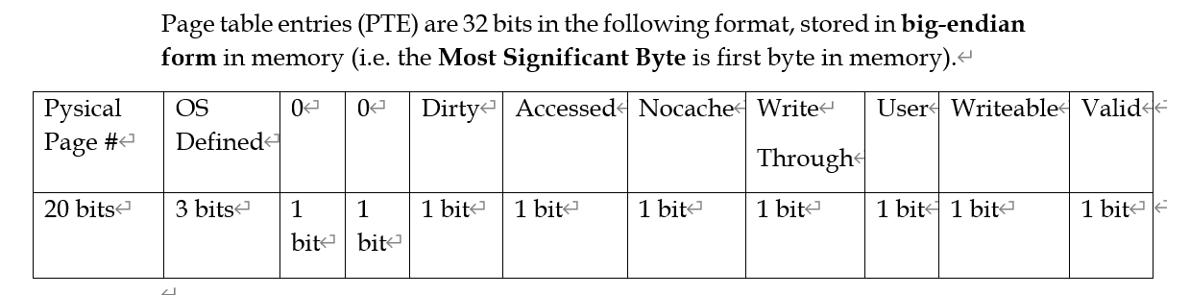

Slide 102
Level 1 base page table： base1 = 0x00200000
Translate virtual address: 0x02803084 to physical address
-> binary 0000 0010 1000 0000 0011 0000 1000 0100
Level 1 page index: 1010-> Page No. 10,
Level 1 PTE address: base1 + offset = base1 + index * PTE size = base1 + 10 * 4
Suppose PTE value: 0x10300028
level 2 page index: 0011 -> Page No.3
The first 20 bits of level 1 PTE: 0x10300
the next-level page base address is base2 = 0x10300 000
Next-level PTE address = base2 + index * PTE size = base2 + 3 * 4
Suppose level 2 PTE value: 0x20314560
Final physical address: 0x20314 084

