Slide 1
Spring 2024 COMP 3511 Review #5

Slide 2
Coverages
Synchronization and Examples
Deadlock

Slide 3
Synchronization

Slide 4
Critical Section Problem
The race condition - the results depend on the timing execution of the code. With some bad luck, i.e., context switches that occur at untimely points during the execution, the result could be wrong. In fact, we may get an indeterminate result , where it is not known what the output will be and it is indeed likely to be different across runs
A Critical Section is a piece of code that accesses a shared variable or a shared resource, thus race condition might occur and needs to be avoided
A critical section must NOT be concurrently executed by more than one thread – mutual exclusion. This guarantees that if one thread is executing within a critical section, the others will be prevented from doing so
The idea behind making a series atomic actions - “all or nothing”; it should either appear as if all of the actions be executed at once, or that none of them occurred. This prevents race condition
However, it is not of advantage to design “atomic update” of complex data structure, a matrix, for instance. Instead, a general set of synchronization primitives are designed, some with hardware support, in combination the operating system assistance
Notes:
A Race Condition is an undesirable situation where several processes access or/and manipulate a shared data concurrently and the outcome of the executions depends on the particular order in which the accesses or executions take place

Slide 5
Solution to Critical-Section Problem
1. Mutual exclusion - If process P_{i} is executing in its critical section, no other processes can be executing in their critical sections
2. Progress - If no process is executing in its critical section and there exist some processes that wish to enter their critical sections, the selection of a process that will enter the critical section next cannot be postponed indefinitely – selection of one process entering
3. Bounded Waiting - A bound must exist on the number of times that other processes are allowed to enter their critical sections after a process has made a request to enter its critical section and before that request is granted – any waiting process
Notes:
There are three possible solutions to the critical-section problem. The key idea is to protect section

Slide 6
Peterson’s Solution
A classical software-based solution- this provides a good algorithmic description of solving the critical-section (CS) problem
Two-process solution
Assume that the load and store instructions are atomic; that is, cannot be interrupted
The two processes share two variables:
int turn;
Boolean flag[2]
The variable turn indicates whose turn (which process) it is to enter the critical section
The flag array is used to indicate if a process is ready to enter the critical section. flag[i] = true implies that process P_{i} is ready and requests to enter the CS

Slide 7
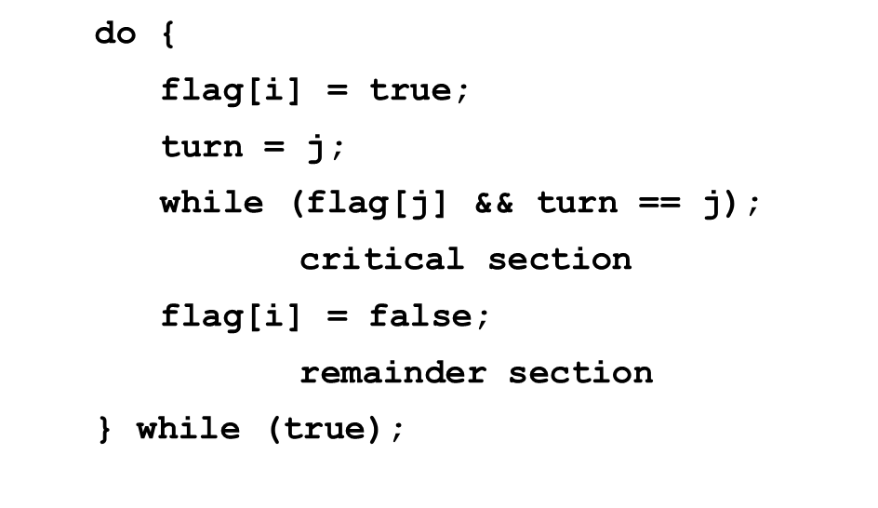
Algorithm for Process P_{i}
P₀
P₁
do {
flag[0] = true;
turn = 1;
while (flag[1] && turn == 1);
critical section
flag[0] = false;
remainder section
} while (true);
do {
flag[1] = true;
turn = 0;
while (flag[0] && turn == 0);
critical section
flag[1] = false;
remainder section
} while (true);

Slide 8
Peterson’s Solution – Proof
Mutual exclusion: P_{i} enters its critical section only if either flag[j] == false or turn ==i. If both processes are trying to enter the critical section flag[0]==flag[1] == true, the value of turn can be either 0 or 1 but not both
P_{i} can be prevented from entering its critical section only if it is stuck in the while loop with the condition flag[j]==true and turn==j;
If P_{j} is not ready to enter the critical section, then flag[j]==false and P_{i} can enter its critical section.
If P_{j} is inside the critical section, once P_{j} exits its critical section, it will reset flag[j]to false, allowing P_{i} can to enter its critical section. If P_{j} resets flag[j] to true, it must also set turn to i. Thus since P_{i} does not change the value of the variable turn while executing the while statement, P_{i} can will enter its critical section (progress) after at most one entry (bounded waiting)

Slide 9
Peterson’s Solution – Discussion
The solution works to protect “Critical Section” part of the codes, but
It is really complex even for a simple example – two processes
Codes are different for different threads, what if there are many
It involves “busy waiting”, when one thread is inside “Critical Section”, the other has to wait, wasting CPU cycles
OS provides better solutions (high level primitives) beyond load and store

Slide 10
Semaphore Recap
Semaphore S – non-negative integer variable, can be considered as a generalized lock
First defined by Dijkstra in late 1960s. It can behave similarly as mutex lock, but more sophisticated in its usage - the main synchronization primitive used in original UNIX
Two standard operations modify S: wait() and signal()
Originally called P() and V(), where P() stands for “proberen” (to test) and V() stands for “verhogen” (to increment) in Dutch
It is critical that semaphore operations are executed atomically, which guarantees that no more than one process can execute wait() and signal() operations on the same semaphore at the same time.

Slide 11
A Sample Synchronization Question
Is binary semaphore equivalent as a mutex lock (Yes/No)? Briefly explain your answer:

Slide 12
A Sample Synchronization Question
Is binary semaphore equivalent as a mutex lock (Yes/No)? Briefly explain your answer:
Answer: No
Binary semaphore initialized to 1 can be used as a mutex lock, but it can be used for other purposes (e.g., when initialized to 0).

Slide 13
A Sample Synchronization Question
Suppose that there are three processes P0, P1 and P2
that need to access a critical section in turn strictly following the order:
P0, P1, P2, P0, P1, P2, P0, P1, P2, …
In other words, we want to execute P0’s critical section, and then P1’s critical section, and then P2’s critical section, and the pattern repeats
In the following slides, you will see a program with missing BLANKS

Slide 14
A Sample Synchronization Question
Goal: access a critical section in turn strictly following the order: P0, P1, P2, P0, P1, P2…
// Initialize
// S0, S1, S2 are // shared
S0 = BLANK1;
S1 = BLANK2;
S2 = BLANK3;
// Process P0
while(true) {
wait(S0);
// critical section
BLANK4;
}
// Process P1
while(true){
BLANK5;
// critical section
BLANK6;
}
// Process P2
while(true) {
BLANK7;
// critical section
signal(S0);
}

Slide 15
A Sample Synchronization Answers
Goal: access a critical section in turn strictly following the order: P0, P1, P2, P0, P1, P2…
// Initialize
// S0, S1, S2 are // shared
S0 = 1;
S1 = 0;
S2 = 0;
// Process P0
while(true) {
wait(S0);
// critical section
signal(S1);
}
// Process P1
while(true){
wait(S1);
// critical section
signal(S2);
}
// Process P2
while(true) {
wait(S2);
// critical section
signal(S0);
}

Slide 16
POSIX Synchronization
POSIX API provides
Mutex locks (Note: pthread library supports mutex locks)
Semaphores (Note: pthread library don’t have a direct support on semaphores)
condition variables (Note: pthread_cond_wait and pthread_cond_signal are used to provide a waiting based on a condition)
Widely used on UNIX, Linux, and MacOS

Slide 17
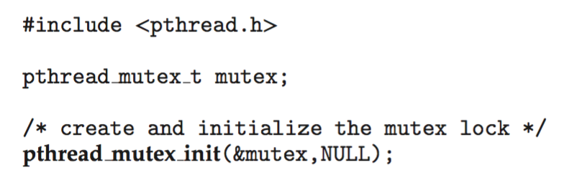
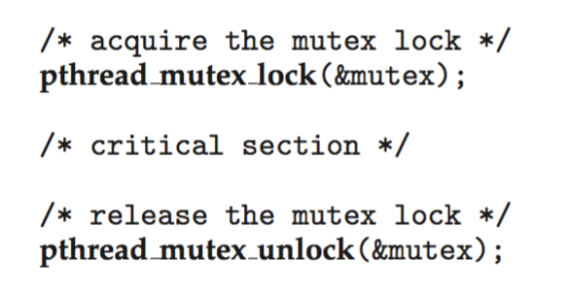
POSIX Mutex Locks
Creating and initializing the lock
Acquiring and releasing the lock

Slide 18
Sample Mutex in Pthread (Question)
int main() {
pthread_t tid1, tid2;
pthread_mutex_t mutex;
pthread_mutex_init(&mutex, NULL);
printf("The original counter value is %d\n", counter);
pthread_create(&tid1, NULL, add, &mutex);
pthread_create(&tid2, NULL, add, &mutex);
pthread_join(tid1, NULL);
pthread_join(tid2, NULL);
printf("The final counter value is %d\n", counter);
return 0;
}
#include <stdio.h>
#include <stdlib.h>
#include <pthread.h>
#include <unistd.h> unsigned int counter = 0;
// This constant controls
// the number of iteration
#define TOTAL_ITERATIONS 5000
void *add(void *arg) {
int i;
pthread_mutex_t* m = BLANK1;
for (i=0; i<TOTAL_ITERATIONS; i++) {
BLANK2;
++counter;
BLANK3;
}
}
What are the missing BLANKs?
What is the purpose of this program?
What is the final counter value?

Slide 19
Sample Mutex in Pthread (Solution)
int main() {
pthread_t tid1, tid2;
pthread_mutex_t mutex;
pthread_mutex_init(&mutex, NULL);
printf("The original counter value is %d\n", counter);
pthread_create(&tid1, NULL, add, &mutex);
pthread_create(&tid2, NULL, add, &mutex);
pthread_join(tid1, NULL);
pthread_join(tid2, NULL);
printf("The final counter value is %d\n", counter);
return 0;
}
#include <stdio.h>
#include <stdlib.h>
#include <pthread.h>
#include <unistd.h> unsigned int counter = 0;
// This constant controls
// the number of iteration
#define TOTAL_ITERATIONS 5000
void *add(void *arg) {
int i;
pthread_mutex_t* m = (pthread_mutex_t*) arg;
for (i=0; i<TOTAL_ITERATIONS; i++) {
pthread_mutex_lock(m);
++counter;
pthread_mutex_unlock(m);
}
}
The purpose of this program is to protect the shared variable counter.
Both threads will increase the counter by 5,000 times, so the final counter value is 10,000.

Slide 20
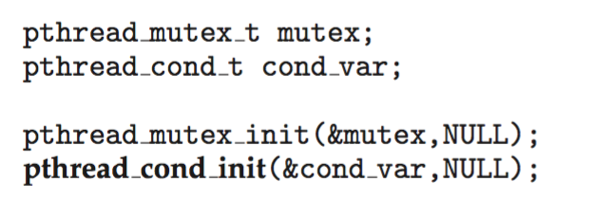
POSIX Condition Variables
POSIX condition variables are associated with a POSIX mutex lock to provide mutual exclusion:
Creating and initializing the condition variable:

Slide 21
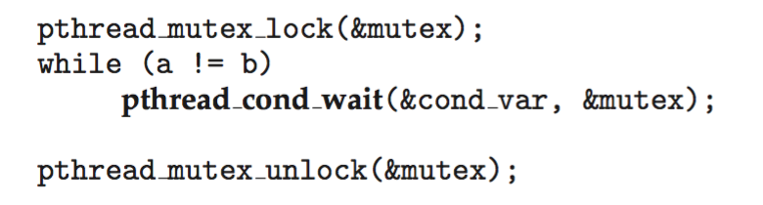
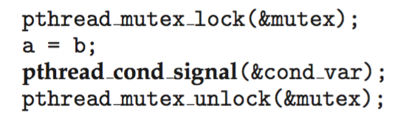
POSIX Condition Variables
Thread waiting for the condition a == b to become true:
Thread signaling another thread waiting on the condition variable:

Slide 22
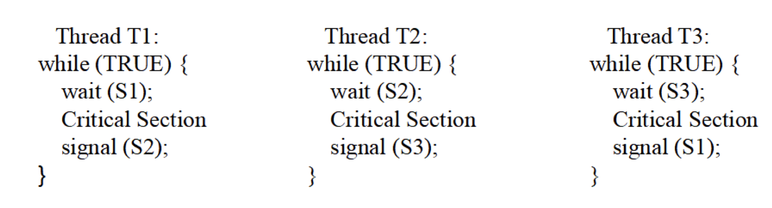
Synchronization Example 1
Suppose the following code ensures that three threads executing in critical section in order, i.e., T1, T2, T3, T1, T2, T3, T1 ...
What shall be the initial values of the three semaphores S1, S2, and S3, respectively?

Slide 23
Synchronization Example 1
Suppose the following code ensures that three threads executing in critical section in order, i.e., T1, T2, T3, T1, T2, T3, T1 ...
What shall be the initial values of the three semaphores S1, S2, and S3, respectively?
S1 = 1; S2 = 0; S3 = 0

Slide 24
Synchronization Example 2
The program below is made up of two concurrent processes sharing semaphores X and Y, both initialized to 0. What will be the output when both processes complete execution? If there is more than one possible output, describe all possibilities.
Process A | Process B
wait(X); cout << “b”; signal(Y); wait(Y); cout << “c”; signal(Y); | signal(X); cout << “a”; wait(Y); cout << “d”;

Slide 25
Synchronization Example 2
Process A | Process B
wait(X); cout << “b”; signal(Y); wait(Y); cout << “c”; signal(Y); | signal(X); cout << “a”; wait(Y); cout << “d”;
Output: b

Slide 26
Synchronization Example 2
Process A | Process B
wait(X); cout << “b”; signal(Y); wait(Y); cout << “c”; signal(Y); | signal(X); cout << “a”; wait(Y); cout << “d”;
Output: b

Slide 27
Synchronization Example 2
Process A | Process B
wait(X); cout << “b”; signal(Y); wait(Y); cout << “c”; signal(Y); | signal(X); cout << “a”; wait(Y); cout << “d”;
Output: b

Slide 28
Synchronization Example 2
Process A | Process B
wait(X); cout << “b”; signal(Y); wait(Y); cout << “c”; signal(Y); | signal(X); cout << “a”; wait(Y); cout << “d”;
Output: bcad

Slide 29
Synchronization Example 2
The program below is made up of two concurrent processes sharing semaphores X and Y, both initialized to 0. What will be the output when both processes complete execution? If there is more than one possible output, describe all possibilities.
Process A | Process B
wait(X); cout << “b”; signal(Y); wait(Y); cout << “c”; signal(Y); | signal(X); cout << “a”; wait(Y); cout << “d”;
Answer: abcd, bacd, bcad (3 possible answers)

Slide 30
Synchronization Example 2
The program below is made up of two concurrent processes sharing semaphores X and Y, both initialized to 0. What will be the output when both processes complete execution? If there is more than one possible output, describe all possibilities.
Process A | Process B
wait(X); cout << “b”; signal(Y); wait(Y); cout << “c”; signal(Y); | signal(X); cout << “a”; wait(Y); cout << “d”;
Answers: abcd, bacd, bcad (3 possible answers)
If we don’t want all processes to complete: bad, abd (Process B catches the Y and Process A suffers from deadlock)

Slide 31
Synchronization Example 3
Three processes use 4 counting semaphores, initialized as S0 = 1, S1 = 0, S2 =0, S3 = 0 How many times will ‘1’ be printed out?
// Process P0 while(true) { wait(S0); print '1'; release(S1); release(S2); release(S3); }
// Process P1 wait(S1); release(S0);
// Process P2 wait(S2); release(S0); wait(S3); release(S0);

Slide 32
Synchronization Example 3
Three processes use 4 counting semaphores, initialized as S0 = 1, S1 = 0, S2 =0, S3 = 0 How many times will ‘1’ be printed out?
// Process P0 while(true) { wait(S0); print '1'; release(S1); release(S2); release(S3); }
// Process P1 wait(S1); release(S0);
// Process P2 wait(S2); release(S0); wait(S3); release(S0);
Answer: four times

Slide 33
Synchronization Example 4
Readers-Writers Problem
Two mutex: mutex and rw_mutex,
Two primitives: wait() and signal()
//The structure of a writer process:
do {
wait(rw_mutex);
...
/*writing is performed*/
... signal(rw_mutex);
} while (true);
// The structure of a reader process:
do {
;
read_count++;
if (read_count == 1)
;
;
...
/* reading is performed */
...
;
read_count--; if (read_count == 0)
;
;
} while (true);

Slide 34
Synchronization Example 4
Readers-Writers Problem
//The structure of a writer process:
do {
wait(rw_mutex);
...
/*writing is performed*/
... signal(rw_mutex);
} while (true);
// The structure of a reader process:
do {
wait(mutex);
read_count++;
if (read_count == 1)
wait(rw_mutex);
signal(mutex);
...
/* reading is performed */
...
;
read_count--; if (read_count == 0)
;
;
} while (true);

Slide 35
Synchronization Example 4
Readers-Writers Problem
//The structure of a writer process:
do {
wait(rw_mutex);
...
/*writing is performed*/
... signal(rw_mutex);
} while (true);
// The structure of a reader process:
do {
wait(mutex);
read_count++;
if (read_count == 1)
wait(rw_mutex);
signal(mutex);
...
/* reading is performed */
...
wait(mutex);
read_count--; if (read_count == 0)
signal(rw_mutex);
signal(mutex);
} while (true);

Slide 36
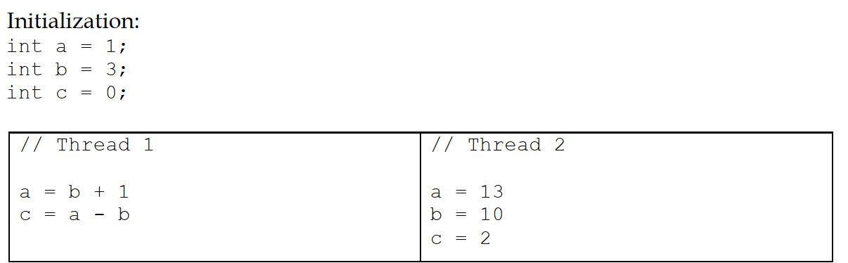
Synchronization Example 5
Suppose that two threads execute the following C code concurrently, accessing shared variables a, b, and c:
What are all the possible values for c after both threads complete? Assume that reads and writes of the variables are atomic, and that the order of execution of statements within each thread is preserved by the C compiler and the hardware so it matches the code above.

Slide 37
Synchronization Example 5
Answer: -6, 1, 2, 3, 10
-6:
Thread 1 executes a=b+1=4. After thread 1 loads a=4 into the register for the subtraction, thread 2 executes all its statements which leads to b=10. Then thread 1 loads b=10 into the register.
Thread 1 calculates c=4-10=-6.
1:
Case 1: Thread 1 executes a=b+1=4. After thread 1 loads 4 and 3 into the registers for the subtraction, thread 2 executes all its statements. Then thread 1 runs c=4-3=1. Case 2: Thread 2 executes a=13, b=10, and c=2. Then, thread 1 runs a=10+1=11 and calculates c=11-10=1.

Slide 38
Synchronization Example 5
Answer: -6, 1, 2, 3, 10
2:
The last statement of thread 2 “c=2” is executed at last. Therefore, c=2.
3:
Thread 1 executes a=3+1=4. Then thread 2 executes a=13, b=10, and c=2. After that, thread 1 executes c=13-10=3.
10:
Thread 1 executes a=3+1=4. Then thread 2 executes a=13 which overwrites the change by thread 1. After that, thread 1 loads a=13 and b=3 for the second statement. Before thread 1 finishes the subtraction, thread 2 executes all its remaining statements. Thread 1 calculates c=13-3=10 and stores the value in c.

Slide 39
Deadlock

Slide 40
The Deadlock Problem
A set of blocked processes each holding resource(s) while waiting to acquire more resource(s) held by another process in the set.
Example 1
A system has 2 tape drives.
P₁ and P₂ each hold one tape drive and each needs another one.
Example 2
semaphores A and B, initialized to 1
P₀ P₁
wait (A); wait(B)
wait (B); wait(A)

Slide 41
The Deadlock Problem
Deadlock – two or more processes are waiting indefinitely for an event that can be caused by only one of the waiting
Let S and Q be two semaphores initialized to 1
P₀ P₁
wait(S); wait(Q);
wait(Q); wait(S);
… …
signal(S); signal(Q);
signal(Q); signal(S);
Consider if P0 executes wait(S) and P1 wait(Q). When P0 executes wait(Q), it must wait until P1 executes signal(Q), However, P1 is waiting until P0 execute signal(S). Since these signal() operations will never be executed, P0 and P1 are deadlocked, extremely difficult to debug
Notes:
Starvation – indefinite blocking
A process may never be removed from the semaphore queue, in which it is suspended. For instance, if we remove processes from the queue associated with a semaphore using LIFO (last-in, first-out) order or based on certain priorities.

Slide 42
Deadlock Characterization
Deadlock involving multiple processes can arise if the following four conditions hold simultaneously – they are necessary but not sufficient conditions
Mutual exclusion: only one process at a time can use a resource
Hold and wait: a process holding at least one resource is waiting to acquire additional resource(s) held by other processes
No preemption: a resource can be released only voluntarily by the process holding it, after that process has completed its task
Circular wait: there exists a set {P₀, P₁, …, P_{n}} of waiting processes such that P₀ is waiting for a resource that is held by P₁, P₁ is waiting for a resource that is held by P₂, …, P_{n–1} is waiting for a resource that is held by P_{n}, and P_{n} is waiting for a resource that is held by P₀.

Slide 43
Methods for Handling Deadlocks
Ensure that the system will never enter a deadlock state:
Deadlock prevention: it provides a set of methods to ensure at least one of the necessary conditions (4 conditions) cannot hold
Deadlock avoidance: this requires additional information given in advance concerning which resources a process will request and use during its lifetime. Within such knowledge, the OS can decide for each resource request whether or not a process should wait
Deadlock detection - allow the system to enter a deadlock state， periodically detect deadlock and then recover from it
Many OSes just ignore the problem and pretend that deadlocks never occur in the system

Slide 44
Deadlock Example
There are certain amount of instances of the same resource R in the system.
Three concurrent processes P1, P2, and P3 respectively require 3,4 and 5 instances of R to finish their tasks.
Based on such requirement, the system allocates 2, 3 and 4 instances of R to P1, P2, and P3, respectively.
How many more available instances of R are required at least to avoid deadlock?
Notes:
Starvation – indefinite blocking
A process may never be removed from the semaphore queue, in which it is suspended. For instance, if we remove processes from the queue associated with a semaphore using LIFO (last-in, first-out) order or based on certain priorities.

Slide 45
Deadlock Example
There are certain amount of instances of the same resource R in the system.
Three concurrent processes P1, P2, and P3 respectively require 3,4 and 5 instances of R to finish their tasks.
Based on such requirement, the system allocates 2, 3 and 4 instances of R to P1, P2, and P3, respectively.
How many more available instances of R are required at least to avoid deadlock?
Answer: 1
Notes:
Starvation – indefinite blocking
A process may never be removed from the semaphore queue, in which it is suspended. For instance, if we remove processes from the queue associated with a semaphore using LIFO (last-in, first-out) order or based on certain priorities.

Slide 46
Resource-Allocation Graph
A set of vertices V and a set of edges E.
V is partitioned into two types:
P = {P₁, P₂, …, P_{n}}, the set consisting of all the processes in the system
R = {R₁, R₂, …, R_{m}}, the set consisting of all resource types in the system
request edge – directed edge P_{i} → R_{j}
assignment edge – directed edge R_{j} → P_{i}

Slide 47
RAG: Important Notes
If a graph contains no cycles ⇒ no deadlock
If a graph contains a cycle ⇒ the system may or may not be in a deadlocked state
if only one instance per resource type, then deadlock
if several instances per resource type, possibility of deadlock

Slide 48
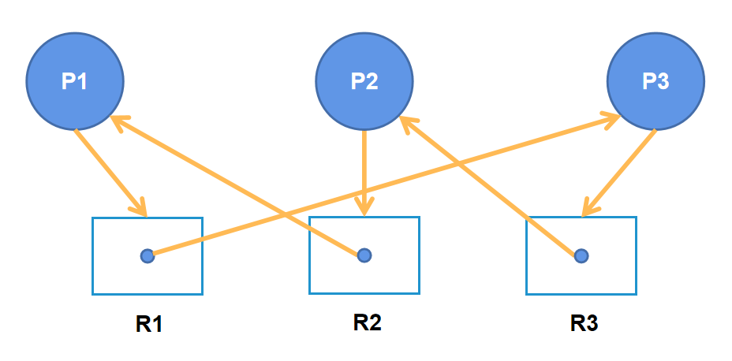
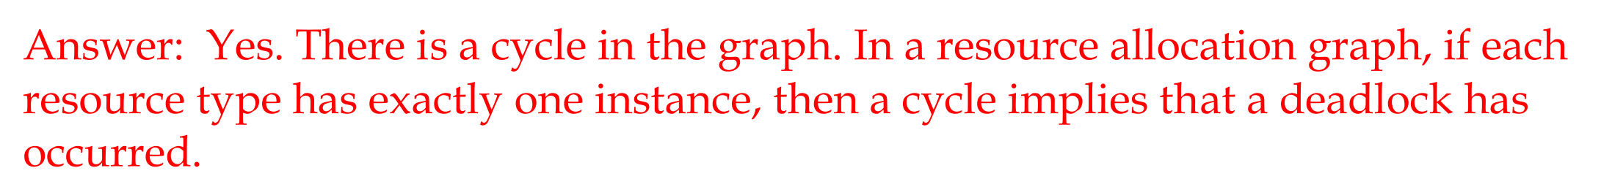
RAG: Single Instance Example
Is there a deadlock in this resource allocation graph?

Slide 49
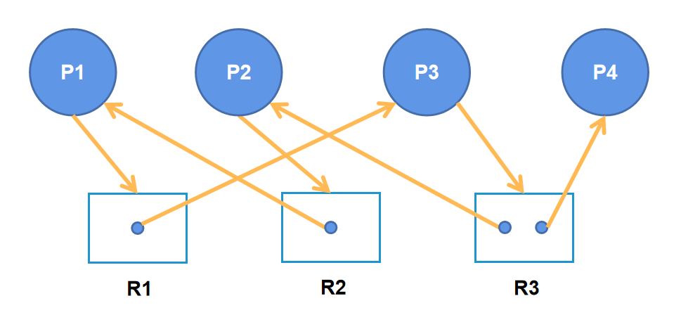
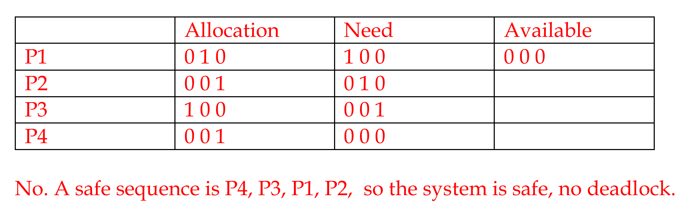
RAG: Multiple Instances Example
Is there a deadlock in this resource allocation graph?

Slide 50


