Slide 1

Chat-bot in Python
Calculator-4000
Daniaruly Alibek
IT2-2503SE
International IT University
A Python-based chat-bot

Slide 2

Aim of project
Chat-bot calculator
Implement a UI-based bot (single-screen application) pattern that mimics the screen of a real calculator.
Create a chatbot that will perform mathematical operations by interacting with the user.
Ensure reliable storage of the calculation history.

Slide 3

Technologies stack
Python 3.x
For interaction with telegram bots and APIs
PytelegrambotAPI
Main programming language
Numexpr
Our “math processor”
Django ORM + SQLite
Our lite DataBase to save information about operations

Slide 4

Architecture and Structure
The data base
db.sqlite3
Django management utility.
manage.py
The root file
Main.py
Database structure
models.py
Django main control panel
settings.py

Slide 5
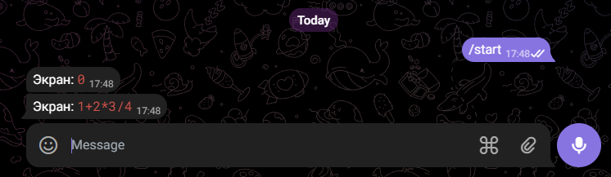
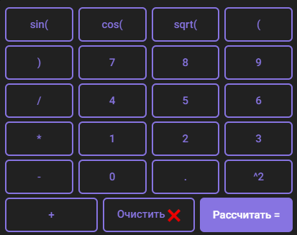
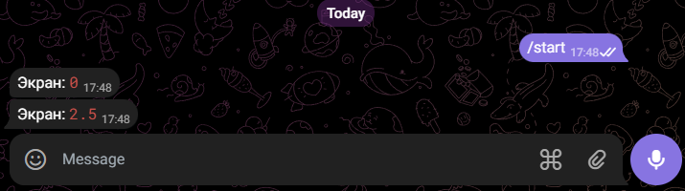
Interface
Interface based on UI style. Mostly, it works more like an application, but with interaction with telegram-bot and with API.

Slide 6

Implementation features
edit_message_text method: Dynamically updating the "screen" without sending new messages.
Auto-clean chat: Delete incoming user messages to keep the interface clean.
Exception Handling (try/except): Interception of critical errors (for example, division by zero or incorrect syntax), preventing the bot from crashing.

Slide 7
Conclusion
A stable hybrid chatbot has been developed.
A user-friendly interface has been implemented.
The requirement for logging and storing data in the database has been fulfilled.
The project is uploaded to GitHub with detailed documentation (README.md ).

