Slide 1
TEAM GIT SOME!
Presents:

Slide 2

Git Some
Find Code Buddies near You!
Imgsrc: https://www.flickr.com/photos/pasant/8743268732/sizes/l

Slide 3
Git Some
Login
Locate
Communicate

Slide 4
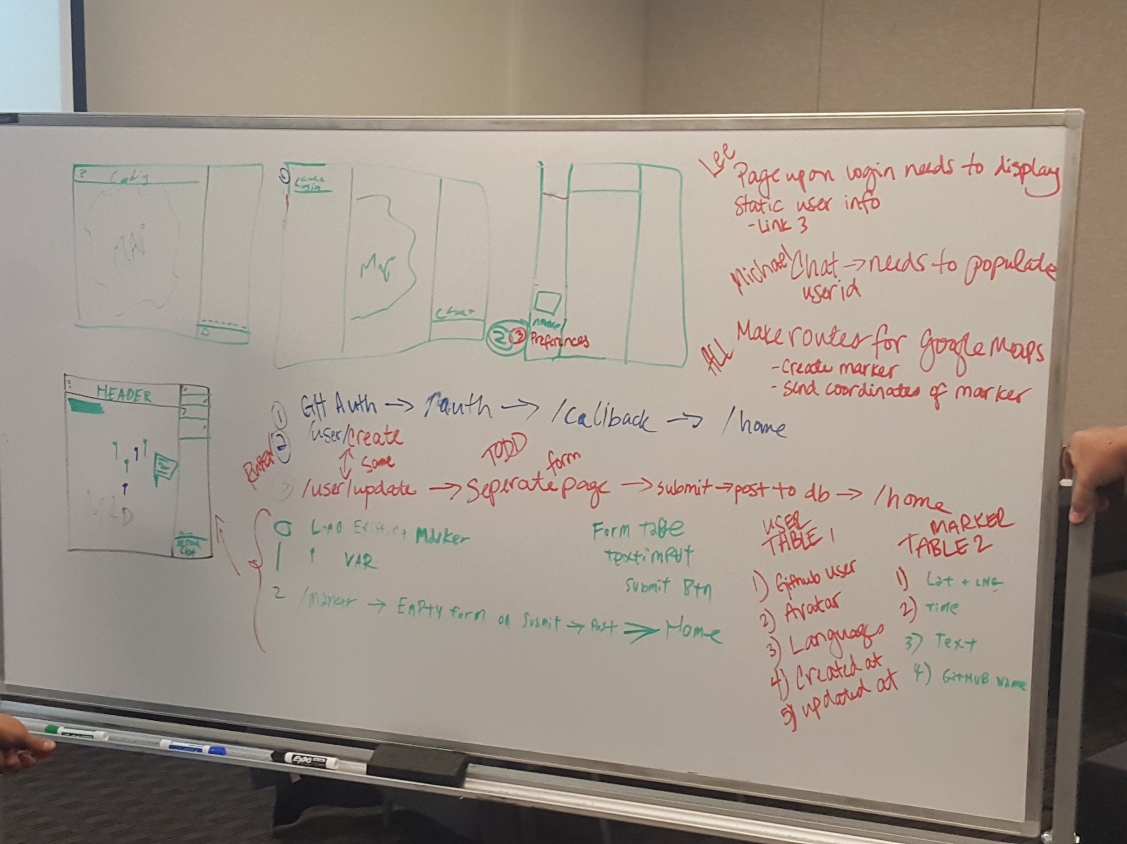

Slide 5
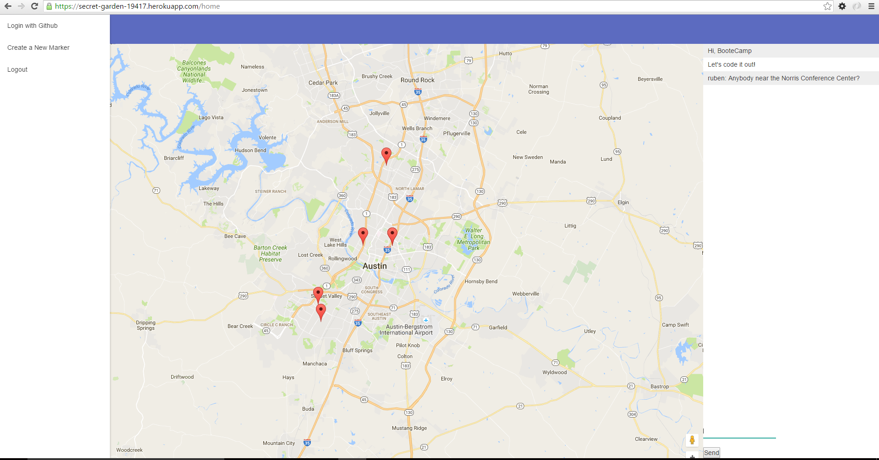

Slide 6
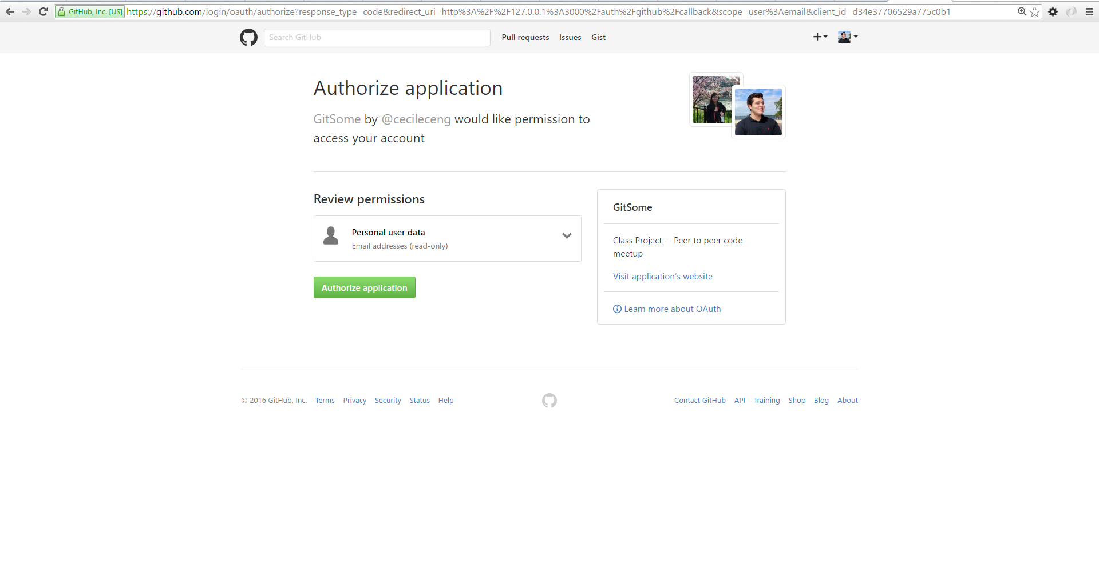

Slide 7
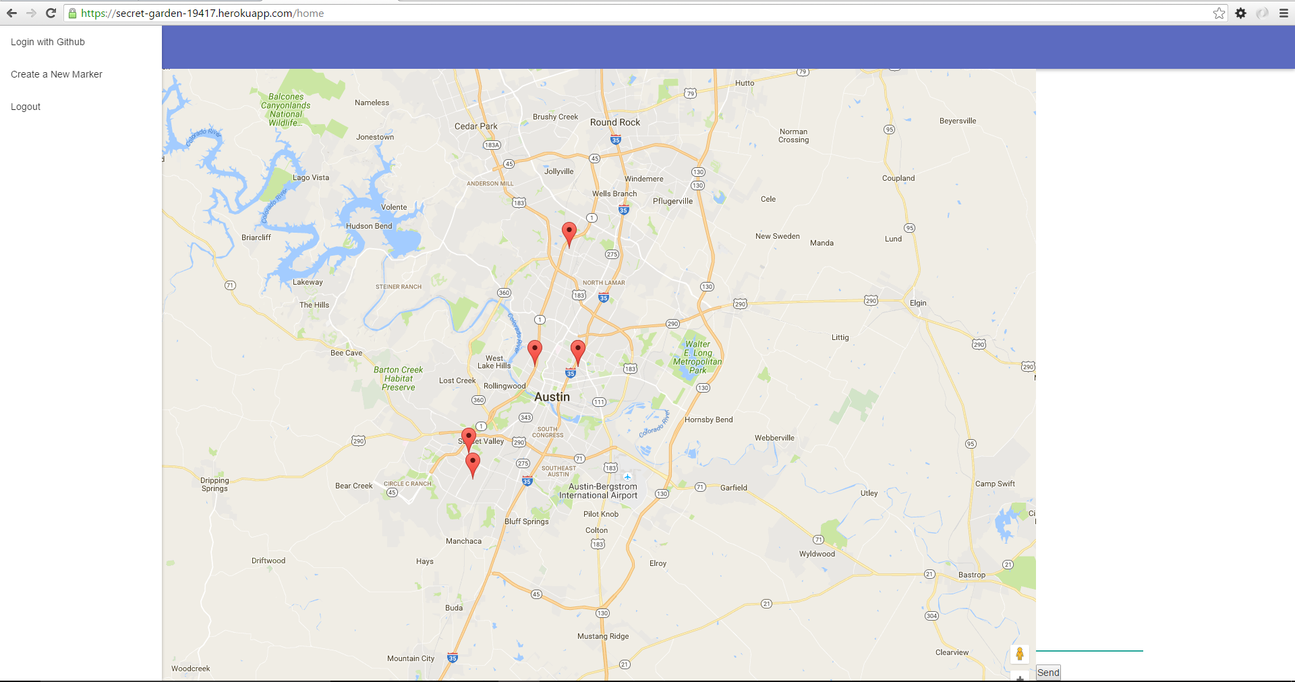

Slide 8
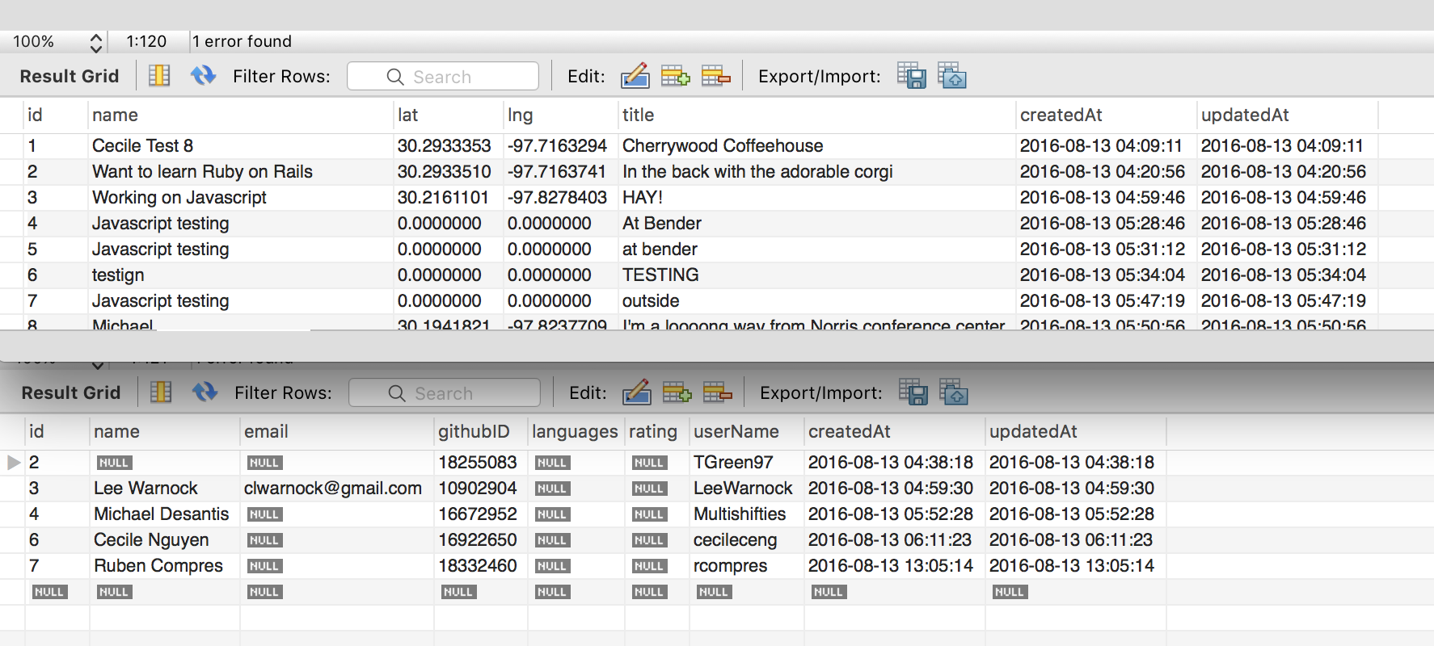

Slide 9
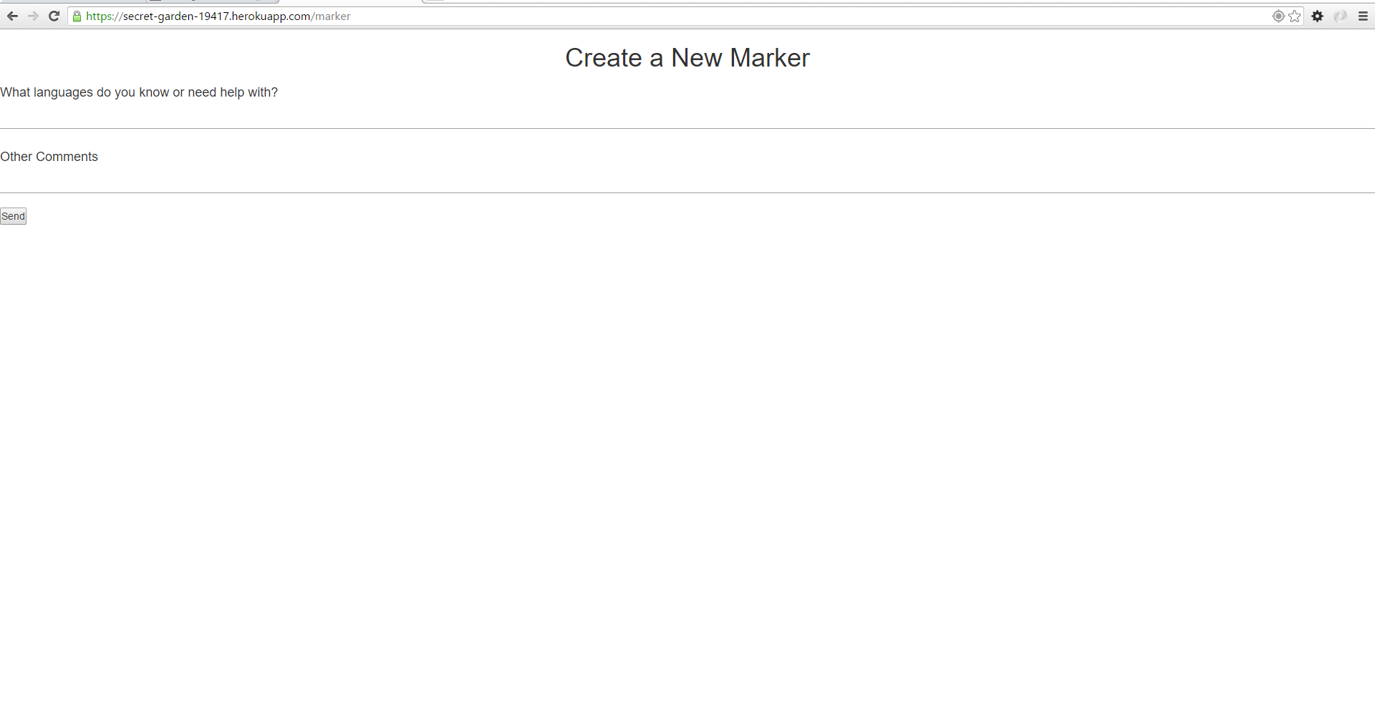

Slide 10
Technologies Used:
Node.js
Express.js
Express.Handlebars
Express Session Management
Passport
oAuth2
googleMapsAPI
Postman
mySQL
Pry.js
Sequelize
Socket.io

Slide 11
DEMO TIME!

Slide 12
Future Development

Slide 13
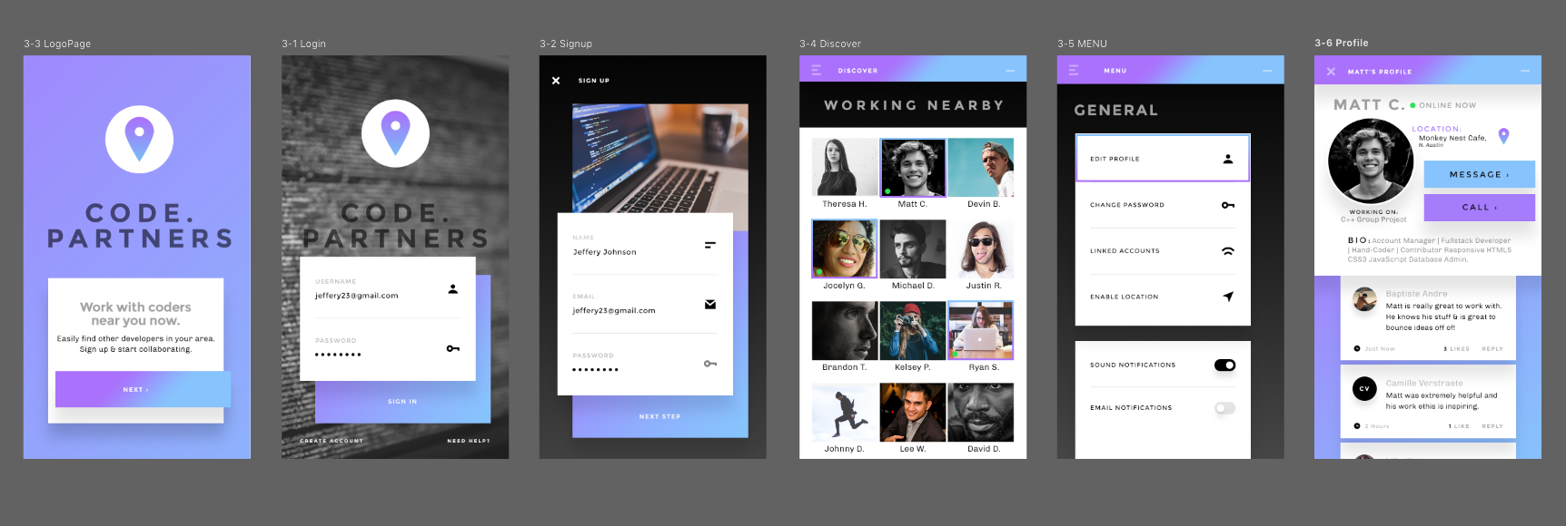

Slide 14
Final Thoughts and Q&A

