Slide 1
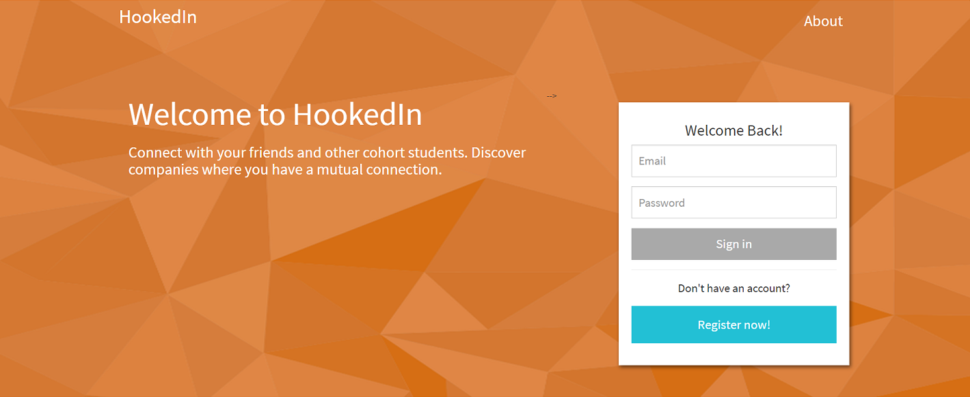

Slide 2


Front-End Technologies
We utilized SASS and Flexbox to create a polished UI.
JQuery was used extensively in dynamically populating user information.

Slide 3


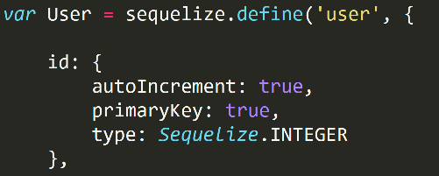
Back-End Technologies
MySQL was used to store user information for both login purposes and populating user profiles.
We used Sequelized to create SQL queries in Node.

Slide 4

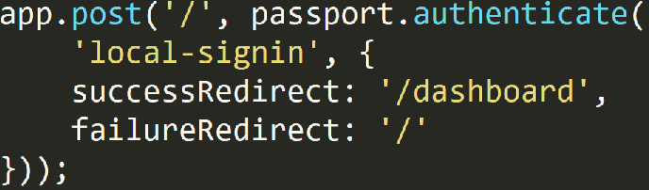

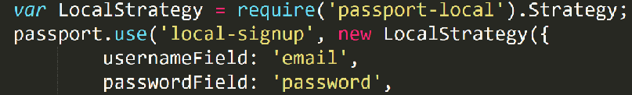
Back-End Technologies
Express created routes and CRUD operations for the database.
User authentication was handled by Passport and bcrypt, framework packages for node.

