Slide 1
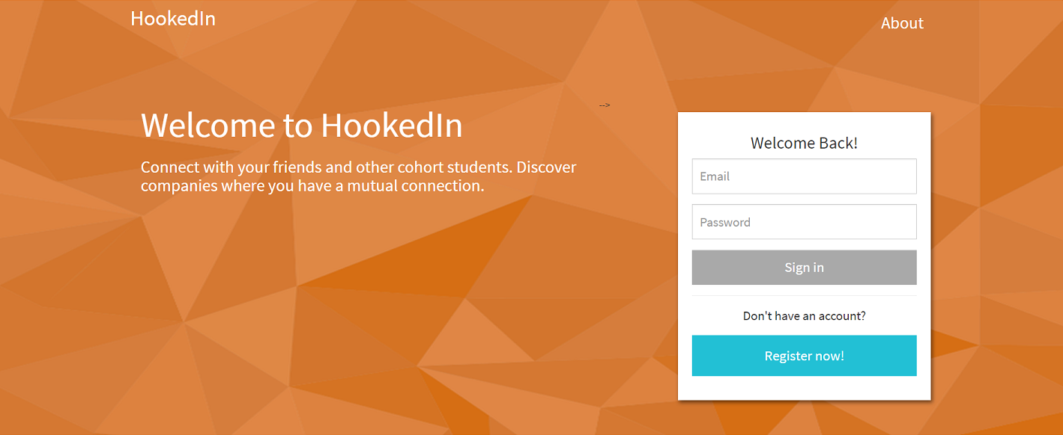

Slide 2
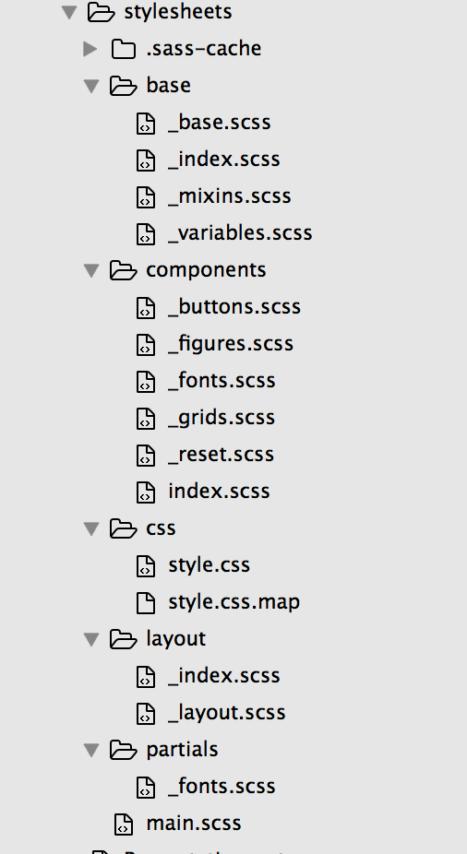

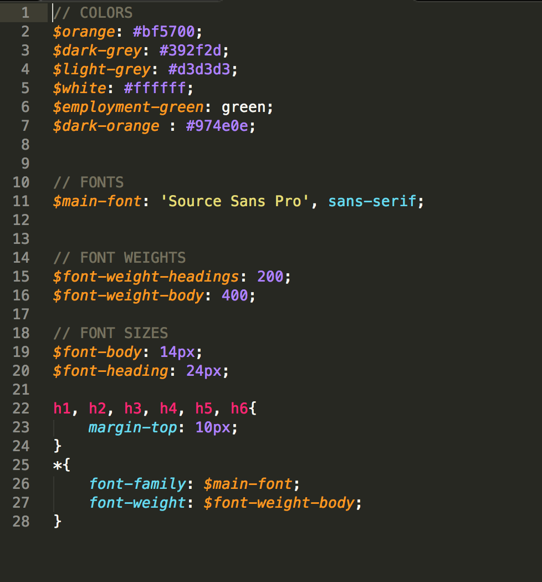
Front-End Technologies
We utilized Sass and Flexbox to create a polished UI.
The Sass file structure kept styling well organized.

Slide 3

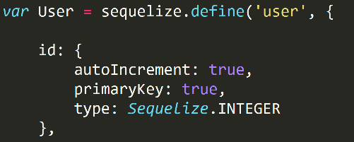

Back-End Technologies
MySQL was used to store user information for both login purposes and populating user profiles.
We used Sequelized to create SQL queries in Node.

Slide 4

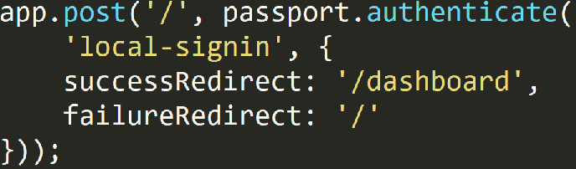

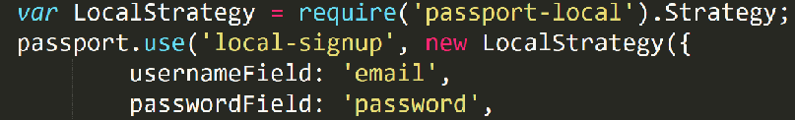
Back-End Technologies
Express created routes and CRUD operations for the database.
User authentication was handled by Passport and bcrypt, framework packages for node.

Slide 5
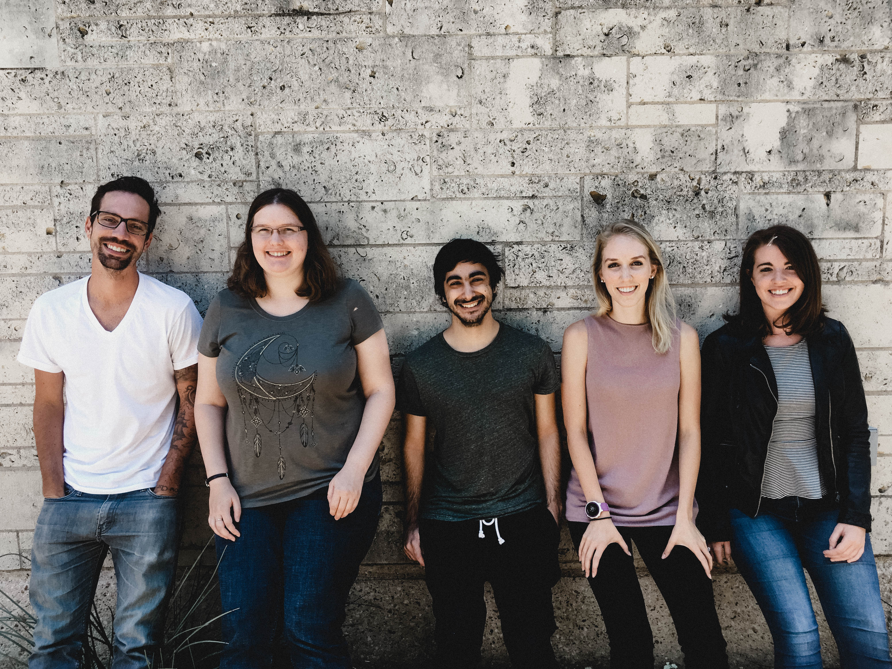
Moving Forward
Future Iterations
Reset password
Statistics page.
Invite only sign up.
Reminder emails to check and update profiles.
Challenges
Intricacies of Passport
Creation of an API for logged in users

