Slide 1

CVPR 2026 · ORAL · arXiv:2512.01643
ViT³: Unlocking Test-Time Training in Vision
Dongchen Han¹, Yining Li¹, Tianyu Li¹, Zixuan Cao¹
Ziming Wang², Jun Song², Yu Cheng², Bo Zheng², Gao Huang^{1✉}
¹ Tsinghua University ² Alibaba Group
A systematic empirical study of Test-Time Training designs for visual sequence modeling
汇报人：李祥
2026.9.28

Slide 2





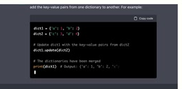
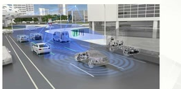
paper
code
The “Long Sequence” Era
Transformers have a quadratic complexity O(N²) with respect to the sequence length N.
Embodied AI
AI Office
Video Generation
Coding Agent
Self-driving
2

Slide 3
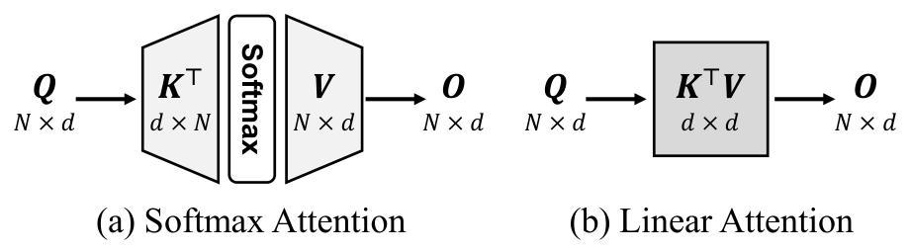
paper
code
A Different View of Attention
Softmax Attention O(N²)
Linear Attention O(N)
O = σ(QK⊤)V
O = (QK⊤)V = Q(K⊤V)
σ is the Softmax function
the associative property
A Different View
Build a model with K, V
Apply the model to Q
Figure 1 (a)(b): attention as building a model with K, V (from the paper)
1. Vaswani et al. “Attention is all you need.” NeurIPS 2017.
2. Katharopoulos et al. “Transformers are RNNs: Fast autoregressive transformers with linear attention.” ICML 2020.
3

Slide 4
paper
code
A Different View of Attention
A Different View
Build a model with K, V
Apply the model to Q
What’s the fundamental difference?
No Compression
Coarse Compression
Efficiency
Efficiency
A Compression Problem
Expressiveness
Expressiveness
Softmax attention keeps the uncompressed K, V — expressive, but the N-width MLP costs O(N²).
Linear attention compresses K, V into a d×d linear state — O(N), but the naive K⊤V compression discards information.
4

Slide 5
paper
code
Compression by Learning
Deep Learning
The most powerful compression algorithm
Normal Training
Test-Time Training
Training
Inner Training
Trillions of Data
Model
Context Info
Inner Model
TTT treats each context as a small training set — compression becomes learning.
1. Sun et al. “Learning to (learn at test time): RNNs with expressive hidden states.” ICML 2025.
5

Slide 6
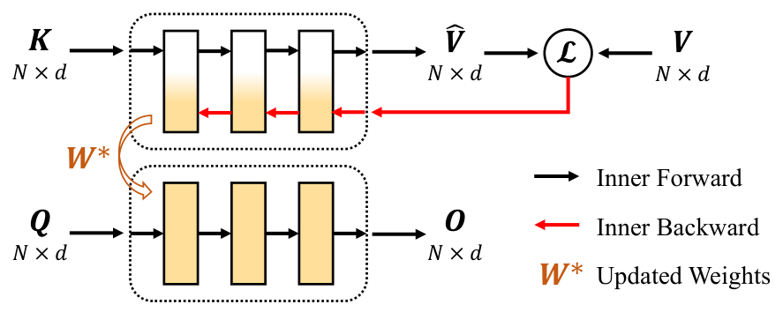
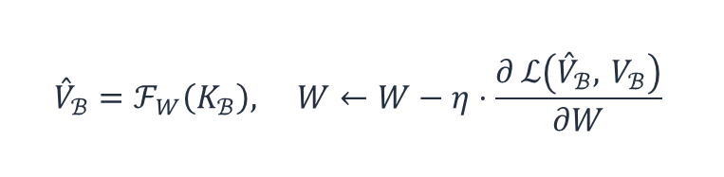
paper
code
Test-Time Training
Replicate the successes of deep learning in sequence modeling
View key–value pairs in the context as
a mini “dataset”, and train an inner model:
$${\overset{ˆ}{V}}_{ℬ}=ℱ_{W}\left(K_{ℬ}\right), W←W−η⋅\frac{∂ ℒ\left({\overset{ˆ}{V}}_{ℬ}, V_{ℬ}\right)}{∂W}$$
Figure 1 (c): the Test-Time Training layer (from the paper)
Apply the inner model to queries: O = F_{W*}(Q)
6

Slide 7
paper
code
Motivation
Bottleneck: a large and under-explored design space
Key choices of the inner training process and the inner model
still lack systematic understanding in existing work.
Han et al. ViT³: Unlocking Test-Time Training in Vision, CVPR 2026 (Oral)
7

Slide 8
paper
code
Exploring Test-Time Training Designs
Inner Training:
Systematically explore
the new design space of TTT
(1) loss
(2) epoch and
(3) learning
function
batch size
rate
from six aspects:
Inner Model:
Baseline: DeiT-T with attention blocks
replaced by TTT layers.
(4) inner
(5) inner
(6) inner
model width
model depth
model arch
Han et al. ViT³: Unlocking Test-Time Training in Vision, CVPR 2026 (Oral)
8

Slide 9
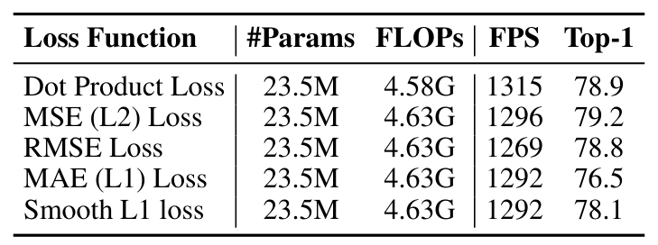


paper
code
Inner Training Configuration
(1) loss function
Insight 1: Inner loss functions ℒ should have non-vanishing $\frac{∂^{2}ℒ}{∂\overset{ˆ}{V} ∂V}$
The outer loop gradient to W_{V}
$$\frac{∂G}{∂W_{V}}=\frac{∂{\overset{ˆ}{V}}_{ℬ}}{∂W}⋅\frac{∂^{2} ℒ\left({\overset{ˆ}{V}}_{ℬ}, V_{ℬ}\right)}{∂{\overset{ˆ}{V}}_{ℬ} ∂V_{ℬ}}⋅\frac{∂V_{ℬ}}{∂W_{V}}$$
If $\frac{∂^{2}ℒ}{∂\overset{ˆ}{V} ∂V}$ vanishes, the gradient signal
Table 1: inner training loss functions (from the paper)
to W_{V} dies — W_{V} can’t be optimized.
Han et al. ViT³: Unlocking Test-Time Training in Vision, CVPR 2026 (Oral)
9

Slide 10
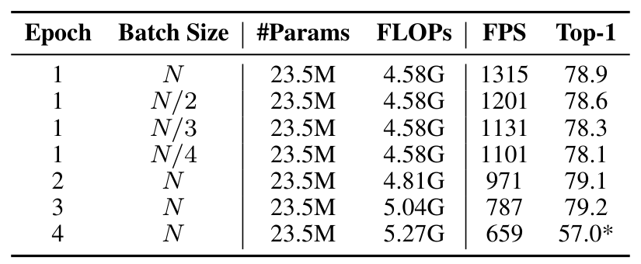
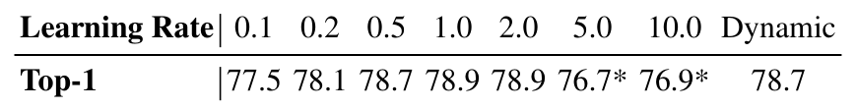
paper
code
Inner Training Configuration
(2) epoch and batch size
(3) learning rate
Insight 2: A single epoch of full-batch
Insight 3: A relatively large, stable inner
(batch gradient) inner training works well for vision
learning rate (1.0) works best
Table 3: inner learning rates (from the paper)
* 5.0 / 10.0: best accuracy before divergence —
excessively large rates cause training instability.
Dynamic (token-wise) rates are less effective for vision.
Table 2: batch sizes and epochs (from the paper)
Han et al. ViT³: Unlocking Test-Time Training in Vision, CVPR 2026 (Oral)
10

Slide 11
paper
code
Inner Model Design
(4) inner model width
Insight 4: Increasing inner model width consistently improves performance
MLP inner model
Inner model incurs more computation
79.8
79.6
Forward pass on keys V̂ = F_{W}(K) — 1× FLOPs
79.6
79.5
Backward pass of the loss ℒ — 2× FLOPs
79.4
Forward pass on queries O = F_{W}(Q) — 1× FLOPs
Top-1 Acc. (%)
79.2
79.2
79.0
Designing lightweight and expressive inner
78.9
models is an important topic.
78.8
1×
2×
3×
4×
Inner Model Width
Data: Table 4 of the paper (MLP inner model, width ratio r1–r4)
Han et al. ViT³: Unlocking Test-Time Training in Vision, CVPR 2026 (Oral)
11

Slide 12
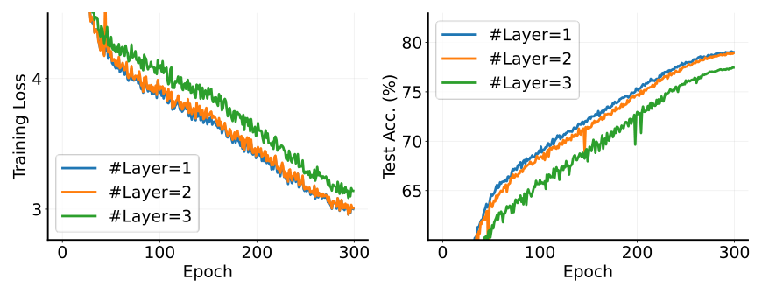
paper
code
Inner Model Design
(5) inner model depth
Insight 5: Deep inner
models suffer from
optimization difficulties
More parameters, yet lower accuracy — deeper inner
modules underfit the training data in practice.
Figure 3: 1/2/3-layer inner models — deeper means higher training loss (from the paper)
Outer loop: the initialization W₀ of a deep inner model becomes difficult to optimize end-to-end
Inner loop: exploding or vanishing inner-loop gradients ∂ℒ/∂W hinder effective compression of K, V
Residual connections and naive initialization offer limited mitigation; enabling deep inner models is a promising direction.
Han et al. ViT³: Unlocking Test-Time Training in Vision, CVPR 2026 (Oral)
12

Slide 13
paper
code
Inner Model Design
(6) inner model arch
Insight 6: Convolutional architectures are particularly
appropriate for visual TTT
··
MLP
DWConv
4.58G FLOPs
4.25G FLOPs
78.9% Acc
80.1% Acc
A natural integration:
Global information: K, V compressed into the updated kernel weights
Local information: the convolution receptive field
Han et al. ViT³: Unlocking Test-Time Training in Vision, CVPR 2026 (Oral)
13

Slide 14
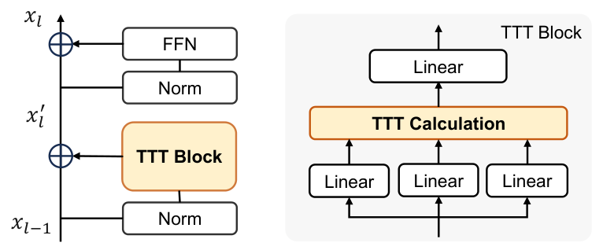


paper
code
ViT³: A Test-Time Training Architecture
Vision Test-Time Training (ViT³)
Inner Training:
a pure TTT baseline with linear complexity
(1) dot-product loss
(2) full-batch gradient descent, single epoch
(3) learning rate 1.0
Inner Model:
(1) $ℱ_{1}=FC\left(x\right)⊙SiLU\left(FC\left(x\right)\right)$
(2) $ℱ_{2}=DWConv\left(x\right)$
Figure 2: the TTT building block (from the paper)
A drop-in replacement for standard attention blocks.
Two families: ViT³ (non-hierarchical) · H-ViT³ (4-stage hierarchical).
DiT³: adapted to diffusion image Transformers for generation.
Han et al. ViT³: Unlocking Test-Time Training in Vision, CVPR 2026 (Oral)
14

Slide 15
paper
code
ViT³: A Test-Time Training Architecture
Matches or outperforms advanced linear-complexity models
CSwin
InternImage
VMamba
H-ViT³ (ours)
86
DiT-B
50
60
85
49
DiT³-B
Top-1 (%)
APᵇ
FID ↓
84
50
48
83
47
40
82
5
10
15
300
400
500
10
15
20
FLOPs (G)
FLOPs (G)
FLOPs (G)
(a) Classification
(b) Detection
(c) Generation
(lower is better)
Data: Tables 5, 8, 10 of the paper — hierarchical backbones; H-ViT³-T/B classification uses MESA training; detection uses Mask R-CNN 1×.
Han et al. ViT³: Unlocking Test-Time Training in Vision, CVPR 2026 (Oral)
15

Slide 16
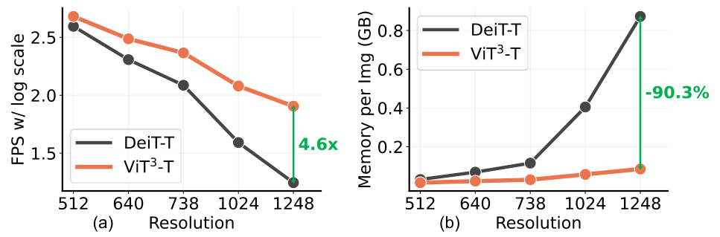
paper
code
ViT³: A Test-Time Training Architecture
Scales more efficiently in throughput and memory consumption
4.6×
speedup over DeiT-T
at 1248² resolution
−90.3%
GPU memory
consumption
per image
Figure 4: (a) FPS on RTX3090, (b) per-image GPU memory usage (from the paper)
6,084 tokens per image at 1248².
Linear time and memory complexity keeps
ViT³ efficient as resolution grows.
Han et al. ViT³: Unlocking Test-Time Training in Vision, CVPR 2026 (Oral)
16

Slide 17
paper
code
Take-away Messages
Test-Time Training Model: A new paradigm
They present the first systematic empirical study of Test-Time
Training designs for vision
They offer six practical insights for building effective yet efficient
TTT modules, with detailed analyses of the TTT design space
They build Vision Test-Time Training (ViT³), a pure TTT baseline
with linear complexity, competitive across three visual tasks
17

Slide 18
Thank you!
Paper
Code
arXiv:2512.01643
github.com

