Slide 1
Personal Voice Assistant
TS- AI TRACK CAPSTONE PROJECT
Presented By:
1.A.V.D.Narishma
2.L.Sailaja
3.A.J.R.Maheswari
4.D.N.S.Deepika
Guided by: Mr. Raja

Slide 2
OUTLINE
Abstract
Problem Statement
Aims , Objective & Proposed System/Solution
System Design
System Development Approach(Technology Used)
Algorithm & Deployment
Conclusion
References
Future Scope

Slide 3
Abstract
In this modern era, day to day life became smarter and interlinked with technology. We already know some voice assistance like google, Siri. etc. Now in our voice assistancesystem, it can act as a basic medical prescriber, daily schedule reminder, note writer, calculatorand a search tool. This project works on voice input and give output through voice and displaysthe text on the screen.
The main agenda of our voice assistance makes people smart and give instant and computedresults. The voice assistance takes the voice input through our microphone (Bluetooth and wired microphone) and it converts our voice into computer understandable language gives the required solutions and answers which are asked by the user
This assistance connects with the world wide web to provide results that the user has questioned. Natural Language Processing algorithm helps computer machines to engage in communication using natural human language in many forms.

Slide 4
Problem Statement
To create a simple personal AI assistant,one simply needs dedicated software and
around an hour of working time.
Artificial Intelligence personal assistants have become plentiful over the last few years,
Applications such as Siri, Bixby, Ok Google and Cortana make mobile device users’ daily
routines that much easier. You may be asking yourself how these functions. Well, the
assistants receive external data (such as movement, voice, light, GPS readings, visually
defined markers, etc.) via the hardware’s sensors for further processing - and take it
from there to function accordingly.

Slide 5
Proposed Solution
To make the peoples task simple.
To help the blind people with the help of this they can easily retrives what they want without taking someone help.
The Solution behind voice assistant it brings AI and machine learning together to
recognize our voice and do what we ask it.
Also it is available to everyone because Voice assistant software can be found on smart speakers, smartwatches, mobile phones, tablets and other devices.
Through simple voice commands, we can ask them to play music, read the news, control our electronic devices, check our bank balance and carry out other tasks.

Slide 6
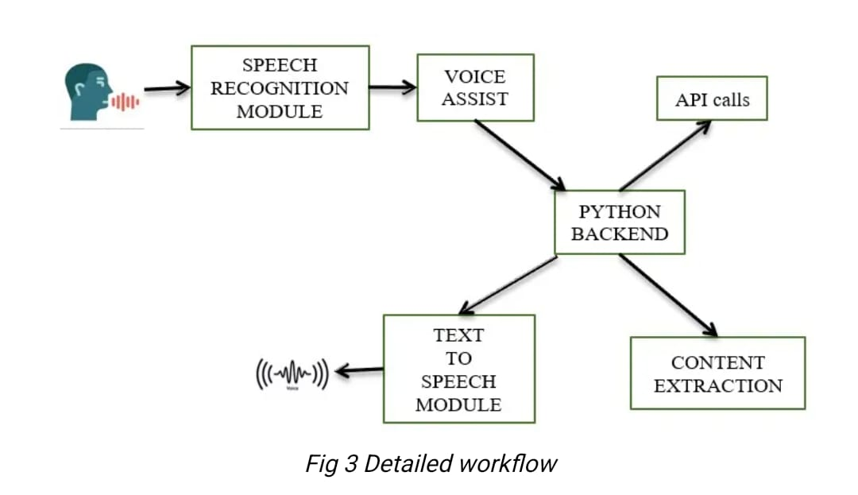
System Architecture

Slide 7
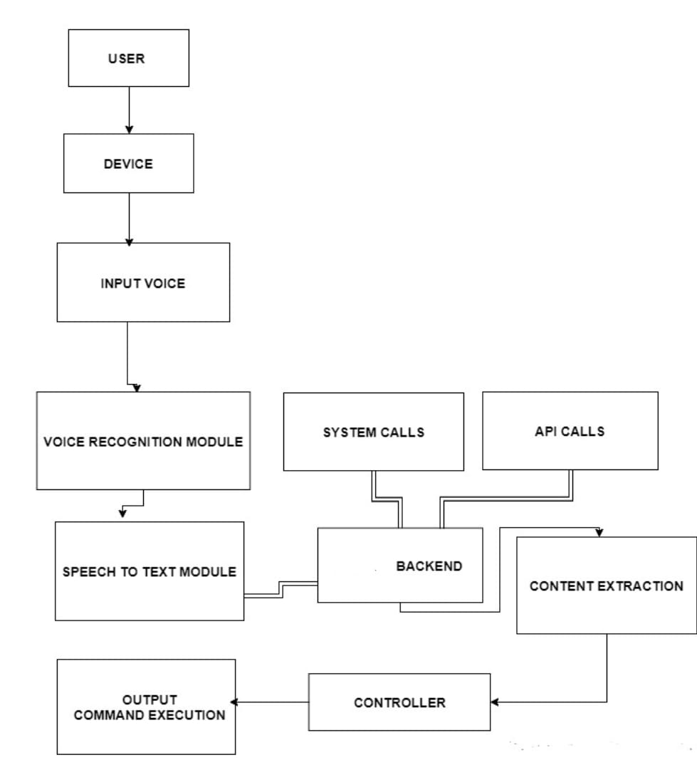
System Deployment Approach

Slide 8
Algorithm & Deployment
Natural Language Processing
Virtual assistants use natural language processing (NLP) to match user text or voice input to executable commands.
NLP is the driving technology that allows machines to understand and interact with human speech, but is not limited to voice interactions.
NLP algorithms are typically based on machine learning algorithms. Instead of hand-coding large sets of rules, NLP can rely on machine learning to automatically learn these rules by analyzing a set of examples (i.e. a large corpus, like a book, down to a collection of sentences), and making a statistical inference.
It giving computers the ability to understand text and spoken words in much the same way human beings can.

Slide 9
Conclusion
Voice Controlled Personal Assistant System will use the Natural language processing and can be integrated with Machine learning techniques to achieve a smart assistant that can perform action on various applications and will make human life comfortable.
The system will have the following phases: Data collection in the form of voice; Voice analysis and conversion to text; Data storage and processing; generating speech from the processed text output.
This application will also make life easier for those who are physically disabled and every common user who is fascinated by voice recognition
Academically, raising awareness for systems like this for students can give them better understanding of topics like Artificial Intelligence, Neural Networks, Natural Language Processing, Machine Learning and Human Computer Interaction and also how to improve user experience in application development.

Slide 10
Future Scope
To build a robust speech recognition experience, the artificial intelligence behind it must become better at handling challenges such as accents and background noise. And, as consumers are becoming increasingly more comfortable and reliant upon using voice to talk to their phones, cars, smart home devices, etc.,
The main reason that the user wants to use the voice assistant is to make their life easier, so by implementing the below mentioned features the user can be facilitated..
Developing for different languages and different accents
Portability for any environment.
Voice authentication technology can be implemented for more security.
Deploy on web using flask or Django

Slide 11
References
DOUGLAS O’SHAUGHNESSY, SENIOR MEMBER, IEEE, “Interacting With Computers by Voice: Automatic Speech Recognition and Synthesis” proceedings of THE IEEE, VOL. 91, NO. 9, SEPTEMBER 2003
Nil Goksel-Canbek2 Mehmet EminMutlu,”On the track of Artificial Intelligence: Learning with Intelligent Personal Assistant” International Journal of Human Sciences, 13(1), 592-601. doi:10.14687/ijhs.v13i1.3549.
Easwara Moorthy, A., Vu, K.-P.L.: Privacy Concerns for Use of Voice Activated Personal Assistant in the Public Space. International Journal of Human-Computer Interaction 31, 307–335 (2015)
Tsiao, J.C.-S., Tong, P.P., Chao, D.Y.: NaturalLanguage Voice-Activated Personal Assistant, United States Patent (10), Patent No.: US 7,216,080 B2(45), 8 May 2007
Gong, L.: San Francisco, CA (US) United States US 2003.01671.67A1(12) Patent Application Publication c (10) Pub. No.: US 2003/0167167 A1 Gong (43) Pub. Date: 4 September 2003 for Intelligent Virtual Assistant

Slide 12
THANK YOU

