Slide 1
STAT 453: Introduction to Deep Learning and Generative Models
Ben Lengerich
Lecture 21: GPT Architectures
November 17, 2025
Reading: See course homepage

Slide 2
From RNN…
Image source: Sebastian Raschka, Vahid Mirjalili. Python Machine Learning. 3rd Edition. Packt, 2019
Ben Lengerich © University of Wisconsin-Madison 2025

Slide 3




From RNN…to GPT
$$x^{t+1}$$
$$x^{t}$$
$$x^{t+1}$$
$$x^{t+2}$$
Image source: Sebastian Raschka, Vahid Mirjalili. Python Machine Learning. 3rd Edition. Packt, 2019
Ben Lengerich © University of Wisconsin-Madison 2025

Slide 4
From RNN…to GPT…by Transformers
Vaswani, A., Shazeer, N., Parmar, N., Uszkoreit, J., Jones, L., Gomez, A.N., Kaiser, L. and Polosukhin, I., 2017. Attention Is All You Need.
Image source: Sebastian Raschka, Vahid Mirjalili. Python Machine Learning. 3rd Edition. Packt, 2019
Ben Lengerich © University of Wisconsin-Madison 2025

Slide 5
From RNN…to GPT…by Transformers
$$x^{t+1}$$
$$x^{t}$$
$$x^{t+1}$$
$$x^{t+2}$$
Vaswani, A., Shazeer, N., Parmar, N., Uszkoreit, J., Jones, L., Gomez, A.N., Kaiser, L. and Polosukhin, I., 2017. Attention Is All You Need.
Image source: Sebastian Raschka, Vahid Mirjalili. Python Machine Learning. 3rd Edition. Packt, 2019
Ben Lengerich © University of Wisconsin-Madison 2025

Slide 6
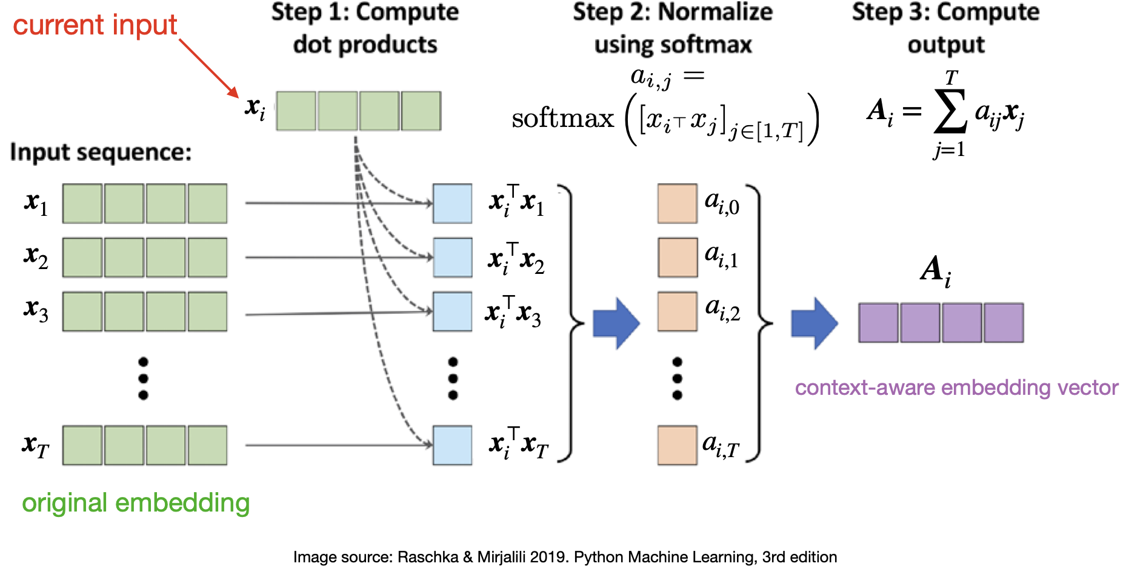
Self-attention (very basic form)
No learnable parameters?
Ben Lengerich © University of Wisconsin-Madison 2025

Slide 7
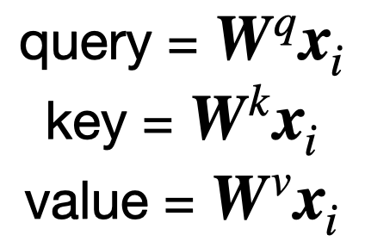
Learnable Self-attention
Previous basic version did not involve any learnable parameters, so not very useful for learning a language model
We are now adding 3 trainable weight matrices that are multiplied with the input sequence embeddings
Ben Lengerich © University of Wisconsin-Madison 2025

Slide 8
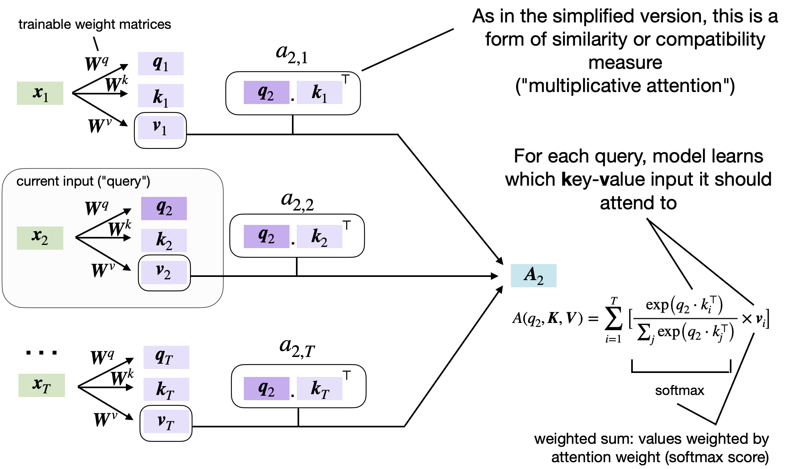
Learnable Self-attention
Ben Lengerich © University of Wisconsin-Madison 2025

Slide 9
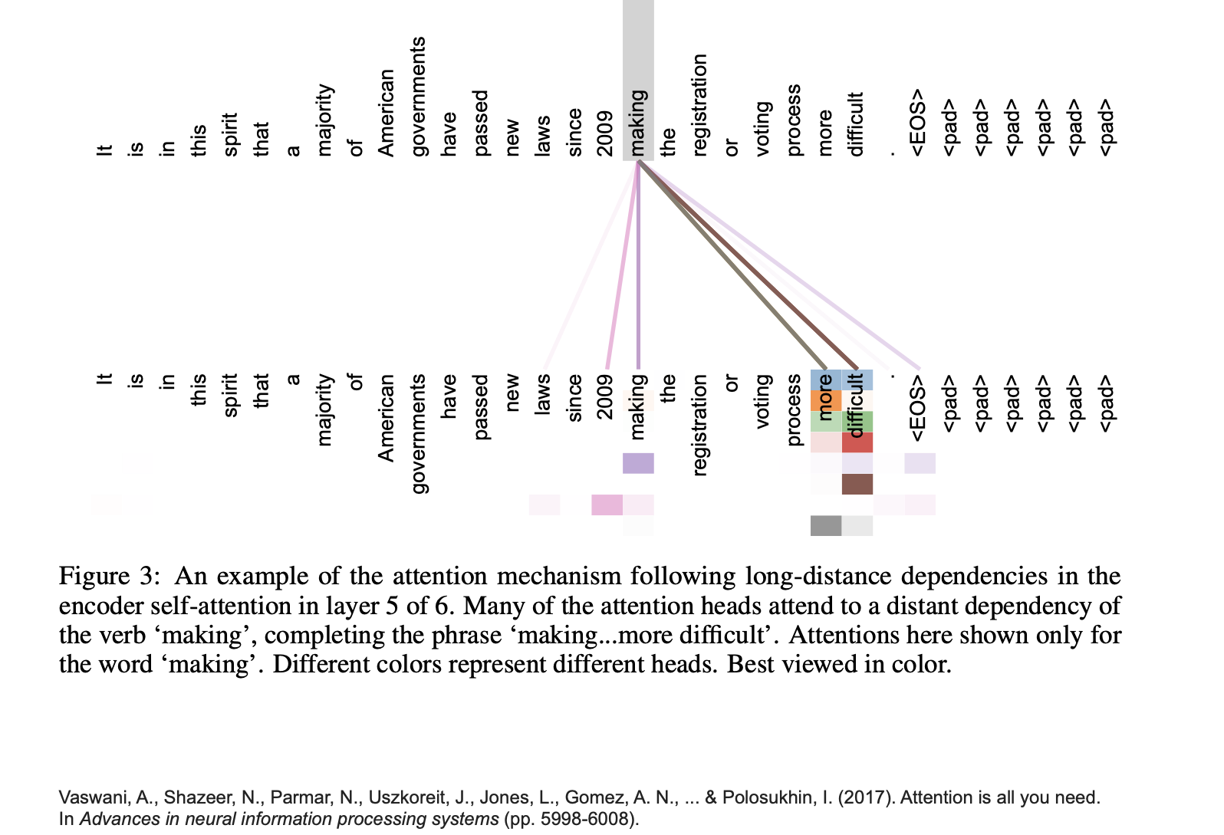
At the end of the day…
Ben Lengerich © University of Wisconsin-Madison 2025

Slide 10
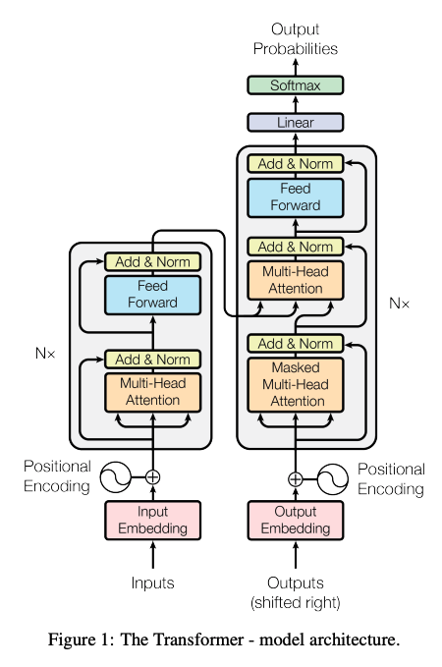
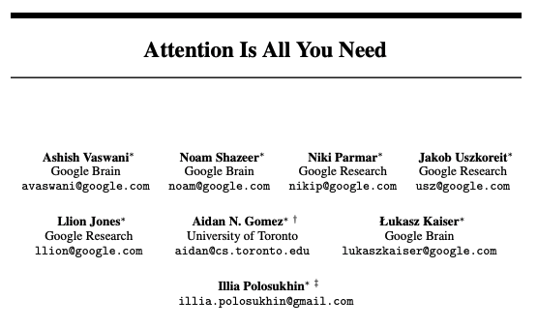
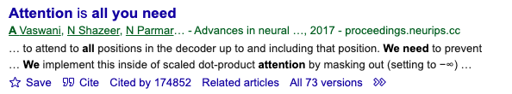
The ”Transformer”
Ben Lengerich © University of Wisconsin-Madison 2025

Slide 11
Many variants of transformer architectures
Ben Lengerich © University of Wisconsin-Madison 2025

Slide 12
Many variants of transformer architectures
Some early transformer architectures
GPT-v1: Generative Pre-Trained Transformer
BERT: Bidirectional Encoder Representations from Transformers
GPT-v2: Language Models are Unsupervised Multitask Learners
GPT-v3: Language Models are Few-Shot Learners
BART: Combining Bidirectional and Auto-Regressive Transformers
Closing Words -- The Recent Growth of Language Transformers
Ben Lengerich © University of Wisconsin-Madison 2025

Slide 13
Today: GPT
Generative Pre-Trained Transformer
Ben Lengerich © University of Wisconsin-Madison 2025

Slide 14
From Transformer to GPT

Slide 15
Recall the ”Transformer”
Ben Lengerich © University of Wisconsin-Madison 2025

Slide 16
Recall the ”Transformer”
Original Transformer (Vaswani et al., 2017):
Encoder-decoder architecture for sequence-to-sequence tasks
Parallelizable self-attention instead of recurrence
Positional encodings enable order sensitivity
Encoder: Processes input sequence
Decoder: Generates output sequence using masked attention + encoder output
Inspired by machine translation (observe full input sequence, predict full output sequence)
Ben Lengerich © University of Wisconsin-Madison 2025

Slide 17
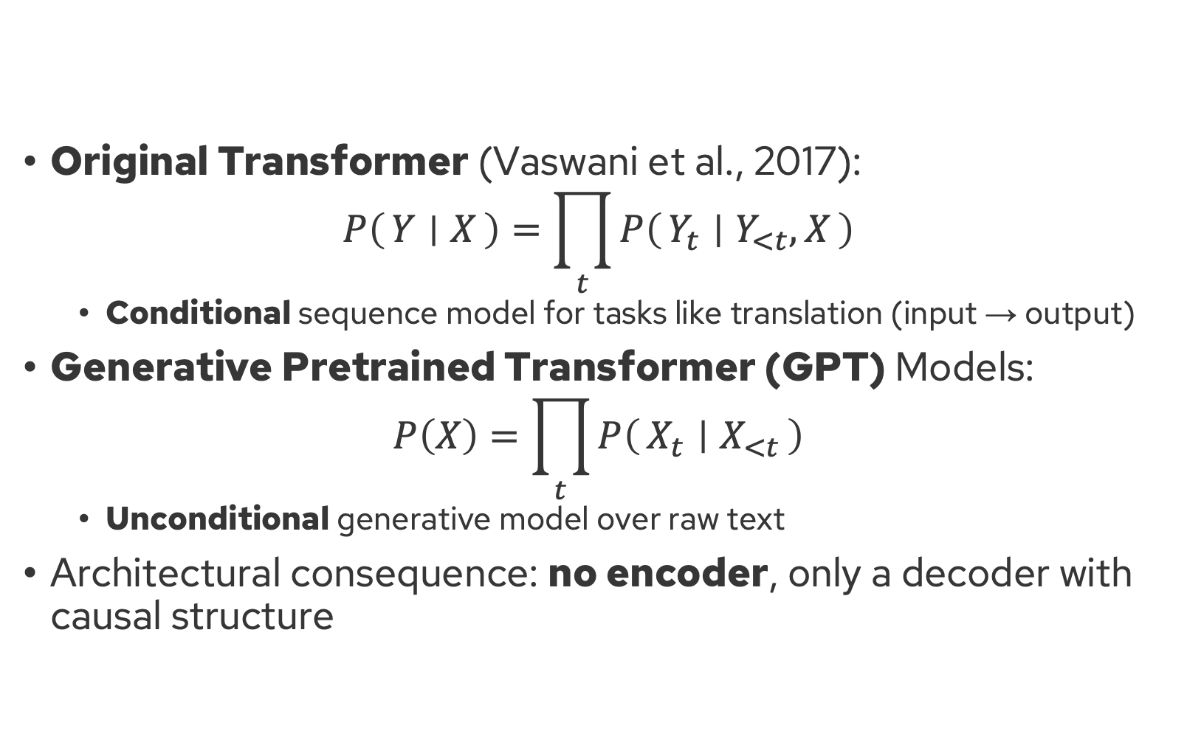
From Sequence Transduction to Sequence Modeling
Original Transformer (Vaswani et al., 2017):
$$P\left(Y ∣ X\right)=\prod_{t}{P\left(Y_{t} ∣ Y_{<t}, X\right)}$$
Conditional sequence model for tasks like translation (input → output)
Generative Pretrained Transformer (GPT) Models:
$$P\left(X\right)=\prod_{t}{P\left(X_{t} ∣ X_{<t}\right)}$$
Unconditional generative model over raw text
Architectural consequence: no encoder, only a decoder with causal structure
Ben Lengerich © University of Wisconsin-Madison 2025

Slide 18

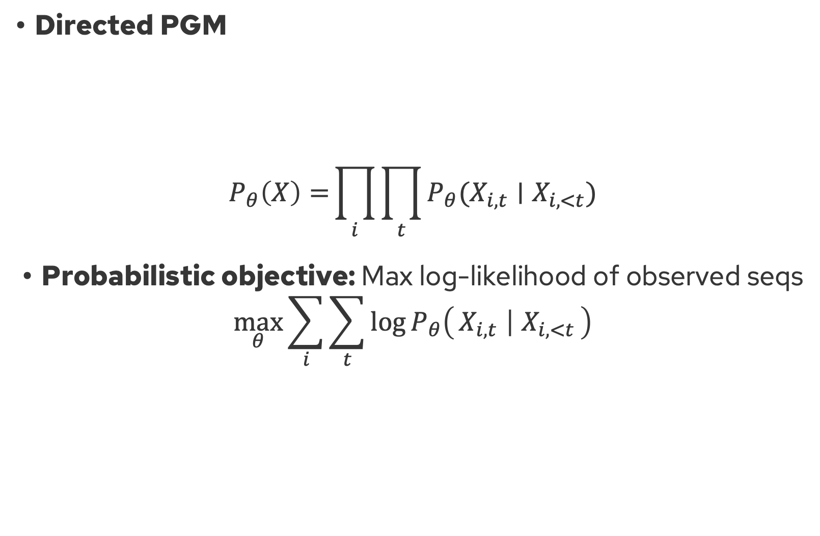



GPT = Probabilistic Model + Transformer Decoder
Directed PGM
$$P_{θ}\left(X\right)={\prod_{i}{\prod_{t}{P_{θ}(X_{i,t}∣X_{i,<t})}}}$$
Probabilistic objective: Max log-likelihood of observed seqs
$$\max_{θ}{\sum_{i}{\sum_{t}{\log{P_{θ}\left(X_{i,t} ∣ X_{i,<t}\right)}}}}$$
$$X_{1}$$
$$X_{2}$$
…
$$X_{T−1}$$
$$X_{T}$$
[Radford et al., Improving Language Understanding by Generative Pre-Training]
Ben Lengerich © University of Wisconsin-Madison 2025

Slide 19

GPT = Probabilistic Model + Transformer Decoder
Directed PGM
$$P_{θ}\left(X\right)={\prod_{i}{\prod_{t}{P_{θ}(X_{i,t}∣X_{i,<t})}}}$$
Model structure:
Input: token embeddings + positional encodings
Masked multi-head attention: Enforces “causality”
Decoder stack: Learns $P(X_{t}∣X_{<t})$
Output: softmax over vocabulary
$$X_{1}$$
$$X_{2}$$
…
$$X_{T−1}$$
$$X_{T}$$
[Radford et al., Improving Language Understanding by Generative Pre-Training]
Ben Lengerich © University of Wisconsin-Madison 2025

Slide 20
Let’s write a GPT

Slide 21
Let’s write a GPT
EasyGPT repo
Adapted from Andrej Karpathy’s nanoGPT
Ben Lengerich © University of Wisconsin-Madison 2025

Slide 22
From our “GPT” to GPT-4

Slide 23
From our “GPT-0” to GPT-1
Architecture:
Tokenizer: Characters → “Byte-Pair Encoder” tokenizer
Activation: ReLU → GELU
Weight sharing for embedding / output
Scale (117M params):
Layers: 4 → 12
Attention Heads: 4 → 12
Block size (max context): 32 → 512
Vocab: 65 → 40000 BPE tokens
Embedding dim: 64 → 768
Training:
Dataset: TinyShakespeare (1MB) → BookCorpus (5GB)
Initialization & normalization: Default → Carefully tuned
Optimizer: Vanilla Adam → Adam + learning rate warmup + weight decay
Inference:
Sampling: Greedy → Top-k
Ben Lengerich © University of Wisconsin-Madison 2025

Slide 24
From GPT-1 to GPT-2
GPT-2: [Radford et al., Language Models are Unsupervised Multitask Learners]
Architecture:
Scale: Variety of options, with biggest (1.5B params):
Layers: 12 → 48
Attention Heads: 12 → 25
Embedding Dim: 768 → 1600
Block size (max context): 512 → 1024
Vocab: 40k → 50k tokens
Training:
Dataset: BookCorpus (5GB) → WebText (40GB)
You can reproduce GPT-2 yourself:
https://github.com/karpathy/nanoGPT
(takes 4 days to train on an 8xA100 machine)
Ben Lengerich © University of Wisconsin-Madison 2025

Slide 25
From GPT-2 to GPT-3
Architecture:
Scale (1.5B → 175B params):
Block size (max context): 1024 → 2048
Layers: 48 → 96
Embedding Dim: 1600 → 12,288
Attention Heads: 25 → 96
Training:
Dataset: WebText (40GB) → Common Crawl + books, Wikipedia, code, etc. (~570GB)
GPT-3: [Brown et al., Language Models are Few-Shot Learners]
Ben Lengerich © University of Wisconsin-Madison 2025

Slide 26
From GPT-3 to GPT-4?
Architecture:
Likely includes MoE
Tokenizer: Includes image patches for multi-modal
Scale:
Total parameters: 175B → Likely >1T
Block size (max context): 2048 → 128k
Training:
Dataset: Common Crawl + books, Wikipedia, code, etc. (~570GB) → Larger, undisclosed data training. Reported 13T tokens (~50TB)
Alignment: Reinforcement learning + human feedback + system-level “safety”
Ben Lengerich © University of Wisconsin-Madison 2025

Slide 27
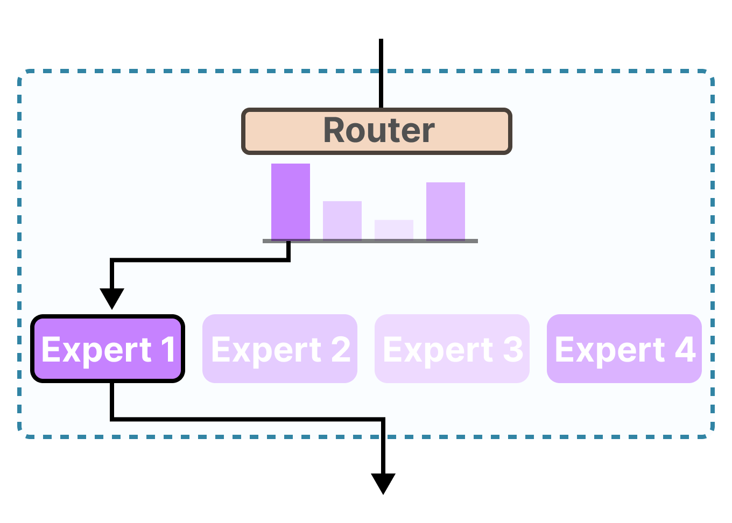
Mixture of Experts
[Grootendorst]
Ben Lengerich © University of Wisconsin-Madison 2025

Slide 28
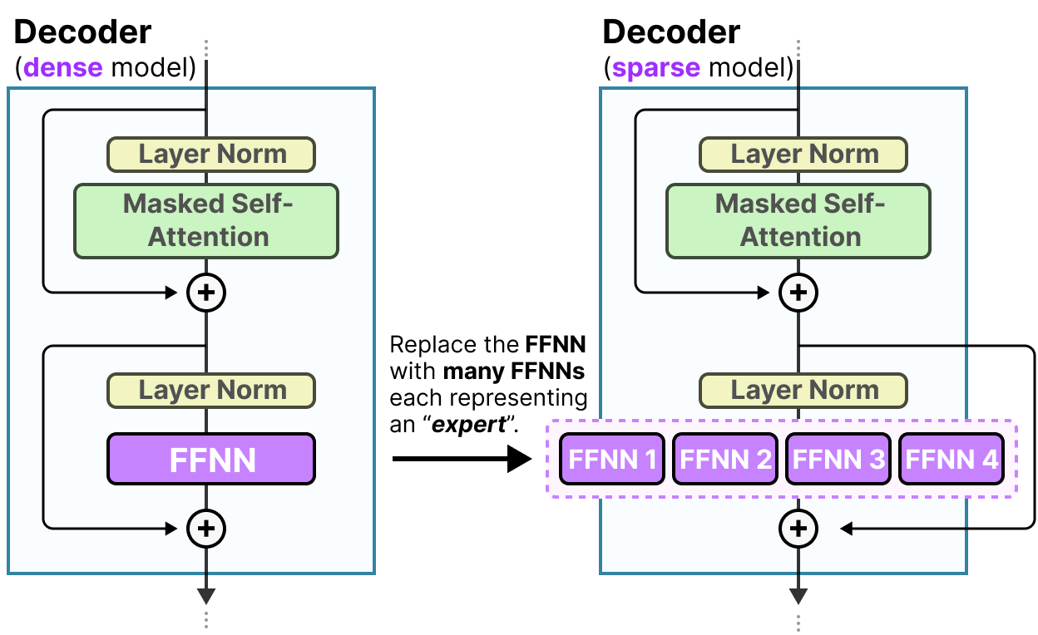
Mixture of Experts inside Transformer Decoder
[Grootendorst]
Ben Lengerich © University of Wisconsin-Madison 2025

Slide 29
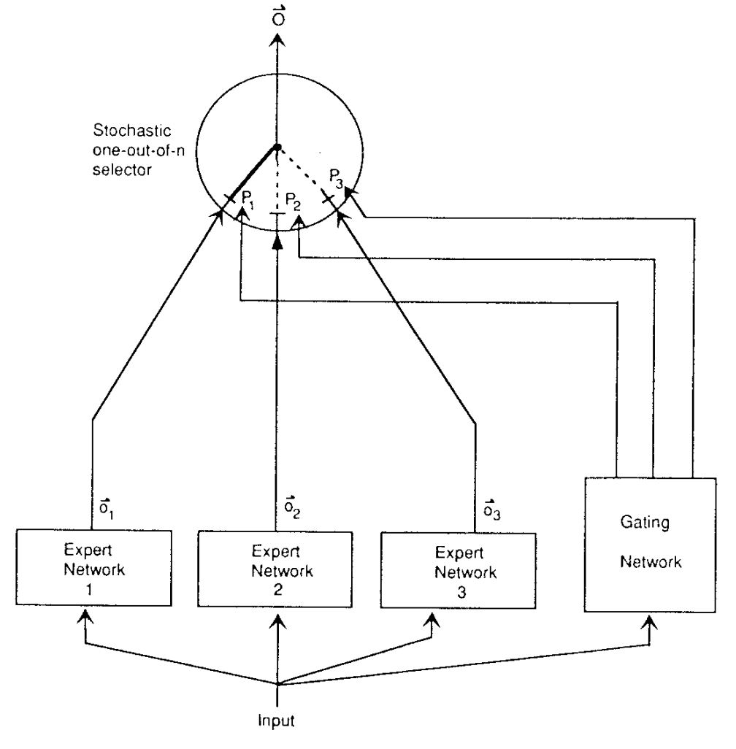
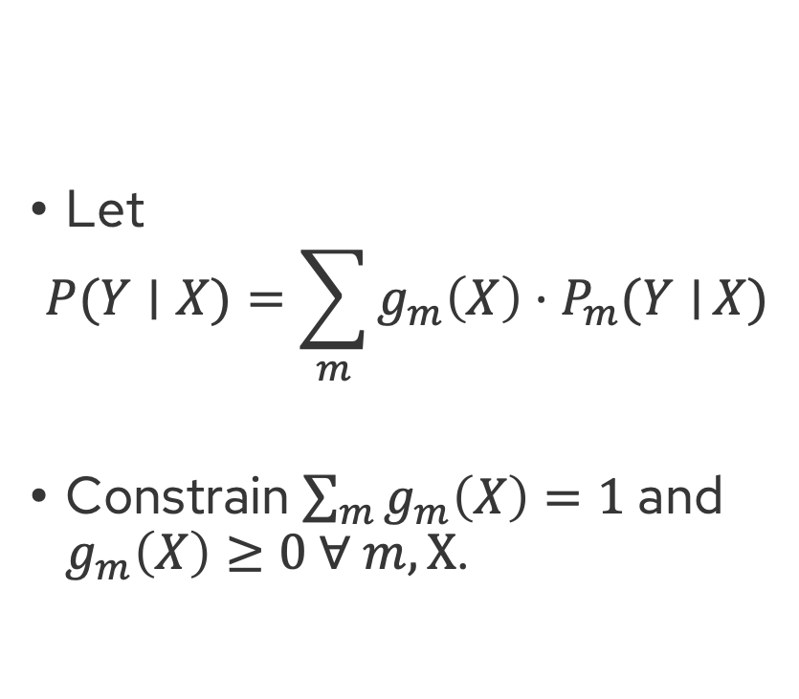
Mixture of Experts: A probabilistic idea
Let
$$P(Y∣X)=\sum_{m}{g_{m}\left(X\right)⋅P_{m}(Y∣}X)$$
Constrain $\sum_{m}{g_{m}\left(X\right)=1}$ and $g_{m}\left(X\right)≥0 ∀ m,X$.
How would you estimate these parameters?
[Hierarchical mixtures of experts and the EM algorithm, 1993]
“Adaptive Mixtures of Local Experts” Jacobs et al 1991
Ben Lengerich © University of Wisconsin-Madison 2025

Slide 30
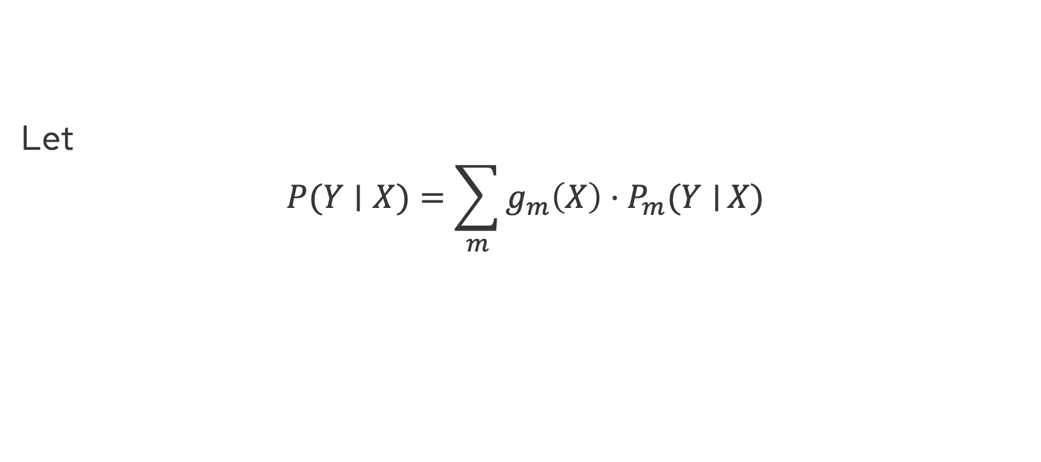
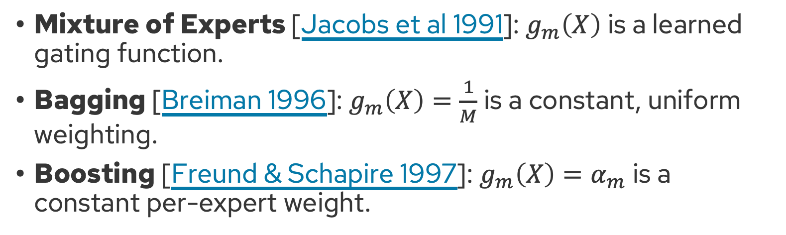
Mixture of Experts: Unifies Several Approaches
Let
$$P(Y∣X)=\sum_{m}{g_{m}\left(X\right)⋅P_{m}(Y∣}X)$$
Mixture of Experts [Jacobs et al 1991]: $g_{m}\left(X\right)$ is a learned gating function.
Bagging [Breiman 1996]: $g_{m}\left(X\right)=\frac{1}{M}$ is a constant, uniform weighting.
Boosting [Freund & Schapire 1997]: $g_{m}\left(X\right)=α_{m}$ is a constant per-expert weight.
Ben Lengerich © University of Wisconsin-Madison 2025

Slide 31
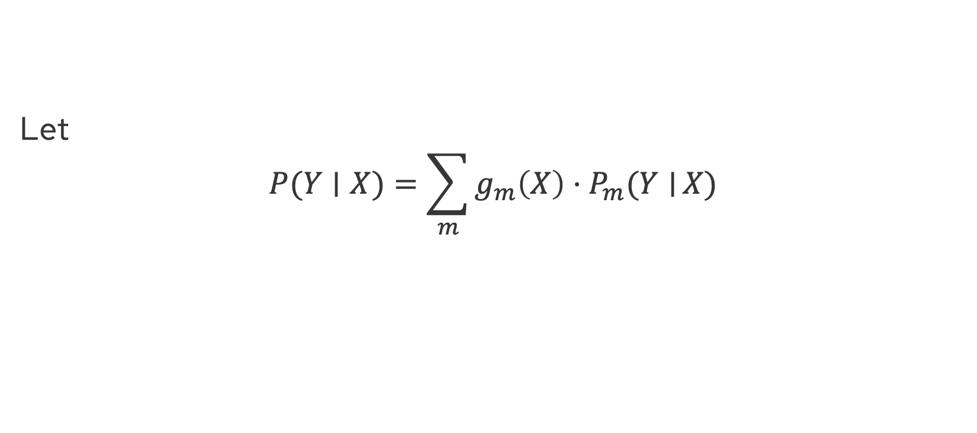
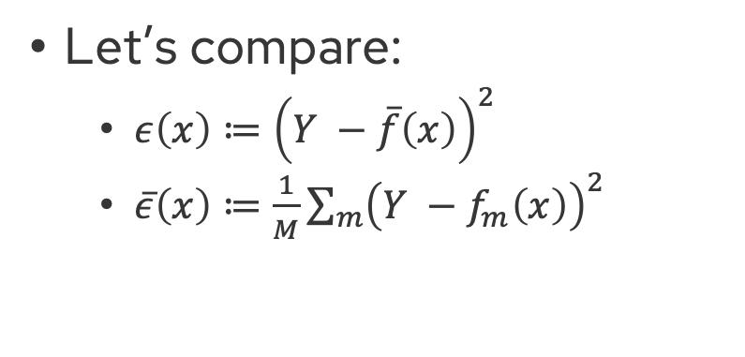
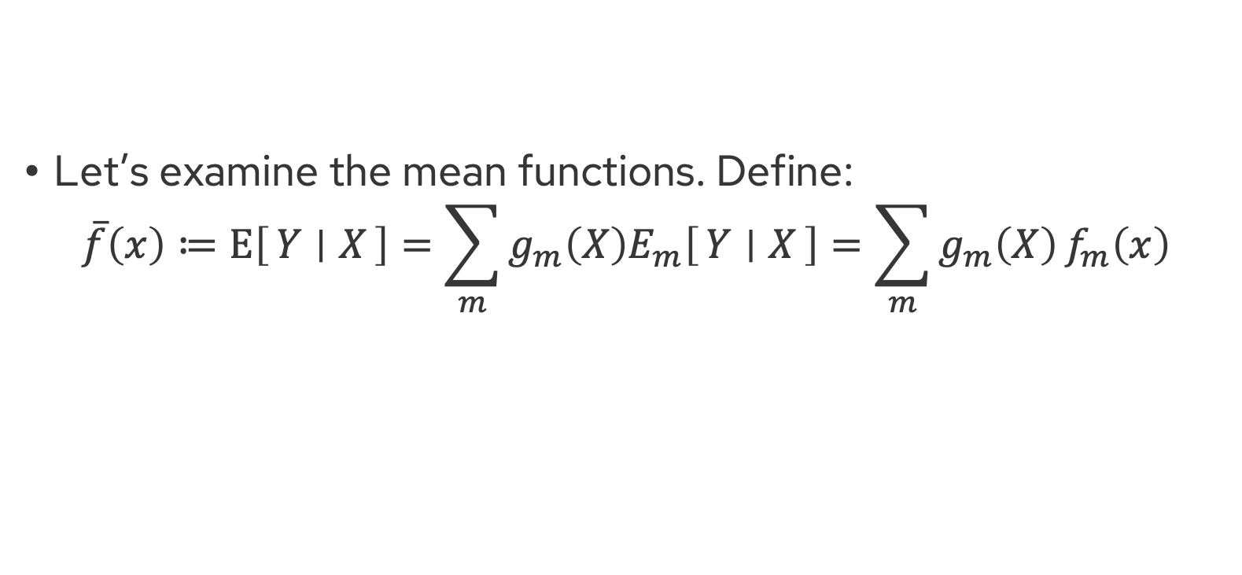
Mixture of Experts: Some analysis
Bonus
Let
$$P(Y∣X)=\sum_{m}{g_{m}\left(X\right)⋅P_{m}(Y∣}X)$$
Let’s examine the mean functions. Define:
$$\overline{f}\left(x\right)≔E\left[Y ∣ X\right]=\sum_{m}{g_{m}\left(X\right){E_{m}\left[Y ∣ X\right]=\sum_{m}{g_{m}\left(X\right)}f}_{m}\left(x\right)}$$
Let’s compare:
$ε\left(x\right)≔{\left(Y −\overline{f}\left(x\right)\right)}^{2}$
$\overline{ε}\left(x\right)≔\frac{1}{M}\sum_{m}{{\left(Y −f_{m}\left(x\right)\right)}^{2}}$
“Ensemble error”
“Average expert error”
Will these be minimized for the same ensemble?
Ben Lengerich © University of Wisconsin-Madison 2025

Slide 32
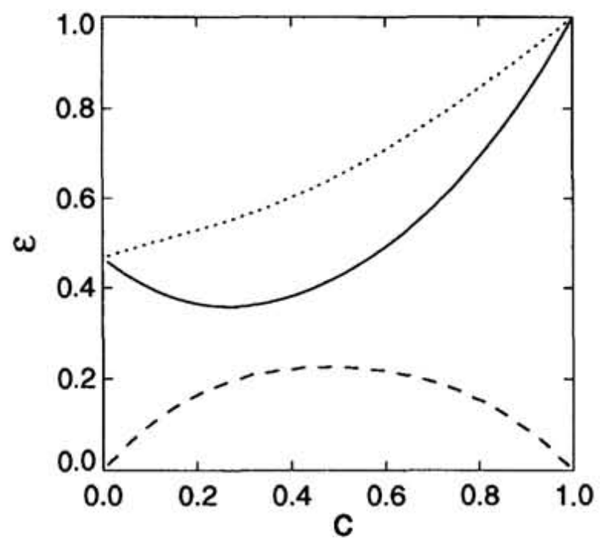
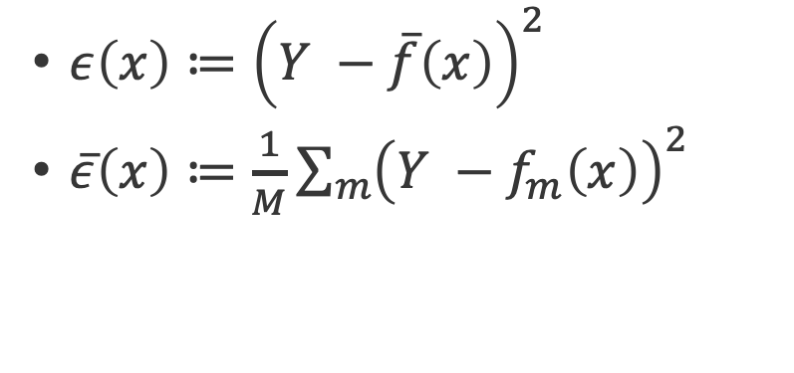
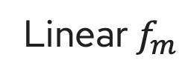
Mixture of Experts: Some analysis
Bonus
Linear $f_{m}$
$ε\left(x\right)≔{\left(Y −\overline{f}\left(x\right)\right)}^{2}$
$\overline{ε}\left(x\right)≔\frac{1}{M}\sum_{m}{{\left(Y −f_{m}\left(x\right)\right)}^{2}}$
“Ensemble error”
“Average expert error”
Diversity in Experts
(% Unique Training Data)
[Sollich & Krogh 1995]
Ben Lengerich © University of Wisconsin-Madison 2025

Slide 33
Mixture of Experts: Some analysis
Bonus
Linear $f_{m}$
$ε\left(x\right)≔{\left(Y −\overline{f}\left(x\right)\right)}^{2}$
$\overline{ε}\left(x\right)≔\frac{1}{M}\sum_{m}{{\left(Y −f_{m}\left(x\right)\right)}^{2}}$
“Ensemble error”
“Average expert error”
Intuition: Expert errors are wrong in individualized ways and cancel out through consensus.
“Disagreement between experts”
Diversity in Experts
(% Unique Training Data)
→ Slight “overfitting” of experts helps!
[Sollich & Krogh 1995]
Ben Lengerich © University of Wisconsin-Madison 2025

Slide 34
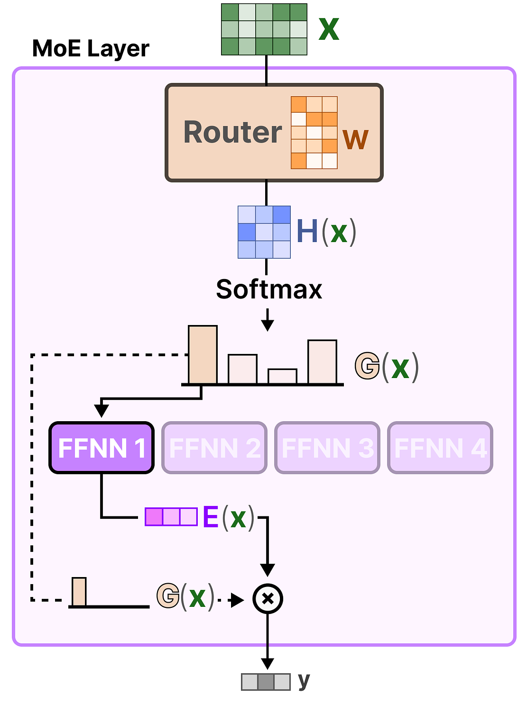
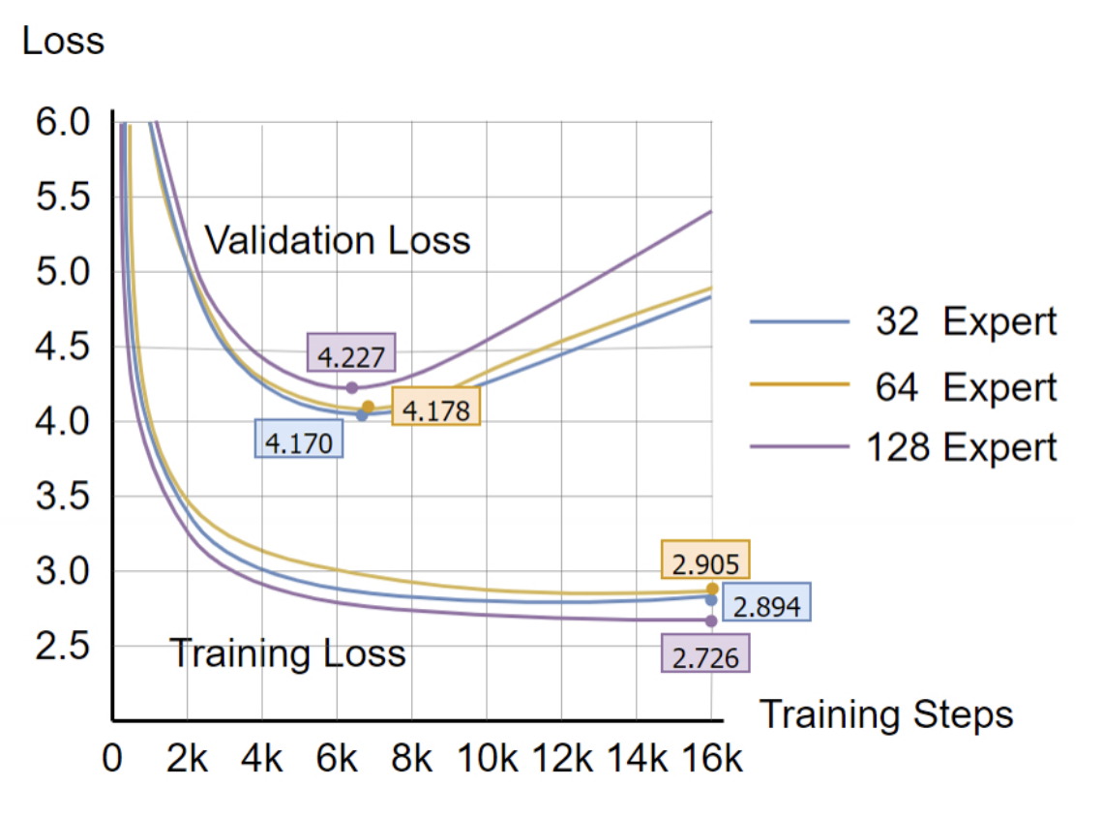
Mixture of Experts: In LLMs
Implications for serving?
Implications for training?
Easy to have experts over-specialize
[Grootendorst]
Ben Lengerich © University of Wisconsin-Madison 2025
[Xie et al 2022]

Slide 35
Summary: From Transformer to GPT
Component | Transformer | GPT
Architecture | Encoder-decoder (full) | Decoder-only
Attention | Full self-attention | Masked (causal) self-attention
Positional encoding | Sinusoidal (original) | Learned positional embeddings
Output | Task-specific | Next-token prediction
Training objective | Flexible (e.g., translation) | Language modeling (autoregressive)
Inference | Depends on task | Greedy / sampling for text gen
Ben Lengerich © University of Wisconsin-Madison 2025

Slide 36
Summary: From GPT-1 to GPT-4
Architecture:
Scale: Variety of options, with biggest (1.5B params → >1T params):
Block size (max context): 512 → 128k
Layers: 12 → >96
Attention Heads: 12 → >96
Embedding Dim: 768 → >12,288
Vocab: 40k → >50k tokens
Tokenizer: Includes image patches for multimodal
Mixture-of-Experts
Training:
Dataset: BookCorpus (5GB) → Private 13T tokens (~50TB)
Reinforcement learning for alignment
Ben Lengerich © University of Wisconsin-Madison 2025

Slide 37
Questions?

