Slide 1
CommunityConnect
SDD(System design document)
Group 5

Slide 2
Overview
Overview
System overview
System Architecture
Hardware Components
Peripherals
Logical And Physical Design
Software Designs
System Interfaces
Data And Database / Files
Data Flow Diagrams
System Performance

Slide 3
DOCUMENT OVERVIEW
This Software Design Document (SDD) outlines the detailed design aspects of the Community Connect platform.
The document covers the software and hardware components, interfaces, and data structures required for the implementation of the platform:
Hardware: Computer Systems, Peripherals, and Networks.
Software: Software Packages, Operating Systems, Application Programming Interfaces, and Database Management Systems.
User Interface Components: The platform's user interface includes interactive components that allow users to engage with features such as event creation, emergency alerts, fundraising campaigns, and community forums.
Audience: software developers, system architects, software engineers, project managers, and stakeholders.
Unified Modeling Language (UML): Use Case Diagrams, Class Diagrams, Sequence Diagrams, Sequence Diagrams and Deployment Diagrams

Slide 4
SYSTEM OVERVIEW
The Community Connect platform serves as a virtual hub that transcends geographical boundaries, enabling users to interact, share ideas, organize events, and respond swiftly to emergent needs through use of features such as event management, emergency alerts, user profiles, and donation processing.
The Community Connect platform interfaces with the following external entities: Users, Emergency Authorities, and Payment Gateways.
The document is tailored for professionals who possess the following skills and expertise: Software Development, Hardware Integration, System Architecture, Database Design, Networking and Security and Privacy.

Slide 5
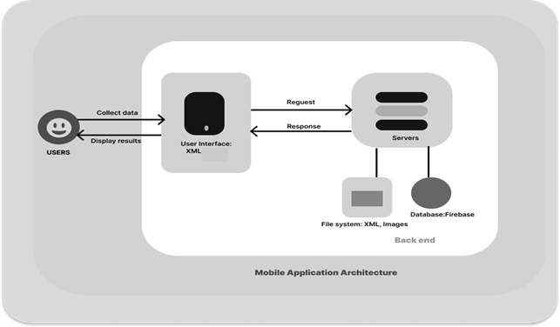
SYSTEM ARCHITECTURE

Slide 6
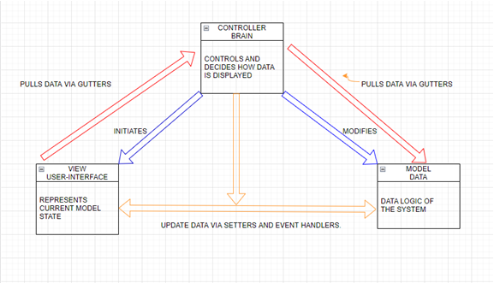

Slide 7
SYSTEM ARCHITECTURE
The architecture is developed to support the platform's diverse functionalities, including community engagement, event management, emergency response, fundraising campaigns, and more. It encompasses both software and hardware components.
The software architecture of the Community Connect platform is structured in a modular and scalable manner: Presentation Layer, Application Layer, Data Layer, and Integration Layer.
The hardware architecture of the Community Connect platform is designed to support the software components and ensure optimal performance, scalability, and reliability.
The hardware architecture encompasses various elements including platforms, networks, peripherals, and their integration: Server Platforms, User Devices, Data Storage and Databases, Peripherals, Integration of Hardware and Software and Servers.

Slide 8
HARDWARE COMPONENTS
The Community Connect platform's hardware design encompasses the following components that contribute to the seamless operation and interaction of the system: Make/Model, Database Servers, Networking Components and Mobile Devices.
The Community Connect platform's computer systems are fundamental to its successful operation, ensuring efficient and reliable hosting of the software application and database:
Platform Types and Hardware Standards
Operating System and Software
Database Management
Performance Optimization
Network Connectivity
Security and Compliance
Monitoring and Management

Slide 9
PERIPHERALS
The Community Connect platform incorporates a variety of peripheral devices and these peripherals facilitate data exchange, storage, and interaction within the system.
The following is a list of peripherals and associated components used in the platform:
Android Devices
Backend Servers
Notification Services
Battery Management
Internet Protocols
Storage Devices
Cameras
Firebase Database
Internet Connectivity

Slide 10
LOGICAL AND PHYSICAL DESIGN
The logical design of hardware integration within the Community Connect platform ensures a coherent and efficient arrangement of hardware components to support the functionalities of the system. The logical design includes: Client-Server Interaction, Data Flow, Push Notifications and Camera Integration
Database Integration
The physical design involves the arrangement of hardware components and the required cabling and connectors to ensure seamless hardware integration within the Community Connect platform. The integration follows these steps: Mobile Devices, Push Notification Devices and cameras
The recovery design includes: Redundancy and Failover, Data Backup and Recovery and Disaster Recovery Planning.

Slide 11
SOFTWARE DESIGNS
The software packages/modules serve as the building blocks of the Community Connect platform, each contributing to its overall functionality and will outline the purpose, functions, implementation, execution location, data definitions, user relationships, and error handling of each of the modules:
User Management Module.
Event Management Module.
Emergency Response Module.
Donation Processing Module
The software integration within the Community Connect platform involves establishing robust linkages and These linkages are designed to ensure efficient data exchange, synchronization, and collaboration among various modules:
User Management and Event Management Integration.
Event Management and Emergency Response Integration.
Notifications Integration

Slide 12
SYSTEM INTERFACES
User Authentication Interface: The User Authentication Interface facilitates communication between the Community Connect platform and the Firebase Authentication service for user authentication and management.
User Post Notification Interface: The User Post Notification Interface connects the Community Connect app with Firebase Cloud Messaging (FCM) to send push notifications for user-generated posts.
Event Data Interface: The Event Data Interface connects the Community Connect app with the Firebase Realtime Database to manage event-related data.
Emergency Notification Interface: The Emergency Notification Interface connects the Community Connect app with Firebase Cloud Messaging (FCM) to send emergency alerts.

Slide 13
DATA AND DATABASE / FILES
The Community Connect platform comprises various software modules that interact with data repositories to deliver its functionalities. Below is an overview of the software modules and their linkages to data repositories:
User Management Module
Event Management Module
Donation Module
Post Creation Module
Notification Module
Admin Dashboard Module

Slide 14
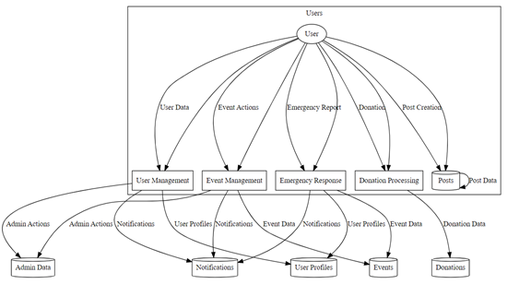
DATA FLOW DIAGRAMS(Summary of top-level (DFD).

Slide 15
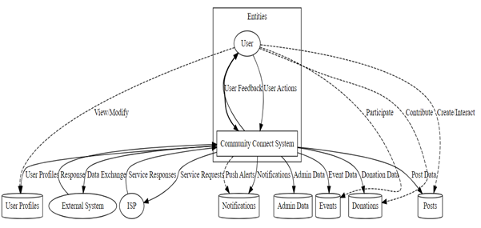
DATA FLOW DIAGRAMS(System level (DFD)

Slide 16
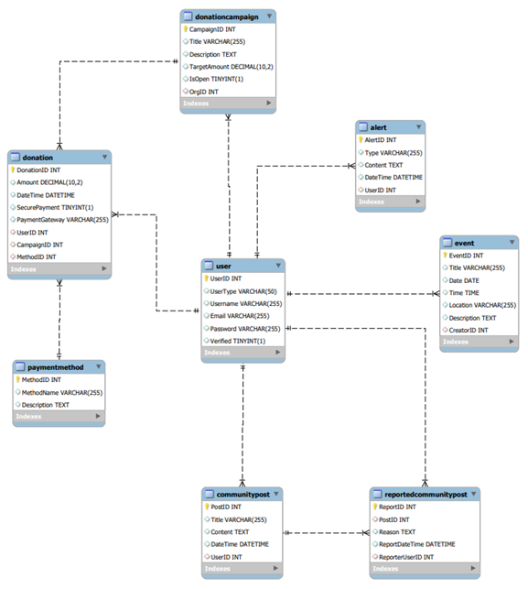
DATABASE DESIGN (ERD)

Slide 17

FILES
The files within the Community Connect app project are organized following a structured directory hierarchy to ensure effective management and maintainability.
/src
/user_management
/event_management
/donation_module
/post_creation
/notification_module
/: Stores resource files including layouts, images, strings, and values.
assets/: Holds additional asset files like fonts, XML.
gradle/: Files related to the Gradle build system.

Slide 18
SYSTEM PERFORMANCE
File and Database Sizes: The file and database sizes depend on factors like the number of users, posts, events, donations, and media content.
System Limits: The system is designed to accommodate a large number of users, posts, events, and donations
Response Time Example: For creating a post, the app's response time should ideally be within 2 seconds.
Capacity Planning: Regularly monitor system usage and performance to ensure that capacity remains within acceptable limits.

