Slide 1

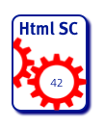
HTML Sanity Checker
Case Study for arc42 Architecture Documentation
Dr. Gernot Starke
https://github.com/aim42/htmlSanityCheck
Notes:
2015.09.19, GS: added „business goal“

Slide 2
Prerequisites
To understand the project & sourcecode
Basic knowledge of HTML (link, anchor, id, URI, ImageMap)
Basic knowledge of Groovy + Gradle
Disclaimer:
This project seriously over-documented
Code is unfinished ☹
https://github.com/aim42/htmlSanityCheck

Slide 3
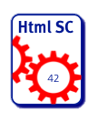
Intro and (Business) Goal
shall support authors
creating digital formats
with hyperlinks and
integration of images and
similar resources.“

Slide 4
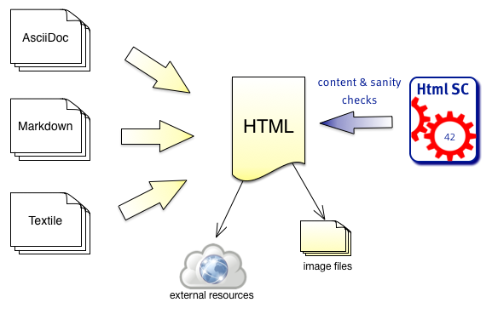
Overview

Slide 5
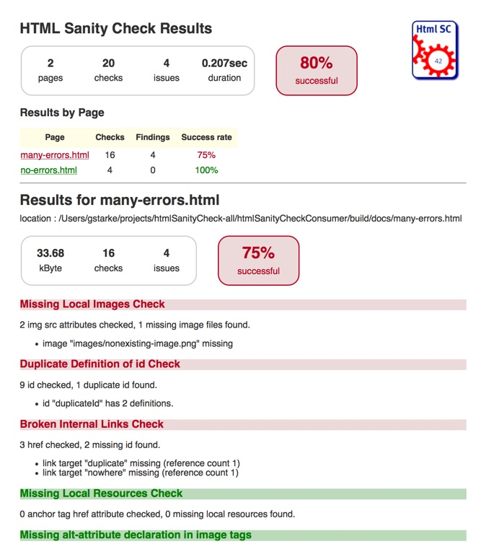
Goal (Output)
HTML report
Summary
Results by page
Minimally styled

Slide 6
Intro (2): What can go wrong...
Common HTML generators* guarantee only syntactic correctness
*: Especially Markdown, AsciiDoc, AsciiDoctor
Potential semantic errors include:
Broken links, i.e.
Broken cross references
Broken imageMaps
Missing images
Ambiguous definitions
Unused resources (i.e. image files)

Slide 7
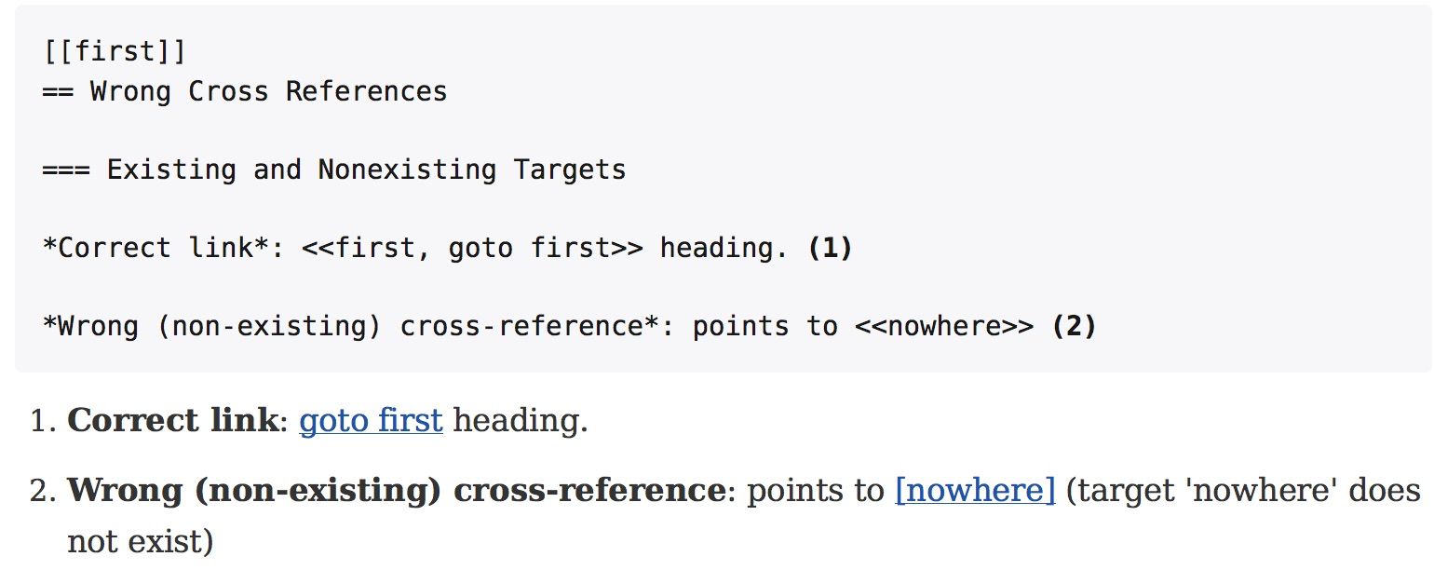
Intro (3): Why can it go wrong?
Markup languages simplify linking.
Generated links sensitive to spelling, typos, renames, deletions

Slide 8
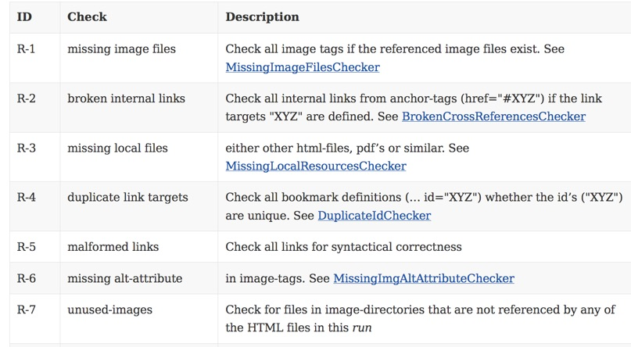
Requirements (1): Checks

Slide 9
Requirements (2), Global
Read HTML file | Shall read HTML file with configurable name / location
Configurable to process multiple files | Shall be configurable for a set of files to be processes in a single run and produce a joint report. Useful for e.g. API documentation with many HTML files referencing each other.
Gradle plugin | Shall be usable as Gradle-plugin
Command line usage | Shall be callable from the command line with minimal prerequisites for installation.
Configurable output
Available on public repository | Like, e.g. Bintray, Jcenter or the Gradle-Plugin-Repository
Include suggestions | In case of e.g. broken cross references, shall provide suggestions what „could have been meant“ (by applying string similarity searches)

Slide 10
Architecture Quality Goals
Priority | Quality Goal | Scenario
1 | Correctness | Every broken internal link (cross reference) is found
1 | Correctness | Every missing local image is found.
1 | Safety | Content of the files to be checked is never altered.
2 | Correctness | Correctness of every checker is automatically tested for positive AND negative cases
3 | Correctness | Every reporting format is tested: Reports must exactly reflect checking results.
3 | Performance | Check of 100kB html file performed under 10 secs (excluding gradle startup)

Slide 11
Constraints
Implement on Java platform
Preferably in Groovy
Runnable as Gradle-plugin without installation*
* except: Java runtime
Available under liberal Open-Source license

Slide 12
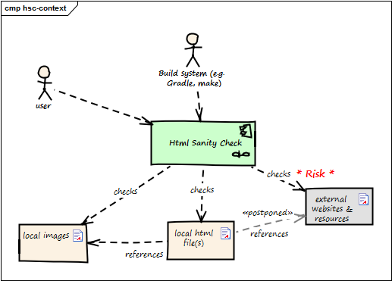
(Business) Context

Slide 13
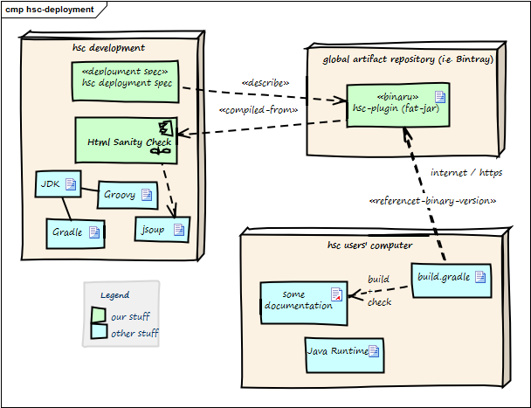
(Technical) Context

Slide 14
Solution Strategy
Use HTML parser with minimal dependencies
Implement in Groovy
Wrapping as Gradle-plugin becomes simple
Apply Template-Method pattern for
Checking algorithms
Report generators
(Details see chap 8: Crosscutting Concepts)

Slide 15
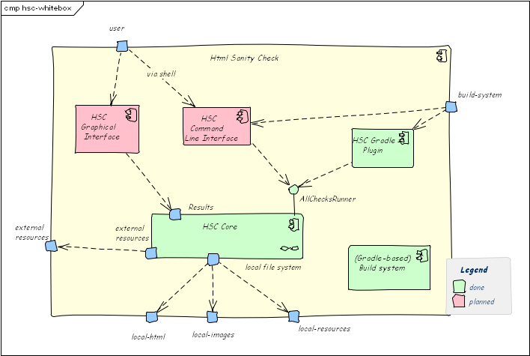
Building Blocks (Level 1)

Slide 16
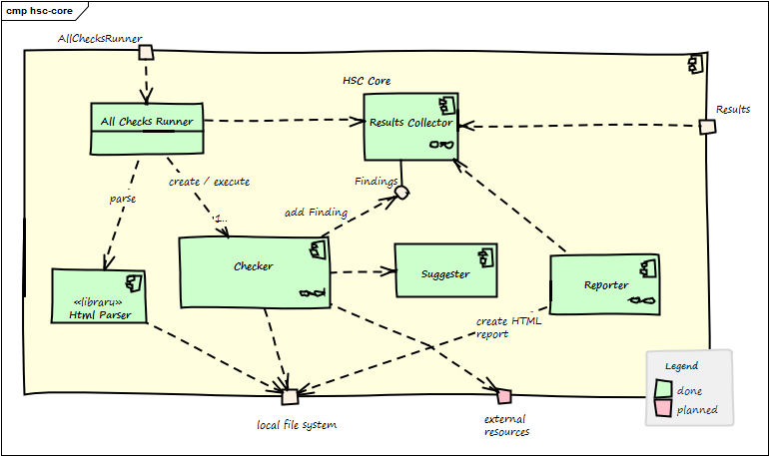
Building Blocks (HSC Core, Level 2)

Slide 17
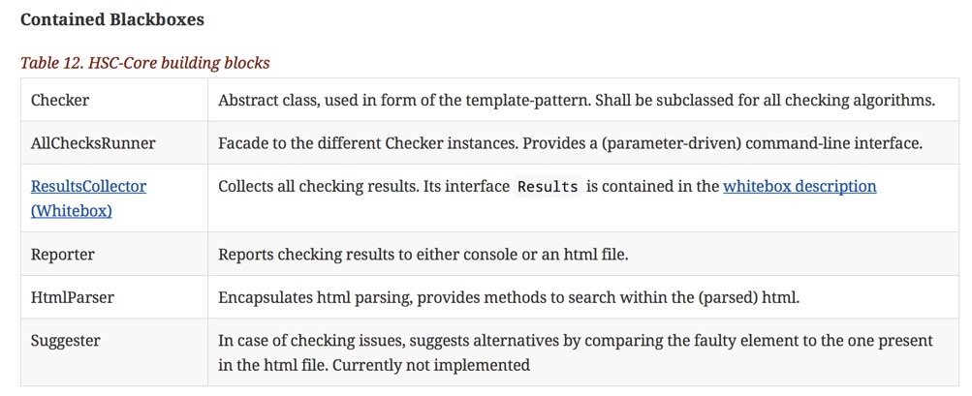
HSC Core, Level 2 (ff)

Slide 18
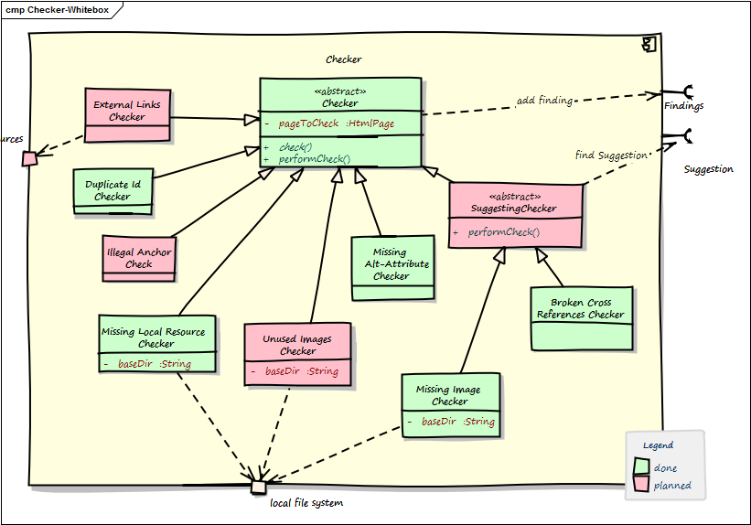
Building Blocks (Checker, Level 3)

Slide 19
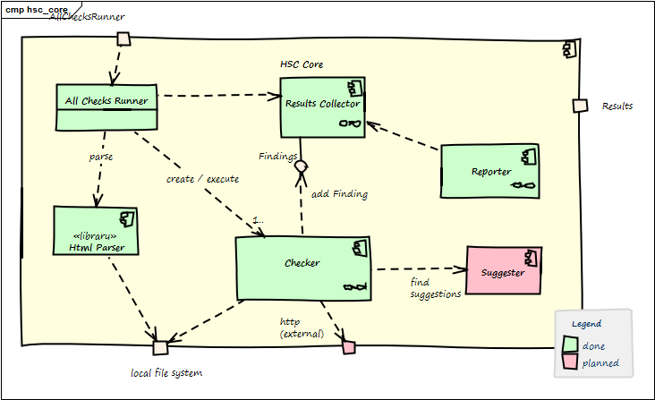
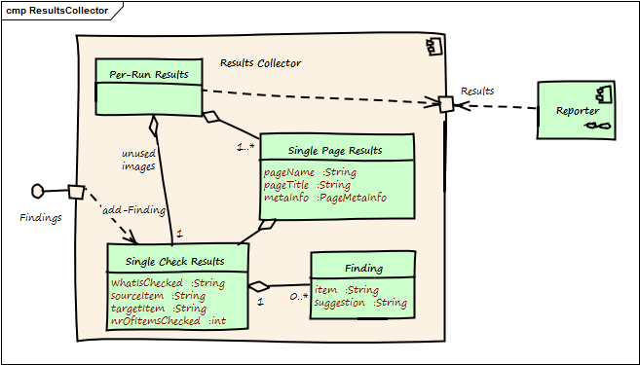
Building Blocks (ResultsCollector, L.3)

Slide 20
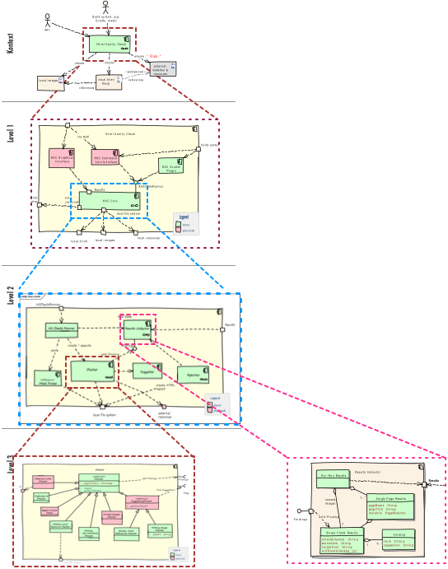
Building Blocks Hierarchy
Gradle sub-projects:
core: org.aim42.htmlsanitycheck
gradle-plugin: org.aim42.htmlsanitycheck
Packages:
o.a.h.check
o.a.h.collect
o.a.h.html
o.a.h.report
Classes:
AllChecksRunner
MissingConfigException
Classes:
Checker.groovy
ImageMapChecker
MissingImageFilesChecker

Slide 21
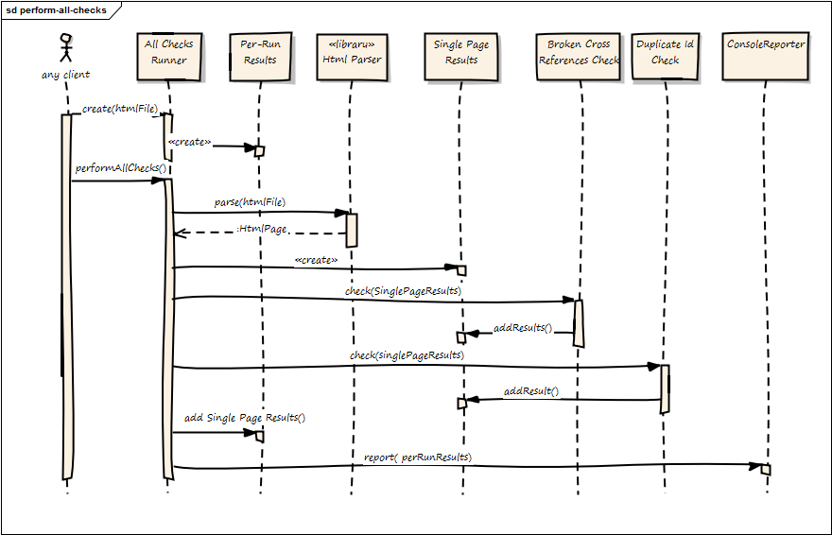
Runtime (perform all checks)

Slide 22
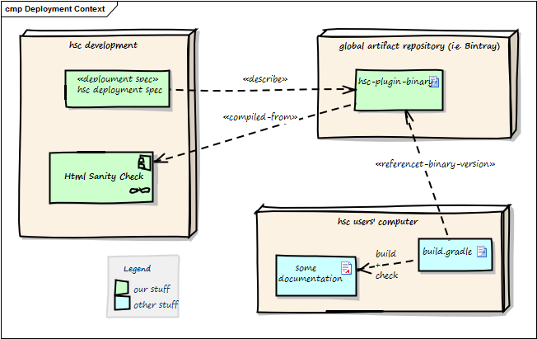
Deployment

Slide 23
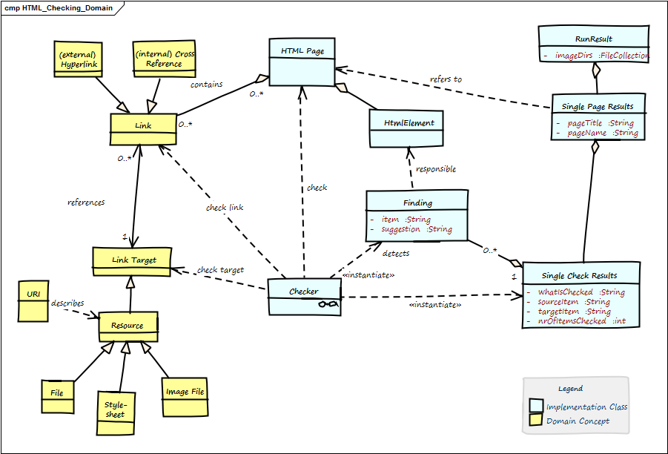
Crosscutting Concepts (Domain)

Slide 24
Crosscutting Concepts (Template Method)
The Template Method defines a skeleton of an algorithm in an operation, and defers some steps to subclasses.
http://sourcemaking.com/design_patterns/template_method
Checking HTML (abstract)
public SingleCheckResults( HtmlPage pageToCheck ){
assert( pageToCheck != null)
checkingResults = new SingleCheckResults()
initCheckingResultsDescription()
return check()
}

Slide 25
Decisions
Criteria | A1: Jsoup | A2: HTMLUnit
No (!) external dependencies | No deps | >15 deps
Simple API | simple | simple
DOM-like navigation | yes | partially
Fast (1 MB page / sec) | yes | no
Result: Jsoup as HTML parser (http://jsoup.org)

Slide 26
Open Issues
Many...:
https://github.com/aim42/htmlsanitycheck/issues

Slide 27
Glossary
Anchor
ID
ImageMap
Link
Resource
URI
HtmlPage
(Single) Check

