Slide 1

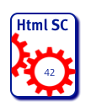
HTML Sanity Checker
Case Study for arc42 Architecture Documentation
Dr. Gernot Starke
https://github.com/aim42/htmlSanityCheck

Slide 2
Prerequisites
To understand the project & sourcecode
Basic knowledge of HTML (link, anchor, id, URI, ImageMap)
Basic knowledge of Groovy + Gradle
Disclaimer:
This project seriously over-documented
Code is unfinished ☹
https://github.com/aim42/htmlSanityCheck

Slide 3
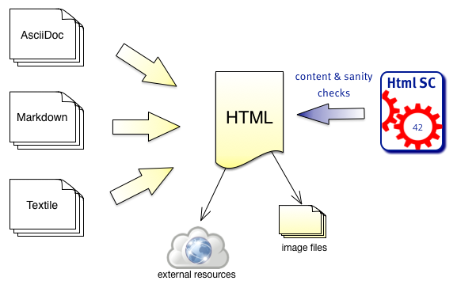
Intro and Business Goals

Slide 4
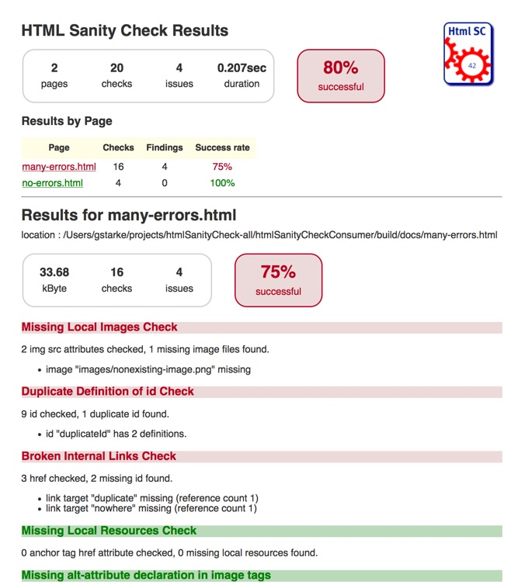
Goal (Output)
HTML report
Summary
Results by page
Minimally styled

Slide 5
Intro (2): What can go wrong...
Common HTML generators* guarantee only syntactic correctness
*: Especially Markdown, AsciiDoc, AsciiDoctor
Potential semantic errors include:
Broken links, i.e.
Broken cross references
Broken imageMaps
Missing images
Ambiguous definitions
Unused resources (i.e. image files)

Slide 6
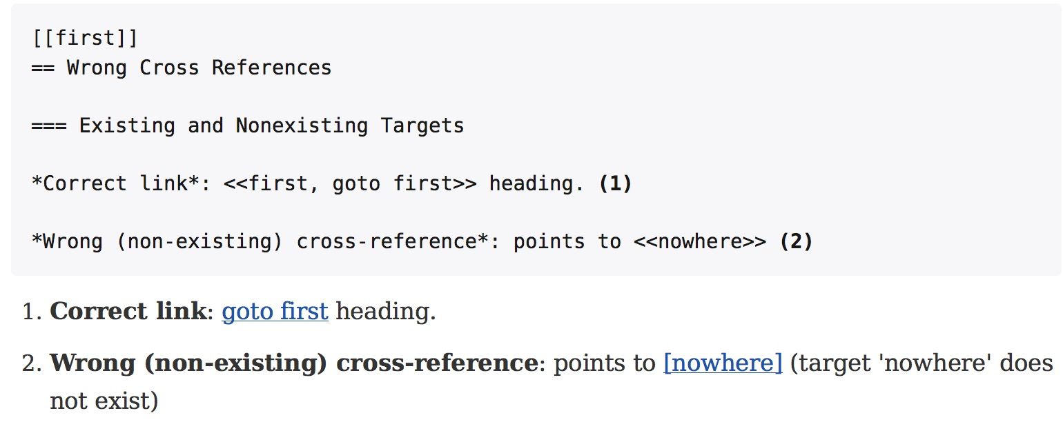
Intro (3): Why can it go wrong?
Markup languages simplify linking.
Generated links sensitive to spelling, typos, renames, deletions

Slide 7
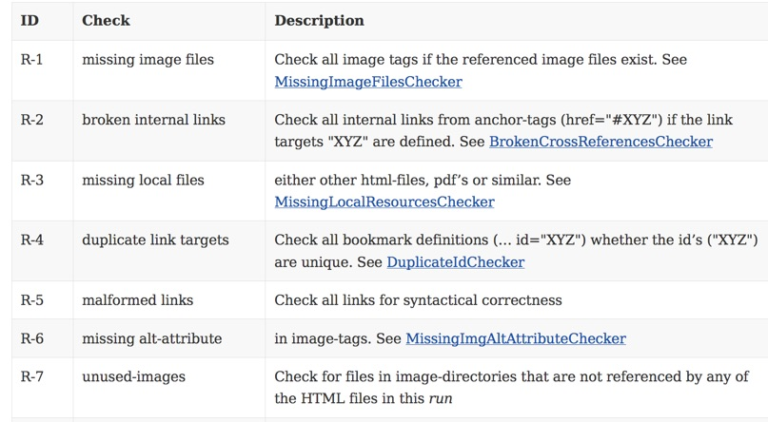
Requirements (2): Checks

Slide 8
Requirements (1)
Read HTML file | Shall read HTML file with configurable name / location
Configurable to process multiple files | Shall be configurable for a set of files to be processes in a single run and produce a joint report. Useful for e.g. API documentation with many HTML files referencing each other.
Gradle plugin | Shall be usable as Gradle-plugin
Command line usage | Shall be callable from the command line with minimal prerequisites for installation.
Configurable output
Available on public repository | Like, e.g. Bintray, Jcenter or the Gradle-Plugin-Repository
Include suggestions | In case of e.g. broken cross references, shall provide suggestions what „could have been meant“ (by applying string similarity searches)

Slide 9
Architecture Quality Goals
Priority | Quality Goal | Scenario
1 | Correctness | Every broken internal link (cross reference) is found
1 | Correctness | Every missing local image is found.
1 | Safety | Content of the files to be checked is never altered.
2 | Correctness | Correctness of every checker is automatically tested for positive AND negative cases
3 | Correctness | Every reporting format is tested: Reports must exactly reflect checking results.
3 | Performance | Check of 100kB html file performed under 10 secs (excluding gradle startup)

Slide 10
Constraints
Implement on Java platform
Preferably in Groovy
Runnable as Gradle-plugin without installation*
* except: Java runtime
Available under liberal Open-Source license

Slide 11
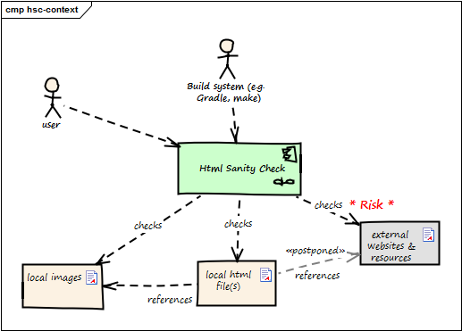
Context

Slide 12
Solution Strategy
Use HTML parser with minimal dependencies
Implement in Groovy
Wrapping as Gradle-plugin becomes simple
Apply Template-Method pattern for
Checking algorithms
Report generators
(Details see chap 8: Crosscutting Concepts)

Slide 13
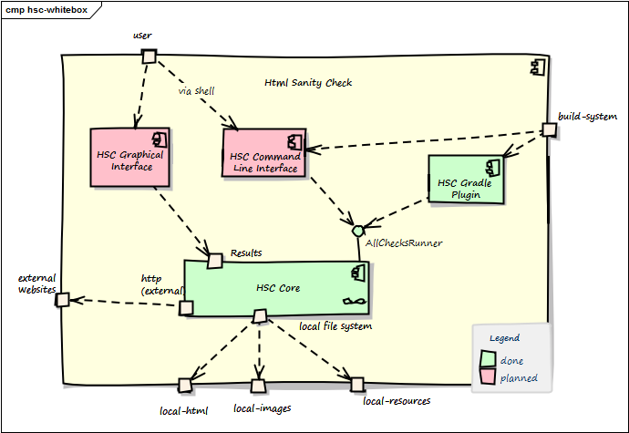
Building Blocks (Level 1)

Slide 14
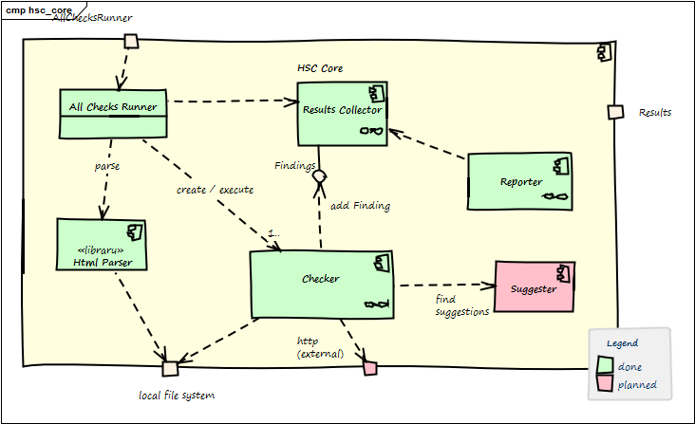
Building Blocks (HSC Core, Level 2)

Slide 15
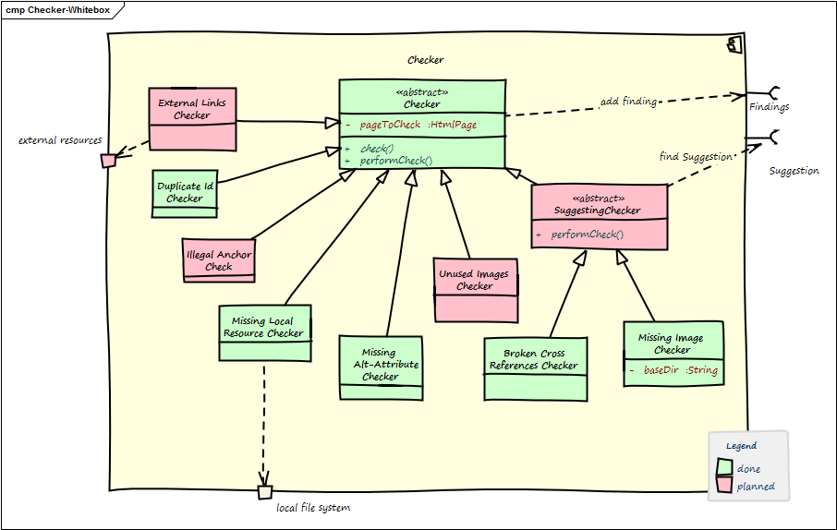
Building Blocks (Checker, Level 3)

Slide 16
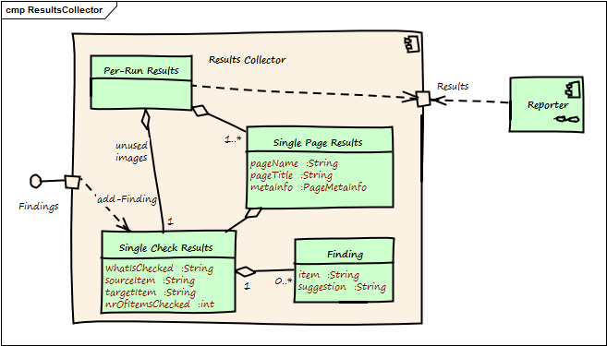
Building Blocks (ResultsCollector, L.3)

Slide 17
Building Blocks Hierarchy
Gradle sub-projects:
core: org.aim42.htmlsanitycheck
gradle-plugin: org.aim42.htmlsanitycheck
Packages:
o.a.h.check
o.a.h.collect
o.a.h.html
o.a.h.report
Classes:
AllChecksRunner
MissingConfigException
Classes:
Checker.groovy
ImageMapChecker
MissingImageFilesChecker

Slide 18
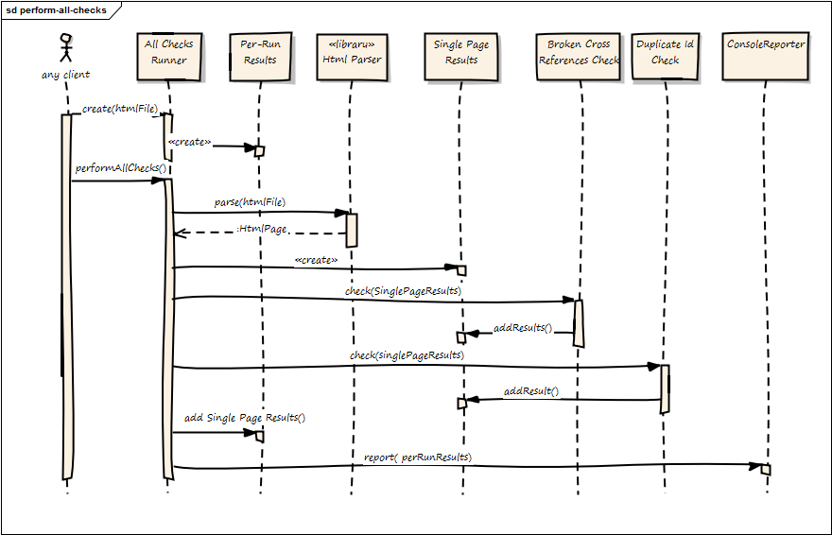
Runtime (perform all checks)

Slide 19
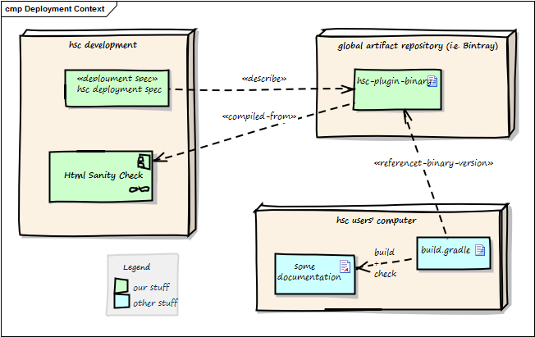
Deployment

Slide 20
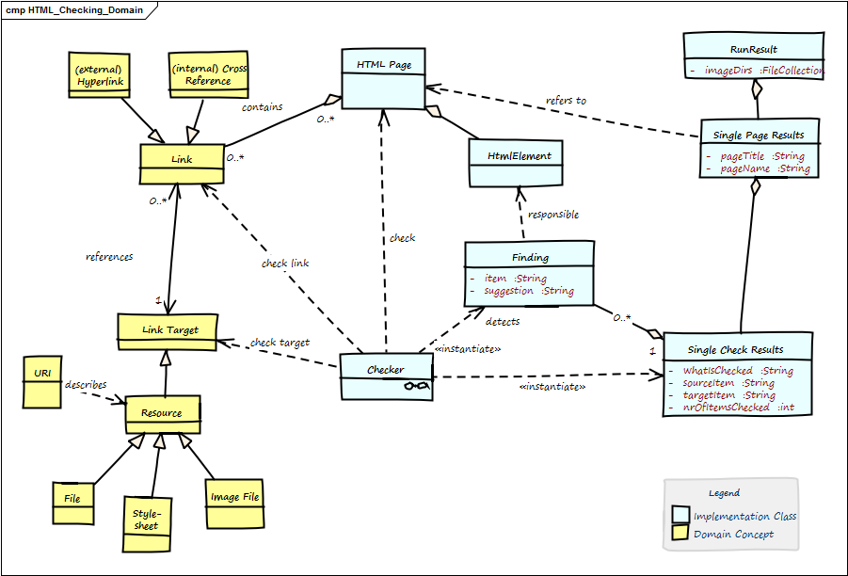
Crosscutting Concepts (Domain)

Slide 21
Crosscutting Concepts (Template Method)
The Template Method defines a skeleton of an algorithm in an operation, and defers some steps to subclasses.
http://sourcemaking.com/design_patterns/template_method
Checking HTML (abstract)
public SingleCheckResults( HtmlPage pageToCheck ){
assert( pageToCheck != null)
checkingResults = new SingleCheckResults()
initCheckingResultsDescription()
return check()
}

Slide 22
Decisions
Criteria | A1: Jsoup | A2: HTMLUnit
No (!) external dependencies | No deps | >15 deps
Simple API | simple | simple
DOM-like navigation | yes | partially
Fast (1 MB page / sec) | yes | no
Result: Jsoup as HTML parser (http://jsoup.org)

Slide 23
Open Issues
Many...:
https://github.com/aim42/htmlsanitycheck/issues

Slide 24
Glossary
Anchor
ID
ImageMap
Link
Resource
URI
HtmlPage
(Single) Check

