Slide 1



Climate information and adaptive Python tools for resilience
Ellen Dyer¹, Mamo Kassegn², and Solomon Gebreyohannis Gebrehiwot²
¹University of Oxford, UK
²Water and Land Resource Center, AAU, Ethiopia

Slide 2
Identifying opportunities to build strong knowledge relationships for climate resilience
Resilience : “… the inherent system characteristics that absorb perturbations without losing function, networks and social capital that allow autonomous action, and resources that promote institutional learning.” (on sources of resilience) (Nelson et al. 2007)
Climate resilience is often framed as resilience to future stresses (climate proofing) but there is value in understanding how resilient water users are to climate perturbations that are being experienced now.
One facet of building climate resilience is to have relevant climate information whether that be historical information that can inform us about the distribution of experienced conditions, forecasts that show possible conditions in an upcoming season, or projections of long-term climate change.
There is a lot of climate information! However, is it the right information for the application, can it be used by the relevant actors, is it being used by the relevant actors?

Slide 3
Identifying opportunities to build strong knowledge relationships for climate resilience
We are trying to complete a network analysis that asks the following questions in the Awash, geared towards the water sector:
How does climate information move around the basin, how is it transformed?
How is climate information communicated, what challenges there are in using climate information?
How can an understanding of knowledge networks and barriers to climate information use help to make using long-term climate information better?

Slide 4
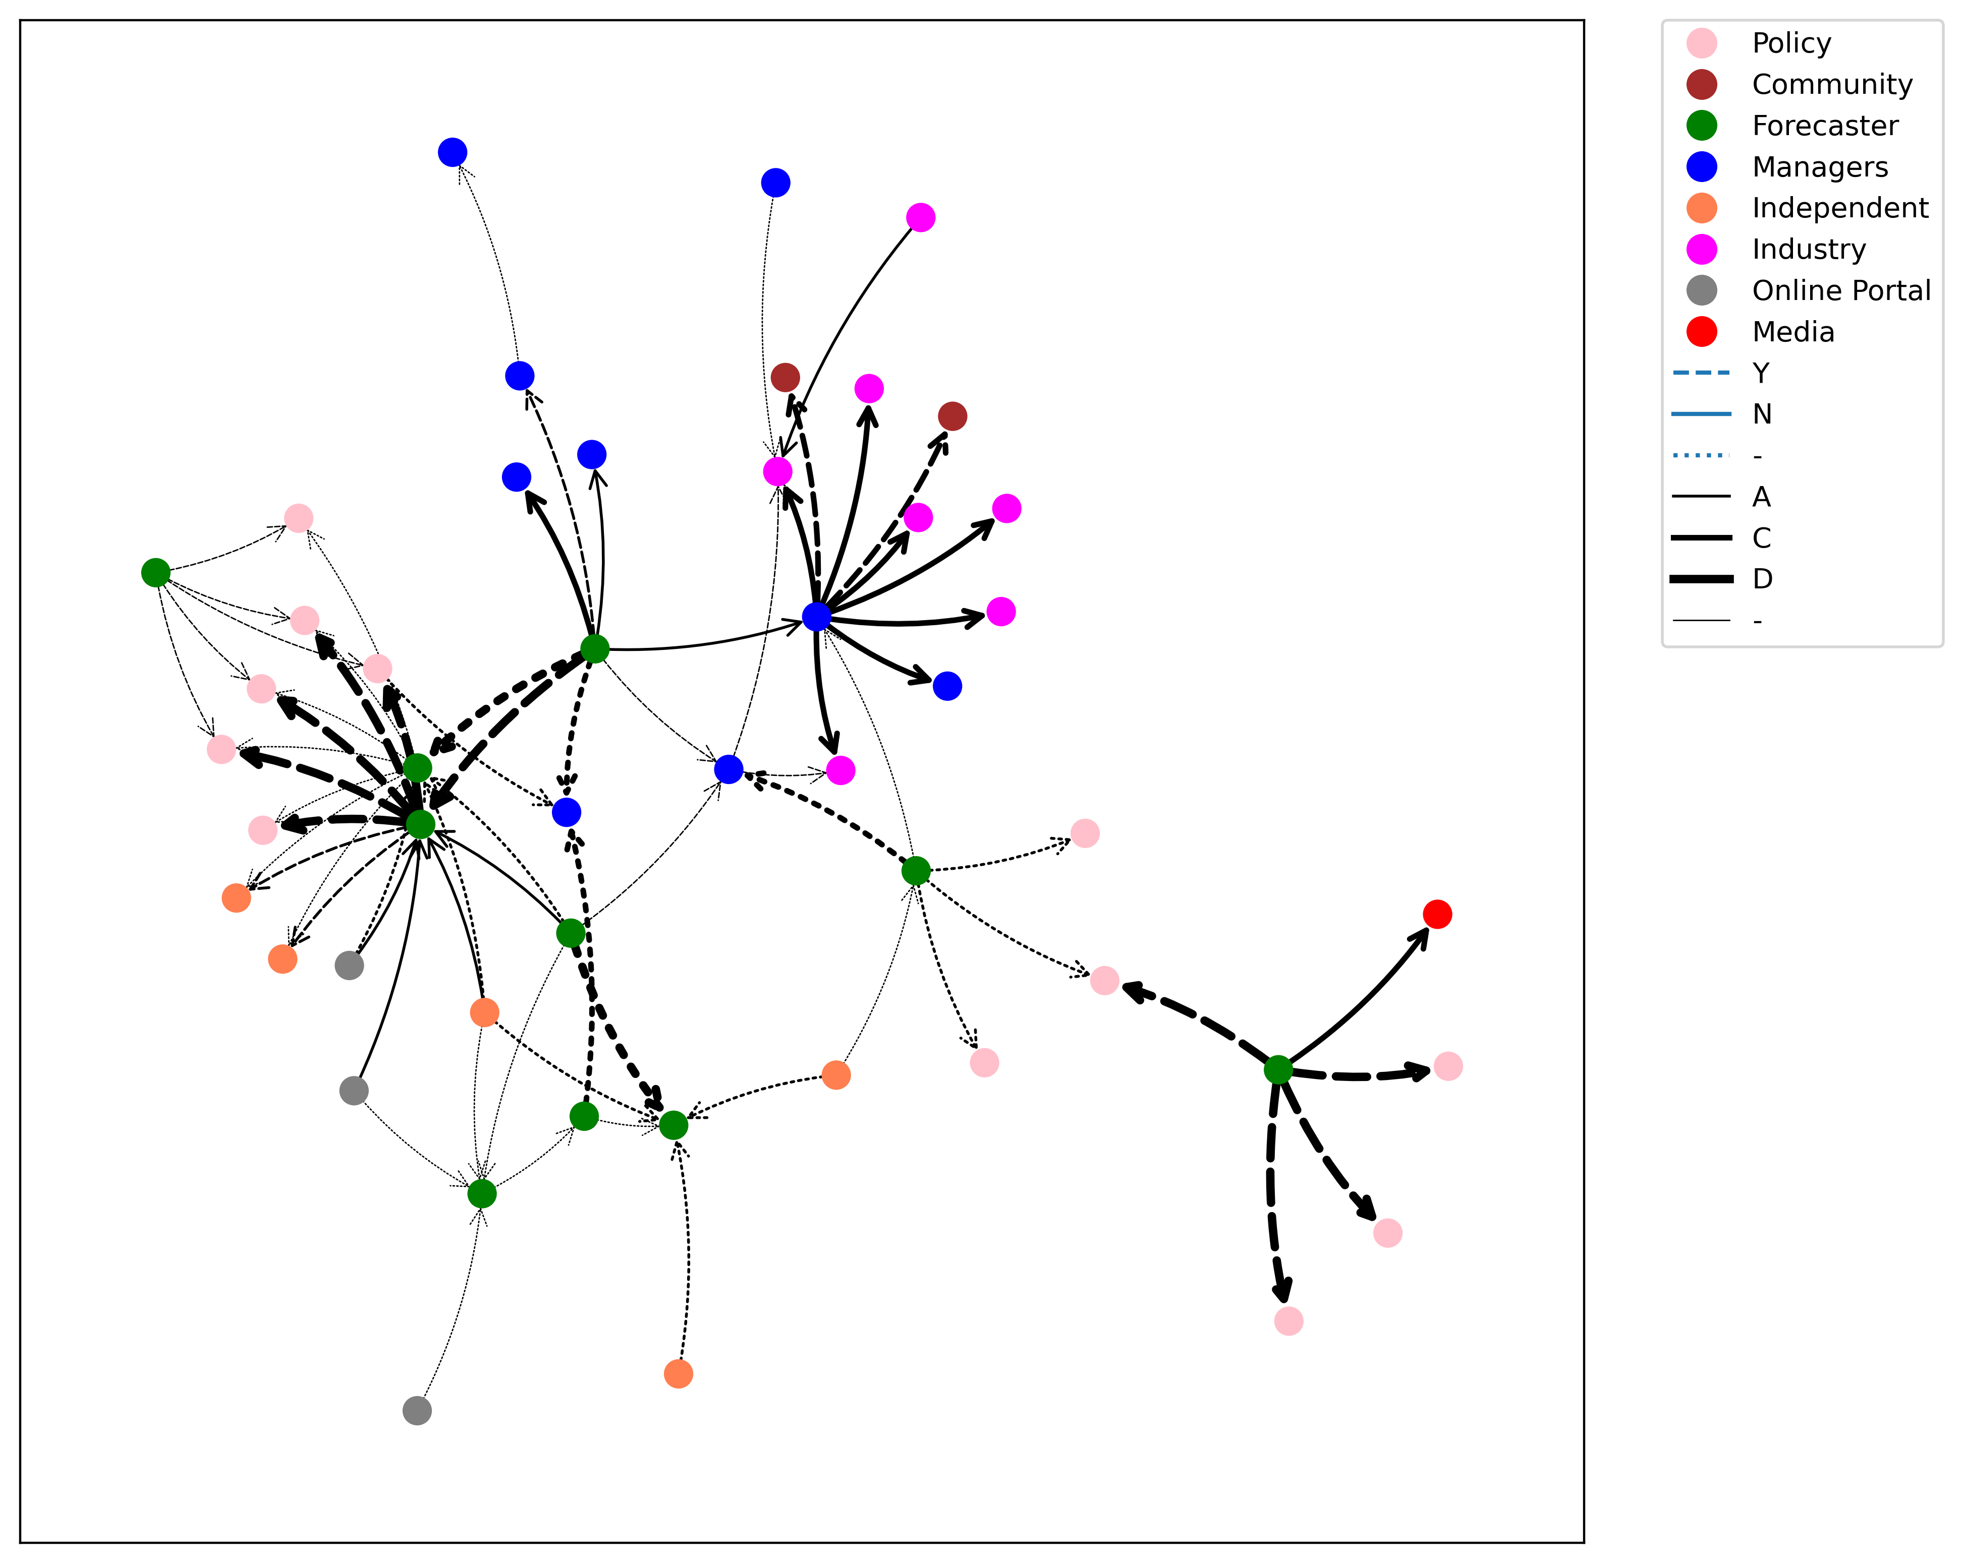
Investigating climate communication
using knowledge networks
Network mapping:
The network mapping is done primarily using questionnaires. The questionnaires investigate what climate information is being used but also asks about information sharing relationships
Not all information is shared from person to person - we would also like to highlight online sources, documents, and meetings that are key access points
The sampling snowballs - after a small set of initial respondents the network is made up of people who have been referred by other respondents based on who they give information to, or get information from
Respondents are anonymised and are represented by functional groups
UNICEF is currently missing from our map and we would be very interested to talk to anyone who uses climate information (or would like to!) in their work

Slide 5
Investigating climate communication
using knowledge networks
Network mapping:
Can identify important information sharers, and transformers
Visualise information flow characteristics (direction, feedback, relationship)
Helps to visualise silos or disconnected parts of the system and who/what is acting as a bridge
Can make some statements about the nature of the whole network using network analysis (depends on the quality and saturation of the network!)
We are continuously adding to the map, and thinking about the most helpful way to share it with stakeholders…

Slide 6
Investigating climate communication
using knowledge networks
Network narratives:
Some of the issues we are exploring require more context to understand than a questionnaire can provide
There are always challenges to using climate information, but these will vary depending on the work or application it is needed for
Some questionnaires are followed up with interviews that are tailored to the functional groups that the respondent belongs to (also happy to do interviews in place of questionnaire)
An opportunity to better understand the details of why using climate information can be problematic, challenging, and in some cases impossible…

Slide 7
Investigating climate communication
using knowledge networks
Network narratives:
Some of the issues we are exploring require more context to understand than a questionnaire can provide
There are always challenges to using climate information, but these will vary depending on the work or application it is needed for
Some questionnaires are followed up with interviews that are tailored to the functional groups that the respondent belongs to (also happy to do interviews in place of questionnaire)
An opportunity to better understand the details of why using climate information can be problematic, challenging, and in some cases impossible…
Seasonality of information and timeliness
Regionalisation or spatial detail of information
Accuracy vs uncertainty
Format of information
Sharing relationships need to be formalised
Hierarchical pipelines of information
Sharing roles and responsibilities around recommendations and decision-making

Slide 8
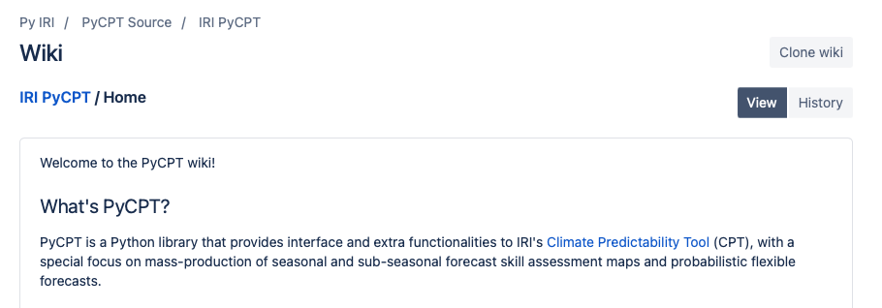
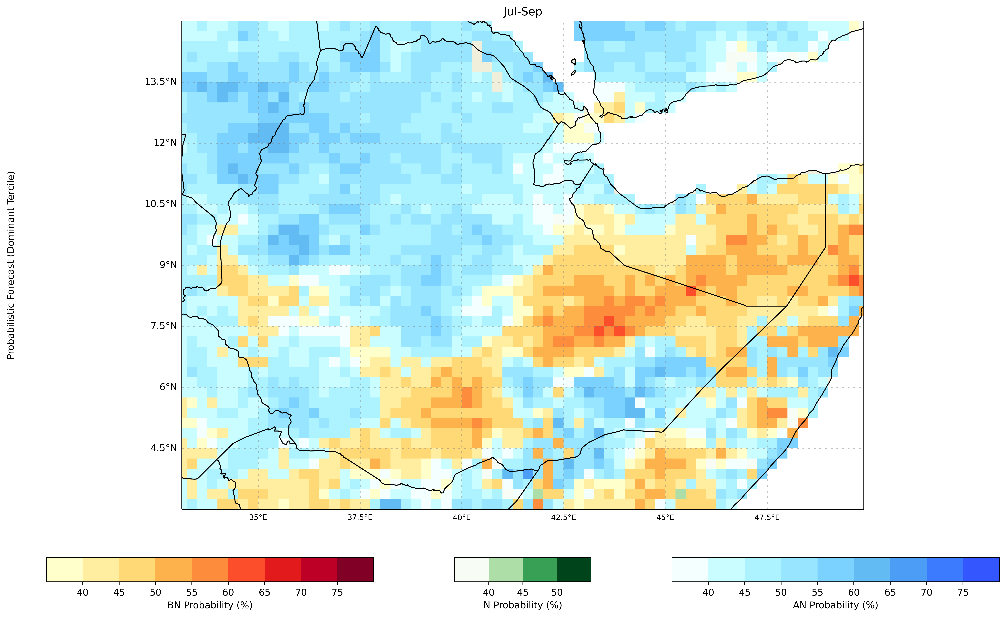
New information settings: an opportunity to
put research into action
Changing forecasting systems and new forms of information
EMI in partnership with IRI Columbia is shifting how it works with seasonal (and short term) forecasts
The set outputs are still fixed but access to model output fields means that it is possible to be more flexible and adaptable with forecast formats or metrics
Also a possibility to evaluate models for Ethiopia more easily
This ensemble information is a similar format to future climate projection ensembles

Slide 9
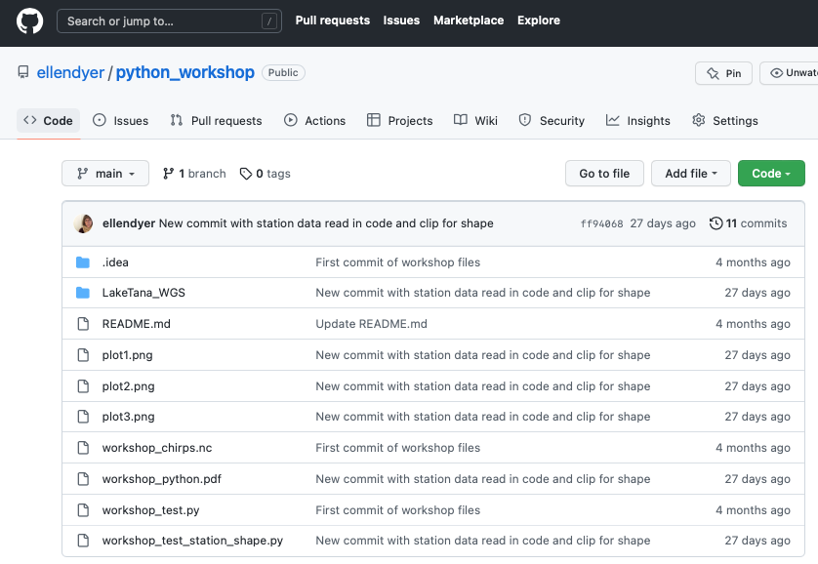
New information settings: an opportunity to
put research into action
Changing forecasting systems and new forms of information
Open source package of code to manipulate forecast, weather station, and observational data from global research centres
EMI reflecting conversations with forecasters
Include some key respondents from other groups in the water sector, health, agriculture to try a co-production exercise
Ongoing online coding support and an open repository
If anyone is interested in getting involved please let us know!

Slide 10

Funded by:

Slide 11
Getting started with python
Reading in gridded data and manipulating it
Example with CHIRPS, HadISST
Simple correlation code
Working with shapefiles

Slide 12
Funded by:

Slide 13
Accessing data and useful modules
Useful modules
Xarray
Xarray user guide https://docs.xarray.dev/en/stable/
A very good intro tutorial to using xarray with climate data - what our workshop has been loosely based on https://xarray-contrib.github.io/xarray-tutorial/oceanhackweek-2020/xarray-oceanhackweek20.html#
Pandas
Xarray can work with csv and excel files but Pandas might be a better tool if this is your main file type and you aren’t making maps with data https://pandas.pydata.org
Mapping and climate libraries
Here is a link to the cartopy documentation https://scitools.org.uk/cartopy/docs/latest/getting_started/index.html (have a look at the gallery to see what is possible)
Has datasets and coding tutorials: https://docs.digitalearthafrica.org/en/latest/sandbox/notebooks/Beginners_guide/07_Intro_to_xarray.html
Digital Earth Africa online courses: https://learn.digitalearthafrica.org/dashboard
PyCLIM examples: https://climate.usu.edu/people/yoshi/pyclm101/index.html
A free short course: https://www.ceh.ac.uk/training/climate-data-analysis-python
Climate index library: https://xclim.readthedocs.io/en/stable/index.html

Slide 14
Accessing data and useful modules
Useful datasets
CHIRPS rainfall (satellite-gauge): https://www.chc.ucsb.edu/data/chirps
TAMSAT rainfall (satellite-gauge): https://www.tamsat.org.uk
CHIRTS monthly max temperature (satellite and ground measurement): https://www.chc.ucsb.edu/data/chirtsmonthly
CRU measurements including temperature: https://crudata.uea.ac.uk/cru/data/hrg/
ERA5 reanalysis (model that incorporates various observations: https://cds.climate.copernicus.eu/cdsapp#!/search?type=dataset&text=ERA5
CMIP6 model output (in IPCC report) can be downloaded from CEDA: https://help.ceda.ac.uk/article/4801-cmip6-data
*You will also need to register for a CEDA account - also useful for a lot of things!
*For ERA5 you will need to register for a Copernicus account - this is really useful to download a lot of data.

Slide 15
Accessing our code and creating more
All the code from the workshop is stored here:
https://github.com/ellendyer/python_workshop
… and we can keep adding to this code after the workshop.
Today and tomorrow: keep a running list of tasks we want to achieve
Ayele… excel forecasts to text
Chali… historical climatologies and trends
Correlations of ElNino years with rainfall (correlate rainfall within ENSO years monthly values - predictability a few months out)
Working with EMI forecasts from daily to seasonal - visualising at different timescales - visualising missing data - visualising extremes
Dealing with many stations at once (*will check example)
Examples of metrics: % anomalies of rainfall in given year, SPI/SPEI
Reading in any netcdf files at once to combine into a dataset
Comparison/validation gridded vs station (important statistics - combine into a package)
Statistical evaluation of models
Physical evaluation of models
Anyone can download code from this repository and I will add any code that you want to share until we do a GitHub workshop!
The workshop setup instructions are on this GitHub so please share with anyone who might be interested.

Slide 16
Working with shapefiles
How to be responsible about providing data
More regionalised data is more useable…
Regionalising data beyond its accuracy is problematic
Challenges in regionalising data
…

Slide 17
Historical and forecast data: formats and availability
Potentially boring issues that make a big difference!
Historical data: reanalysis, satellite, gridded data
Historical data: station data
Forecast data: visual, gridded, localised?
What changes with PyCPT?

Slide 18
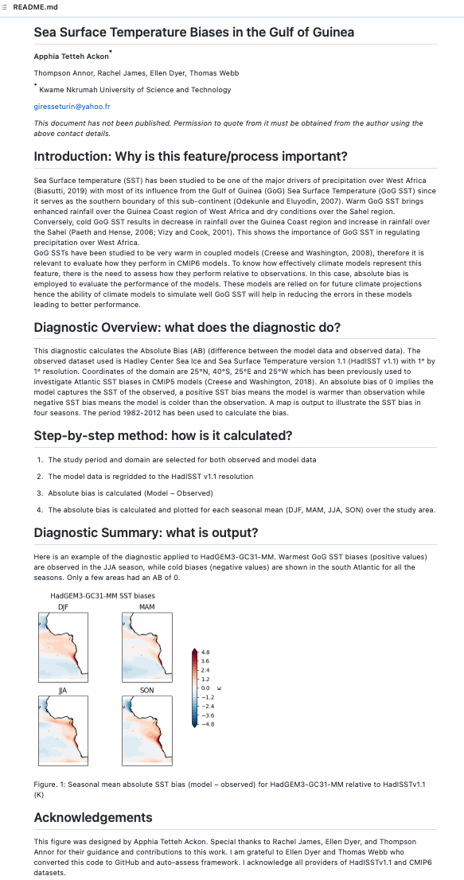
Model evaluation: an example using GCMs
LaunchPAD priority on African Diagnostics
https://github.com/Priority-on-African-Diagnostics/LaunchPAD
Working with ECRs at African Universities
Physical diagnostics of key circulation features or processes that drive local climate variability
SSTs, jets etc.

Slide 19
Model evaluation: an example using GCMs
LaunchPAD priority on African Diagnostics
https://github.com/Priority-on-African-Diagnostics/LaunchPAD
Working with ECRs at African Universities
Physical diagnostics of key circulation features or processes that drive local climate variability
SSTs, jets etc.

Slide 20
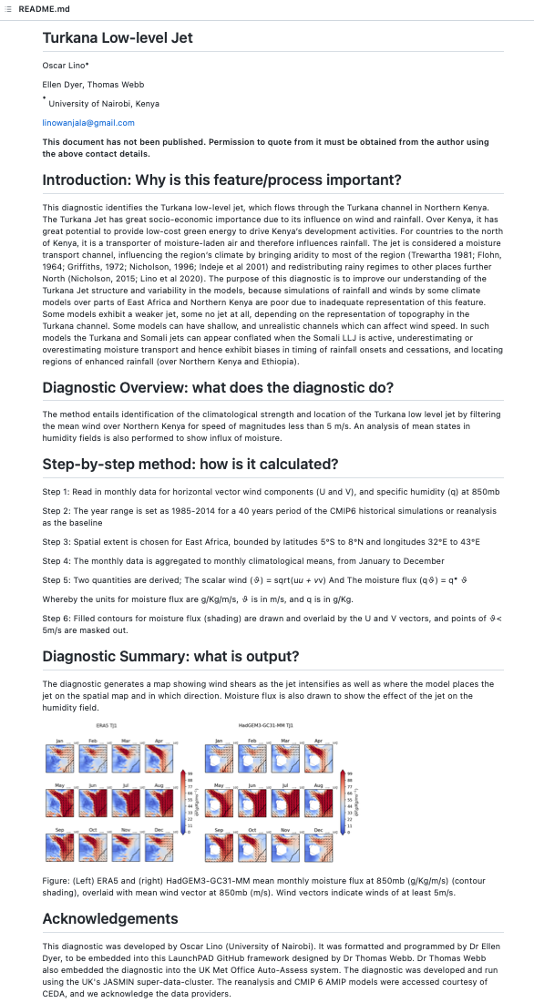
Model evaluation: an example using GCMs
LaunchPAD priority on African Diagnostics
https://github.com/Priority-on-African-Diagnostics/LaunchPAD
Working with ECRs at African Universities
Physical diagnostics of key circulation features or processes that drive local climate variability
SSTs, jets etc.

Slide 21
Model evaluation: an example using GCMs
LaunchPAD priority on African Diagnostics
https://github.com/Priority-on-African-Diagnostics/LaunchPAD
Working with ECRs at African Universities
Physical diagnostics of key circulation features or processes that drive local climate variability
SSTs, jets etc.

Slide 22
Model evaluation: an example using GCMs
LaunchPAD priority on African Diagnostics
https://github.com/Priority-on-African-Diagnostics/LaunchPAD
Working with ECRs at African Universities
Physical diagnostics of key circulation features or processes that drive local climate variability
SSTs, jets etc.
Missing Ethiopia specific diagnostics…. what would be useful?
Ethiopian Diagnostics
…

Slide 23
Working with station data
Station data formats clash with gridded formats
try code example to link the two
how is station data shared ~ is there a systematic approach that can be supported by code libraries

Slide 24
Future topics of interest and how to continue engaging
Some suggestions
model evaluation
GitHub
a set of tasks to work on after this workshop
regular online catch-ups on targeted themes
Your ideas
…

Slide 25
Funded by:

Slide 26
Adaptive metrics: does flexibility work?
Health example ~ malaria
Merging climate information with other sources
What steps would make this possible
Shifting to forecasting metrics rather than summaries
HOW is the data used - does this affect how it is produced?

Slide 27
Adaptive metrics: does flexibility work?
Water example ~ water resource management
Historical data for water availability - how to make this more useable in terms of format, beyond probabilities?
Historical and forecast information are necessary for water resource planning and allocation
seasonal for reservoir operation
long term scenarios for planning

Slide 28
Adaptive metrics: does flexibility work?
Sustainable co-production and flexible metrics that fit into existing systems and are locally owned
…

Slide 29
Please get in touch if you have any questions, suggestions, or are interested in participating through a questionnaire or interview
ellen.dyer@ouce.ox.ac.uk
solomon.g@wlrc-eth.org

Slide 30
Funded by:

Slide 31
Writing code for research: python and code management
Thursday Nov 3 (AAU)
9:00 - 9:30 ~ Introduction to the workshop from Ellen and Mamo
9:30 - 11:00 ~ Getting set up with python
11:00 - 12:00 ~ First plotting exercise
Lunch
1:00 - 3:00 ~ Modify first plotting exercise - group activity with correlations and xclim
3:00 - 4:00 ~ Working with shape files

Slide 32
Writing code for research: python and code management
Friday Nov 4 (AAU)
9:00 - 9:30 ~ Discussion about seasonal, historical, and future simulations
9:30 - 11:00 ~ Discussion of future training or coding topics (share GitHub)
11:00 - 12:00 ~ Working with station data
Lunch
1:00 - 3:00 ~ Working with precipitation and flow curves (examples Ellen and Mamo)
3:00 - 4:00 ~ Accessing and working across datasets (CEDA, Copernicus)

Slide 33

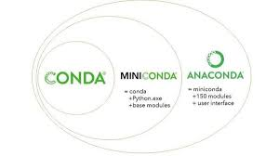

Writing code for research: python and code management
Why Python?
Why Miniconda?
Why GitHub?

Slide 34
Writing code for research: useful tools
Conda:
Download the conda cheat sheet (it is very useful!): https://docs.conda.io/projects/conda/en/latest/user-guide/cheatsheet.html
Take a look at this list of common conda issues and help to solve them: https://docs.conda.io/projects/conda/en/latest/user-guide/troubleshooting.html
You can install CDO and NCVIEW with conda (https://anaconda.org/conda-forge/ncview , https://anaconda.org/conda-forge/cdo ) (these are very useful for previewing and altering netcdf files, especially large netcdf files)
Xarray
Xarray user guide https://docs.xarray.dev/en/stable/
Xarray can work with csv and excel files but Pandas might be a better tool if this is your main file type and you aren’t making maps with data https://pandas.pydata.org
A very good intro tutorial to using xarray with climate data - what our workshop has been loosely based on https://xarray-contrib.github.io/xarray-tutorial/oceanhackweek-2020/xarray-oceanhackweek20.html#
Mapping and climate libraries
Here is a link to the cartopy documentation https://scitools.org.uk/cartopy/docs/latest/getting_started/index.html (have a look at the gallery to see what is possible)
Has datasets and coding tutorials: https://docs.digitalearthafrica.org/en/latest/sandbox/notebooks/Beginners_guide/07_Intro_to_xarray.html
Digital Earth Africa online courses: https://learn.digitalearthafrica.org/dashboard
PyCLIM examples: https://climate.usu.edu/people/yoshi/pyclm101/index.html
A free short course: https://www.ceh.ac.uk/training/climate-data-analysis-python
Climate index library: https://xclim.readthedocs.io/en/stable/index.html

Slide 35
Writing code for research: accessing data
ICPAC has a big directory: https://www.icpac.net/open-data-sources/
CHIRPS rainfall (satellite-gauge): https://www.chc.ucsb.edu/data/chirps
TAMSAT rainfall (satellite-gauge): https://www.tamsat.org.uk
CHIRTS monthly max temperature (satellite and ground measurement): https://www.chc.ucsb.edu/data/chirtsmonthly
CRU measurements including temperature: https://crudata.uea.ac.uk/cru/data/hrg/
ERA5 reanalysis (model that incorporates various observations: https://cds.climate.copernicus.eu/cdsapp#!/search?type=dataset&text=ERA5
CMIP6 model output (in IPCC report) can be downloaded from CEDA: https://help.ceda.ac.uk/article/4801-cmip6-data
*You will also need to register for a ceda account - also useful for a lot of things!
*For ERA5 you will need to register for a Copernicus account - this is really useful to download a lot of data.

Slide 37
Writing code for research: GitHub!
Using GitHub to share and update code
A good tutorial website: https://www.atlassian.com/git/tutorials
Start with Beginner - this will explain what Git is and show you how to install it on your own computer: https://www.atlassian.com/git/tutorials/what-is-version-control
Getting started will show you how to clone an online repository: https://www.atlassian.com/git/tutorials/setting-up-a-repository
We can try collaborating using the workshop Git: https://www.atlassian.com/git/tutorials/syncing
——————————————————————-
Git is easy to use if you are already writing code in PyCharm or VSCode.
You can also use Git with Spyder just like you would on the command line - to do this you always have to type !git instead of just git.
In toolbar click on View > Panes > Project (make sure there is a check mark)

Slide 38
Writing code for research: GitHub!
https://github.com/ellendyer/python_workshop
https://github.com/Priority-on-African-Diagnostics

Slide 39
Model evaluation: an example using GCMs
LaunchPAD priority on African Diagnostics
https://github.com/Priority-on-African-Diagnostics/LaunchPAD
Working with ECRs at African Universities
Physical diagnostics of key circulation features or processes that drive local climate variability
SSTs, jets etc.

Slide 40
Model evaluation: an example using GCMs
LaunchPAD priority on African Diagnostics
https://github.com/Priority-on-African-Diagnostics/LaunchPAD
Working with ECRs at African Universities
Physical diagnostics of key circulation features or processes that drive local climate variability
SSTs, jets etc.

Slide 41
Writing code for research: GitHub!
We can run through an example with your repository of choice together
!git clone {repository}
!git branch -a
!git branch {newbranch}
!git checkout {newbranch}
!git branch -a
!git status
!git add {file}
!git status
!git commit -m ‘any message of your choice’
!git push origin {your-branch-name}
!git pull origin {name of remote branch you want to track}

