Slide 1




Light Electronic Action Framework
Veterans Health Administration

Slide 2
What is VA LEAF?
VA LEAF is a web application, and Class II VA Software, designed to help facilities rapidly develop common form/workflow solutions
Developed by VA employees to solve common issues
No licensing costs, open source technologies
Centralized server eliminates need for local IT server support
Low maintenance and easy to learn.
Mission: To empower VA employees in digital process improvement.

Slide 3
Solve common issues
Never lose a request
Always know where a request is in the process
Guard sensitive data
Ensure transparency of the process
Improve timeliness of reviewers and implementation
Great user experience saves time and reduces stress
No new username/passwords, uses existing security infrastructure

Slide 4



What are some things I can do?
for Pro Sites
Resource Committee
Travel & Tuition Reimbursement
Org Chart
WHAT
Real-time processing, tracking of FTE, equipment, and other resource requests
Digitize travel
requests and tuition reimbursement approvals
Automated Org Charting that ties in vacancy data. Includes search ability.
WHO
Associate Directors
Service Line Directors
Service Line Personnel
Travelers and students
Admin staff
Fiscal staff
Human Resources
Admin staff
Fiscal staff
STARTUP
EFFORT
Low
~ 10 Hours
High
40-80 hours
Low
~ 15 Hours

Slide 5
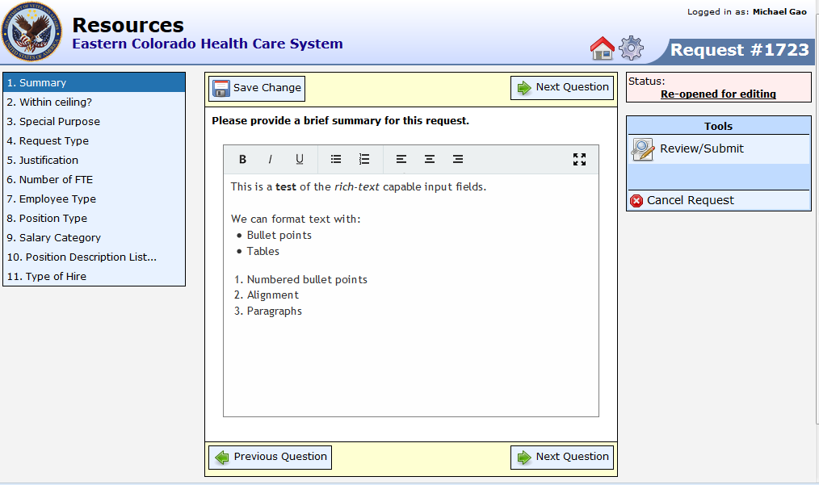
Clean Data Entry
Complex forms can be presented in small and manageable sections
All data fields can be used as search filters

Slide 6
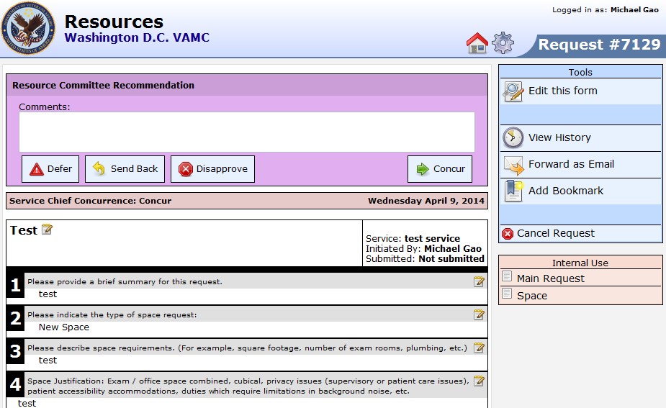
Intuitive Design
Easy to use interface for decision-making
Supports E-mail notifications and other custom events

Slide 7
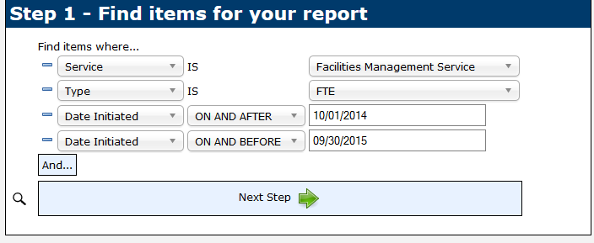
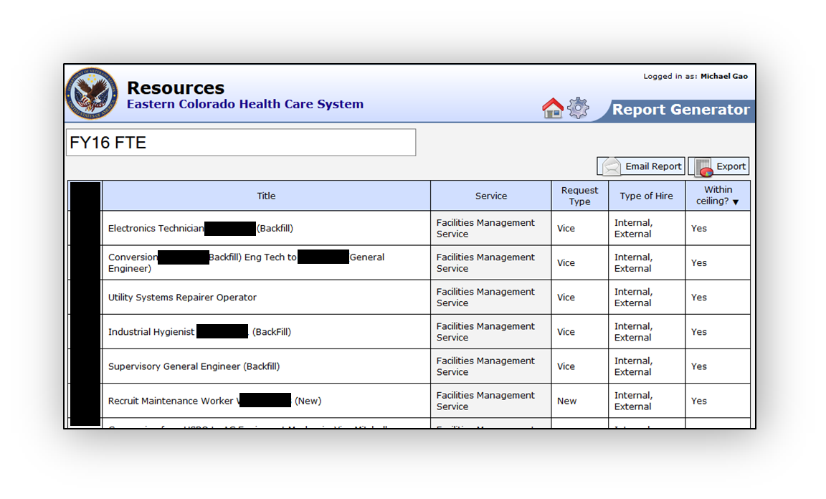
Powerful Report Builder
Build collaborative spreadsheets and dashboards
Always up to date, and easily share reports with others
One-click export to Excel

Slide 8
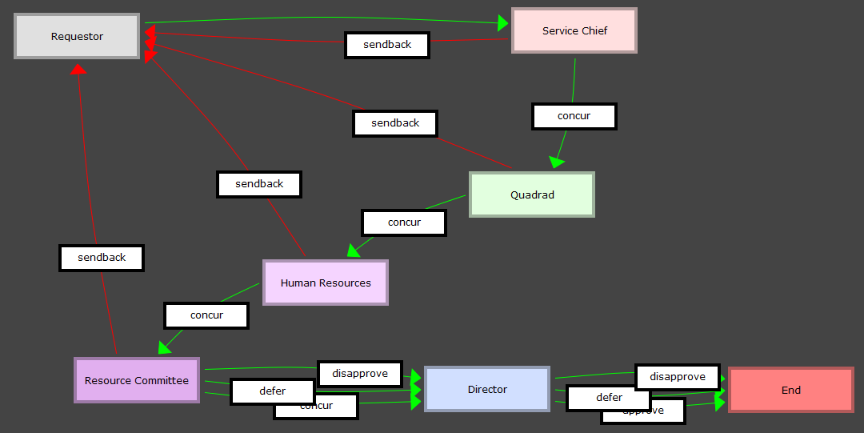
Simple Configuration
Rapid development, iteration, and amendments
Role-based security identifies authorized users. PIV-card compatible.

Slide 9

Responsibilities
Your Facility
Maintain forms, workflows, privilege groups, and any customizations made
Ensure personnel are apprised of the system
Server maintenance
Backup databases
Fix software issues
Apply software updates

Slide 10
Keys to success
Leadership Buy-in. Inform leadership and obtain buy-in.
Start Small. Start with one specific process in mind.
Project Manager. Technical skills not required. Tech comfort preferred.
Other Key Traits:
Volunteers!
Good communication skills.
Collaborative nature.
Mission: To empower VA employees in digital process improvement.

