Slide 1

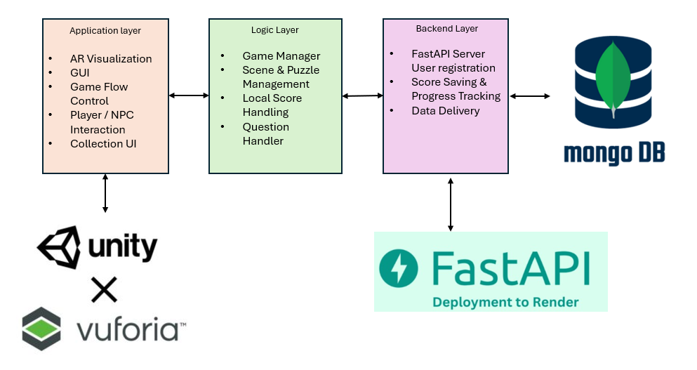
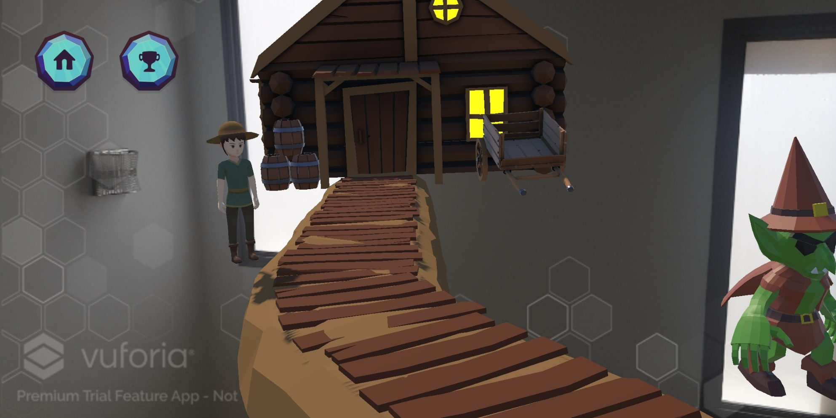
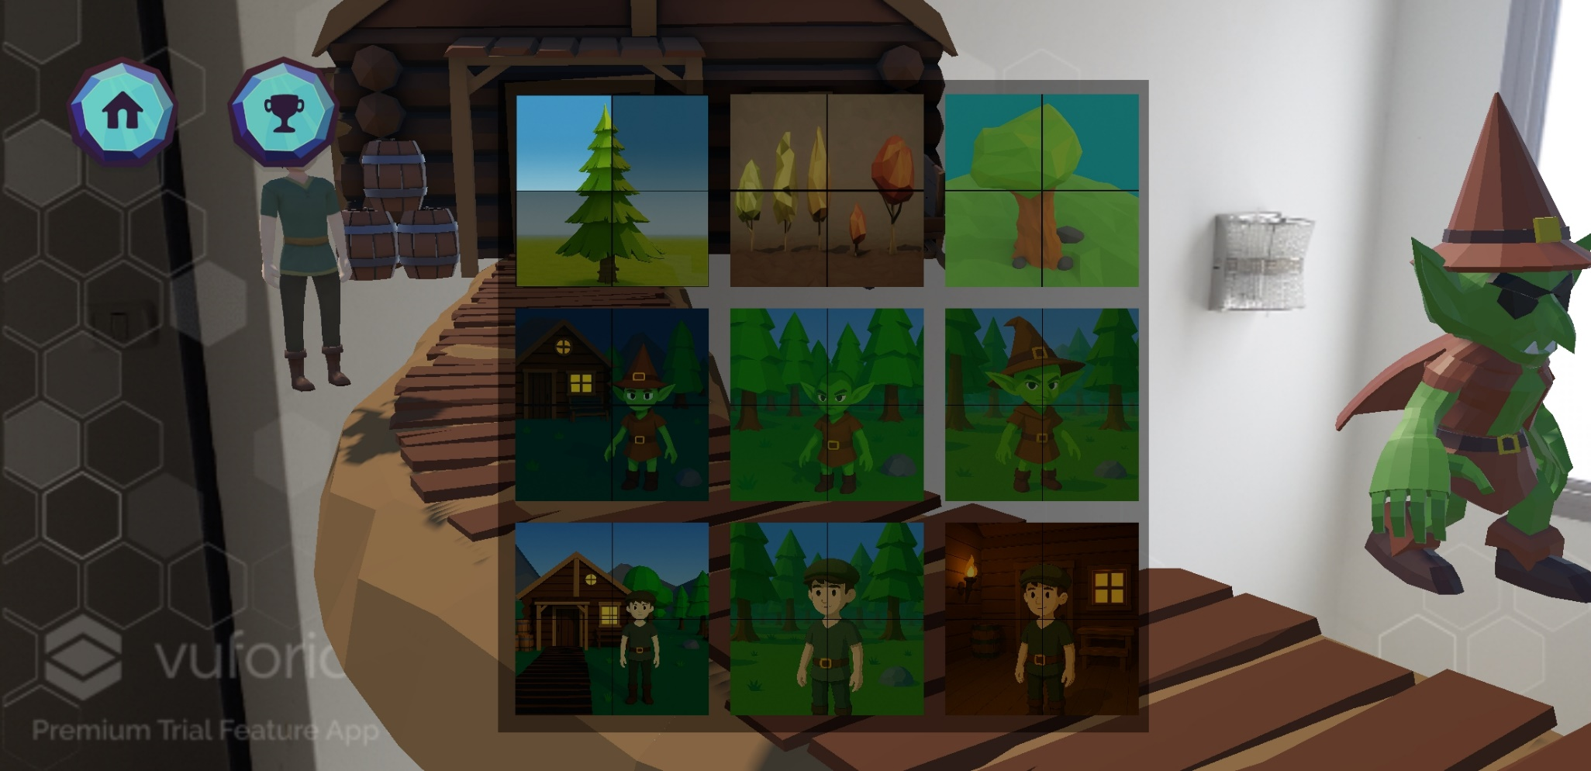
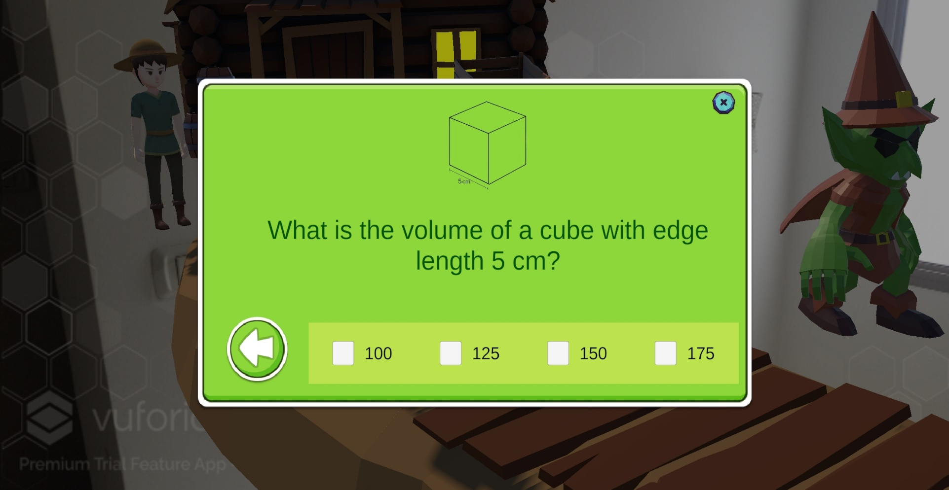
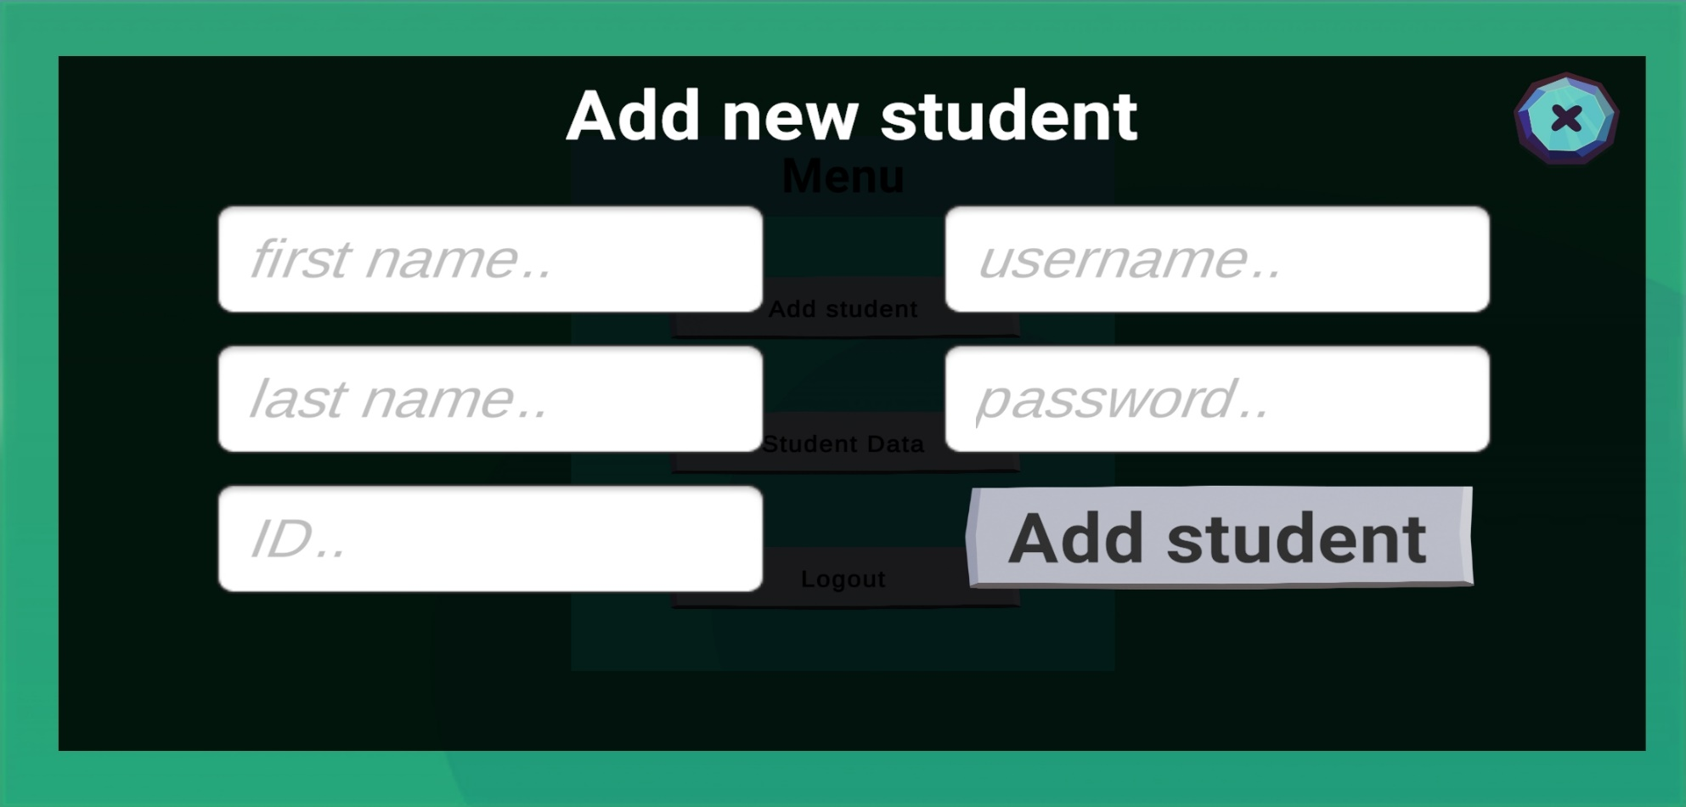
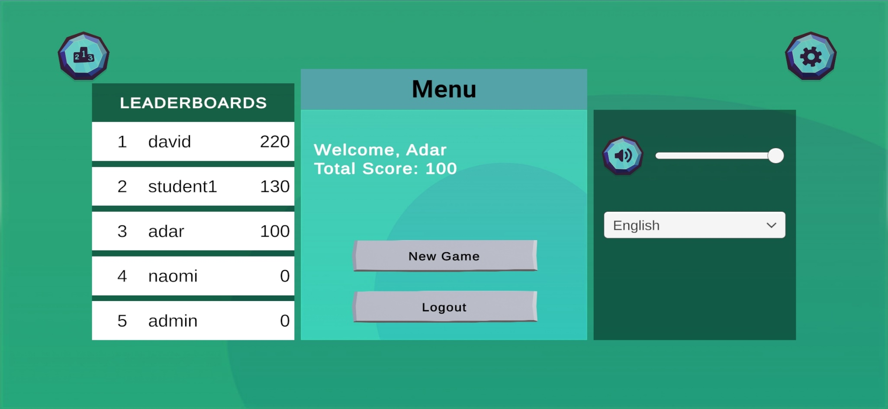
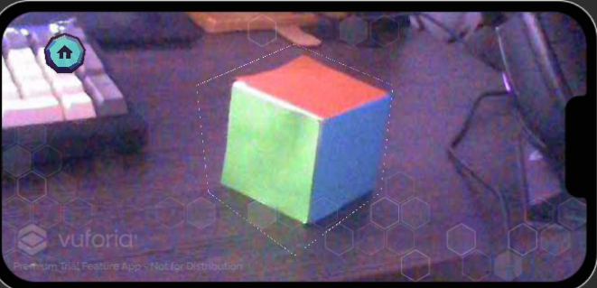

MathStARz
Adar Cohen & Yaniv Blitzman
Advisors:
Dr. Unkelos Shpigel Naomi
Dr. Nataly Levi
This AR educational app helps students learn geometry through interactive gameplay. By scanning a 3D model target, students enter a 3D world where they solve questions, interact with NPCs, and collect puzzle pieces as rewards. Built with Unity and Vuforia, the app connects to a FastAPI backend with MongoDB for tracking progress and managing users. It supports students, teachers, and admins, enabling personalized learning and performance monitoring.
REQUIREMENTS
ARCHITECTURE
Utilize AR technology to present math concepts through a 3D interactive experience. (FR)
Include gamification features such as points, badges, and leaderboards to engage and motivate students. (FR)
Provide user controls for sound settings, including audio volume and background music. (FR)
Main control buttons must display both text and icons for clarity. (NFR)
Sound settings should feature sliders ranging from 0 to 1 for fine volume adjustment. (NFR)
Ensure all assets, including 3D models, are modular and reusable for future updates. (NFR)
MOTIVATION
Many students struggle to understand abstract geometry concepts through traditional methods.
Studies show that interactive and visual learning improves comprehension and retention (OECD, 2022).
AR technology allows students to connect real-world objects with virtual learning content.
SCREENSHOTS
INTERVIEWS
EVALUATION
Positive Feedback: High SUS score (86.4).
Praised Features: Immersive AR experience, clear 3D visualizations of shapes, interactive NPC guidance, rewarding puzzle system.
Suggested Improvements: More shape variety, adaptive difficulty for math questions, enhanced feedback on incorrect answers.
Security: Ensure safe data storage, stronger authentication for teacher/admin roles.
Ariel Avrahami
A high school mathematics teacher

