Slide 1
EXPERIMENT NO – 1
Protecting user system / device that is connected to online :
Enabling and Disabling of Firewall
Windows Firewall that filters information coming to your system from the Internet and blocking potentially harmful programs.
Firewall helps prevent hackers and malicious software from gaining access to your PC through the internet or a network.
Steps:
Step1: Go to Start and open Control Panel.
Step2: Select System and Security>Windows Defender Firewall
Step 3: Choose Turn Windows Firewall on or off
Step 4: Select Turn on Windows Firewall for private and public network settings.

Slide 2
EXPERIMENT NO – 1
b) Antivirus And Anti-Spyware installation
Antivirus is a software to protect Operating system from malware like viruses, computer worms, botnets, rootkits, key loggers and etc.
Virus is a computer program that can copy itself and infect a computer without permission or knowledge of the user. A virus might corrupt or delete data on a computer.
Software : total 360 security antivirus

Slide 3
EXPERIMENT NO – 1
Steps to install Antivirus:
Step 1: Go to browser, search for total 360 security antivirus software or any other antivirus software.
Step 2: Click on the download.
Step3: Open the Downloads folder and Double click the downloaded file and install it.
Step 4: Click on start>go to Full Check and Check Now

Slide 4
EXPERIMENT NO – 1
b) Anti-Spyware installation
Anti-spyware is a type of software that is designed to detect and remove unwanted spyware programs if installed.
Anti-spyware Prevent the installation of ActiveX-based spyware, adware, browser hijackers, and other potentially unwanted software.
Spyware is a type of malware that is installed on a computer without the user's knowledge in order to collect information about them. This can pose a security risk to the user, but more frequently spyware degrades system performance by taking up processing power, installing additional software, or redirecting users' browser activity.
Tool : SpywareBlaster6.0

Slide 5
EXPERIMENT NO – 1
Steps to install Anti-Spyware:
Step 1: Go to browser and search for antispyware blaster and Select 2nd link Download SpywareBlaster6.0
Step 2 : Select downloads and click on spyware Blaster.
Step3: Open the spyware blaster setup6.0 from the downloads and install it.
Step4: Double-click on setup file>Agree to agreement>Browse the location>click next>Install.
Step5: Open the application>click next>select manual updating and click next.
Step6: Select the browser you want to protect>select activate-X protection

Slide 6
EXPERIMENT NO – 1
c) Set up password protection
It helps to protect your personal and sensitive information from unauthorized access.
Steps:
Step1:Go to Start and open Control Panel.
Step2: Select User Accounts>click Change Account Type.
Steps3: Double click on User account>click on create password.
Step4:Enter new password and confirm the password>click create password.

Slide 7
EXPERIMENT NO – 2
NTFS (New Technology File System) file system using NTFS Permissions Reporter :
NTFS Permissions reporting is good ways of auditing the level of access that user have on files and folders so that maintaining NTFS folder security is enhanced.
Managing folders is a difficult task since it requires constant monitoring of the NTFS
permissions to avoid unauthorized access. However, if you have a good tool, you can
conveniently present easy-to-read reports listing the permissions granted to a user or a group of users.
Tool : NTFS Permissions Reporter
The NTFS Permissions Reporter by is an excellent tool that allows you to export file and folder permissions for further reviewing.

Slide 8
EXPERIMENT NO – 2
Steps to install NTFS Permissions Reporter
Step1:Go to google, search NTFS Permissions Reporter
Step2: Click on first link NTFS Permissions Reporting Software for Windows
Steps3: Click on Download Now button.
Step4: Click on Start Download button and install it.

Slide 9
EXPERIMENT NO – 3
Cross-Site Scripting Attack using Bwapp:
URL : https://bwapp.hakhub.net/login.php
Cross-site scripting is a type of security vulnerability that can be found in some web applications.
XSS attacks enable attackers to inject client-side scripts into web pages viewed by other users.
Two types : Reflected XSS and Stored XSS

Slide 10
EXPERIMENT NO – 3
Cross-Site Scripting using Bwapp:
Commonly used main prevention methods include:
Data validation
Filtering
Escaping

Slide 11
EXPERIMENT NO – 4
Reversing the android application [Security Tampered]:
Reverse engineering an Android application typically involves using specialized tools to decompile the applications compiled code and resources into a human-readable form.
Tool :
Dex2jar : https://sourceforge.net/projects/dex2jar/
JD-GUI : http://java-decompiler.github.io/
APK File : https://github.com/0xArab/diva-apk-file
In command prompt, go to root directory inside dex2jar-2.0 execute the below code, to get .jar file in the same folder
d2j-dex2jar.bat -f ../DivaApplication.apk

Slide 12
EXPERIMENT NO – 5
Http Header Injection [Get/post method] using Bwapp :
When the attacker tricks the web application into inserting extra HTTP headers into legitimate HTTP responses. HTTP header injection is a technique that can be used to facilitate malicious attacks.
Tool : Burp suite , Firefox
Bwapp Login : https://bwapp.hakhub.net/login.php
Username : bee
Password : bug

Slide 13
EXPERIMENT NO – 6
Brute force attack using Burp suite:
A brute force attack is a hacking method that uses trial and error to crack passwords, login credentials, and encryption keys.
The attacker systematically checks all possible passwords until the correct one is found.
Tool : Burp suite , Firefox
URL : https://bwapp.hakhub.net/login.php

Slide 14
EXPERIMENT NO – 7
SQL Injection Using Bwapp:
SQL Injection is a web page vulnerability that lets an attacker make queries with the database.
Attackers take advantage of web application vulnerability and inject an SQL command via the input from users to the application.
Tool : Burp suite , Firefox
Bwapp Login : http://localhost/bwapp
Username : bee
Password : bug

Slide 15
EXPERIMENT NO – 8
NMap or Zenmap network scanning :
Nmap is short for Network Mapper. It is an open-source tool that is used to scan IP addresses and ports in a network and to detect installed applications.
Nmap allows network admins to find which devices are running on their network, discover open ports and services, and detect vulnerabilities.
Tool : nmap
Download link:
https://nmap.org/download.html#windows
Ip address along with range : 142.251.215.228-254 (google.com)

Slide 16
EXPERIMENT NO – 9
Threat Modeling with STRIDE:
By identifying vulnerabilities, helping with risk assessment, and suggesting corrective action, threat modeling helps improve cybersecurity and trust in key business systems.
Threat Modeling Steps
Defining security requirements
Creating an application diagram
Identifying threats
Mitigating threats
Validating that threats have been mitigated

Slide 17
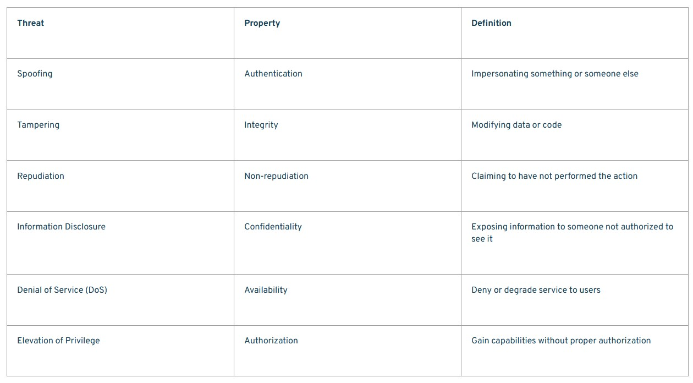
STRIDE
STRIDE is basically to identify potential vulnerabilities and classify threats under 6 types of attacks.

Slide 18
Tool : Microsoft Threat Modeling Tool
Microsoft Threat Modeling Tool is a tool that helps in finding threats in the design phase of the projects.
Tool Download link:
https://www.microsoft.com/en-us/download/details.aspx?id=49168

Slide 19
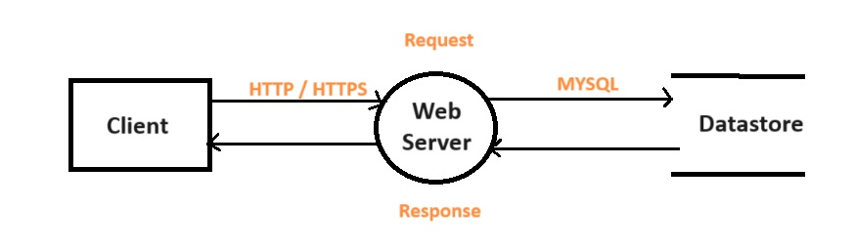
Dataflow Diagram

Slide 20
EXPERIMENT NO – 10
Docker image and container creations :
Docker is a software platform that allows you to build, test, and deploy applications quickly.
A docker image is a file used to execute code in a docker containers.
A container give you an isolated environment to run your code
Tool : docker

Slide 21
EXPERIMENT NO – 11
Perform Dynamic Application Security Testing using OWASP ZAP:
OWASP(Open Web Application Security Project ) ZAP (Zed Attack Proxy) is a penetration testing tool that helps developers and security professionals detect and find vulnerabilities in web applications.
Tool : OWSAP ZAP, Firefox
URL : Download owsap zap tool - https://www.zaproxy.org/
Testing Link : http://localhost/bwapp/login.php

Slide 22
EXPERIMENT NO – 12
Cryptography technique using CRYPT TOOL:
Tool : CRYPT (Download link : https://www.cryptool.org/en/ct1/downloads)
Crypto means hidden and graph means writing.
Cryptography is the study of encrypting and decrypting data to prevent unauthorized access.
Cryptography allows for the secure transmission of digital data between willing parties.

Slide 23
EXPERIMENT NO – 13
Wireshark packet analyzer:
Wireshark is a free and open-source packet analyser that can capture and display real-time details of network traffic. It is used for network troubleshooting issues, analysis, inspecting packet contents, analyzing network performance, and identifying potential security vulnerabilities.
Wireshark's functionality makes it an essential tool for network administrators, analysts, and security professionals.
Tool :
Download : https://www.wireshark.org/

Slide 24
EXPERIMENT NO – 14
Process observation and analysis with Process Hacker :
Process Hacker is an open-source tool that will allow you to see what processes are running on a device, identify programs that are eating up CPU resources and identify network connections that are associated with a process. These types of features make Process Hacker an ideal tool for monitoring malware on a device.
Tool : processhacker
Download link:
https://processhacker.sourceforge.io/downloads.php

