Slide 1
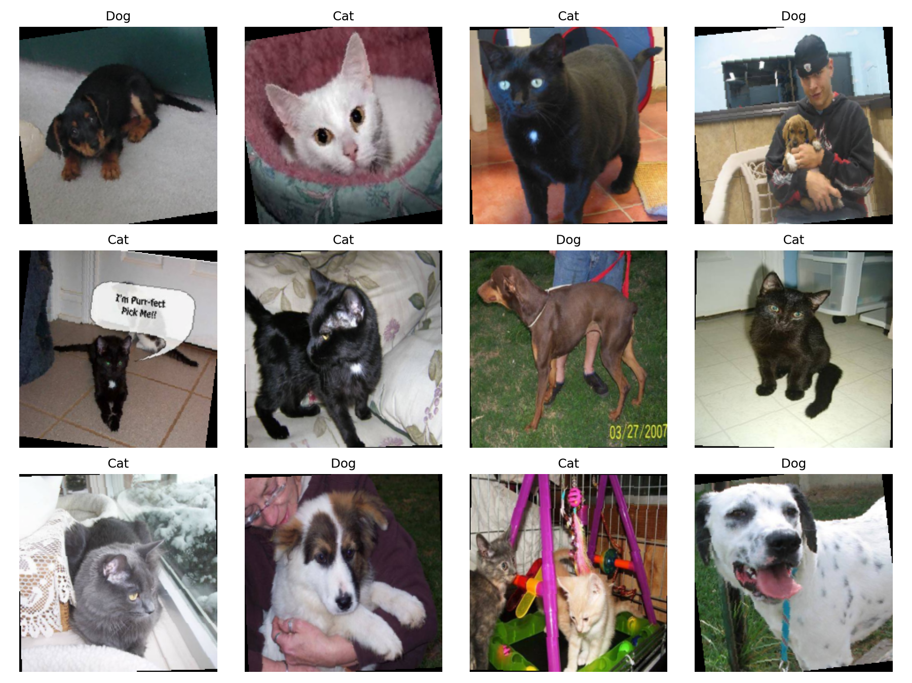
MACHINE LEARNING • MINI-PROJECT
HOUSEHOLD ANIMALS
CLASSIFICATION
A comparative study of CNN training, regularization, transfer learning and fine-tuning
ANISH A KUNDER
ADARSHA E
PES1UG24AM343
PES1UG24AM334
CAT (0) / DOG (1) • KAGGLE DATASET
UE24CS352A | PES UNIVERSITY
UE24CS352A • MACHINE LEARNING MINI-PROJECT
01

Slide 2
01 / PROBLEM
A binary classifier — and a controlled comparison
The goal is not only to predict a label, but to measure which training strategy generalizes best.
LABEL 0
LABEL 1
CAT
DOG
Research question
How much do regularization, pretrained features and fine-tuning improve classification compared with a CNN trained from scratch?
Keep the train / validation / test protocol consistent.
Compare four experiments on one held-out test set.
Add a visual explanation through Grad-CAM.
Representative labeled examples from the project dataset
UE24CS352A • MACHINE LEARNING MINI-PROJECT
02

Slide 3
02 / DATASET
25,000 images in; 24,994 used after quality checks
Balanced cats-versus-dogs data, with a reproducible split and explicit duplicate checks.
25,000
6
24,994
ORIGINAL LABELED IMAGES
EXCLUDED AFTER CHECKS
IMAGES IN THE SPLITS
Reasons recorded in excluded.csv
STRATIFIED SPLIT • SEED 42
TRAIN 19,994 (80%)
VAL 3,998
TEST 1,002
CLASS BALANCE
TRAIN
VALIDATION
TEST
9,997 cats • 9,997 dogs
1,999 cats • 1,999 dogs
501 cats • 501 dogs
Integrity checks: readable images • filename-derived labels • exact RGB-pixel duplicate hashes • no cross-split overlap
UE24CS352A • MACHINE LEARNING MINI-PROJECT
03

Slide 4
03 / PREPROCESSING
A reproducible pipeline prevents avoidable evaluation errors
The images stay in place; CSV manifests define which files belong to each split.
01
02
03
04
05
VALIDATE
DEDUPLICATE
SPLIT
TRANSFORM
AUGMENT
Can the image open? Does its filename map to a label?
Hash decoded RGB pixels; exclude six images.
Stratify by class with seed 42; verify no overlap.
Resize to 224 × 224; normalize with ImageNet mean / std.
Train only: horizontal flip (p = 0.5), rotation ±10°.
FAIR EVALUATION
Validation and test images receive no random augmentation. Seeds are fixed, including DataLoader workers.
Training augmentation applies to the regularized VGG-6 and VGG-16 experiments, not the original baseline.
UE24CS352A • MACHINE LEARNING MINI-PROJECT
04

Slide 5
04 / EXPERIMENTS
Four experiments isolate the effect of each training strategy
All experiments use 224 × 224 inputs, RMSprop, batch size 32 and BCE-with-logits loss.
01
VGG-6 baseline
02
VGG-6 + regularization
TRAIN FROM SCRATCH
CONTROL OVERFITTING
4 convolutional blocks
32 → 64 → 128 → 128 filters
No dropout; no augmentation
Same VGG-6 backbone
Dropout = 0.5
Flip + rotation augmentation
03
Frozen VGG-16
04
Fine-tuned VGG-16
TRANSFER LEARNING
ADAPT HIGH-LEVEL FEATURES
ImageNet-pretrained features
Convolutions frozen
Train replacement binary head
Blocks 1–4 frozen
Block 5 + classifier trainable
10 additional epochs; LR = 1e-5
Checkpoint policy: save the model with the lowest validation loss; use the same held-out test set for comparisons.
UE24CS352A • MACHINE LEARNING MINI-PROJECT
05

Slide 6
05 / RESULTS
Transfer learning delivers the largest accuracy jump
All four results were measured on the same 1,002-image test set using a 0.5 threshold.
TEST ACCURACY BY EXPERIMENT
99.50%
VGG-6 baseline
87.13%
HIGHEST TEST ACCURACY
873 / 1,002 correct
Fine-tuned comparison model
VGG-6 + regularization
92.91%
931 / 1,002 correct
+12.38 pp
Frozen VGG-16
98.70%
accuracy gain vs. baseline
989 / 1,002 correct
Fine-tuned VGG-16
99.50%
MACRO F1 • BASELINE → FINE-TUNED
997 / 1,002 correct
0.8712 → 0.9950
Bars are scaled to 0–100%; exact percentages are shown at right.
UE24CS352A • MACHINE LEARNING MINI-PROJECT
06

Slide 7
06 / MODEL SELECTION
Why the deployed model is not the highest test scorer
A key methodological choice: select with validation data, then use the test set for evaluation.
DEPLOYED MODEL
COMPARISON ONLY
Frozen VGG-16
Fine-tuned VGG-16
Checkpoint: best.pt • epoch 2
Test accuracy: 99.50%
Lowest validation loss: ≈ 0.0428
Validation loss did not improve, so this model was not chosen for deployment.
Selected before test-set evaluation
1
TRAIN
2
VALIDATE
3
TEST
Fit parameters
Choose checkpoint
Report held-out performance
The 99.50% fine-tuning result is reported transparently, but it did not drive model selection.
UE24CS352A • MACHINE LEARNING MINI-PROJECT
07

Slide 8
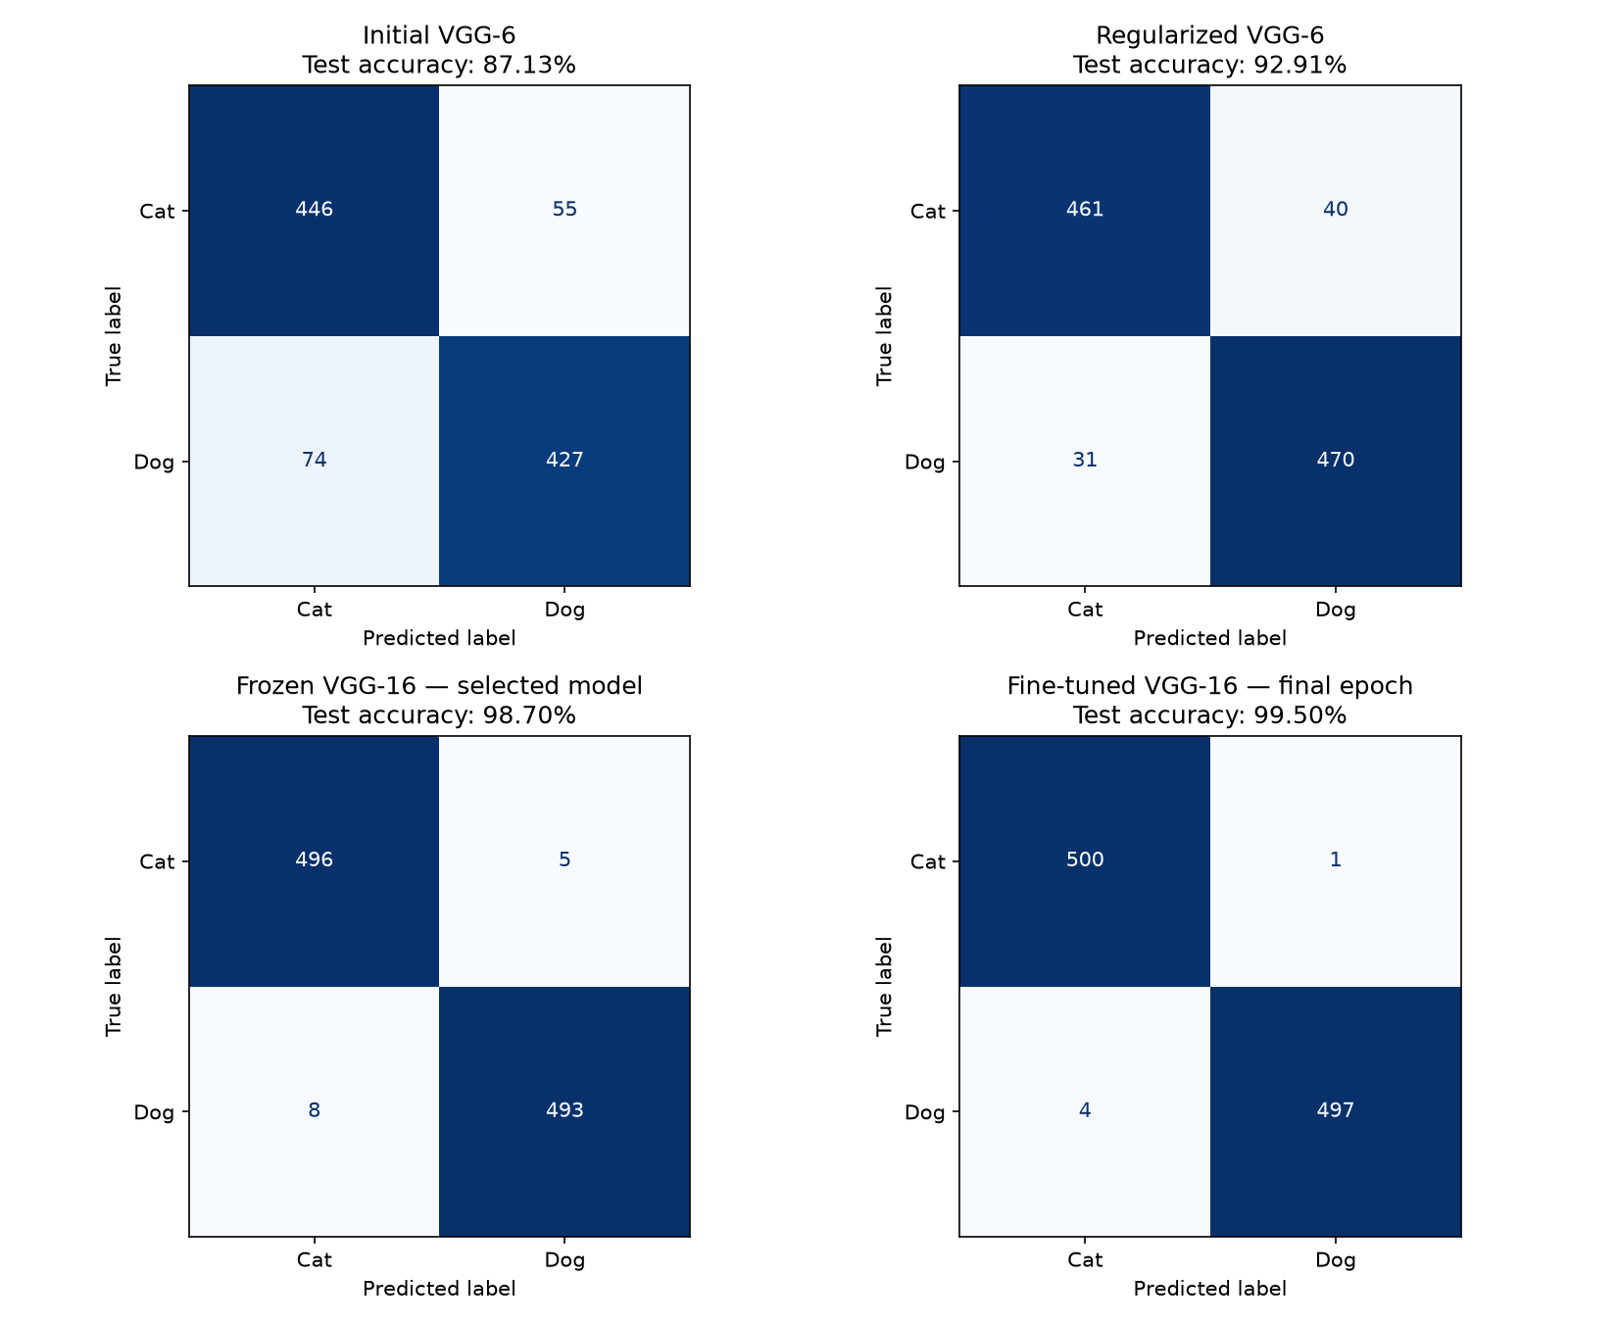
07 / ERROR ANALYSIS
The number of test mistakes falls at each stage
Confusion matrices show how the predictions changed across the same held-out examples.
TEST ERRORS
129 → 5
From initial VGG-6 to fine-tuned VGG-16
BASELINE OVERFITTING
Train accuracy reached 99.59%, while final validation accuracy was 86.17%.
Dropout + augmentation helped VGG-6 generalize better.
UE24CS352A • MACHINE LEARNING MINI-PROJECT
08

Slide 9
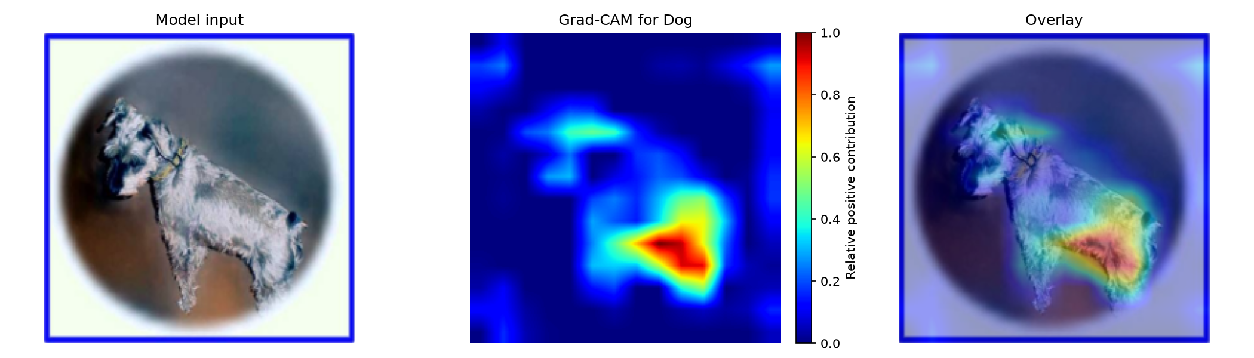
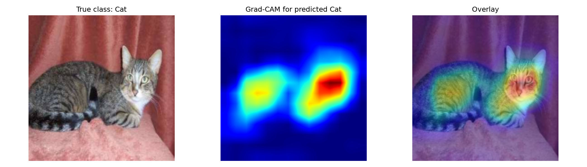
08 / EXPLAINABILITY
Grad-CAM highlights image regions that influence a prediction
Applied to the final convolutional layer of VGG-16: features[29].
DOG EXAMPLE • INPUT / HEATMAP / OVERLAY
CAT EXAMPLE • INPUT / HEATMAP / OVERLAY
HOW IT WORKS
1
Capture feature maps
2
Backpropagate class score
3
Weight channels by gradients
4
Apply ReLU, resize + normalize
Interpretation: a qualitative localization cue, not a segmentation mask or proof of causation.
UE24CS352A • MACHINE LEARNING MINI-PROJECT
09

Slide 10
09 / DEMO & IMPLEMENTATION
A simple interface makes the model inspectable
The Streamlit demo connects prediction, class probabilities and visual explanations.
USER FLOW
PROJECT STRUCTURE
01
Upload image
training.ipynb
Training, evaluation, visualizations
JPG / JPEG / PNG / WebP
scripts/prepare_data.py
Image checks and split manifests
02
Run classifier
scripts/data.py
Transforms and data loaders
Cat or dog + probability scores
scripts/models.py
VGG-6 and VGG-16 definitions
03
Explain prediction
Generate Grad-CAM heatmap + overlay
scripts/explain.py
Binary Grad-CAM implementation
Export result
app.py
Streamlit prediction demo
04
Download overlay as PNG
Demo supports CPU fallback; a thread lock protects the shared model while Grad-CAM hooks are active.
UE24CS352A • MACHINE LEARNING MINI-PROJECT
10

Slide 11
10 / CONCLUSION
Transfer learning made the biggest difference.
The strongest test score is an important comparison; validation-based selection keeps evaluation disciplined.
KEY TAKEAWAYS
LIMITATIONS TO STATE
Regularization improved the scratch-trained VGG-6.
One random split / seed was evaluated.
ImageNet-pretrained VGG-16 raised test accuracy to 98.70%.
Near-duplicate detection was not implemented.
External-dataset performance is untested.
Fine-tuning reached 99.50% on this test split.
Binary output always chooses cat or dog, even for unrelated images.
Grad-CAM adds a qualitative view into model decisions.
Probabilities are not calibrated confidence guarantees.
SOURCE CODE
github.com/Adarsh-031/household-animals-classification-using-deeplearning
References: Kaggle Dogs vs. Cats • Simonyan & Zisserman (VGG, 2015) • Selvaraju et al. (Grad-CAM, 2017)
UE24CS352A • MACHINE LEARNING MINI-PROJECT
11

