Slide 1
Introduction to Digital Image Processing

Slide 2
Digital Image and Digital Image Processing
Image – A two-dimensional signal that can be observed by human visual system
Digital image – Representation of images by sampling in time and space.
Digital image processing – perform digital signal processing operations on digital images

Slide 3
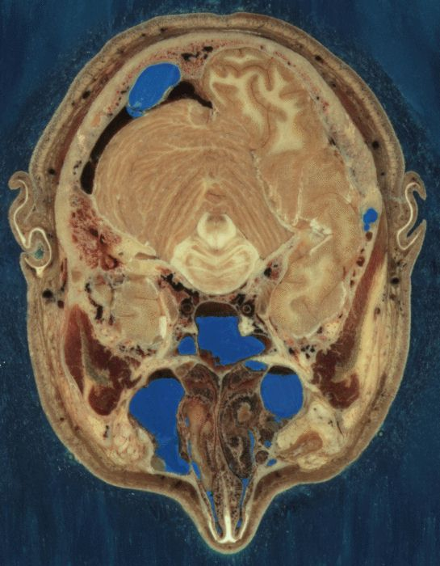
Examples of DIP:
CT: Computer Tomography
http://www.nlm.nih.gov/research/visible/image/head.jpg
Section through Visible Human Male - head, including cerebellum, cerebral cortex, brainstem, nasal passages (from Head subset)
This is an example of the “visible human project” sponsored by NIH
DIP techniques applicable:
  Enhancement
  Segmentation

Slide 4
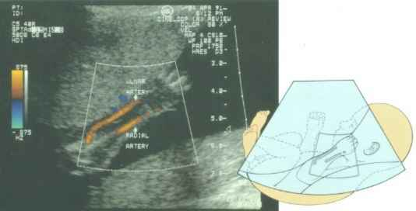
Ultrasound Image
Profiles of a fetus at 4 months, the face is about 4cm long
Ultra sound image is another imaging modality
The fetal arm with the major arteries (radial and ulnar) clearly delineated.

Slide 5
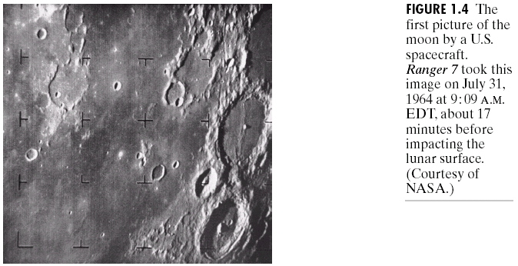
Chapter 1: Introduction

Slide 6
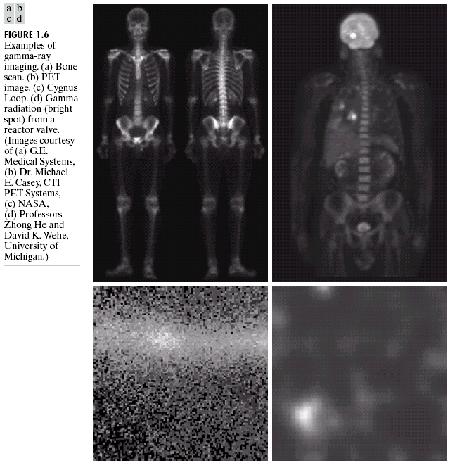
Chapter 1: Introduction

Slide 7
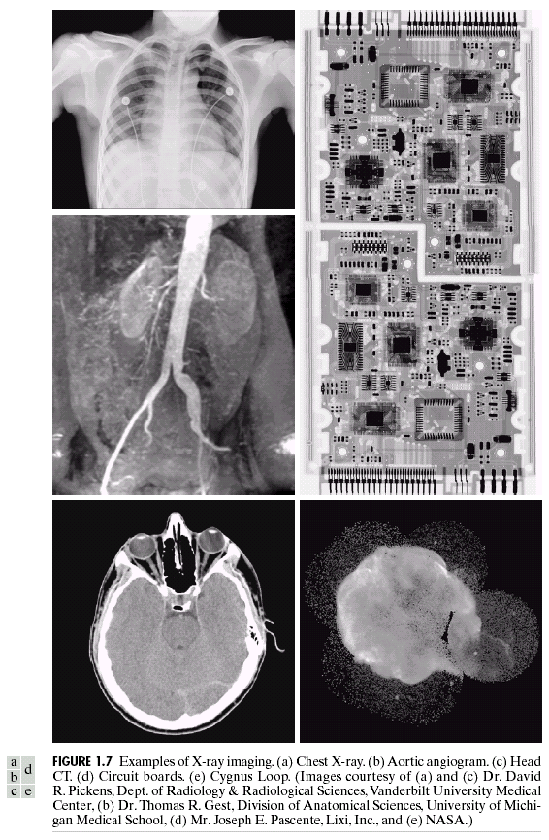
Chapter 1: Introduction
Figure 1.7 X-Ray images. (a) Chest X-ray. (b) Aortic angiogram. (c) Head CT. (d) Circuit boards. (e) Cygnus Loop.

Slide 8
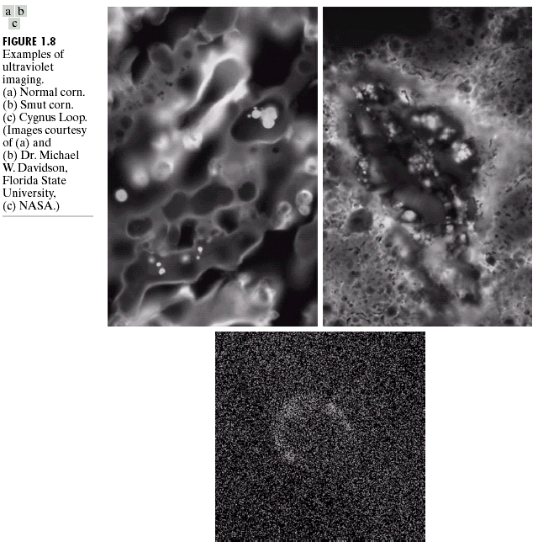
Chapter 1: Introduction
(c) 2002-2004 by Yu Hen Hu

Slide 9
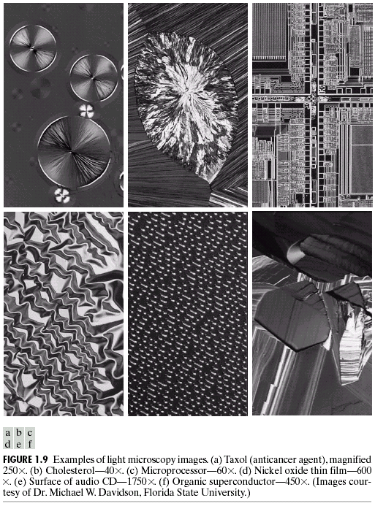
Chapter 1: Introduction
Figure 1.9 Light microscopy images. (a) Taxol (anticancer agent), magnified 250X, (b) Cholesterol, 40X (c) microprocessor 60X. (d) Nickel oxide thin film, 600 X. (e) Surface of audio CD 1750 X. (f) Organic superconductor 450 X.
(c) 2002-2004 by Yu Hen Hu

Slide 10
Why DIP?
One picture worth 1000 words!
Support visual communication
Facilitate inspection, diagnosis of complex systems
  Human body
  Manufacturing
Entertainment
Keep record, history
Managing multimedia information
Security,
  monitoring,
  watermarking, etc

Slide 11
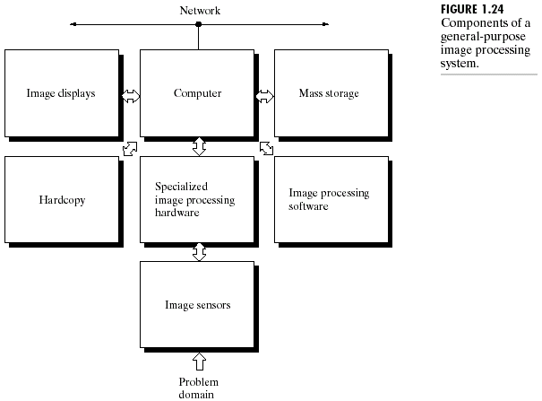
Chapter 1: Introduction
(c) 2002-2004 by Yu Hen Hu

