Slide 1

PS09 / HACKATHON
FORGETGRAPH
Dependency-Aware Deletion
Orchestrator for ML Pipelines
Track dependencies. Coordinate deletion.
Rebuild and independently verify.
TEAM HELL GOD
A controlled deletion workflow for machine-learning artifacts

Slide 2
02 / PROBLEM & PROPOSED SOLUTION
Why deletion must go beyond the source record
THE PROBLEM
OUR PROPOSED SOLUTION
A database delete can leave derived feature rows, cached predictions and a trained Ridge model untouched. The system may therefore continue using data influenced by the deleted record.
• Trace lineage and identify all affected artifacts.
• Delete the source, rebuild features, handle cache and retrain Ridge.
• Compare with an independently trained reference model; save JSON + SVG receipt.
Ek source record se engineered features, saved predictions aur ek trained model feed ho sakta hai. Sirf original row ko delete karne se ye downstream artifacts unchanged reh sakte hain. Isliye, PS09 dependency chain ke poore network mein coordinated updates demand karta hai, jiske baad ek independent check zaroori hai.
ARTIFACT 01
ARTIFACT 02
ARTIFACT 03
ARTIFACT 04
SOURCE RECORDS
FEATURE DATASET
PREDICTION CACHE
RIDGE MODEL
Original data
Engineered rows
Saved outputs
Trained parameters
FORGETGRAPH • DEPENDENCY-AWARE DELETION
02

Slide 3
03 / KEY FEATURES & TECHNICAL APPROACH
Core capabilities, backed by a practical Python stack
Follow recorded relationships from a source record to downstream ML artifacts.
Track which feature rows, saved predictions and model depend on the selected source.
Find the feature rows, cache entries and model affected.
Find the feature rows, cache entries and model affected.
Remove source data, record tombstones and rebuild retained features.
Remove source data, record tombstones and rebuild retained features.
Use request identity and idempotent execution.
Use request identity and idempotent execution.
Block tombstoned IDs from managed ingestion.
Block tombstoned IDs from managed ingestion.
Compare models independently and preserve a deletion receipt.
Compare models independently and preserve a deletion receipt.
TECHNOLOGY STACK
Python — orchestration • Streamlit — interactive dashboard • SQLite — persistent records • Pandas + NumPy — data and numerical operations • scikit-learn — Ridge Regression • pytest — automated tests
Key distinction: execution status and independent verification status are recorded separately.
The stack supports a reproducible prototype; integrations and additional model families are future extensions.
FORGETGRAPH • DEPENDENCY-AWARE DELETION
03

Slide 4
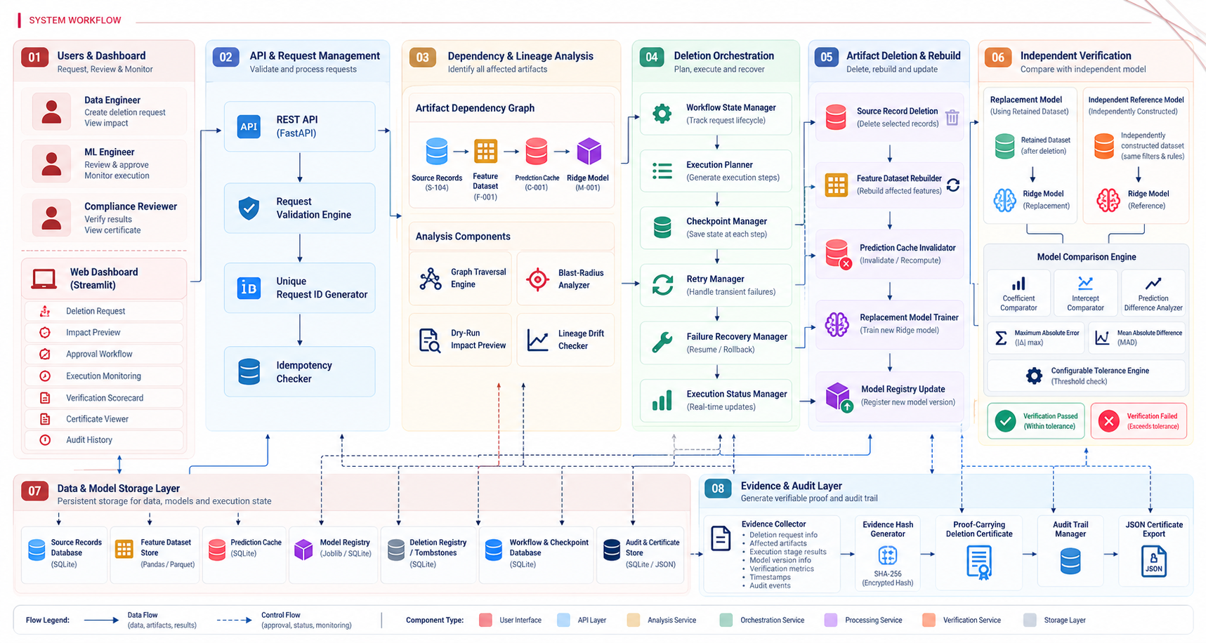
04 / END-TO-END WORKFLOW
#proposed extension
Deletion workflow
FORGETGRAPH • DEPENDENCY-AWARE DELETION
04

Slide 5
05 / DIFFERENTIATION
What makes FORGETGRAPH different—and why it matters
Identifies downstream artifacts before execution, so the system can act on the recorded dependency path.
Keeps deleted IDs in a persistent registry and blocks them from managed re-ingestion.
A repeated request can return its recorded outcome instead of repeating destructive work.
Dependency graph identifies affected artifact paths.
Persistent deletion registry blocks managed re-ingestion.
Repeated requests do not repeat unsafe work.
Shows completed, skipped and failed stages instead of hiding partial outcomes.
Stores stage progress so a failed workflow can be resumed in a controlled way.
Keeps request history, receipt revisions and verification evidence available for review.
Completed, skipped and failed stages remain visible.
Persisted state supports controlled retry.
Requests and receipt revisions remain reviewable.
WHY IT MATTERS • A workflow can finish execution while verification still fails. FORGETGRAPH reports these as separate outcomes.
FORGETGRAPH • DEPENDENCY-AWARE DELETION
05

Slide 6
06 / SYSTEM ARCHITECTURE
FORGETGRAPH | Logical System Architecture
Layered application design with isolated verification and persistent deletion evidence
USER / OPERATOR
Operator
Streamlit Presentation
Deletion request • request ID
Dashboard • request form • status • receipt view
APPLICATION & ORCHESTRATION LAYER
DATA & MODEL PROCESSING LAYER
Request Controller
Deletion Orchestrator
Lineage & Impact
Source Manager
Feature Builder
Validation • request ID • idempotency
Coordinates stages • checkpoints • recovery
Trace dependencies • identify affected artifacts
Delete target row • write tombstone
Rebuild features from retained records
Cache Manager
Model Trainer
Independent Verifier
Evidence Receipt Builder
Invalidate affected predictions
Train replacement Ridge model
Train reference model separately • compare outputs
Compile statuses • metrics • timestamps • hash
PERSISTENCE LAYER
Source Dataset
SQLite Metadata Store
Model & Feature Artifacts
Audit & Evidence Store
Original records • retained records
Lineage • tombstones • idempotency • checkpoints
Feature output • model versions • cache state
Execution history • verification result • receipt JSON / SVG
IMPLEMENTATION STACK • Python | Streamlit | SQLite | Pandas / NumPy | scikit-learn (Ridge) | pytest
FORGETGRAPH • DEPENDENCY-AWARE DELETION
06

Slide 7
07 / HOW THE STRATEGY WORKS
07 / HOW THE STRATEGY WORKS
How the strategy works: execute, then verify independently
Independent verification: how we check the rebuilt model
We train two Ridge models separately on the same retained data and settings, then compare their results against declared tolerances.
RETAINED DATA + SAME DECLARED SETTINGS
PRODUCTION PATH
After the requested source record is removed
REFERENCE PATH
Train replacement Ridge model
Train reference model separately
PATH A / REPLACEMENT MODEL
PATH B / REFERENCE MODEL
Train the model used by the updated pipeline
Train a separate model as the comparison baseline
COMPARE MODEL OUTPUTS
Coefficients • intercept • predictions
COMPARE THE TWO MODEL RESULTS
MAX PREDICTION Δ
Coefficients • Intercept • Predictions
MEAN PREDICTION Δ
PASS / FAIL RULE
0.0
0.0
1e-10 / 1e-8
WITHIN DECLARED TOLERANCES → PASS
OUTSIDE DECLARED TOLERANCES → FAIL
Strategy: use the same retained data, preprocessing, feature order and Ridge settings; compare within pre-declared tolerances. A numerical PASS is not universal proof of erasure.
Verification status: PASSED
Verification status: FAILED
Important: execution can be COMPLETED while verification is FAILED. The receipt records both statuses separately.
07
FORGETGRAPH • DEPENDENCY-AWARE DELETION
07
FORGETGRAPH • DEPENDENCY-AWARE DELETION

Slide 8
08 / CHALLENGES, FUTURE SCOPE & MARKET IMPACT
From a focused prototype to a deployable capability
CURRENT CHALLENGES
FUTURE SCOPE
MARKET PATH & IMPACT
• Accuracy depends on complete lineage.
• Support more model families and pipelines.
• Start with ML teams managing sensitive datasets.
• Prototype supports a focused Ridge workflow.
• Integrate with model registries and feature stores.
• Offer as an internal platform or governance tool.
• External copies and unmanaged systems are out of scope.
• Add cloud and distributed orchestration.
• Integrate into MLOps and data-platform workflows.
• Production deployment needs access controls and monitoring.
• Strengthen lineage discovery and policy controls.
• Reduce manual cleanup and improve reviewability.
• Large-scale rebuilds may increase compute cost.
• Different pipelines need different deletion adapters.
EXPECTED IMPACT • more consistent deletion handling • clearer operational evidence • better integration with ML governance workflows
FORGETGRAPH • DEPENDENCY-AWARE DELETION
08

Slide 9
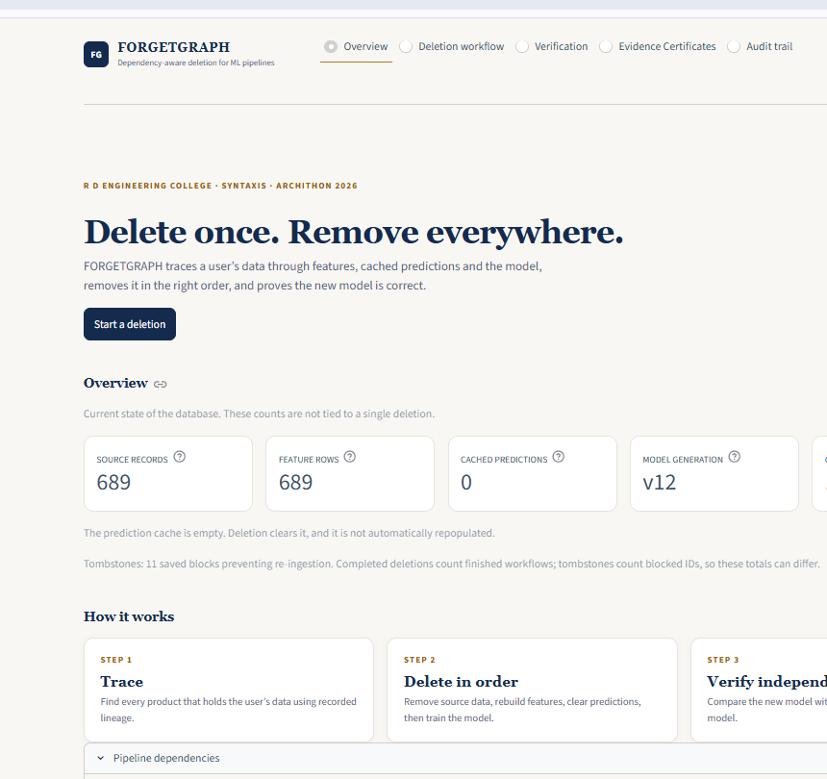
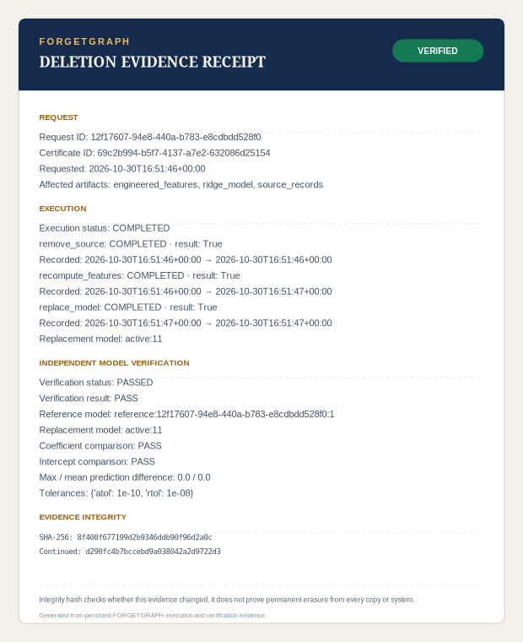
09 / PRODUCT OUTPUT
What the system produces
A live operational view plus a downloadable, verifiable Deletion Evidence Receipt.
APPLICATION DASHBOARD • OVERVIEW & PIPELINE STATUS
DELETION EVIDENCE RECEIPT • SVG PREVIEW
09

Slide 10
FORGET GRAPH
THANK YOU
TEAM HELL GOD
Track dependencies.
Coordinate deletion. Verify the result.
WE ARE OPEN FOR QUESTIONS :-

