Slide 1


VISVESVARAYA TECHNOLOGICAL UNIVERSITY, BELAGAVI-590018, KARNATAKA
BAPUJI INSTITUTE OF ENGINEERING AND TECHNOLOGY
DAVANAGERE-577004
DEPARTMENT OF COMPUTER SCIENCE AND ENGINEERING
MAJOR PROJECT PHASE II (BCS786)
on
“Metaheuristic Deep Learning Models for Leukemia Classification and Grading”
Program Coordinator:
Dr. Nirmala C R
Hod(CS&E) and
Placement Dean
Project Coordinator: Prof. Vinayaka P Assistant Professor
Under the Guidance of: Dr. Pradeep N Professor (Dept. of CS&E)

Slide 2
Team Members
Adarsh A Inamdar 4BD22CS002
Anmol Kundap 4BD22CS017
Amogh K Baliga 4BD22CS008
Tanushree M Pujar 4BD22CS176

Slide 3
Table of contents:
Introduction
Literature Survey
Problem Statements
Objectives
Methodology
Screenshots
Future Scope
Conclusion
References

Slide 4
Introduction
Leukemia is a blood cancer that originates in the bone marrow and disrupts normal blood cell production, leading to serious health complications. Traditional diagnosis relies on manual blood smear analysis, which is time-consuming and prone to human error. With increasing leukemia cases, automated diagnostic support systems are essential. This project proposes a PSO-optimised ResNet-18 model to automatically classify leukemia types and grade disease severity using blood smear images, improving accuracy, speed, and diagnostic consistency.

Slide 5
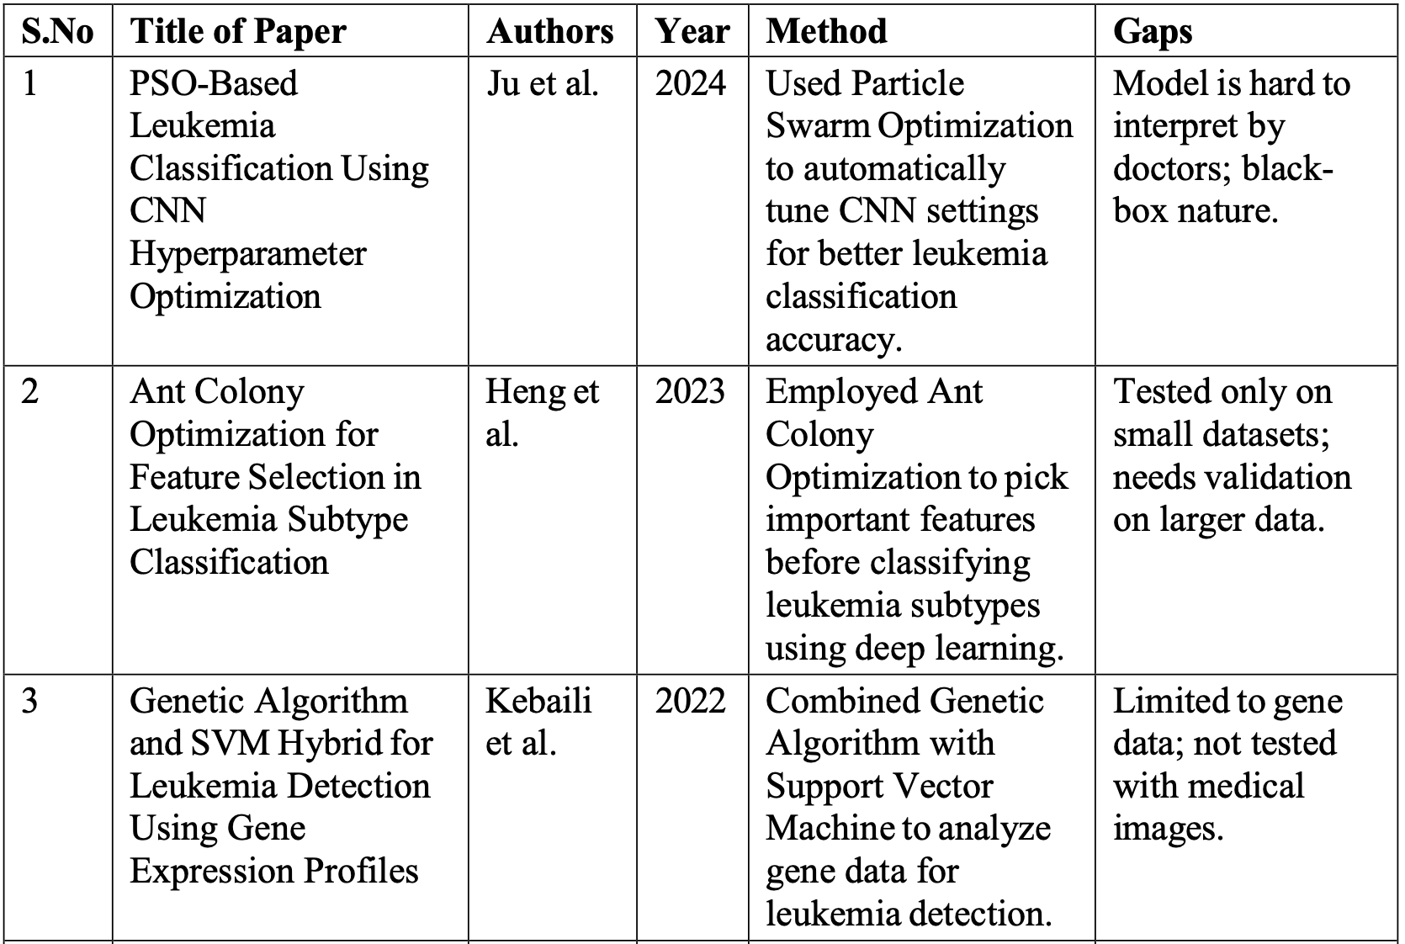
Literature Survey

Slide 6
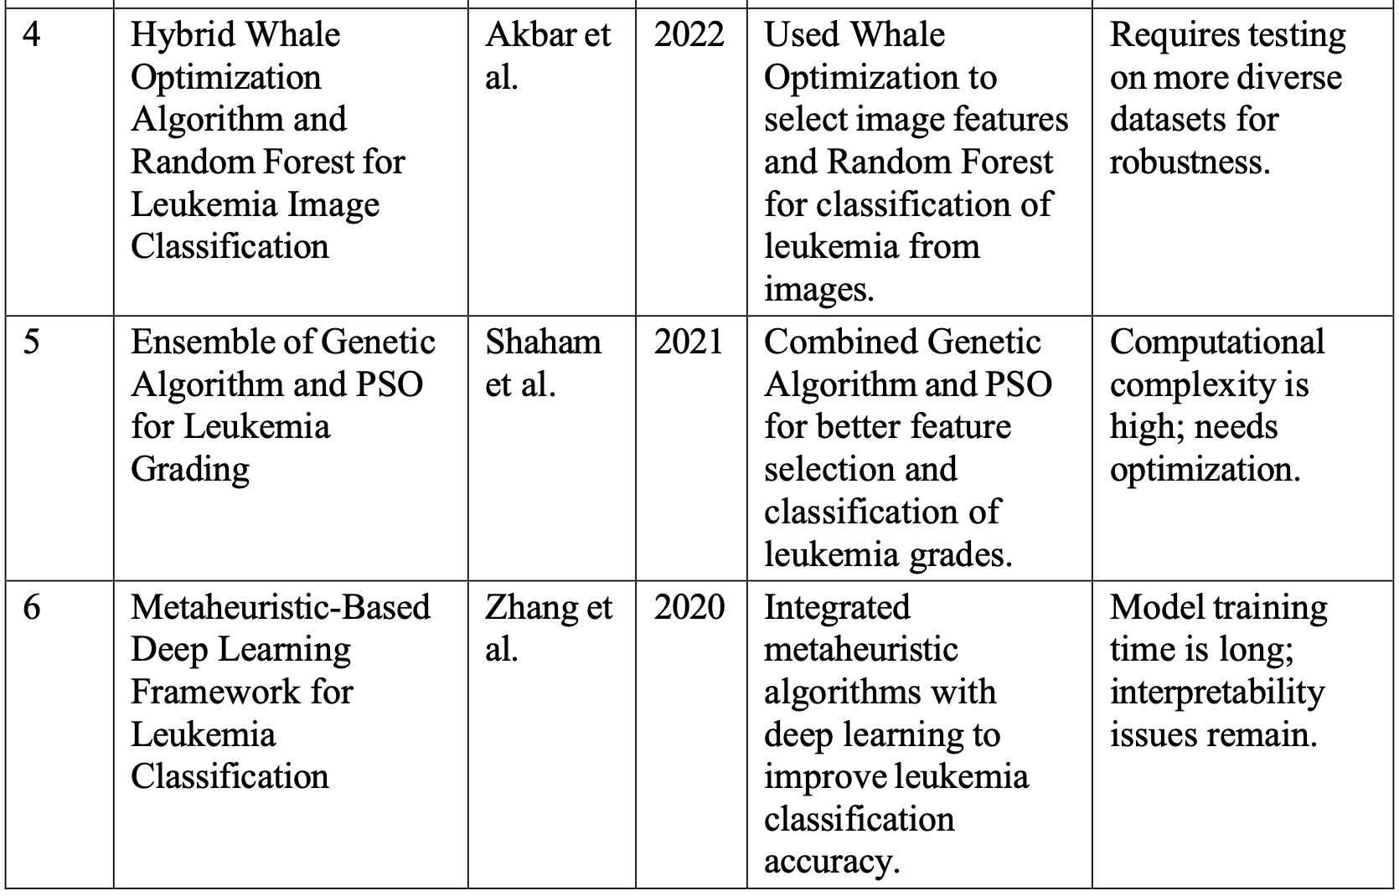

Slide 7
Problem Statement
Leukemia diagnosis requires precise classification and grading to guide effective treatment decisions. Existing automated systems predominantly focus on either classification or grading in isolation, lacking an integrated approach that addresses both simultaneously. Moreover, the accuracy and robustness of these systems are often compromised due to challenges such as imbalanced datasets, high-dimensional feature spaces, and limited interpretability. Current models rarely employ metaheuristic optimization techniques, which can enhance model performance by effectively selecting relevant features and tuning parameters. This gap results in suboptimal diagnostic outcomes and limited clinical applicability. Therefore, there is a critical need to develop a metaheuristic-driven framework that concurrently performs leukemia classification and grading, optimizing diagnostic accuracy and providing reliable, interpretable results suitable for clinical integration.

Slide 8
Project Objectives
To design and implement a unified system for automated leukemia classification and grading.
To employ metaheuristic algorithms (e.g., PSO, GA) for optimal feature selection and hyper-parameter tuning of classifiers.
To enhance accuracy, sensitivity, and reliability of classification and grading on imbalanced medical datasets.
To integrate the classification and grading stages into a single efficient pipeline, enabling streamlined analysis and faster decision support.

Slide 9
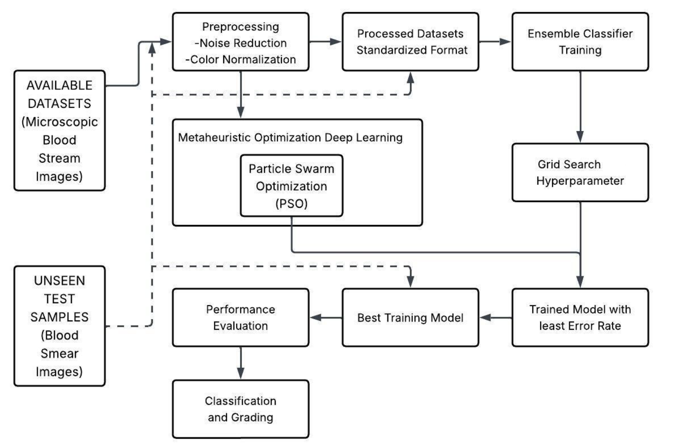
Methodology

Slide 10
Methodology
Dataset Collection: Microscopic blood smear images representing different leukemia types are used as input.
Image Preprocessing: Noise removal, colour normalisation, and standardisation to ensure uniform image quality and size.
Deep Learning Feature Extraction: CNN-based models automatically extract relevant features from preprocessed images.
Metaheuristic Optimisation (PSO): Particle Swarm Optimisation tunes model parameters and improves learning efficiency while reducing classification error.
Ensemble Training and Hyper-parameter Tuning: Multiple models are trained for robust prediction, combined with grid search to optimise learning rate, batch size, and network settings.
Model Selection: The best-performing model is chosen based on minimum error and optimal performance.
Performance Evaluation: Evaluation on unseen test data using accuracy, precision, recall, and F1-score.
Classification and Grading: Leukemia classified into ALL, AML, CLL, and CML, with severity graded as Grade-1, Grade-2, and Grade-3.
Clinical Decision Support: The final system provides accurate and consistent leukemia diagnosis and grading for clinical use.

Slide 11
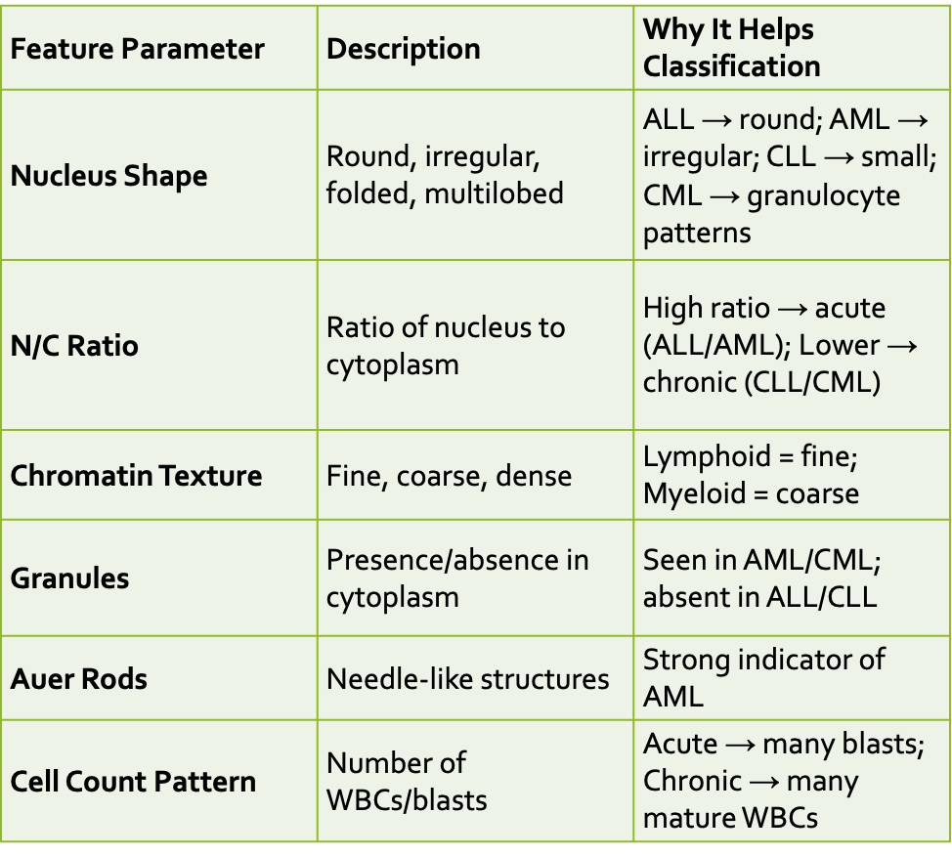
FEATURE PARAMETERS FOR CLASSIFICATION

Slide 12
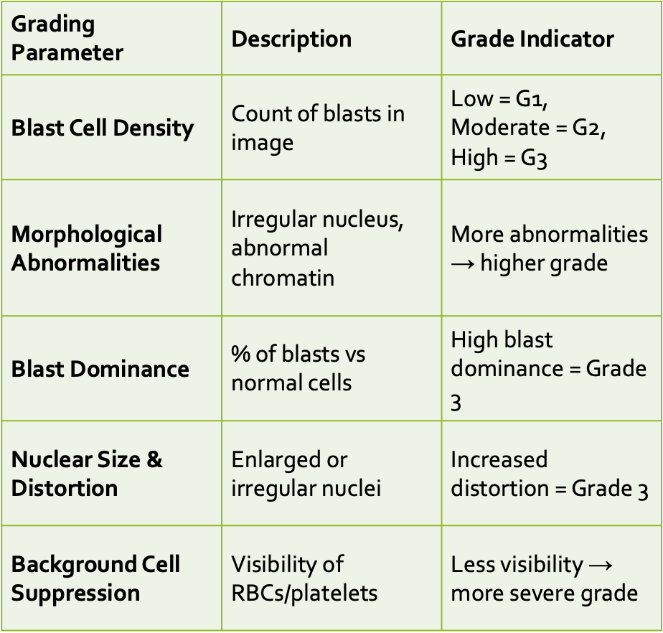
FEATURE PARAMETERS FOR GRADING

Slide 13
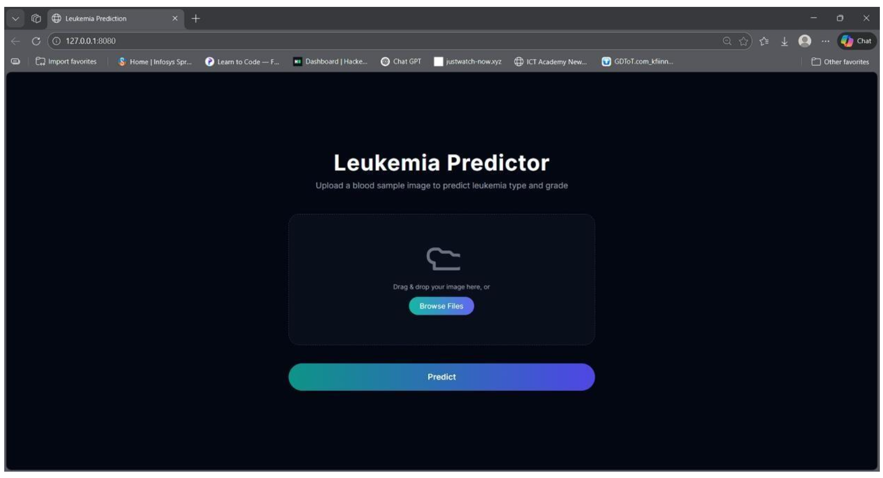
Screenshots:

Slide 14
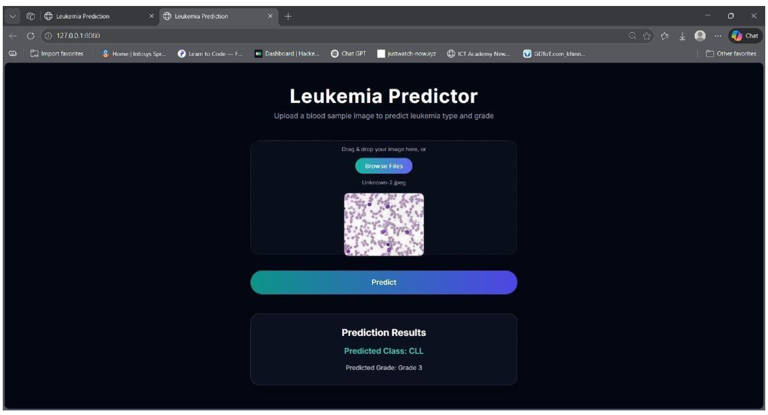
Screenshots:

Slide 15
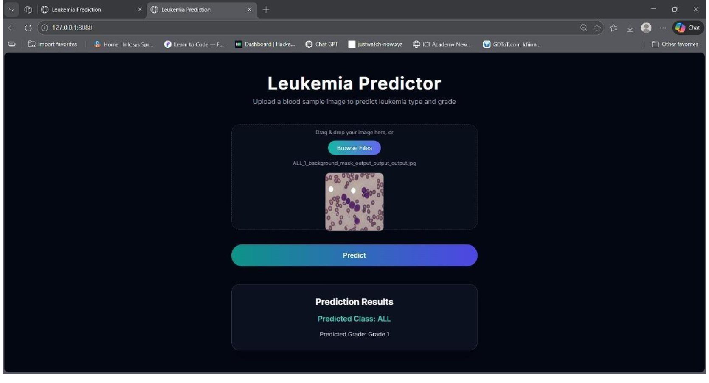
Screenshots:

Slide 16
Future Scope...
Deeper CNN Architectures: Use ResNet-34/50/101 to capture complex patterns and improve accuracy.
Enhanced Optimization Methods: Apply advanced or hybrid metaheuristic techniques to boost performance and reduce training time.
Multi-Modal Data Integration: Combine image data with clinical, lab, or genetic information for more reliable diagnosis.
Real-Time Clinical Deployment: Implement the system in hospitals for large-scale, real-time leukemia screening and decision support.

Slide 17


Conclusion
This project presents a PSO–ResNet-18 based framework for accurate leukemia classification and severity grading from blood smear images. Particle Swarm Optimization improves feature relevance and learning configurations, allowing ResNet-18 to focus on critical cellular patterns such as morphology, nucleus structure, and texture. The residual learning capability ensures stable training and strong generalization. Overall, the system offers an efficient and reliable decision-support tool for improved leukemia diagnosis and clinical outcomes.

Slide 18
Reference
[1] R. Siegel, K. Miller, and A. Jemal, “Cancer statistics,” CA: A Cancer Journal for Clinicians, vol. 70, no. 1, pp. 7–30, 2020.
[2] J. H. Jaffe et al., “World Health Organization classification of tumours of haematopoietic and lymphoid tissues,” IARC Press, Lyon, France, 2017.
[3] S. H. Swerdlow et al., “The 2016 revision of the WHO classification of lymphoid neoplasms,” Blood, vol. 127, no. 20, pp. 2375–2390, 2016.
[4] K. He, X. Zhang, S. Ren, and J. Sun, “Deep residual learning for image recognition,” in Proc. IEEE Conf. Computer Vision and Pattern Recognition (CVPR), Las Vegas, NV, USA, pp. 770–778, 2016.
[5] E. A. Rytting and M. E. Jabbour, “Acute lymphoblastic leukemia,” Lancet, vol. 385, no. 9963, pp. 335–347, 2015.

Slide 19
[6] D. Thomas and H. Kantarjian, “Acute myelogenous leukemia,” New England Journal of Medicine, vol. 353, no. 10, pp. 1059–1072, 2005.
[7] F. Scotti, “ALL-IDB: The Acute Lymphoblastic Leukemia Image Database for image processing,” Proc. IEEE Int. Conf. Image Processing, pp. 2045–2048, 2005.
[8] S. Shafin et al., “Classification of normal and leukemic cells from microscopic blood images,” Proc. ISBI, pp. 1–5, 2019.
[9] P. T. Mooney, “Blood cell detection and classification dataset,” Kaggle, 2018.
[10] D. Arber et al., “The 2016 WHO classification of acute myeloid leukemia,” Blood, vol. 127, no. 20, pp. 2391–2405, 2016.

