Slide 1



Bapuji Institute of Engineering and Technology, Davanagere-577004
Department of Computer Science and Engineering,
Presentation on
Major Project Phase-II (BCS786)
Metaheuristic Deep Learning Model for Leukemia Classification and Grading
Team Associates
Name of the Student
USN
Anmol Kundap
4BD22CS017
4BD22CS176 4BD22CS002 4BD22CS008
Tanushree M Pujar Adarsh A Inamdar Amogh K Baliga
Guide
ProjectCoordinator
Program Coordinator
Prof. Vinayak P
Dr. PradeepN
Ph.D
M Tech.
Dr.Nirmala CR
Ph.D.
Professor
Assistant Professor
Head of the department

Slide 2
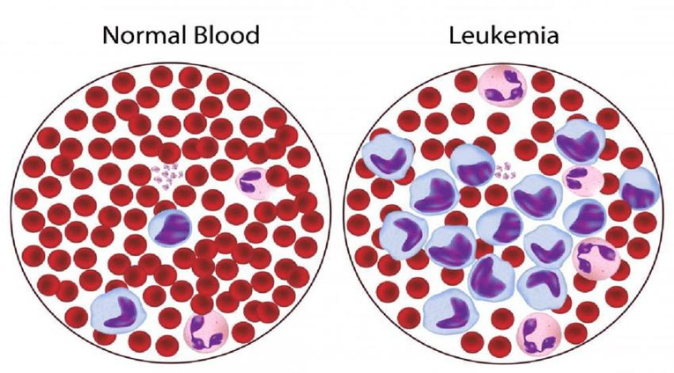
Introduction
Leukemia is a type of blood cancer that starts in the bone marrow, where new blood cells are made. Instead of making healthy cells, the body makes too many abnormal white blood cells that cannot fight infections. These bad cells push out the healthy ones, causing problems like tiredness (low red blood cells), frequent infections (weak white blood cells), and easy bleeding or bruising (low platelets). It can happen because of changes in cell DNA, sometimes linked to radiation, harmful chemicals, smoking, or past cancer treatments. Leukemia can affect anyone, but finding it early and starting treatment helps in better recovery.

Slide 3


Problem Statement
Current systems for leukemia diagnosis focus only on classification or grading, not both together. They also face issues like low accuracy, imbalanced data, and poor interpretability. A metaheuristic-based framework is needed to improve both classification and grading simultaneously, giving more accurate and reliable results for clinical use.
Existing methods face several challenges:
Manual analysis is time-consuming and error-prone.
Current AI models are not optimised for both classification and grading simultaneously.
Limited usage of Metaheuristic Optimisation in Hyper-parameter tuning.
Datasets are often imbalanced, affecting model robustness.

Slide 4

Objectives
•
Design a unified system for automated Leukemia classification and grading.
•
Employ Metaheuristic algorithms for optimal feature selection and Hyper-parameter tuning.
•
Enhance accuracy, sensitivity, and reliability on imbalanced medical datasets.
•
Integrate classification and grading stages for streamlined analysis and faster decision support.

Slide 5

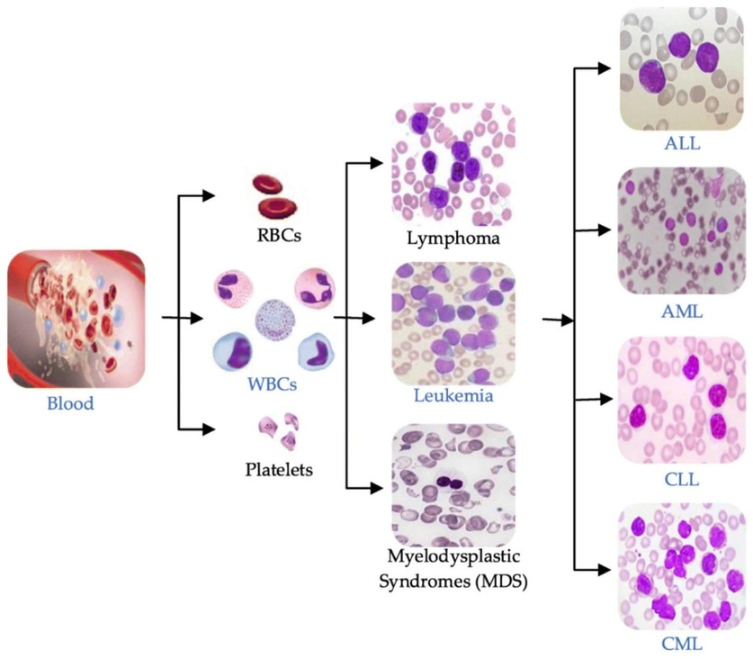
Types of Leukemia
Leukemia is classified by its speed of development and affected cell type.
1
Acute Lymphoblastic Leukemia (ALL)
Fast-growing, affects lymphoid cells, common in children.
2
Acute Myeloid Leukemia (AML)
Rapid, affects myeloid cells, seen in both children and adults.
3
Chronic Lymphocytic Leukemia (CLL)
Slow-growing, affects lymphocytes, common in older adults.
4
Chronic Myeloid Leukemia (CML)
Slow progression, affects myeloid cells, may evolve to acute.

Slide 6

Leukemia Grading
Leukemia is classified first and then simultaneously graded into 3 category:
1
Chronic Phase (less than 10%)
Mild or no symptoms; good response to treatment
2
Accelerated Phase (10% to 19%)
Anemia, enlarged spleen, increasing WBCs, disease progressing
3
Blast Crisis (20% or more)
Resemblances acute Leukemia; severe symptoms; poor prognosis

Slide 7
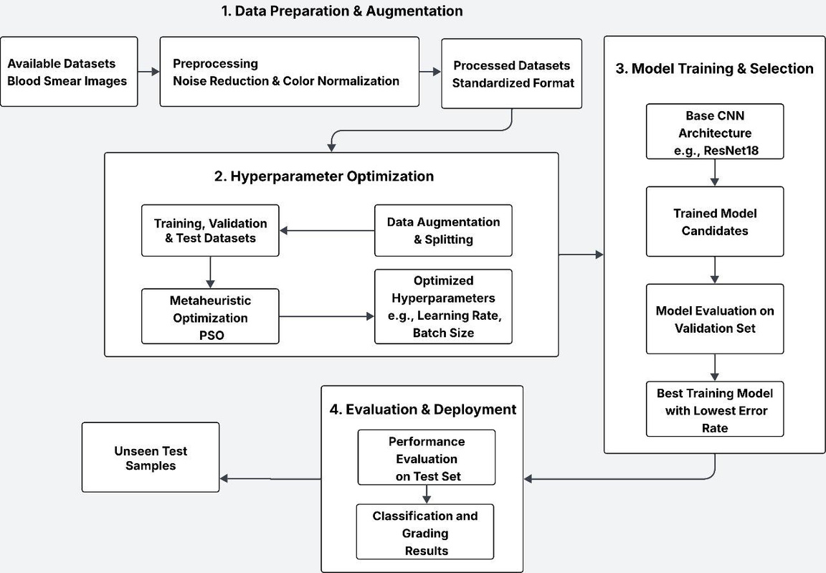
Methodology

Slide 8
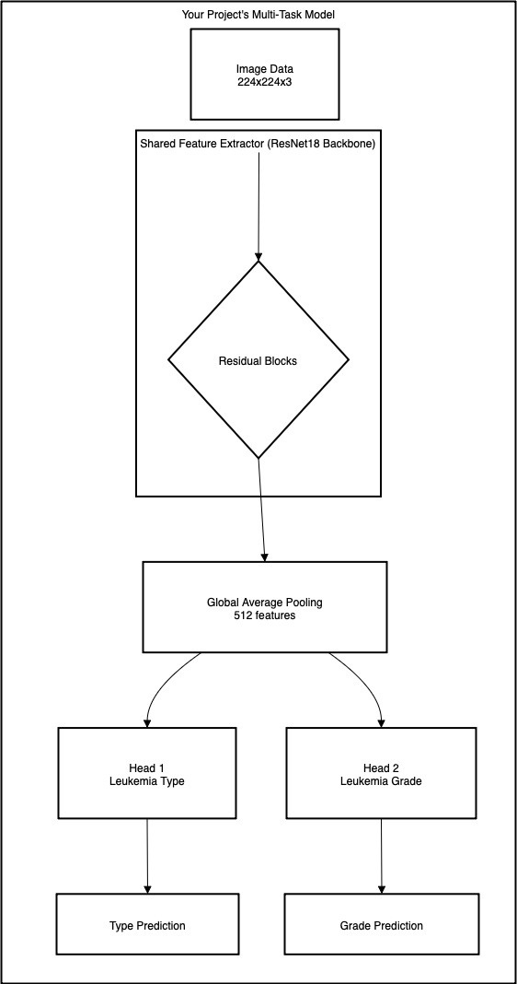
Work Flow Diagram

Slide 9

Conclusion
We have built a unified system that can classify and grade Leukemia together. Metaheuristic method PSO was used to select features and tune the model. The system combines both tasks in one pipeline for faster results. The next step is to improve its accuracy and reliability, especially on imbalanced medical data.

Slide 10

References
ALL-IDB(Acute Lyphoblastic Leukemia Image Database) - https://home.di.unimi.it/scottin/all/
C-NMC(Leukemia Classification) – https://www.kaggle.com./datasets/shafiullahshafin/c-nmc/
Blood Cell Detection and Classification(BCCD) – https://www.kaggle.com/datasets/paultimothymooney/blood-cells
Kennedy,J.,& Elberhart, R.(1995).Particle swarm optimization in proceeding of ICNN’95-International Conference onNeuralnetworks,1942-1948

