Slide 1

DATA MANAGEMENT
Topic: Suicide Data Analysis
Online ETP Presentation
17th December,2020
Submitted by:
∙ Adarsh Ranjan
∙ 11808745
∙ B Tech CSE

Slide 2

INTRODUCTION
This project covers the analysis part of suicide rate of various Asian and European Countries from the year span of 1988-2019. The dataset is sourced from Kaggle website containing 9 fields and around 27000 records.
The technology or the tool used for the project is Microsoft Excel. Microsoft Excel is a helpful and powerful program for data analysis and documentation.

Slide 3
Source Of Dataset
The data set was taken from a Kaggle account.
Link:-
https://www.kaggle.com/russellyates88/suicide-rates-overview-1985-to-2016

Slide 4
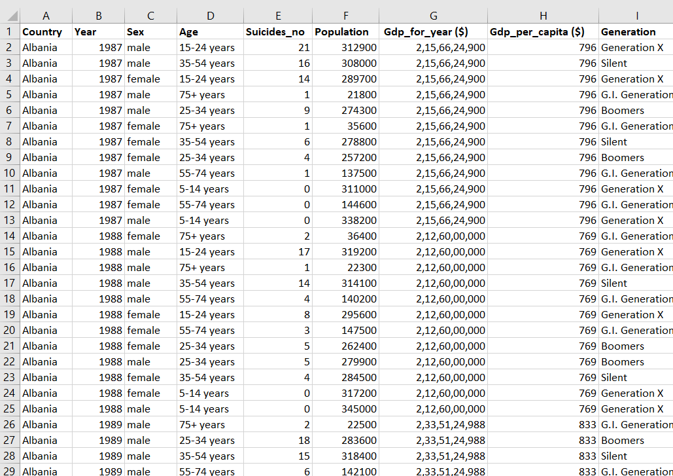
Suicide Dataset

Slide 5
Objective
1. Analysis of the top 10 countries with maximum suicide rate over a particular year.
2. Analysis of the top 10 countries with minimum suicide rate over a particular year.
3. Analysis of the number of suicide happened year wise.
4. Age wise analysis of the suicide rate.
5. Generation wise analysis of the suicide rate.
6. Analysis of the top 10 countries with the highest population over the year.
7. Analysis of the top 10 countries with the lowest population over the year.
8. Analysis of top 10 countries with highest GDP over the year.
9. Analysis of top 10 countries with lowest GDP over the year.

Slide 6
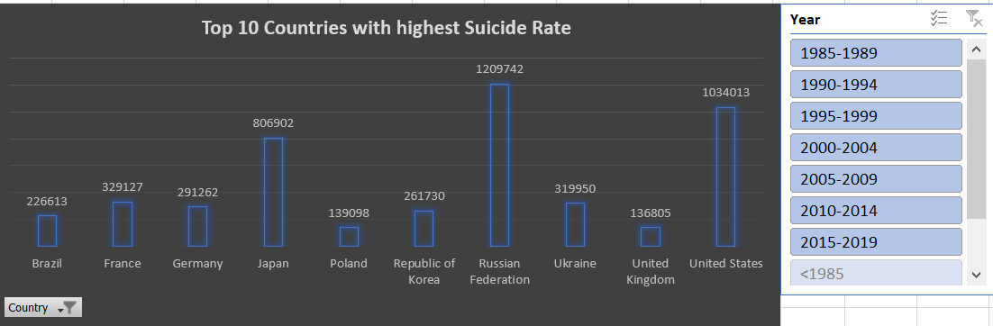
Analysis Of Objective
Analysis of the top 10 countries with maximum suicide rate over a particular year.

Slide 7
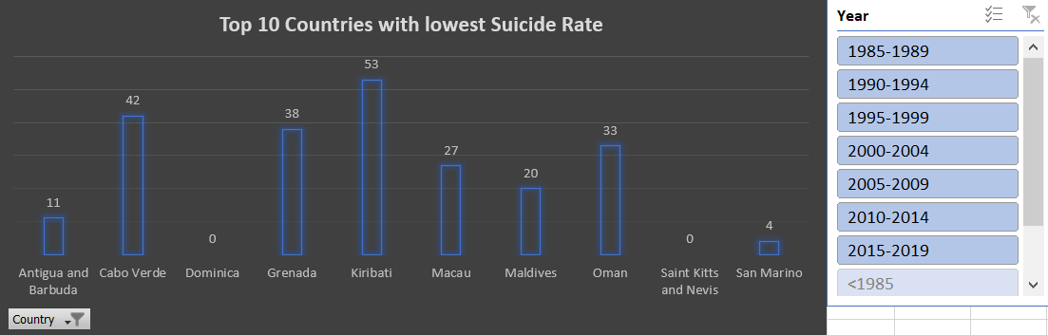
2. Analysis of the top 10 countries with minimum suicide rate over a particular year.

Slide 8
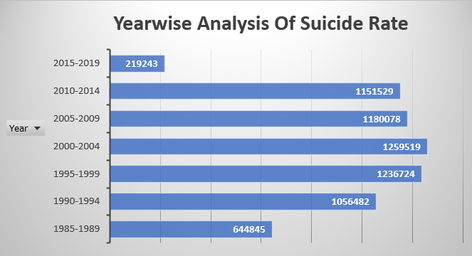
3. Analysis of the number of suicide happened year wise.

Slide 9
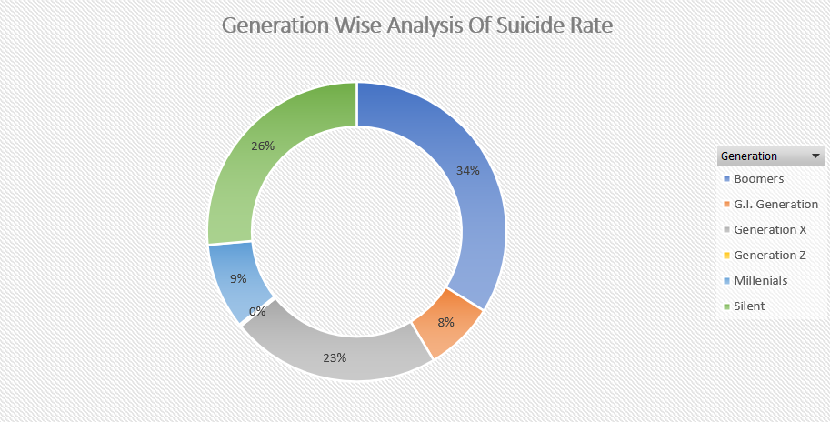
4. Generation wise analysis of the suicide rate.

Slide 10
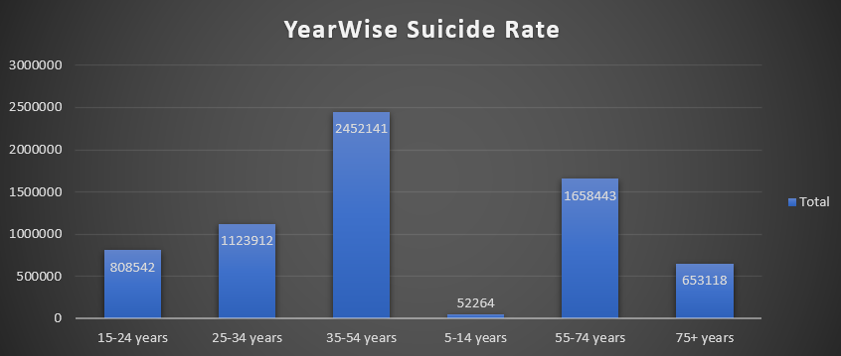
5. Age wise analysis of Suicide rate.

Slide 11
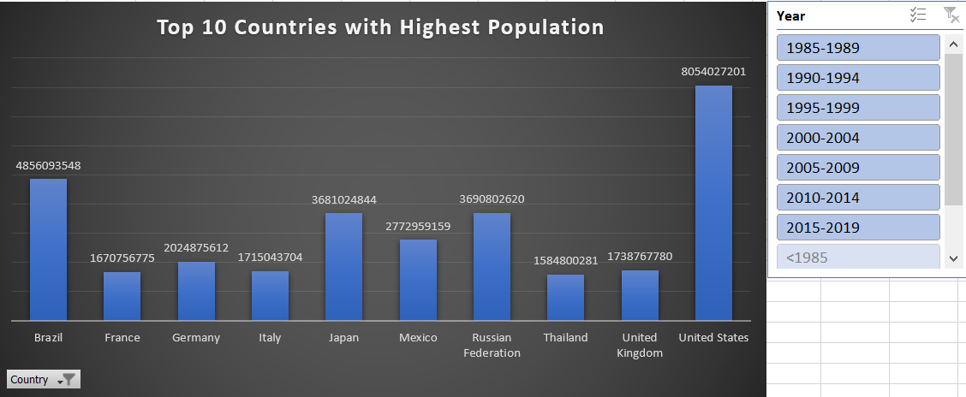
6. Analysis of top 10 countries with highest population over the year.

Slide 12
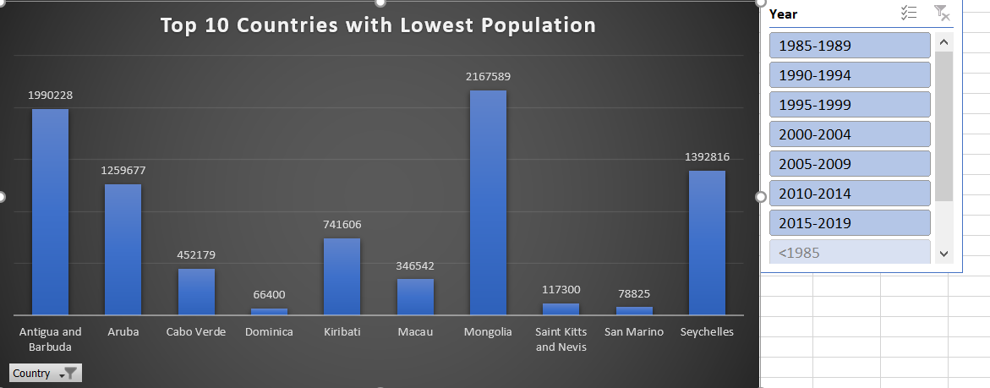
7. Analysis of top 10 countries with lowest population over the year.

Slide 13
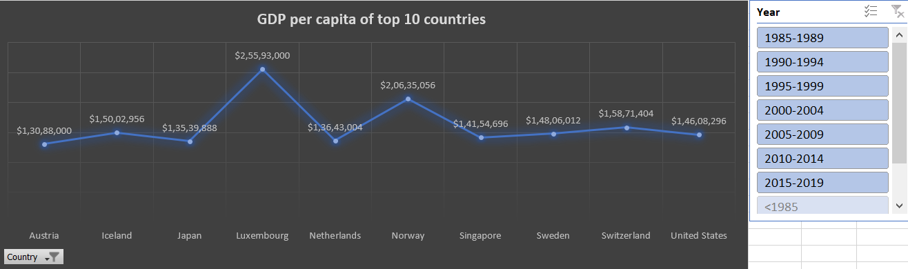
8. Analysis of top 10 countries with highest GDP over the year.

Slide 14
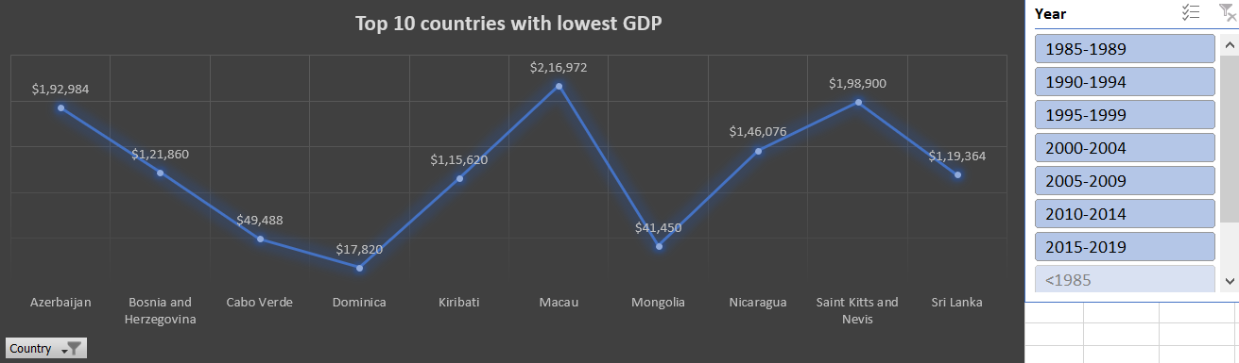
9. Analysis of top 10 countries with lowest GDP over the year.

Slide 15
Result Of Analysis
1. Analysis of the top 10 countries with maximum suicide rate over a particular year.
Between 1985-1989 = United States
Between 1990-1994 = Russian Federation
Between 1995-1999 = Russian Federation
Between 2000-2004 = Russian Federation
Between 2005-2009 = Russian Federation
Between 2010-2014 = United States
Between 2015-2019 = United States

Slide 16
2. Analysis of the top 10 countries with minimum suicide rate over a particular year.
Between 1985-1989 = Antigua and Barbuda, Bahamas, Dominica
Between 1990-1994 = Saint Kitts and Nevis
Between 1995-1999 = Qatar and Antigua and Barbuda
Between 2000-2004 = Kiribati and Montenegro
Between 2005-2009 = Antigua and Barbuda, San Marino
Between 2010-2014 = Antigua and Barbuda
Between 2015-2019 = Grenada

Slide 17
3. Analysis of the number of suicide happened year wise.
Between 1985-1989 = 644845
Between 1990-1994 = 1056482
Between 1995-1999 = 1236724
Between 2000-2004 = 1259519
Between 2005-2009 = 1180078
Between 2010-2014 = 1151529
Between 2015-2019 = 219243

Slide 18
4. Generation wise analysis of Suicide rate.
Boomers = 2284498
G.I. Generation = 510009
Generation X = 1532804
Generation Z = 15906
Millenials = 623459
Silent = 1781744

Slide 19
5. Age wise analysis of Suicide Rate.
5-14 years = 52264
15-24 years = 808542
25-34 years = 1123912
35-54 years = 2452141
55-74 years = 1658443
75+ years = 653114

Slide 20
6. Analysis of the top 10 countries with the highest population over the year
United States = 8054027201
United Kingdom = 1738767780
Thailand = 1584800281
Russian Federation = 3690802620
Mexico = 2772959159
Japan = 3681024844
Italy = 1715043704
Germany = 2024875612
France = 1670756775
Brazil = 4856093548

Slide 21
7. Analysis of the top 10 countries with the lowest population over the year
Antigua and Barbuda = 1990228
Aruba = 1259677
Cabo Verde = 452179
Dominica = 66400
Kiribati = 741606
Macau = 346542
Mongolia = 2167589
Saint Kitts and Nevis = 117300
San Marino = 78825
Seychelles = 1392816

Slide 22
8. Analysis of top 10 countries with highest GDP over the year.
Luxembourg = $2,55,93,000
Norway = $2,06,35,056
Switzerland = $1,58,71,404
Austria = $1,30,88,000
Iceland = $1,50,02,956
Japan = $1,35,39,888
United States = $1,46,08,296
Singapore = $1,41,54,696
Netherlands = $1,36,43,004
Sweden = $1,48,06,012

Slide 23
9. Analysis of top 10 countries with lowest GDP over the year.
Azerbaijan = $1,92,984
Bosnia = $1,21,860
Cabo Verde = $49,488
Dominica = $17,820
Kiribati = $1,15,620
Macau = $2,16,972
Mongolia = $41,450
Nicaragua = $1,46,076
Saint Kitts = $1,98,900
Sri Lanka = $1,19,364

Slide 24


