Slide 1

PARKINSON DISEASE DETECTION SYSTEM
(MINI PROJECT)
PRESENTED BY:
SANA MANSOORI
B.TECH(CSE) , 210121935
PRESENTED BY:
ADARSH GUPTA
B.TECH(CSE) , 210111954

Slide 2
CONTENT
PARKINSON DISEASE DETECTION SYSTEM
PARKINSON DISEASE ?
INFO ABOUT PROJECT MODEL
ARCHITECTURAL DIAGRAM
DATAFLOW DIAGRAM
RANDOM FOREST CLASSIFIER
SVM (SUPPORT VECTOR MACHINE)
CONCLUSION AND FUTURE WORK

Slide 3
WHAT IS PARKINSON DISEASE ?
Parkinson's disease is a neurodegenerative disorder affecting dopamine neurons in the brain, causing movement issues like tremors and stiffness. Symptoms include shaking, rigidity, slow movement, and thought and behavior changes.

Slide 4
PARKINSON DISEASE DETECTION SYSTEM
This project aims to detect Parkinson's disease in early stages by utilizing machine learning algorithms to compare user-input data with historical data. The model uses data from both normal and affected individuals, with 20% for testing and 80% for training.

Slide 5
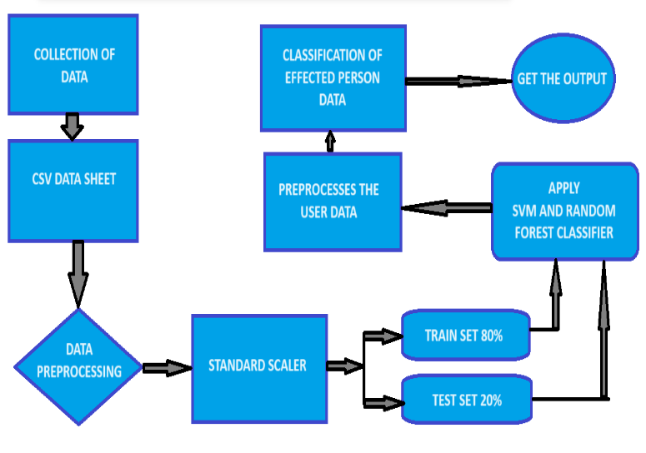
ARCHITECTURAL DIAGRAM

Slide 6
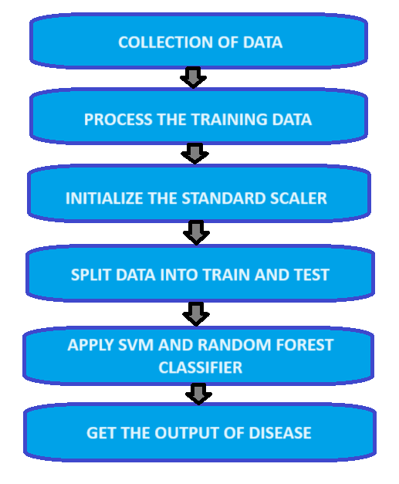
DATAFLOW DIAGRAM

Slide 7
RANDOM FOREST CLASSIFIER
Random forest is a Supervised Machine Learning Algorithm that is used widely in Classification and Regression problems. It builds decision trees on different samples and takes their majority vote for classification and average in case of regression.

Slide 8
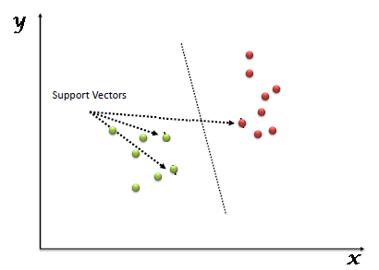
SVM (SUPPORT VECTOR MACHINE)
Support Vector Machine (SVM) is a supervised machine learning algorithm used for classification and regression problems, plotting data items in n-dimensional space and finding a hyperplane for classification.

Slide 9
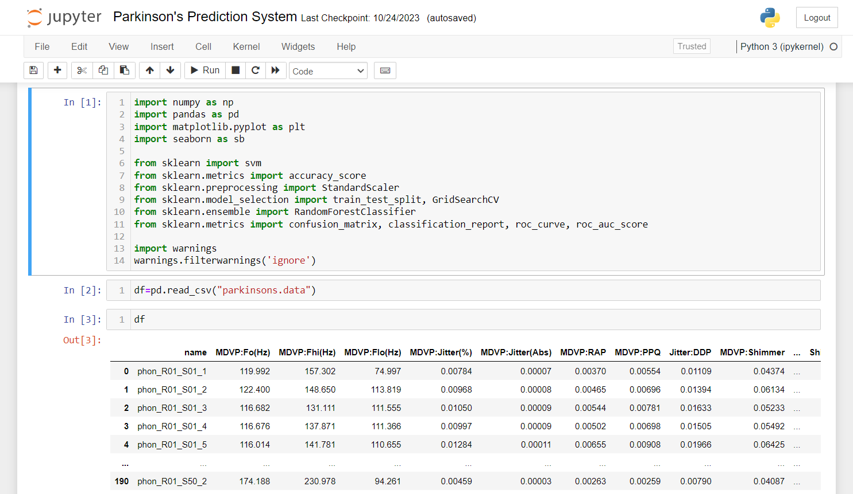
CODING PLATFORM : ANACONDA (JUPYTER NOTEBOOK)
PARKINSON DISEASE DETECTION SYSTEM PROJECT

Slide 10
CONCLUSION AND FUTURE WORK
The project aims to predict early Parkinson disease using user symptoms, with an accuracy of 88% using random forest classifier and 87% using svm model.
Future Parkinson's disease detection systems will integrate technology, research, and healthcare advancements, utilizing a multidisciplinary approach to advance early diagnosis, improve patient care, and contribute to ongoing research.

Slide 11
Thankyou

