Slide 1


FAKE NEWS DETECTION USING NLP
Department of Computer Science and Engineering,
Bapuji Institute of Engineering and Technology,Davanagere- 577004
Project Associates
Anmol Kundap 4BD22CS017
Adarsh A Inamdar 4BD22CS002
Amogh K Baliga 4BD22CS008
Tanushree M Pujar 4BD22CS176
Project Guide
Dr.Pradeep N
Dept of CS&E
BIET,Davanagere
Mini-Project Coordinator
Dr. Jyothi G C
Program Coordinator

Slide 2
Contents
Introduction
Problem statement
Tools and Technologies
Methodology
Result and Outcomes
Conclusion

Slide 3
What is fake news?
Fake news is false or misleading information presented as if it were real news. It is often created to influence people’s opinion, spread rumours, or make money.
Fake news is a lie made to look like real news.

Slide 4
Problem Statement
Growing spread of misinformation online.
Impact on public trust and societal stability.
Difficulty in manual verification due to the high volume of data.

Slide 5



Technology Stack
Programming Languages:

Slide 6
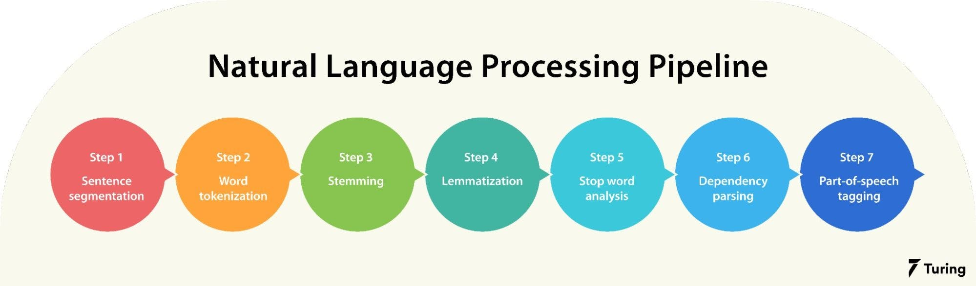
Technology Stack
Libraries/Frameworks: Flask Requests BeautifulSoup4
sentence-transformers torch bs4 newspaper3k

Slide 7


Technology Stack
Infrastructure:
Model Choose to develop:

Slide 8
A Step Toward Combating Misinformation
Methodology
1. Web Scraping: Collect news data from websites and social media platforms.
2. NLP Model Development: Analyze text patterns using models.
3. Platform Design: User interface for news validation.

Slide 9
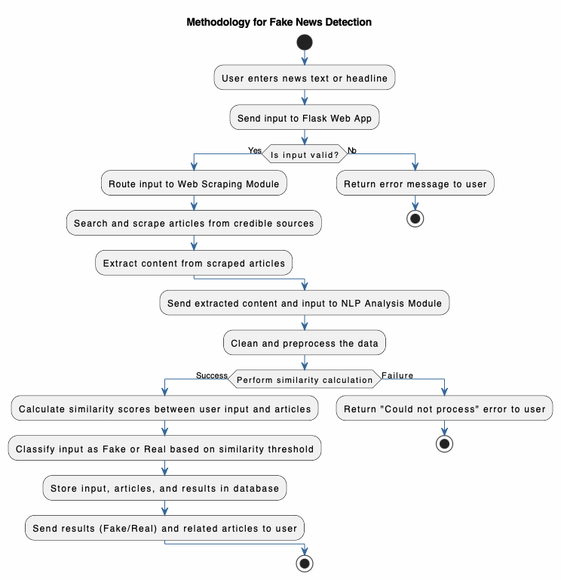

Slide 10
Results and Expected Outcomes
Accuracy improvement through NLP.
Scalability via automated web scraping.
Real-world impact in reducing misinformation.

Slide 11
Conclusion
Importance of fake news detection.
Integration of NLP and web scraping as an innovative solution.
Request for support and feedback.

Slide 12
TRY IT OUT!

Slide 13
THANK YOU

