Slide 1
Mutual Fund Analytics Capstone
Data Engineering & Quantitative Analysis
Prepared by Bluestock AI

Slide 2
Executive Summary
End-to-End Analytics Architecture
ETL Pipeline: Scraped, cleaned, and warehoused 1M+ rows of NAV and transaction data into a SQLite Star Schema.
Quantitative Engine: Computed CAGR, Sharpe, Alpha, Beta, VaR, and executed Monte Carlo simulations.
Dashboarding: Built a live, interactive Streamlit Glassmorphism application.

Slide 3
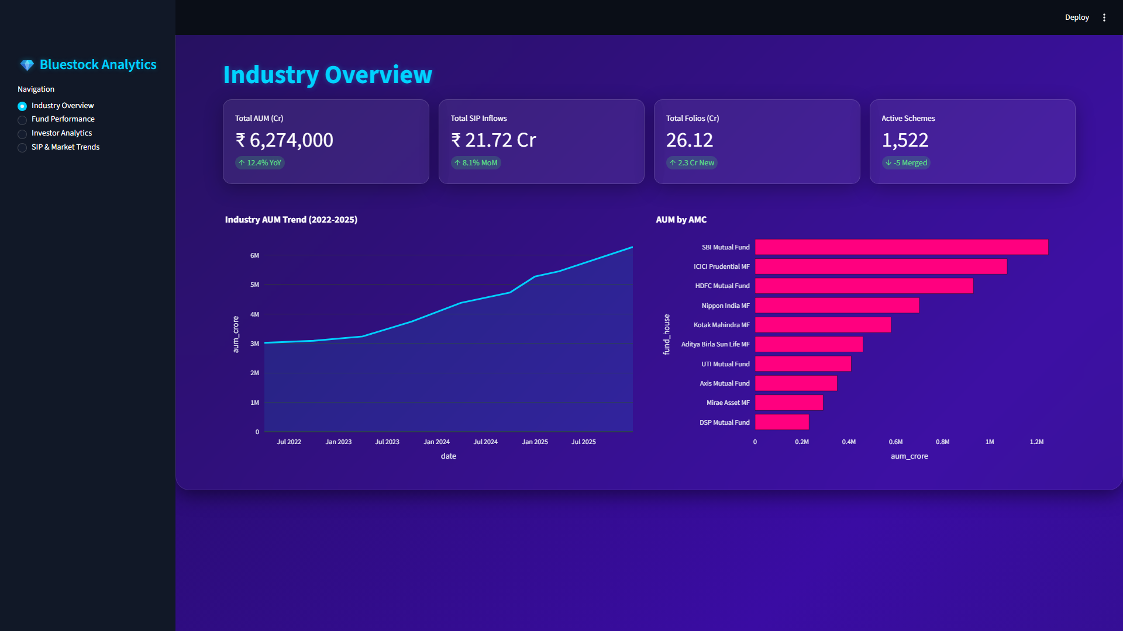
Industry Overview Dashboard

