Slide 1
Lab 1
Team X-4B

Slide 2
Team Members
Aanchal Agarwal (PES2UG20CS005)
Ananya Adiga (PES2UG20CS043)
Anirudh Chakravarty Kumar (PES2UG20CS049)
Adarsh Liju Abraham (PES2UG20CS017)

Slide 3
Task 1: Case Study

Slide 4
1 a). Identify from the observations, where all would you think Service Inc. did not meet the intent of the Agile Manifesto?
Focus was on extensive documentations rather than on the working software
Operate on an air tight requirement
Planning and client requirements were frozen before committing to their resources i.e Design phase
Services.inc assumed to be successful in shielding it's core engineering team from the customer complaints
Failed as an organisation to deliver the needs of its customer
The ways of working in services.inc engineering management is hierarchical and bureaucratic and they did not have a scrum master.
Services.inc was clearly considering keeping the relationship limited to low value IT services if Product.inc gave a ‘GO’ to them, in order to achieve 40% profitability. Contract negotiations were clearly given prime focus.
In the 4 week sprints, the quality engineers joined after two weeks and nothing was ready for testing till the end of third week. In Agile quick testings are done in the count of 6-7 days and regular quality checks are done with a higher frequency
Product owners in the scrum teams have worked with the products ever since the centres have been set up but have never met a customer
The team members who were responsible for for emergency product issues which majorly upset the sprint deliverables and the sprint backlog underwent changes till the third week. This depicts that they were not completely ready to respond to changes and were fixed with following a plan.

Slide 5
1 b) Identify from the observations, where all would you think Service Inc. deviated from what is expected from a SCRUM implementation?
Stan managed the conduction of planned anonymous surveys (conducted by Product Inc.) seeking feedback from both lead engineers and managers in diverse engineering roles in each centre. Due to the way the survey was conducted and controlled by Product Inc., there was no scope of Service Inc. influencing the responses though Service Inc. tried it’s best to coach its employees beforehand.
The 4 week sprint at each of four centres ended up taking 5 weeks , they failed in maintaining and keeping the sprint speed in mind
In the presentation presented by Stan, Services.inc was clearly considering keeping the relationship limited to low value IT services if Product.inc gave a ‘GO’ to them, in order to achieve 40% profitability, this indicates they failed in maintaining a contract negotiation with Product.inc
They also planned to compromise with moderate value product maintenance services in order to achieve their profits, they clearly prioritised their profits rather than on the client’s requirements about the quality of product
The ways of working in services.inc engineering management is hierarchical and bureaucratic and they did not have a scrum master.
Product owners in the scrum teams have worked with the products ever since the centres have been set up but have never met a customer so user recommendations were overlooked.
the backlog at the beginning of the scrum is more ambitious than the average velocity of the scrum teams recorded so far as the teams prefer to take ambitious targets
The project manager has been trained into the new role of Scrum Master. This is not ideal. They generally are different from the usual.

Slide 6
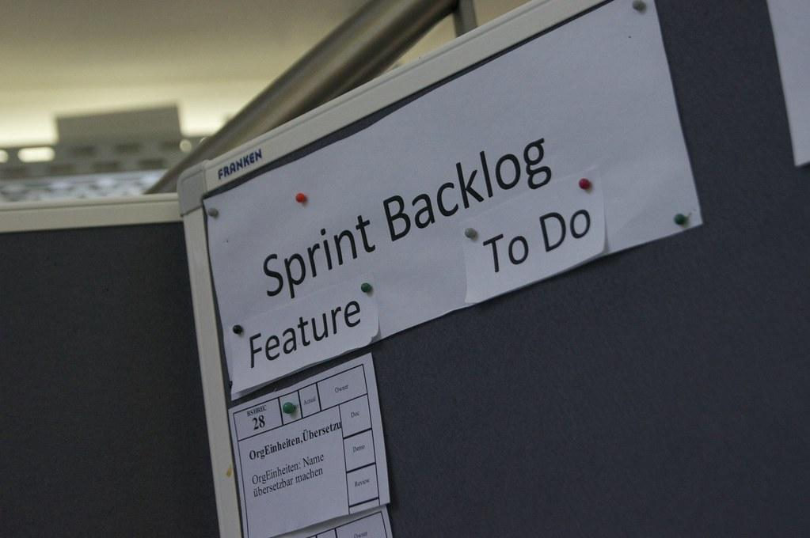
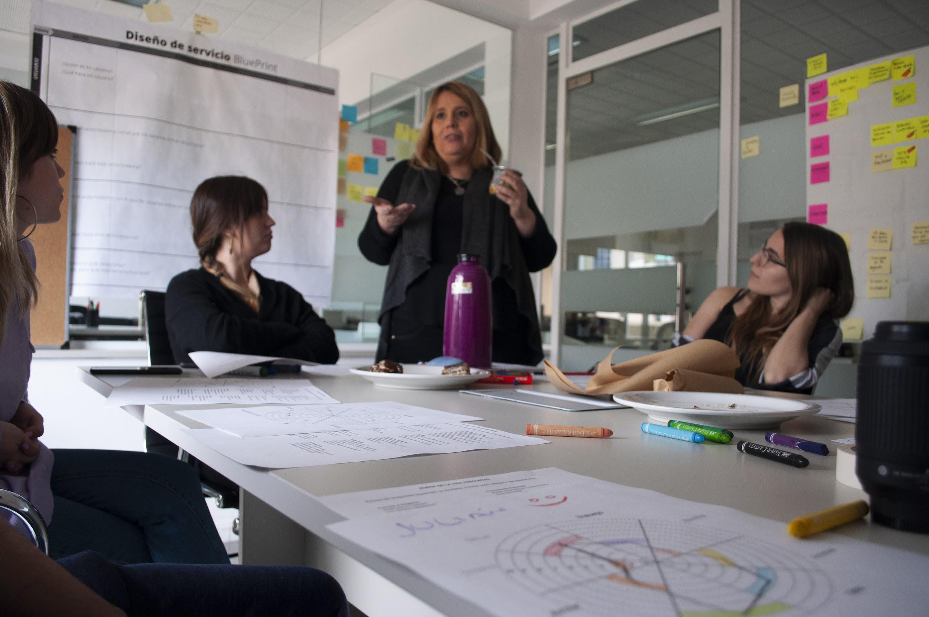
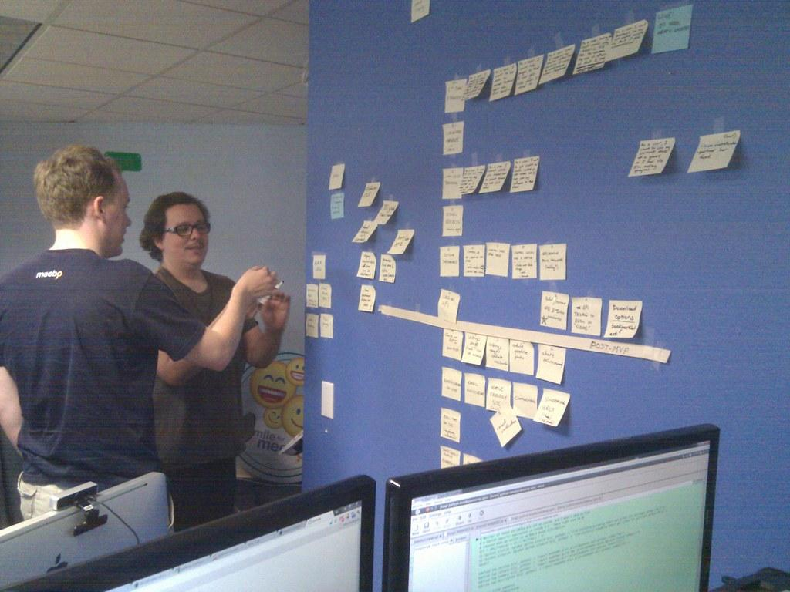

1 c) Discuss each of the findings in the table and indicate whether the finding contributed positively or negatively in vgo/no go recommendation:
POSITIVES
Services.inc was successful in maintaining a scrum master,product owner ,testers and developers.
They clearly held a regular scrum ,stand-up and sprint meetings without fail where they kept track of the progress in each member’s assigned work .
Scrum masters and product owners were rotated across sprints thus a member was not assigned just a single role throughout the project
They conducted a 4 week sprint and had a tested part of the project at the end of 4 weeks each time
The scrum master assigned tasks, kept track of them,was committed on behalf of the team and also convinced and motivated the team members in achieving the commitments made.
A feedback was taken in every sprint meeting.
The task list was ready by the end of 1st week after a detailed discussion with the scrum master,product owner and team members

Slide 7
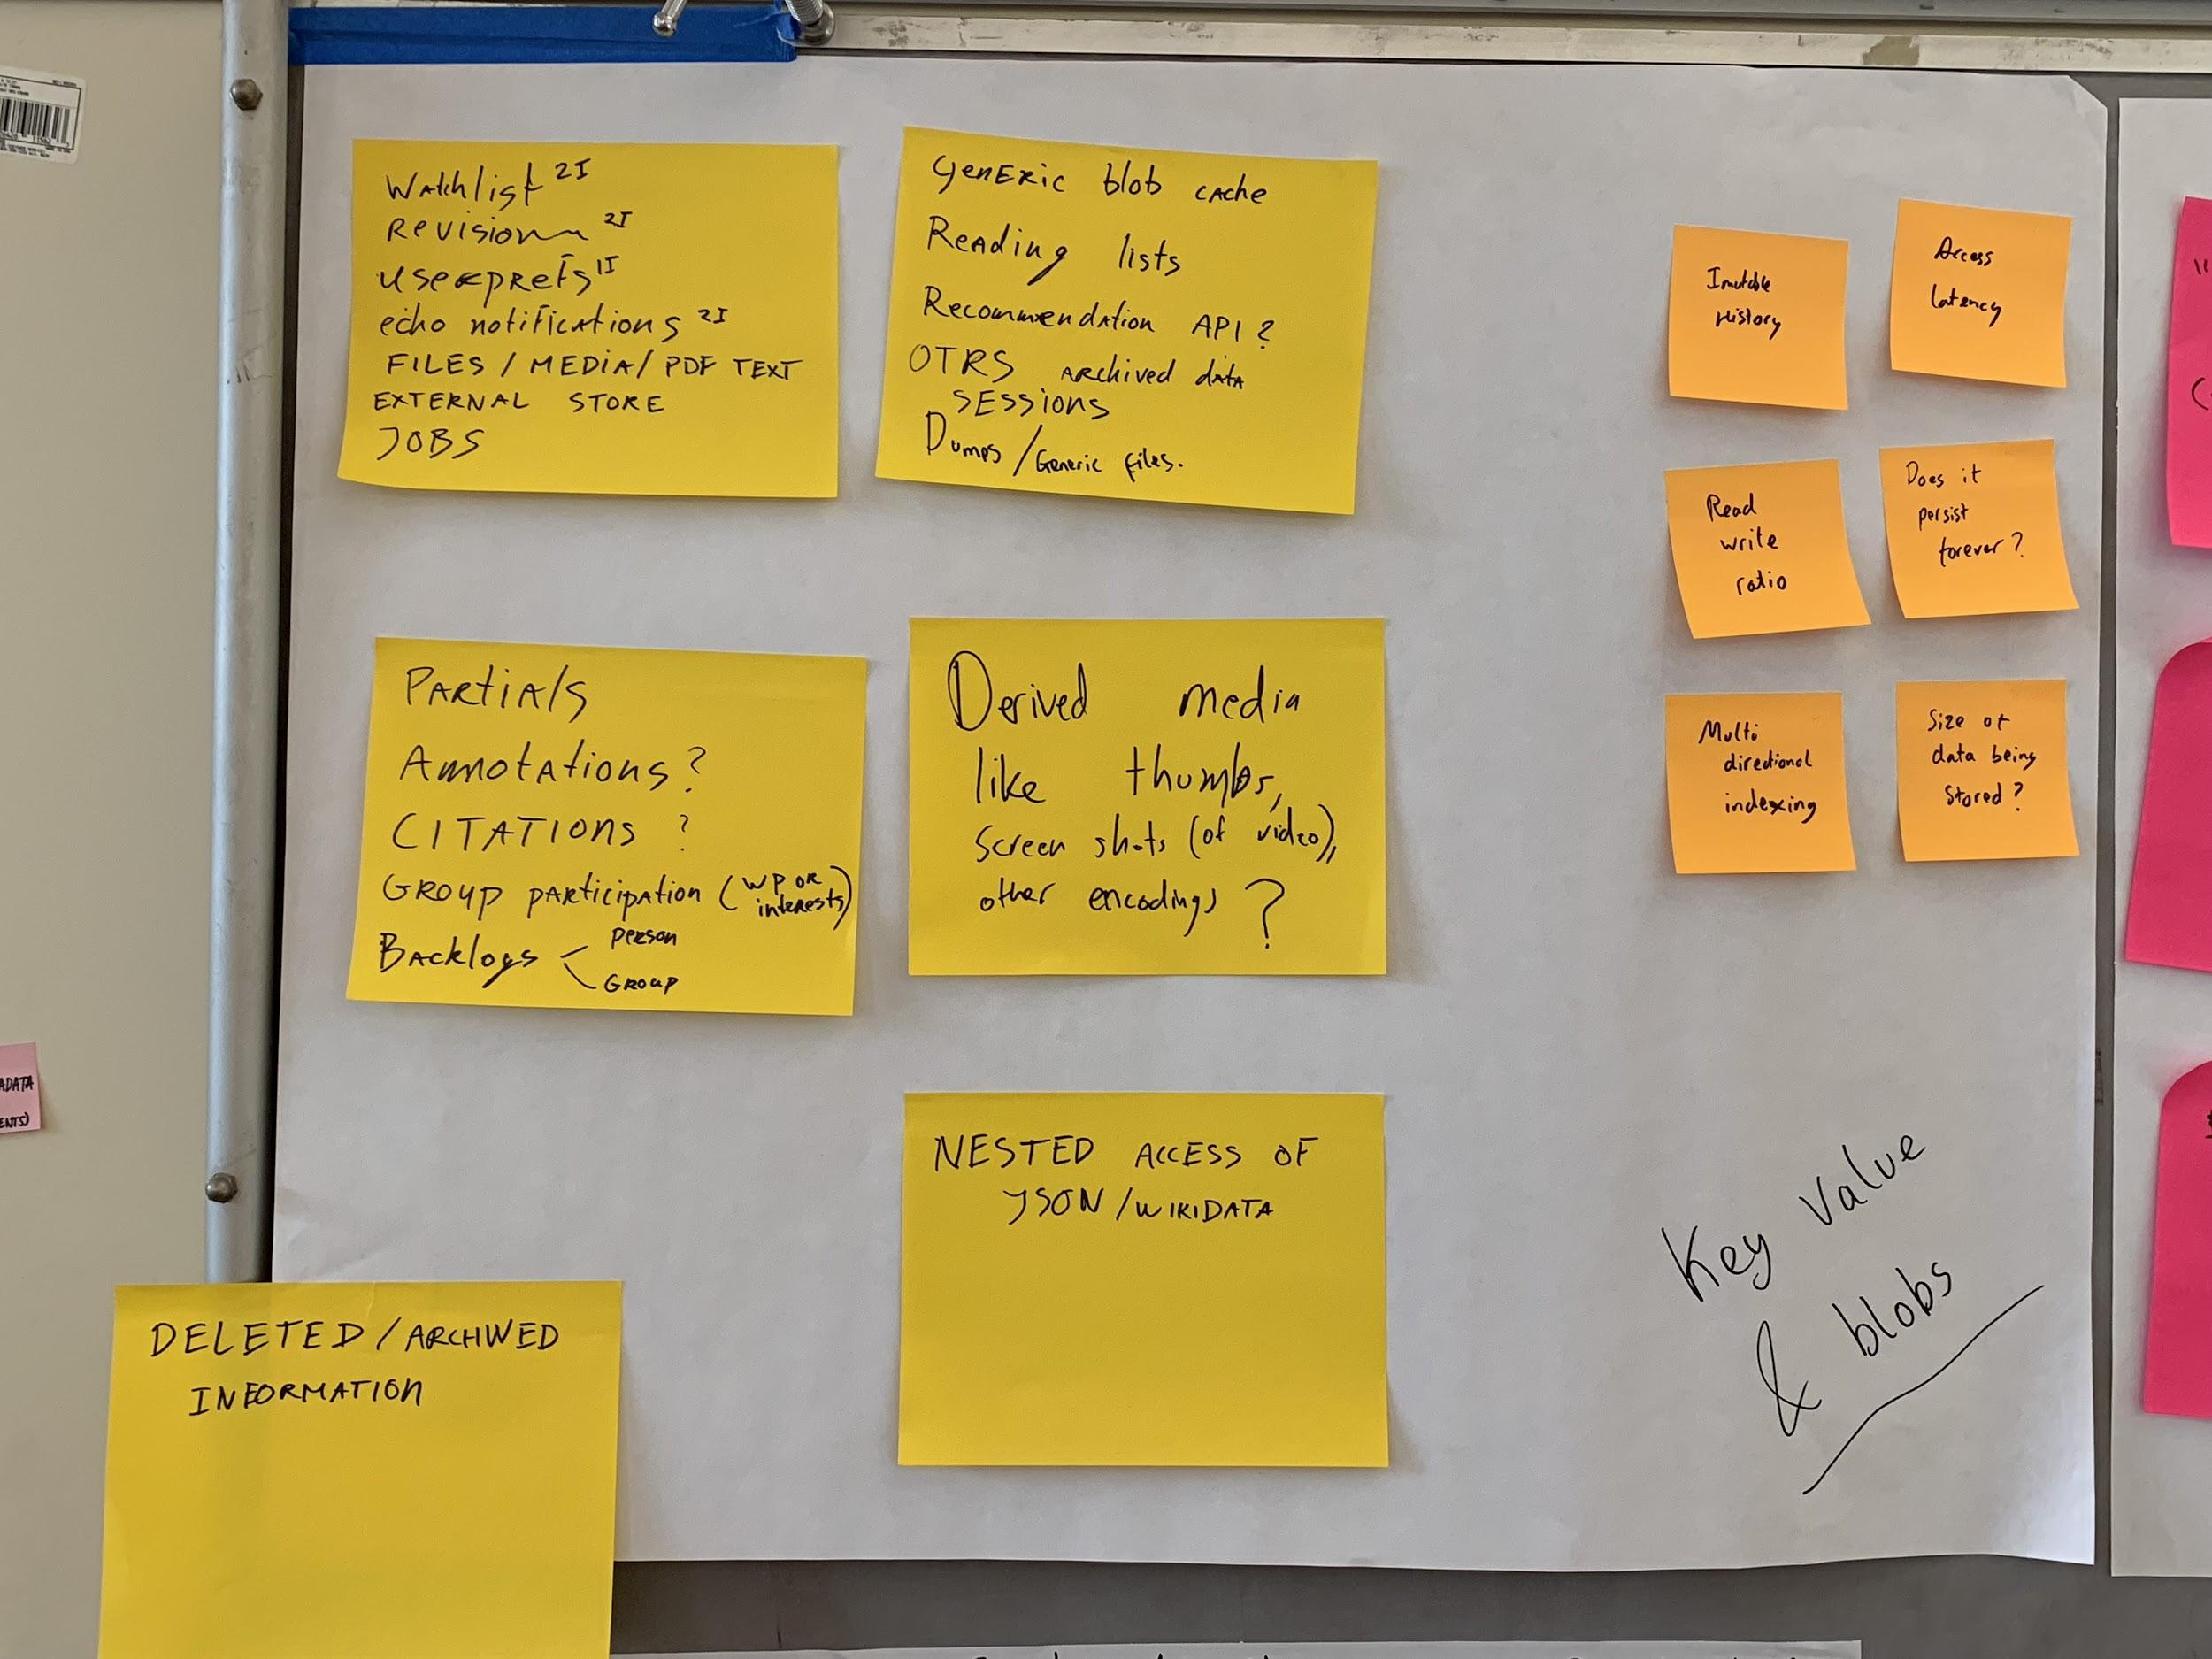
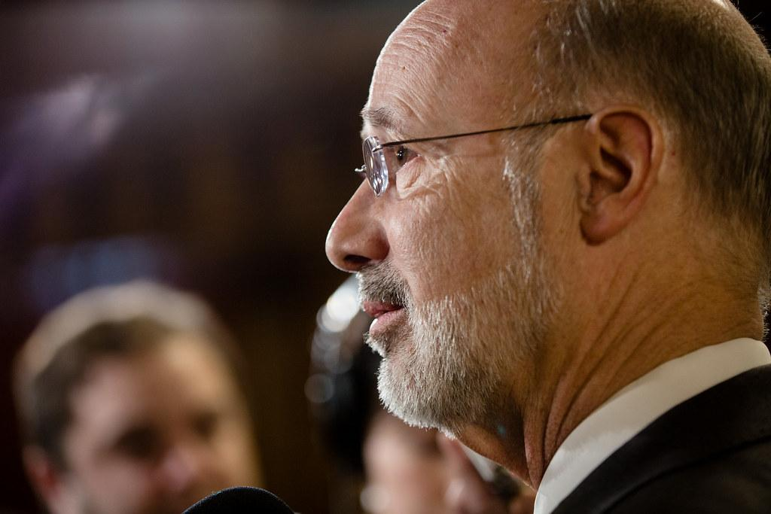


1 c) Discuss each of the findings in the table and indicate whether the finding contributed positively or negatively in vgo/no go recommendation:
NEGATIVES
In the 4-week sprints, quality engineers joined after 2 weeks as they were rotated among projects and their was nothing till the end of 3rd week. They could have avoided this by cross training
Emergency product issues majorly upset the sprint deliverables as a result the backlog underwent changes till 3rd week
The backlog at the beginning of the scrum is more ambitious than the average velocity of the scrum teams recorded so far as the teams prefer to take ambitious targets. They were encouraged to do so.
Product owners in the scrum teams have worked with the products ever since the centres have been set up but have never met a customer

Slide 8




2) How can Service Inc. achieve 40% growth in margin while
achieving only a 25% growth in revenue?
Profit Profit Profit!!!!
This depended on the ability to get started with Product Inc. on a critical product. Product Inc. SVP as he heard the presentation was seriously considering keeping Service Inc. relationship limited to low value IT services and moderate value product maintenance services.

Slide 9
3)What are the cultural differences between Service Inc. and Product Inc. that you think is a challenge for successful scrum implementation that would satisfy Product Inc.?
Culturally Service Inc. and Product Inc. are poles apart:
Product Inc. is a flat organization with open offices, where engineers and managers Including VPs and SVPs share open cubicles, with the senior managers having offices in corners where engineers do not need to go often, and are designed with dedicated conference rooms for meetings
On the contrary, in Service Inc.., one can make out the seniority of a manager in the organization by the size of his desk and room that he has been allocated.
Stan who works for product.inc, had the habit of talking directly to engineers and junior managers which is the friendly and interactive environment he works in at product.inc rather than seeking meetings with them in the presence of Service Inc. general managers in one of those elaborate cabins.
This is another example of how product.inc and services.inc are culturally different. Product.inc values interactions with the employees and the every manager is approachable and open to any kind of suggestions and feedback by their employees rather than following a hierarchical and bureaucratic management

Slide 10
Task - 2 : Design an ecommerce website

Slide 11
Sprint Pre Planning

Slide 12
Sprint Pre Planning
Week 1
Week 2
Week 2
Week 4
Review your product roadmap
Groom your product backlog and update user stories
Propose a sprint goal and backlog before the sprint planning meeting
Walk through each user story and describe what tasks need to be done

Slide 13
Scope for Sprints

Slide 14
Week 1
Week 2
Week 3
Week 4
Construct a Wireframe
Ask the User to come up with more requirements
Come up with a User Friendly Interface
Research on the technology that will be implemented
Ask inputs from users
Make changes to Wireframe if required
Create an PRD
and analyse it with stakeholders
Potential tools and Frameworks to do
Discuss with testing team on possible bugs during deployment
Take further inputs from the Product owner and ask if further changes are to be made.
Have a full fledged working website
Have the entire sprint repeated if the final product is unsatisfactory for the client
Release For First Sprint : Basic Interface and Architecture along with tools that are going to be used

Slide 15
Identifying the requirements of the stakeholders and prioritize them.

Slide 16
1. Fast, stable & secure website
2. Highly-responsive mobile site
3. User-friendly web design
4. Robust operation systems
5. Fast checkout process
6. Transparent brand information pages
7. SEO-friendly web pages
8. Smooth sales channels integration

Slide 17
9. Product reviews
10. Personalized product recommendations ( cookie based)
11. Low shipping fee
12. Integration with a digital payments gateway (Ex RazorPay)
13. Integration with a digital advertising service
14. Integration with an email and push notifications marketing tool
15. Bug Reporting System
16. Report + Analytics tool

Slide 18
Roadmap

Slide 19
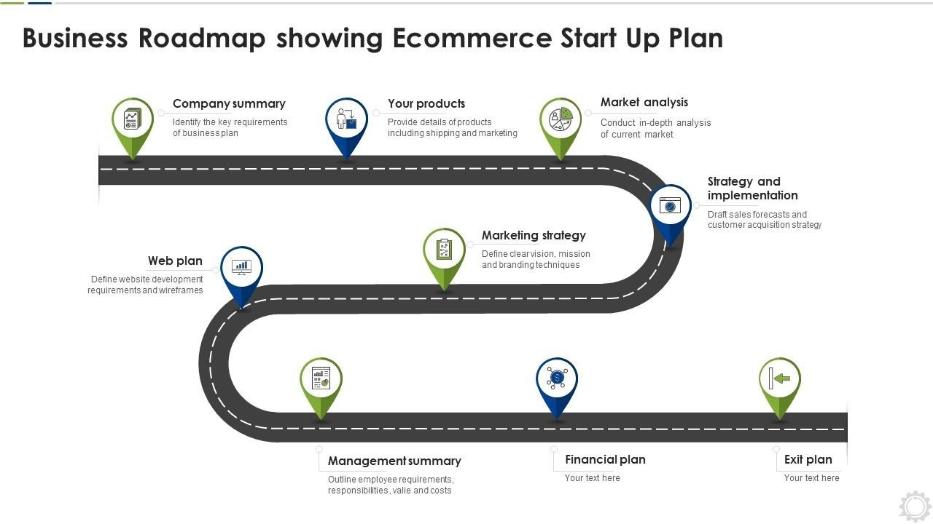

Slide 20
Burndown Chart

Slide 21
