Slide 1
SMART INDIA HACKATHON 2026
VANI
PROBLEM STATEMENT ID
SIH26173
PROBLEM STATEMENT TITLE
iTantra - Indian Multilingual TTS & STT Aided Neural Transceiver Radio Access for low bitrate links
Speak in one Indian language. The other phone hears it in hers. No network, no cloud, nothing leaves the device.
THEME
Smart Automation
PS CATEGORY
Software
ORGANISATION
Indian Space Research Organisation (ISRO)
TEAM NAME
VANI
TEAM ID
fill from portal
Every figure in this deck is measured from the running app on an Android device. Nothing is projected or illustrative.
10 Indic languages
Zero cloud calls
Text-only link
Team VANI · Smart India Hackathon 2026 idea submission

Slide 2
IDEA TITLE
Say it in Hindi. It arrives spoken in Marathi.
VANI bundles speech recognition, neural translation and speech synthesis inside both phones. Only the recognised sentence crosses the link - about 90 bytes of text where the same utterance would cost roughly 91 KB of raw audio. The receiving phone rebuilds it as audible speech in the listener's own language.
THE GAP THE PROBLEM STATEMENT NAMES
WHAT VANI DOES ABOUT IT
Voice costs bandwidth. 16 kHz mono PCM is about 32 KB for every second of speech.
Tap and speak. Hold the mic, release it, and the utterance is captured on the phone.
Text assumes literacy. A typed message excludes the people voice is meant to reach.
Recognised and translated on-device. IndicConformer, then IndicTrans2 - Hindi to Marathi, never through English.
The two sides differ. Caller and responder often share no written language at all.
Spoken on the far phone. IndicF5 renders it as a replayable voice note in that language.
NOVELTY 1
NOVELTY 2
NOVELTY 3
No cloud, no token, no cost
Indic to Indic, no English pivot
A different voice per language
Every stage runs in-process. No network call; works in airplane mode.
Most Indian stacks route through English and lose the idiom.
IndicF5 is zero-shot prompted, so Marathi is not read in a Hindi voice.

Slide 3
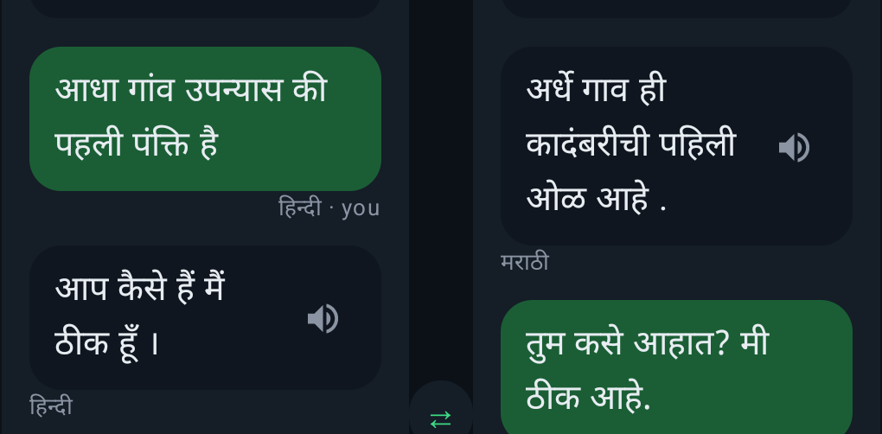
TECHNICAL APPROACH
Three neural models per phone. The link carries text.
SENDER - ANDROID PHONE, OFFLINE
THE LINK
RECEIVER - ANDROID PHONE, OFFLINE
MicRecorder
AudioRecord - 16 kHz mono PCM16
~90 B
DhVaaniEngine
IndicF5 - flow matching - 8 Euler steps
log-mel 80 x T
UTF-8
of text crosses the link
UTF-8
conditioned on
ConformerStt
IndicConformer-HI - CTC greedy - INT8
against ~91 KB of raw 16 kHz PCM for the same sentence.
Reference prompt
per-language voice clip - 320 mel frames
Devanagari text
Bluetooth RFCOMM / Wi-Fi Direct, the transport SIH26173 names.
24 kHz PCM16
TranslatorEngine
IndicTrans2 320M - [hi, mr] token prefix
Player
AudioTrack - one buffer per utterance
Today: in-app loopback.
HOW IT IS BUILT
Kotlin 1.8, Jetpack Compose Material3, 3,094 lines, no XML. One Activity, two panels, no navigation graph.
ONNX Runtime Android 1.22.0 on the CPU execution provider. Threads = cores/2 capped at 4; more measured slower.
5 of 6 graphs INT8-quantised. Mel, FFT and iSTFT are Kotlin - no NDK, no native audio code.
STT 137.3 MB - MT 528.5 MB - TTS 185.3 MB - voices 6.8 MB. 857.9 MB of assets streams from a 718.9 MB install.
Captured from the built app: Hindi in, Marathi out, replay cached.

Slide 4
FEASIBILITY AND VIABILITY
Measured on the running app, walls included.
13.1%
RISKS AND HOW WE CLOSE THEM
word error rate
4.8% character error rate
TTS render dominates the end-to-end path.
8.5-11.2 s to make 2.2-3.1 s of audio; steps, prompt length and threads were swept and none moved it.
Scored on-device against AI4Bharat Kathbath Hindi: 40 clips, 207 s of speech, 19 speakers.
Speech recognition covers Hindi today.
0.23x
627 ms
12.9 s
One IndicConformer export is bundled; the family ships per-language models, so this is an asset swap.
faster than real time
Hindi to Marathi
mic release to first audio
The link is in-app loopback, not radio yet.
WHERE THE 16.2 SECONDS GO
Every stage either side of the transport is built; RFCOMM pairing and a 90-byte text frame are what is left.
STT 1,092 ms - MT 627 ms - TTS render 11,199 ms - playback 3,307 ms
719 MB install, 858 MB of models.
Already inside the 800 MB ceiling without cutting quality; INT4 weights are the next reduction.
The flow-matching solve is 69% of the path. Sweeping steps, guidance and threads changed nothing.
Cost and deployment: zero inference cost per message, no server estate, no API quota. One APK, installed once, works in airplane mode.
Android emulator, debug build, single run per figure. Cold model load adds 52.9 s.
Voice identity: 7 of 19 reference clips pass the quality gates, so 7 languages borrow a donor voice; 11 screened replacements are ready.

Slide 5
IMPACT AND BENEFITS
A thousand times less to send. And nobody has to read.
~1,000x
smaller payload on the constrained link
2.9 s of speech = 92,800 bytes at 16 kHz mono PCM16.
Its 7-word Hindi transcript = 90 bytes of UTF-8. Same meaning, 0.1% of the airtime.
Low-literacy users
Injured or panicking
Cross-language teams
Narrow links
Neither side has to read or type.
A mic hold is one gesture. Composing text is not available.
Responder and caller rarely share a written language.
90 bytes fits where 91 KB of audio cannot go at all.
AGAINST THE SIH26173 MINIMUM DEMO
BUILT
Speak a sentence in one Indian language into one phone.
BUILT
Show it transcribed on-device - 13.1% word error rate, 4.8% character error rate, measured.
BUILT
A second phone speaks it back intelligibly in its own language, as a replayable voice note.
OPEN
Carry the text over Bluetooth rather than the in-app loopback - the one remaining integration step.
BUILT
Report end-to-end latency and word error rate - 12.9 s and 13.1%, both from the running app.
Nothing on this slide is projected. Every figure came from a run of the installed build.

Slide 6
RESEARCH AND REFERENCES
What we built on, and what we measured ourselves.
BUNDLED MODELS - RUN INSIDE THE APK
PEER-REVIEWED BASIS
ai4bharat/indicconformer_stt_hi_hybrid_ctc_rnnt_large
arXiv:2305.16307
Speech recognition. CTC branch, INT8 ONNX export, 137.3 MB.
IndicTrans2: Towards High-Quality and Accessible Machine Translation Models for all 22 Scheduled Indian Languages
ai4bharat/indictrans2-indic-indic-dist-320M
Machine translation, Indic to Indic, no English pivot. 528.5 MB.
ai4bharat/IndicF5
arXiv:2409.05356
Zero-shot flow-matching synthesis, 8 Euler steps, CFG 2.0. 185.3 MB.
IndicVoices-R: Unlocking a Massive Multilingual Multi-speaker Speech Corpus for Scaling Indian Speech
DATA AND LICENCE
RUNTIME AND TOOLING
ai4bharat/Kathbath - CC-BY-4.0
Microsoft ONNX Runtime 1.22.0 (onnxruntime-android), CPU execution provider. No NNAPI or GPU delegate is used.
Source of the 22 reference voice clips shipped in the app, and of the 40-clip Hindi set the word error rate is scored on. Each clip's exact transcript is bundled beside it and used verbatim.
Kotlin 1.8.22, Jetpack Compose Material3, AGP 7.4.2. minSdk 26, target 34, arm64-v8a and x86_64.
Clips are screened by measured pitch, internal-pause fraction and token density before shipping.
models.ai4bharat.org - model cards for all three bundled networks.
Measured by this team, not cited: word and character error rate over 40 Kathbath Hindi clips scored with normalised Levenshtein; per-stage latency from on-device logs; and the Euler-step, guidance and thread sweeps behind the feasibility slide.

