Slide 1
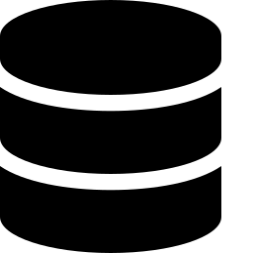
IBM DB2
A Relational Database Management System for Enterprise Data
DEVELOPED BY IBM • RELATIONAL DBMS • SQL & NoSQL
Introduction to Database Systems

Slide 2


What is IBM DB2?
The relational database engine built by IBM
A Relational DBMS
DB2 is a Relational Database Management System (RDBMS) developed by IBM.
Built for Enterprise Data
It is used to store, manage, and retrieve data efficiently in enterprise applications.
Decades of Development
Originally developed in the 1980s by IBM, and continuously evolved since.
IBM DB2 — Overview
2

Slide 3





Built for Enterprise Scale
IBM's Tool for Large-Scale Data
How Data is Organized
DB2 is IBM's tool for managing large volumes of structured data in businesses such as:
Tables
Data is stored in the form of tables — organized into rows and columns.
Keys & Relationships
Relationships between tables are maintained using keys.
Banks
Airlines
Hospitals
...and other applications where reliability and scale are critical.
Example: a CUSTOMERS table linked to an ACCOUNTS table through a shared customer key.
IBM DB2 — Overview
3

Slide 4
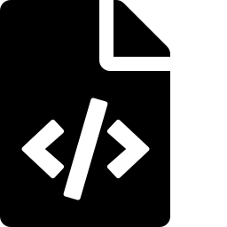



Key Features
What makes DB2 a strong choice for enterprise systems
SQL & NoSQL Support
High Performance at Scale
Supports both SQL and NoSQL (JSON) data formats.
Built for large-scale transactional systems, e.g. ATM and airline transactions.
Security & Reliability
AI-Integrated Optimization
Provides strong security and reliability for critical business data.
AI-integrated features help optimize query execution automatically.
IBM DB2 — Overview
4

Slide 5
Supports ACID Properties
Guarantees that keep transactions safe and reliable
A
C
I
D
Atomicity
Consistency
Isolation
Durability
A transaction is all-or-nothing — it fully completes or doesn't happen at all.
A transaction brings the database from one valid state to another.
Concurrent transactions don't interfere with one another.
Once committed, a transaction's changes persist even after a failure.
IBM DB2 — Overview
5

Slide 6


Extended Capabilities
Beyond core storage — programmability and connectivity
PL/SQL Support
Used for writing stored procedures, triggers, and functions directly inside the database.
XML / JSON Support
Useful for handling semi-structured data alongside traditional relational tables.
Application Connectivity
Compatible with JDBC, ODBC, .NET, and Python (via the ibm-db driver) for connecting applications.
IBM DB2 — Overview
6

Slide 7



DB2 Tools
Tools used to run, manage, and tune a DB2 database
DB2 Command Line Processor
IBM Data Studio
DB2 Explain
A command-line tool used to run SQL commands directly against the database.
A GUI tool for database design, query building, and administration.
A tool used to analyze and optimize query execution plans.
IBM DB2 — Overview
7

Slide 8
Key Takeaways
DB2 is a relational DBMS developed by IBM to store, manage, and retrieve enterprise data efficiently.
Data lives in tables (rows & columns); relationships are maintained using keys.
Supports SQL, NoSQL (JSON), PL/SQL, and XML — with strong security, performance, and ACID guarantees.
Comes with tools like the Command Line Processor, IBM Data Studio, and DB2 Explain.
Questions?

