Slide 1
X Education - Lead Scoring Case Study
19 Aug 2024

Slide 2
Problem Statement
X Education, an online education company, markets its courses to industry professionals via various platforms like Google. When interested individuals visit their website, they may browse courses, watch videos, or fill out forms with their contact details, which classifies them as leads. Sales team members then follow up with these leads through calls and emails, but the conversion rate is currently around 30%, and many leads do not convert.
To improve efficiency and boost the conversion rate, X Education wants to identify 'Hot Leads'—those most likely to convert into paying customers. By focusing their efforts on these high-potential leads, the company aims to increase the conversion rate to approximately 80%. We will develop a model to assign lead scores, allowing the sales team to prioritize leads with higher conversion potential.

Slide 3
Exploratory Data Analysis

Slide 4
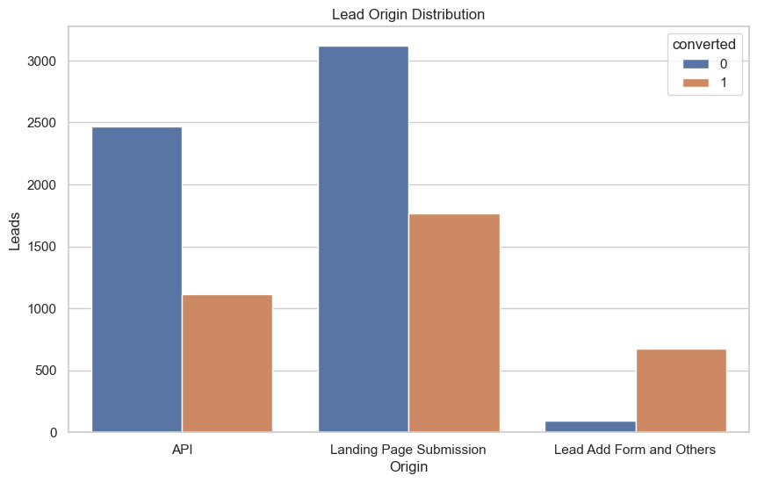
Increasing leads and conversions can be achieved by enhancing API and landing page submissions, as driving more users to complete the lead form will significantly boost conversion rates.

Slide 5
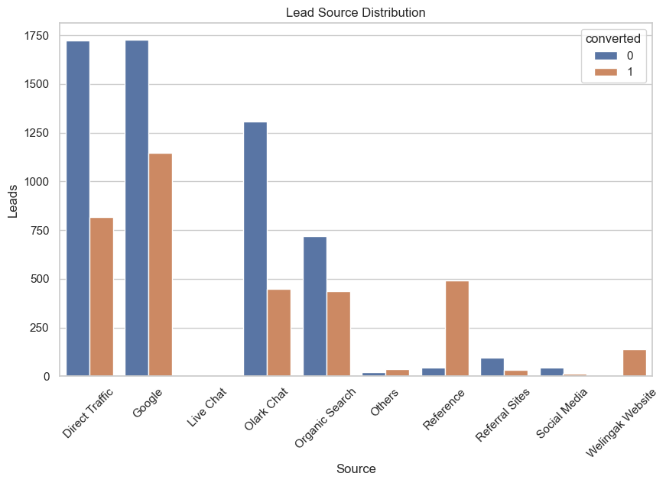
Direct traffic and Google generate the most leads, Live Chat generates the fewest, and the Welingak website has the highest conversion rate, so concentrating on high-lead sources such as Olark Chat, Organic Search, Direct Traffic, and Google could improve lead conversions.

Slide 6
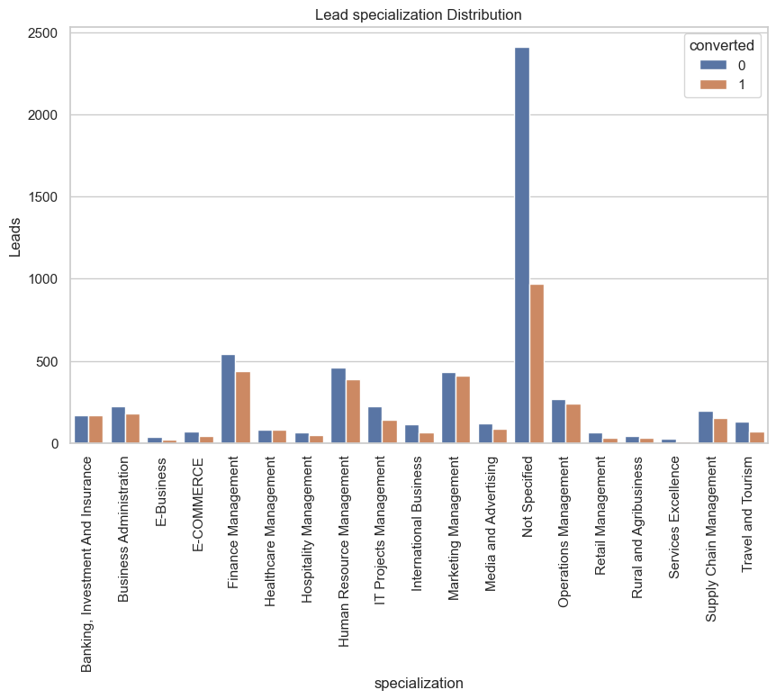
Excluding unspecified categories, Management is the most commonly selected specification.

Slide 7
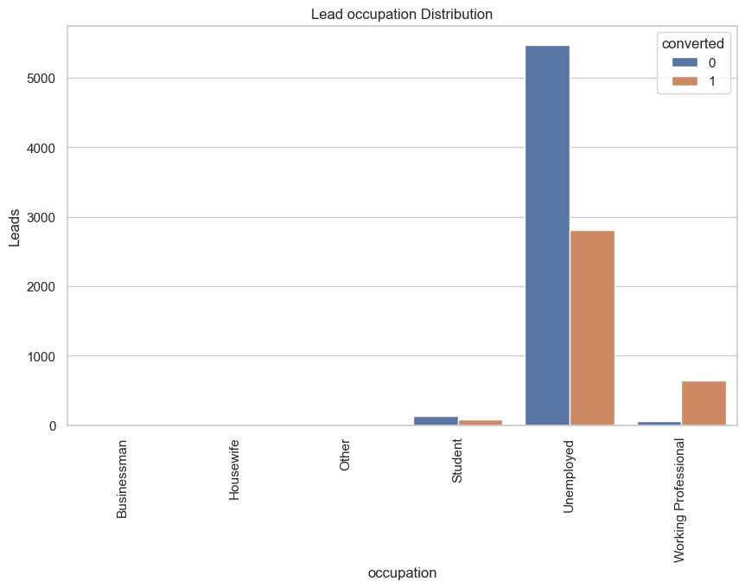
Unemployed leads have the highest number of visitors, while Working Professionals achieve the highest conversion rates.

Slide 8
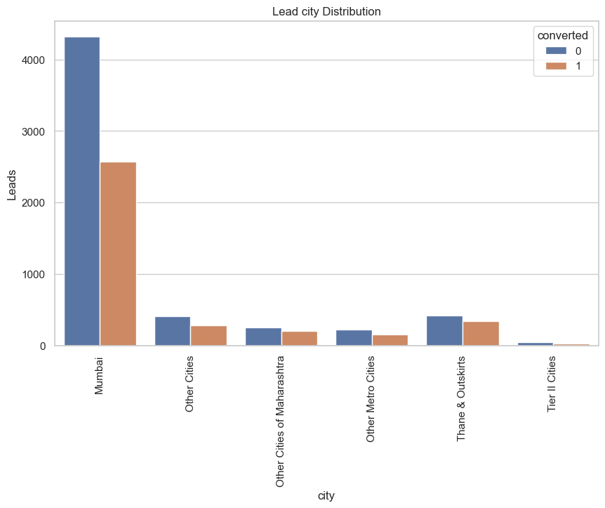
Mumbai is the most frequently occurring city in this segment

Slide 9
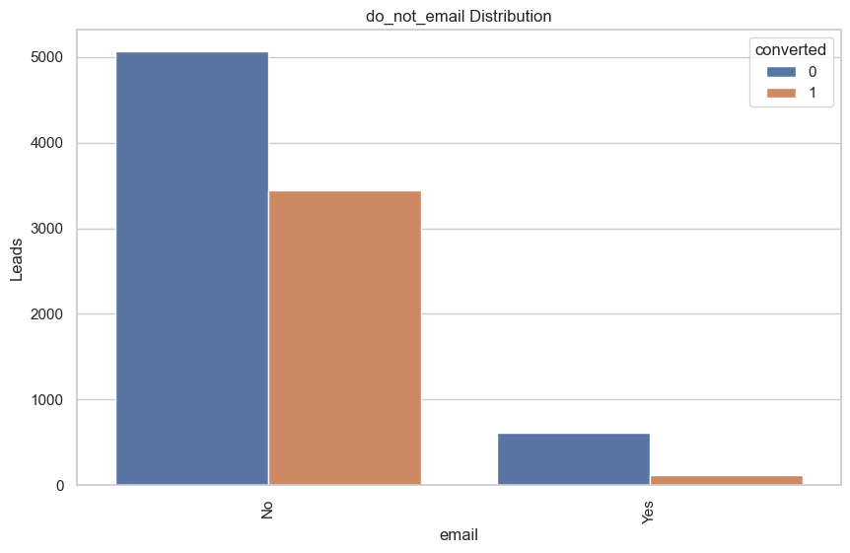

Slide 10
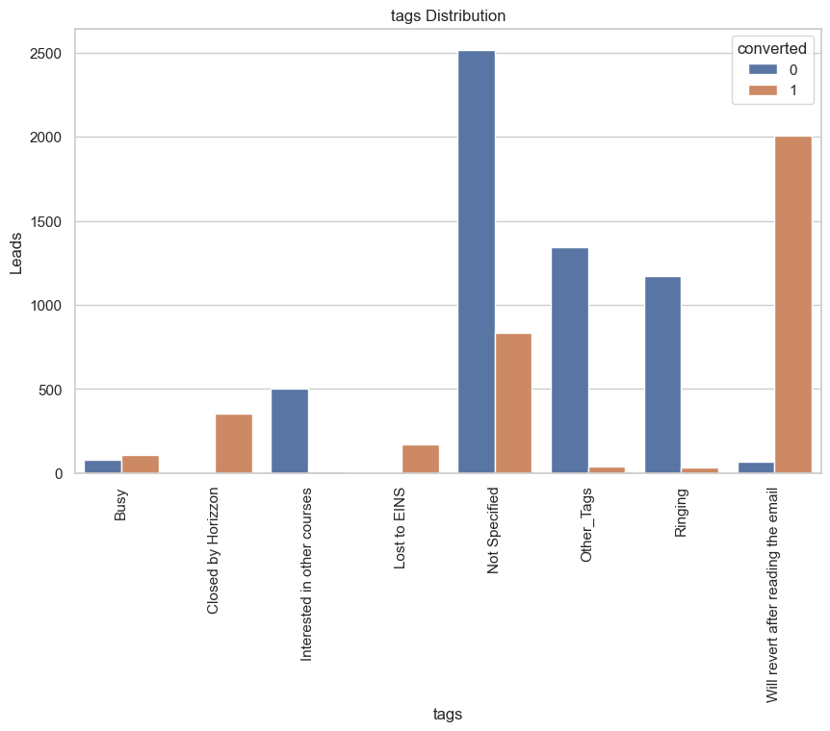
Will revert after reading the email has the highest rate of conversion

Slide 11
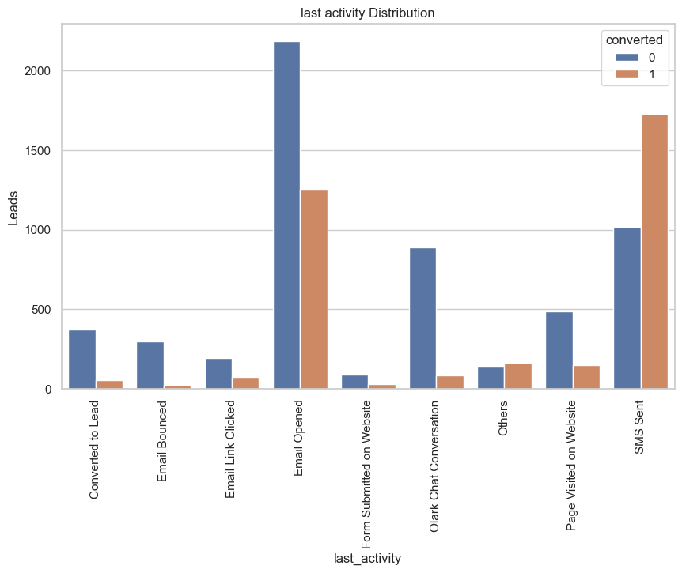
"Email opened" and "SMS sent" are the top categories, with "SMS sent" showing the highest potential due to its highest conversion rate.

Slide 12
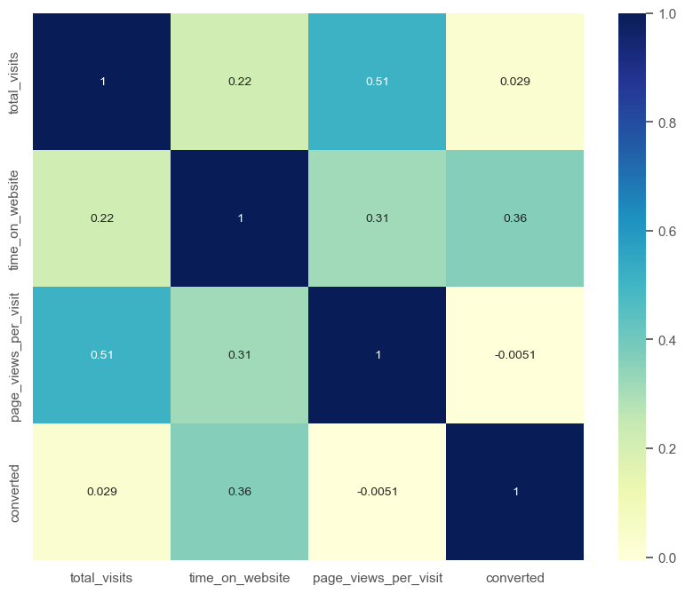
Correlation between the numeric variables

Slide 13
Model Building and Evaluation

Slide 14
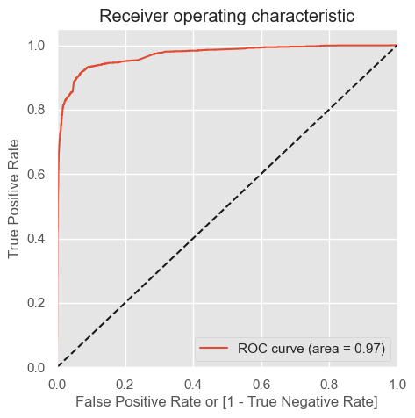
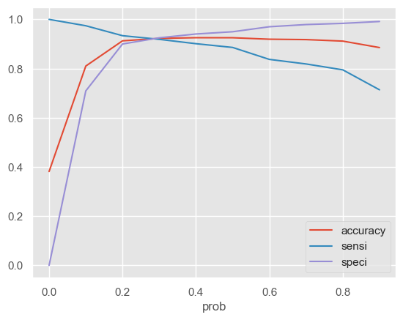
Liner Regression Model parameters – Area under ROC Curve – 0.97, cut-off – 0.28

Slide 15
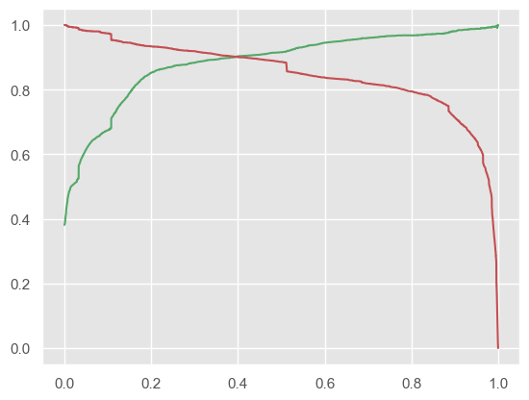
Liner Regression Model parameters – final cut-off – 0.40

Slide 16
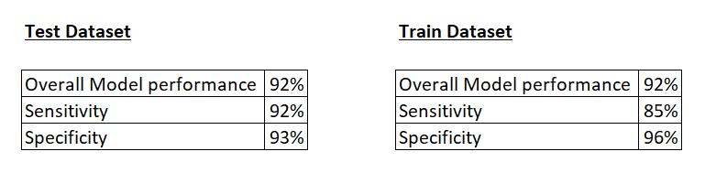
Performance of both the data splits looks good.

Slide 17
Conclusion
To enhance the overall conversion rate, X Education Company should focus on the following key aspects:
Increase user engagement on their website to boost conversion rates.
Increase Total Visits through advertising and other strategies to drive higher conversions.
Improve the Olark Chat service as it is currently negatively impacting conversions.

