Slide 1
Automated parking occupancy detection
Presented By :Yasin Shafi
Guided By : Archa Mam

Slide 2

Introduction
Urban mobility is a critical aspect of modern cities. This presentation explores how deep learning can enhance real-time detection of parking slot occupancy using security camera footage. We aim to improve parking efﬁciency and reduce congestion.

Slide 3
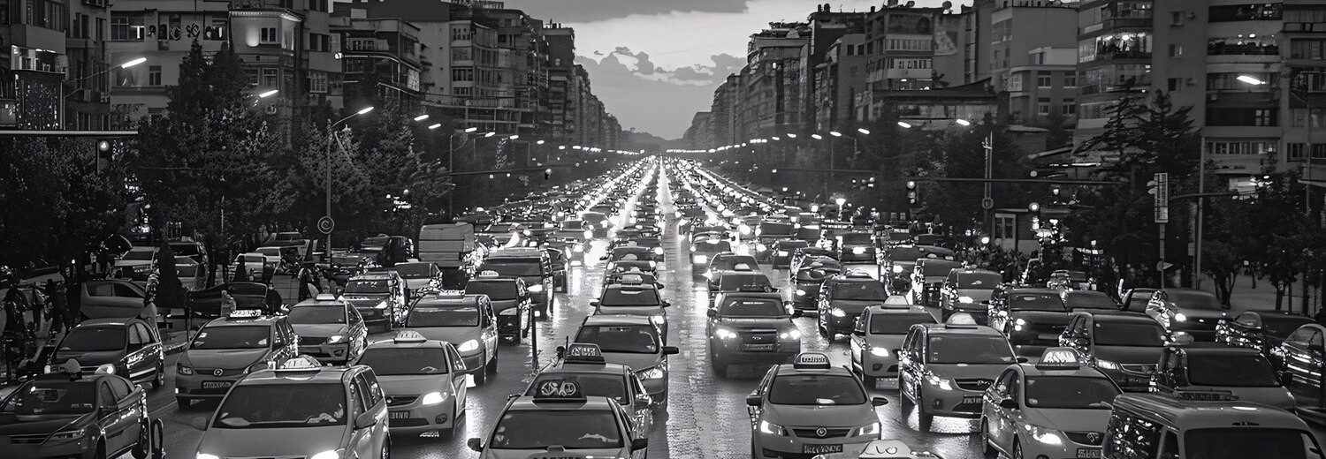
Cities face signiﬁcant mobility challenges, including trafﬁc congestion, limited parking, and inefﬁcient use of resources. Addressing these issues requires innovative solutions that leverage technology and data to enhance urban living.

Slide 4

Deep learning is a subset of machine learning that employs neural networks to analyze large datasets. It excels in image recognition tasks, making it suitable for detecting parking slot occupancy from video feeds.

Slide 5
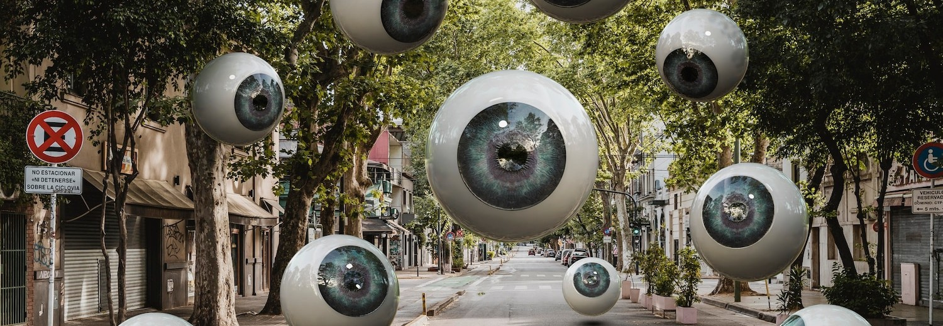
To implement our solution, we utilize security camera footage from urban areas. This data is processed to extract relevant features, enabling the deep learning model to accurately assess parking slot occupancy in real-time.

Slide 6

Model Training Process
The training of our deep learning model involves using labeled datasets that indicate occupied and available parking slots. By employing techniques like transfer learning, we enhance model performance and accuracy.

Slide 7




Our system processes live footage to detect parking slot availability. Utilizing techniques, it identiﬁes slots and classiﬁes them as
, providing instant updates to users.
or

Slide 8


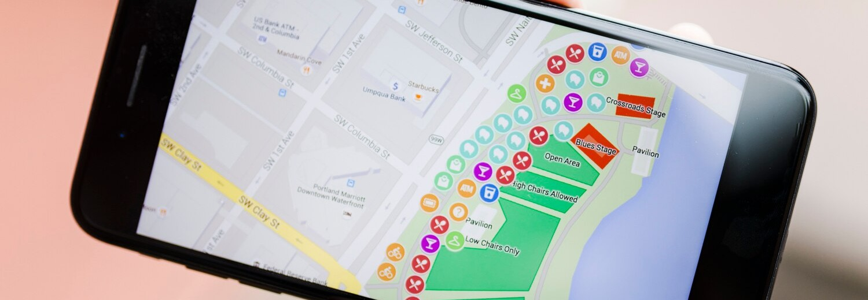
An intuitive displays real-time parking availability to drivers. Features include for nearby available slots and , streamlining the parking experience and reducing search time.

Slide 9
Machine Learning Methods
Computer Vision: Convolutional Neural Networks (CNNs) are frequently employed to process and analyze visual data from cameras to detect and recognize parking spaces, obstacles, and other vehicles
Reinforcement Learning: This is used for decision-making and planning, helping the system to learn optimal parking strategies through trial and error and feedback from its environment
Sensor Fusion: Machine learning algorithms integrate data from various sensors (such as cameras, LiDAR, and ultrasonic sensors) to create a comprehensive understanding of the parking environment
Object Detection and Tracking: Algorithms like YOLO (You Only Look Once) or SSD (Single Shot Multi box Detector) are used to identify and track objects around the vehicle, aiding in navigation and collision avoidance.

Slide 10




Case Studies
Several cities have successfully implemented similar systems, resulting in improved and reduced congestion. Case studies highlight the positive impact of leveraging
for urban mobility solutions.

Slide 11


Looking ahead, integrating and expanding our model to include other factors, such as weather and events, can further enhance the accuracy of parking predictions and improve overall urban mobility.

Slide 12
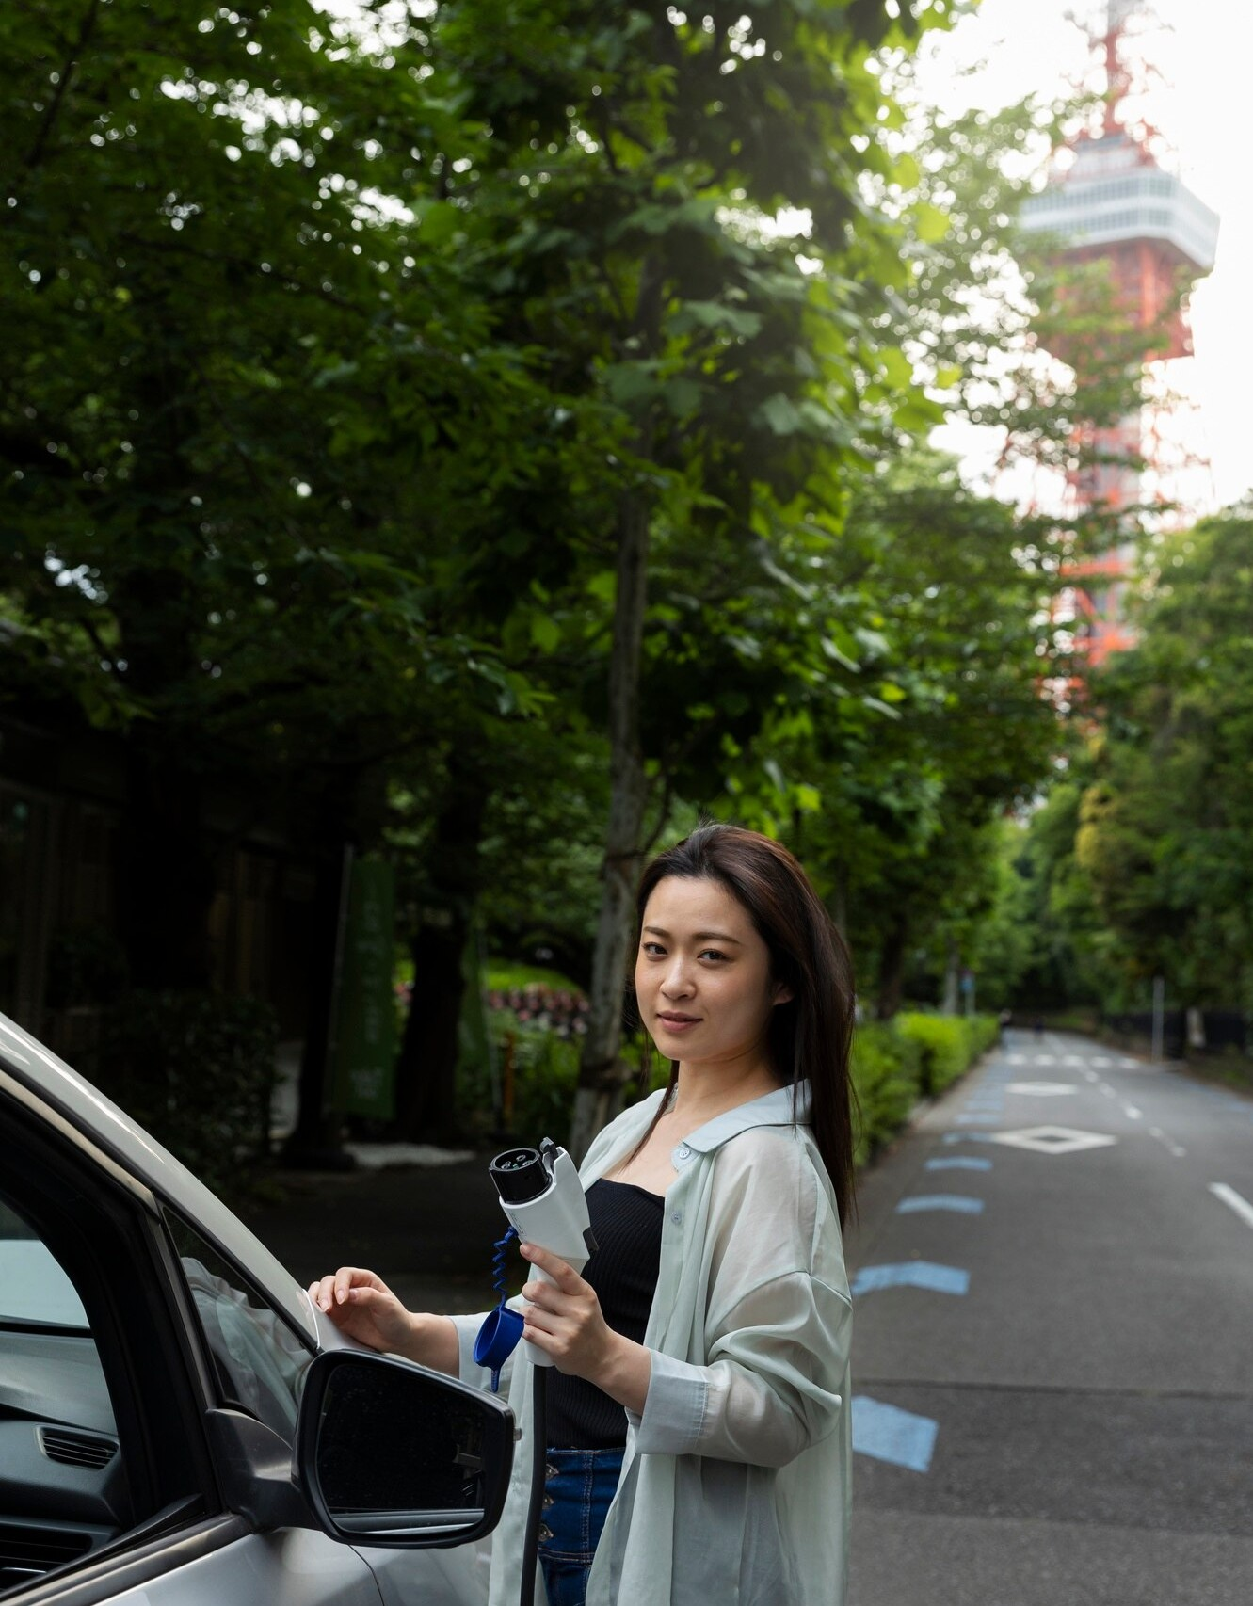

Conclusion
In conclusion, utilizing
real-time detection of parking slot occupancy can signiﬁcantly enhance urban mobility. By adopting such
for
innovative technologies, cities can improve the quality of life for residents and visitors alike.

Slide 13
Thanks!

