Slide 1
TECH2LEARN
AWAIKEN HACKS DEVPOST

Slide 2
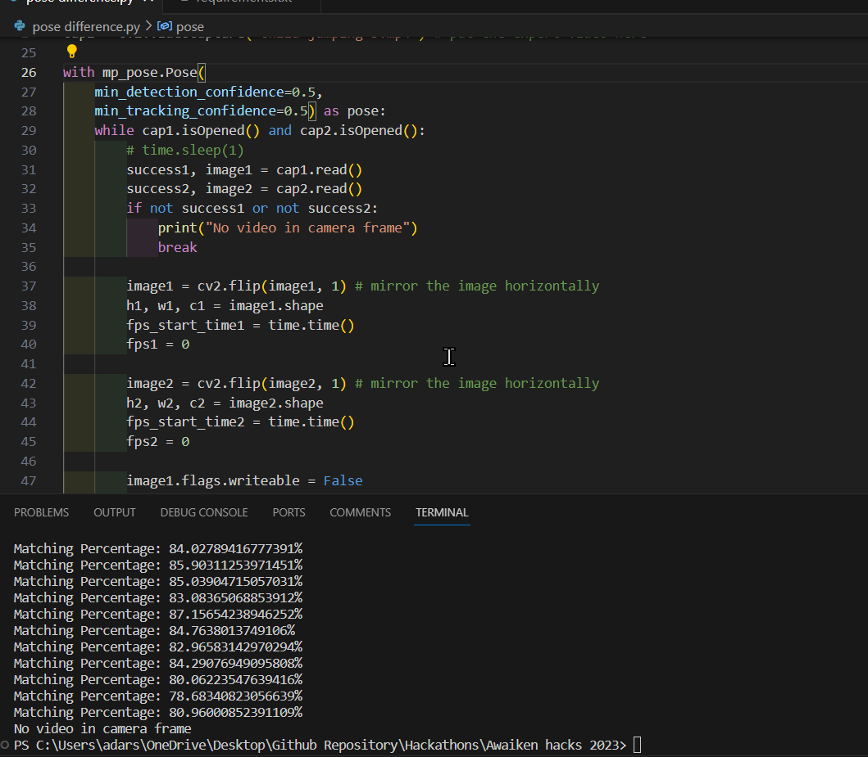

Slide 3
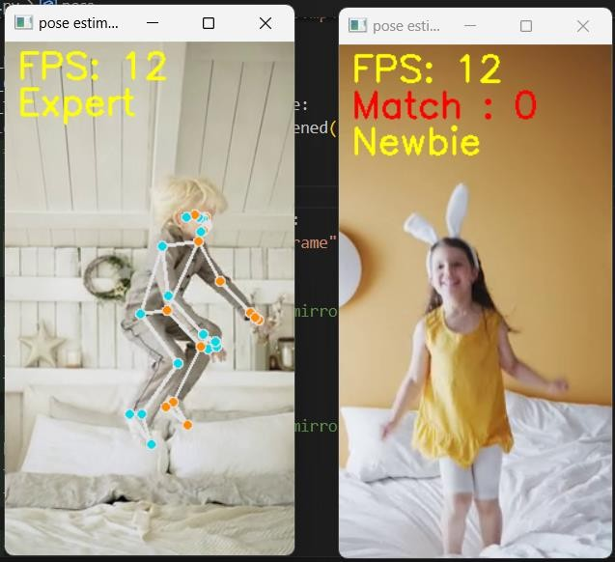
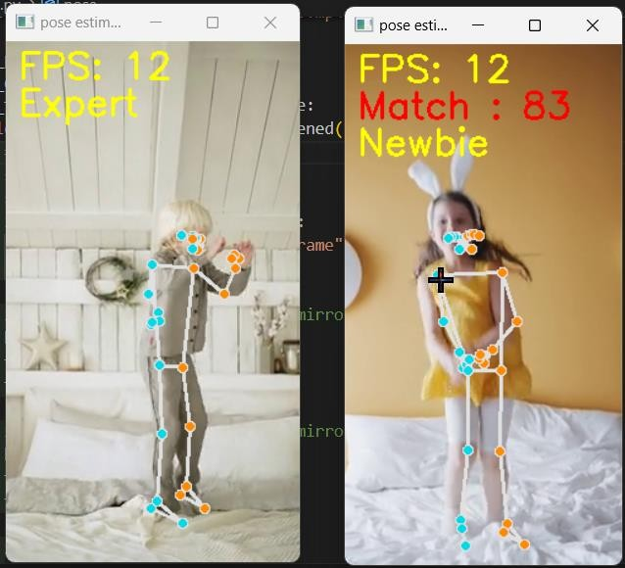

Slide 4
