Slide 1

In-Process ASGI Caching Middleware & Single-Flight Cache Stampede Mitigator
High-Concurrency Request Coalescing, Stateless HMAC-SHA256 JWT Gatekeeping, and Multi-Tenant Redis Caching over 50,000 PostgreSQL Records
C S Akshay Khanna Reddy (25BCE1113)
Adarsh Varshan V N (25BCE1055)
Raghav Manickam (25BCE1978)
Architecture Design & Locust Benchmarking
ASGI Middleware Engine, Single-Flight Locking & Telemetry
PostgreSQL 50k Schema Engineering & Docker Orchestration

Slide 2
Problem Statement, Motivation & Objectives
The Core Problem
Objectives
Cold cache misses trigger "Thundering Herd" stampedes — N concurrent requests flood PostgreSQL simultaneously, exhausting asyncpg connection pools. External reverse proxies like NGINX or Varnish add an extra network hop on every miss and lack native visibility into application JWT claims without costly Lua or sub-request overhead.
1
Intercept Inside the Event Loop
Handle HTTP scopes directly inside FastAPI/Uvicorn's ASGI event loop — zero external hop.
2
Single-Flight Coalescing
Coalesce concurrent cache misses using a per-key asyncio.Lock mechanism so only one request hits the DB.
3
Pre-Cache Security
Enforce stateless HMAC-SHA256 JWT auth and role-scoped key namespacing in CPU memory before any Redis or DB access.

Slide 3


5-Layer System Architecture & Request Pipeline
5-Container Docker Stack
5-Stage In-Process ASGI Pipeline
PostgreSQL 15
01
Route Filter
Port :5432 — primary data store
Bypasses non-GET mutations (PUT) and control baselines (/nocache).
Redis 7 allkeys-lru
02
Port :6379 — distributed cache layer
Pre-Cache JWT & RBAC
Validates HMAC-SHA256 tokens in CPU memory in <0.25 ms —
before touching Redis.
Streamlit Telemetry
03
Port :8501 — live observability dashboard
Dynamic Key Namespacing
Constructs GET:/admin/analytics:role:{role}:user:{sub}
per request.
FastAPI ASGI Middleware
04
Port :8000 — core application server
Fast-Path Redis GET
Returns warm payloads in O(1) time with X-Cache: HIT header.
05
Locust Load Engine
Port :8089 — distributed benchmarking harness
Single-Flight Lock
Leader queries PostgreSQL (MISS); followers wait on asyncio.Lock and read from Redis (HIT-COALESCED).

Slide 4
Implementation Details: DBMS, Schema & Connectivity
🗄️ Origin Database
⚙️ Two-Tier Readiness
Single high-cardinality products table seeded with 50,000 enterprise hardware rows via PostgreSQL generate_series. B-Tree indexes on category and stock columns ensure efficient query paths even at scale.
Docker healthchecks (pg_isready & redis-cli ping) gate container startup sequencing. FastAPI lifespan hooks pre-allocate 10–30 persistent binary

Slide 5
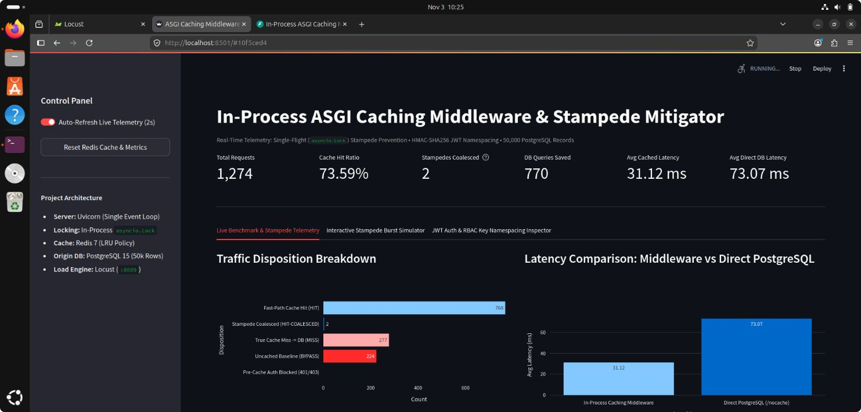
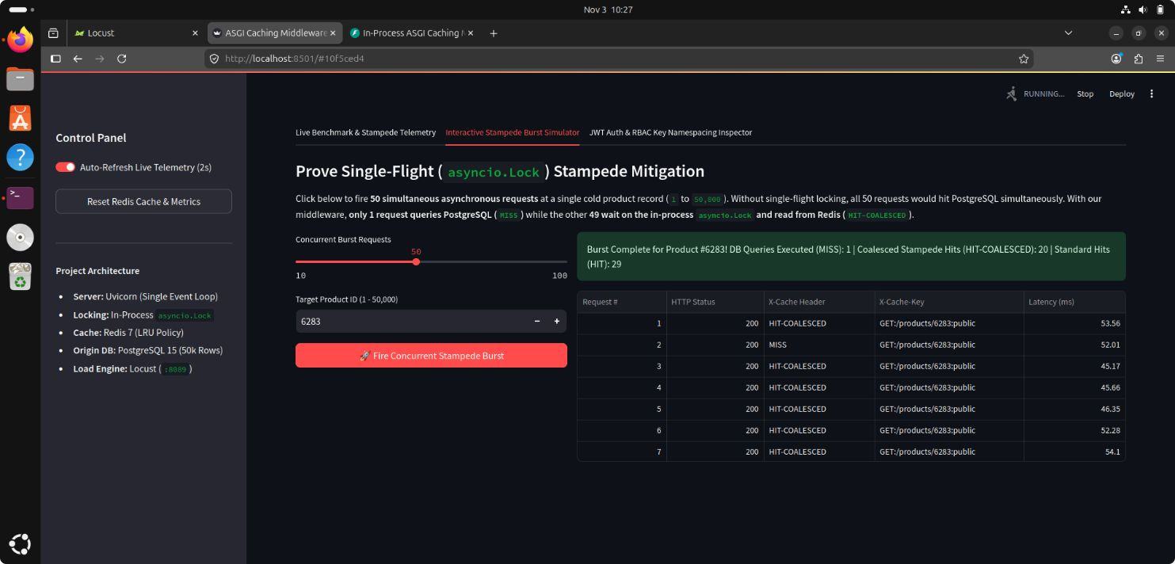
Live Telemetry Dashboard & Stampede Burst Simulator
Streamlit Live Telemetry Dashboard
50-Request Stampede Burst Simulator
The dashboard tracks Total Requests, a sustained 73.59%+ Cache Hit Ratio, DB Queries Saved, and a 40-request circular ring buffer showing real-time traffic disposition — including Fast-Path Cache HITs, True Cache MISSes, and Uncached baseline requests.
Hits (HIT-COALESCED)ld Product #6283 yields exactly
Firing 50 simultaneous async requests against cold Product #6283 yields exactly 1 DB Query (MISS), 20 Coalesced Stampede Hits (HIT-COALESCED), and 29 Standard Hits (HIT) — saving 98% of database queries through the asyncio.Lock single-flight mechanism.

Slide 6
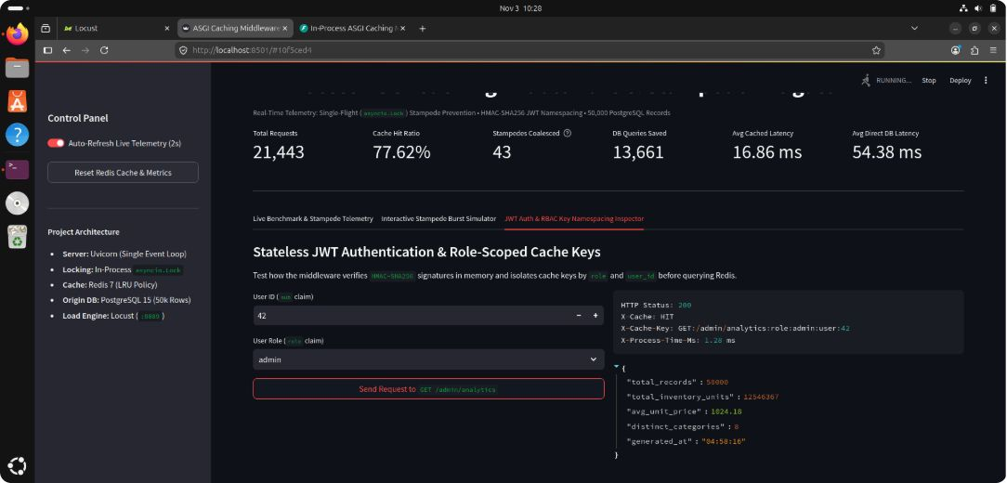
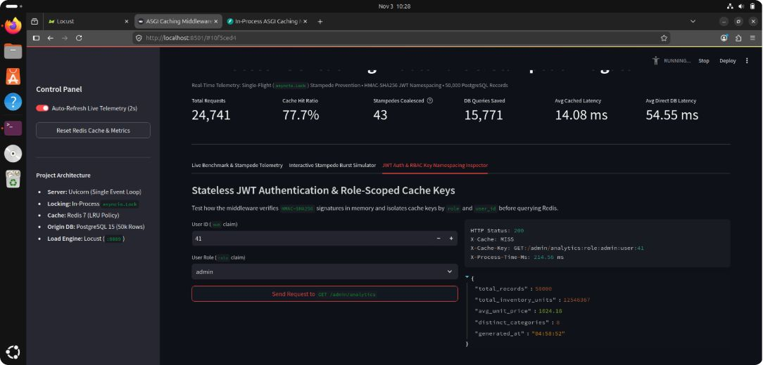
Stateless JWT, RBAC & Multi-Tenant Isolation
Admin Scoped Cache Hit
Multi-Tenant Isolation
Repeating GET /admin/analytics for Admin User 42 drops latency from 328.38 ms (cold 50k SQL aggregation) to 1.28 ms — a 256.5× speedup.
Admin User 41 receives a separate key (...:user:41), structurally preventing cross-tenant data leakage at the key-namespace level.

Slide 7
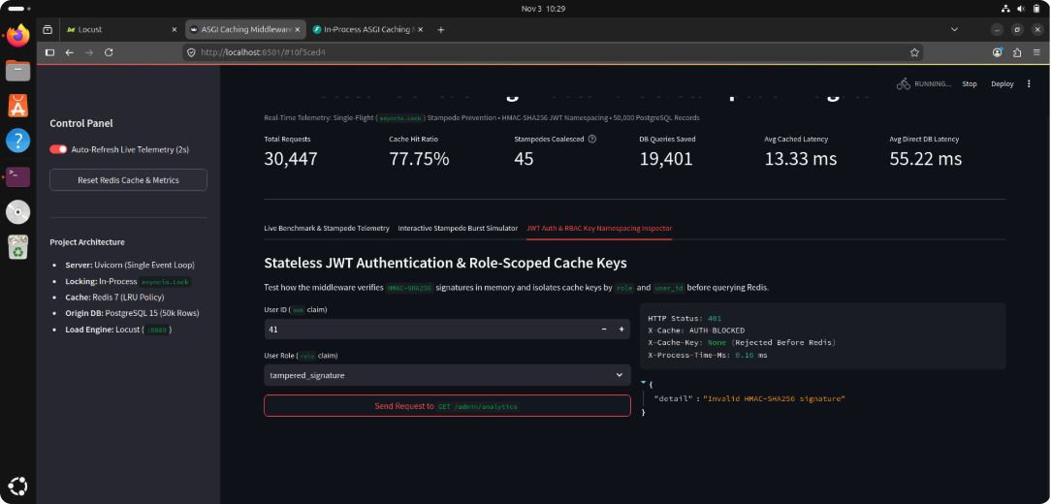
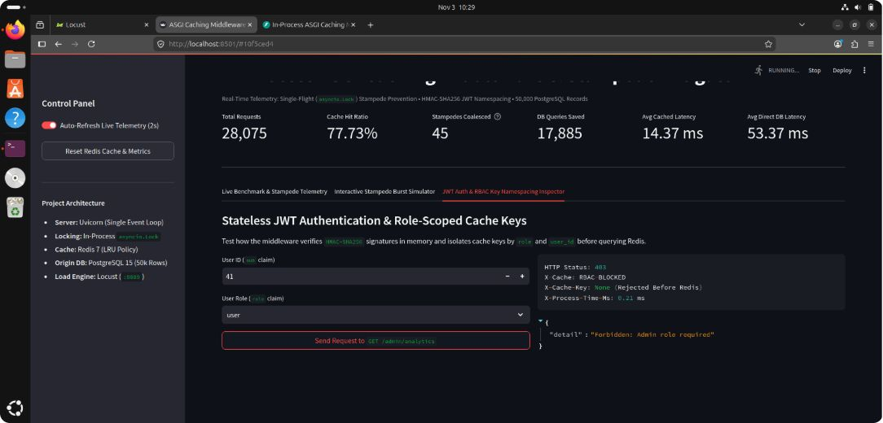
Stateless JWT, RBAC & Multi-Tenant Isolation
Pre-Cache Security Enforcement
Non-admin roles are blocked in 0.21 ms (403 RBAC-BLOCKED); tampered JWT signatures are rejected in 0.16 ms (401 AUTH-BLOCKED) — all security enforcement occurs before touching Redis or PostgreSQL.

Slide 8
Testing Results & Key Benchmark Findings
105.7
25ms
RPS Sustained
Cached Median
Locust benchmark across 5,259 requests at 10 virtual users with 0% failures
Hot cached product latency vs 85 ms on Direct DB — 3 ms minimum observed
77.75%
19,401
Peak Hit Ratio
DB Queries Saved
Longitudinal peak cache hit ratio over 30,447 total requests
Total PostgreSQL queries eliminated across the full telemetry run
Locust Benchmark Configuration
Longitudinal Latency Summary
5,259 requests | 10 virtual users | 6:2:2:1 task ratio across Hot Cached Products, Cold Miss, Analytics, and NoCache baseline endpoints. Zero error rate throughout the entire sustained load run.
Average Cached Latency: 13.33 ms
Average Direct PostgreSQL Latency: 55.22 ms
This yields a 4.14× overall end-to-end speedup across all request types measured over 30,447 total requests in the longitudinal telemetry session.

Slide 9


Limitations, Future Enhancements & Conclusion
Known Limitations
Future Enhancements
01
Single-Process Lock Boundary
Eventual Consistency Trade-Off
Distributed Redis Redlock & Pub/Sub
Enable horizontal multi-container single-flight coalescing across pods without a shared process boundary.
asyncio.Lock enforces coalescing only within a single Uvicorn worker (--workers 1). Horizontal multi-pod scaling requires a distributed locking primitive — Redis Redlock or equivalent.
Concurrent PUT/GET interleaving introduces a microsecond stale-read or Write-Read-Write race window — an accepted trade-off for lock-free read-path throughput.
02
Deferred Double-Delete & MessagePack
Eliminate Write-Read-Write race windows and replace JSON serialization with compact binary MessagePack encoding.
03
Probabilistic Early Expiration (XFetch)
Proactively refresh cache entries before TTL expiry, eliminating cold-miss stampedes at the expiration boundary.
This system demonstrates that in-process ASGI middleware can eliminate thundering herd stampedes, enforce zero-trust JWT security, and deliver 4.14× end-to-end speedups — all without an external reverse proxy.

