Slide 1
Introduction to Computer Networks

Slide 2
We are living in a connected world which is dominated by information.
Information can be analog or digital.
Digital is better
  computers manipulate digital information
  infinitely replicable
  networks can move bits efficiently
Information is being produced, exchanged, and traced across the globe in real time.
It's possible as almost everyone and everything in the digital world is interconnected through one way or the other.
We need
  Ways to represent all types of information as bits
  Ways to move lots of bits everywhere, cheaply, and with quality of service

Slide 3
Computer Networks
A group of two or more similar things or people interconnected with each other is called network .
“Computer network is a collection of autonomous computers interconnected by a single technology. Two computers are said to be interconnected if they are able to exchange information.- Tanenbaum

Slide 4
A computer network is an interconnection among two or more computers or computing devices. Such interconnection allows computers to share data and resources among each other.
Resource sharing - The goal is to make all programs, equipment, and especially data available to anyone on the network without regard to the physical location of the resource or the user.
The network size may vary from small to large depending on the number of computers it connects. A computer network can include different types of hosts (also called nodes) like server, desktop, laptop, cellular phones.

Slide 5
In a communication network, each device that is a part of a network and that can receive, create, store or send data to different network routes is called a node.
In the context of data communication, a node can be a device such as a modem, hub, bridge, switch, router, digital telephone handset, a printer, a computer or a server.

Slide 6
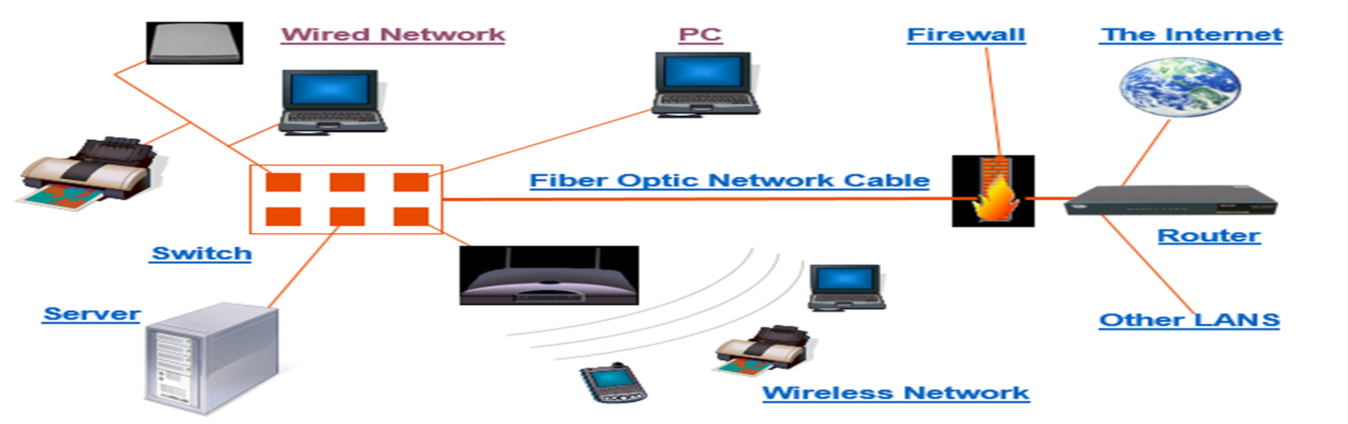

Slide 8
USES OF COMPUTER NETWORKS
Business Applications
  Resource sharing - to distribute information throughout the company
  Client-server model
  Communication medium – email, VoIP
  Desktop sharing
  e-commerce
Home Applications
  peer-to-peer
Mobile Users
Social Issues

Slide 9
Types of computer networking which are used world wide
  LAN - Local Area Network
  WAN - Wide Area Network
  WLAN - Wireless Local Area Network
  PAN - Personal Area Network
  SAN - Storage Area Network
  GAN - Global Area Network
  MAN - Metropolitan Area Network
  CAN - Controller Area Network
  DAN - Desk Area Network
  VPN - Virtual Private Network

Slide 10
Types of Network based on size
The types of network are classified based upon the size, the area it covers and its physical architecture. The three primary network categories are LAN, WAN and MAN. Each network differs in their characteristics such as distance, transmission speed, cables and cost.

Slide 11
Basic types
LAN (Local Area Network) – Wired and Wireless LANs
Group of interconnected computers within a small area. (room, building, campus)
Two or more pc's can from a LAN to share files, folders, printers, applications and other devices.
Coaxial or CAT 5 cables are normally used for connections.
Due to short distances, errors and noise are minimum.
Data transfer rate is 10 to 100 mbps.
Example: A computer lab in a college.

Slide 12
Wired LANs
transceivers
●     
Ethernet bus
Ethernet hub
Copyright ©2000 The McGraw Hill Companies
Leon-Garcia & Widjaja: Communication Networks
Figure 1.17

Slide 13
WLAN (Wireless LAN)
  A LAN that uses high frequency radio waves for communication.
  Provides short range connectivity with high speed data transmission.

Slide 14
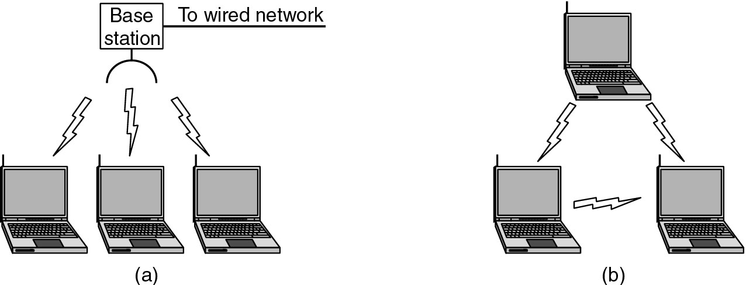
Wireless LANs
(a) Wireless networking with a base station. (b) Ad hoc networking.

Slide 15
MAN (Metropolitan Area Network)
Design to extend over a large area.
  campus networks connecting LANs logically or physically.
  often have a backbone
Connecting number of LAN's to form larger network, so that resources can be shared.
Networks can be up to 5 to 50 km.
Owned by organization or individual.
Data transfer rate is low compare to LAN.
Example: Organization with different branches located in the city.

Slide 16
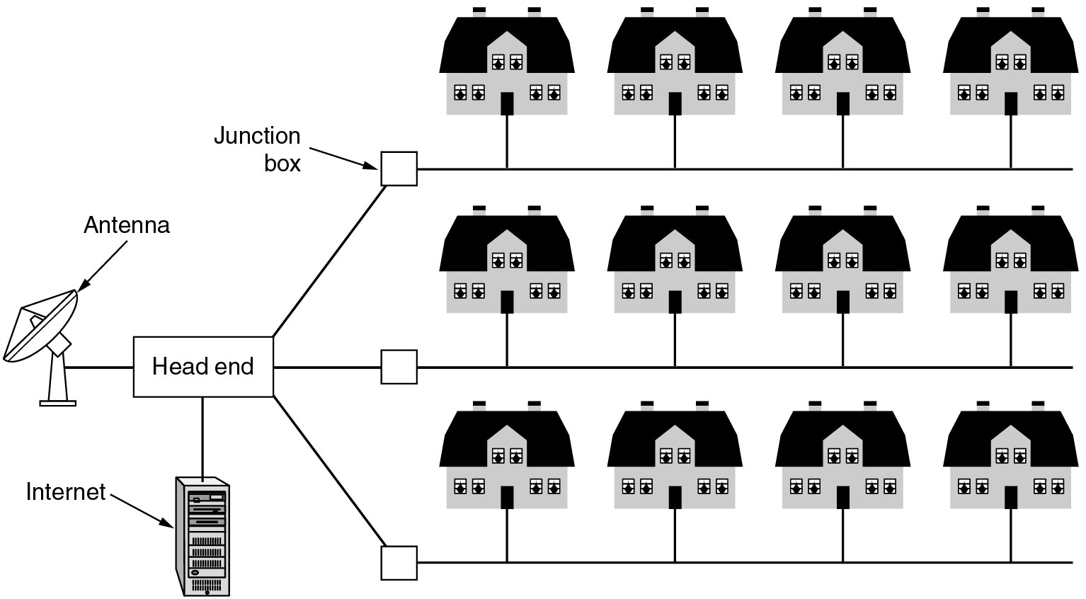
Metropolitan Area Networks
A metropolitan area network based on cable TV.

Slide 17
WAN (Wide Area Network)
country and worldwide network.
Contains multiple LAN's and MAN's.
Distinguished in terms of geographical range.
Uses satellites and microwave relays.
Data transfer rate depends upon the ISP provider and varies over the location.
Best example is the internet.

Slide 18
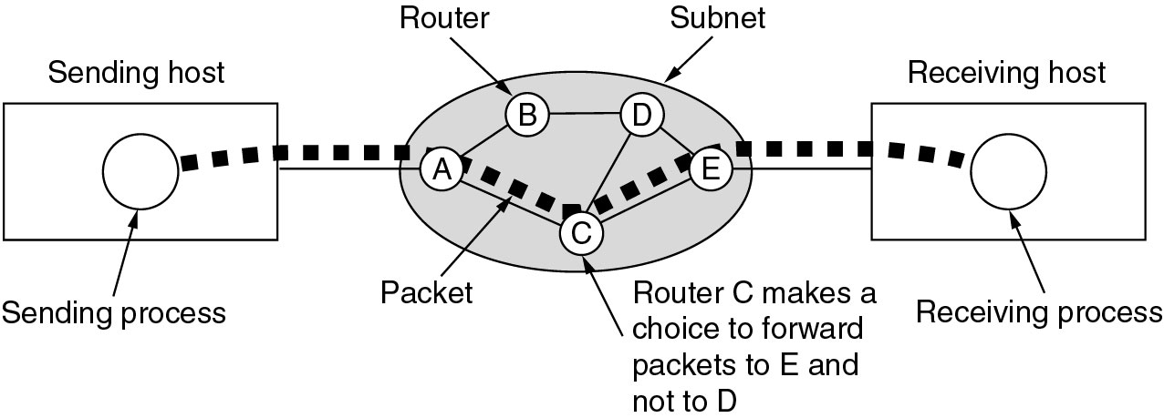
Wide Area Networks (WANs)
A stream of packets from sender to receiver.

Slide 19
Other types
PAN (Personal Area Network)
  Network organized by the individual user for its personal use with technologies that communicate over short ranges.
SAN (Storage Area Network)
  Connects servers to data storage devices via fiber-optic cables.
  E.g.: Used for daily backup of organization or a mirror copy

Slide 21
Data Communication
When we communicate, we are sharing information.
This sharing can be local or remote.
Between individuals, local communication usually occurs face to face, while remote communication takes place over distance.
A data communications system has five components

Slide 22
Message
The message is the information (data) to be communicated.
Sender
The sender is the device that sends the data message.
Receiver
The receiver is the device that receives the message.
Transmission medium
The transmission medium is the physical path by which a message travels from sender to receiver.
Protocol.
A protocol is a set of rules that govern data communications. It represents an agreement between the communicating devices. Without a protocol, two devices may be connected but not communicating,

Slide 23
Data Representation
Information today comes in different forms such as text, numbers, images, audio, and video.
Text
  In data communications, text is represented as a bit pattern, a sequence of bits (0s or 1s).
  Different sets of bit patterns have been designed to represent text symbols. Each set is called a code, and the process of representing symbols is called coding.
  Today, the prevalent coding system is called Unicode, which uses 32 bits to represent a symbol or character used in any language in the world.
  Unicode stands for Universal Character Set. ASCII stands for American Standard Code for Information Interchange. Unicode is standardized by the IT industry to be used in encoding and representing characters in computers. ASCII is used for electronic communication and in programming languages such as HTML.
  ASCII developed some decades ago in the United States, now constitutes the first 127 characters in Unicode and is also referred to as Basic Latin.

Slide 24
Numbers
  Represented by bit patterns.
  However, a code such as ASCII is not used to represent numbers; the number is directly converted to a binary number to simplify mathematical operations.
Images
  Represented by bit patterns.
  In its simplest form, an image is composed of a matrix of pixels (picture elements), where each pixel is a small dot.
  The size of the pixel depends on the resolution. e.g. 1920x1080

Slide 25
Audio
  refers to the recording or broadcasting of sound or music.
  is by nature different from text, numbers, or images. It is continuous, not discrete.
Video
  refers to the recording or broadcasting of a picture or movie. Video can either be produced as a continuous entity (e.g., by a TV camera), or it can be a combination of images, each a discrete entity, arranged to convey the idea of motion.

Slide 26
Communication Media
A path through which information are transmitted from one place to another is called communication media. It is also referred to as communication medium or link.
In network communication, the communication media’ are wires, cables and other means through which information travels from its source to its destination.

Slide 27
Features of a communication Media
Transmission speed (measured in bps)
Bandwidth (capacity of communication media, measure is Hertz or bps)
It measures the amount of information that can be transmitted through the media within the given period of time.
  For analog signals bandwidth is represented in hertz (Hz).
  For digital signals, it is represented in bits per second (bps).
Transmission mode
  Asynchronous transmission
  Synchronous transmission
Transmission direction
  Simplex
  Half duplex
  Full-duplex

Slide 28
Asynchronous and Synchronous transmission
Asynchronous transmission is where data is transmitted one character at a time, where each character is five to eight bits in length.
The most common transfer rates in these are between 1200 & 19200 bits per second.
This is used mainly to transfer medium quantities of data over a long distances.

Slide 29
Synchronous transmission is a mode of transmission where data is transferred in a block of bits at a go without a start and stop.
It is a more efficient mode of transfer used mainly to transfer large quantities of data e.g. contents in disk already assembled.

Slide 30
Data Flow
Communication between two devices can be simplex, half-duplex, or full-duplex

Slide 31
Simplex
  In simplex mode, the communication is unidirectional, as on a one way street. Only one of the two devices on a link can transmit; the other can only receive. Keyboards and traditional monitors are examples of simplex devices.
Half-Duplex
  In half-duplex mode, each station can both transmit and receive, but not at the same time. When one device is sending, the other can only receive, and vice versa. Walkie-talkies and CB (citizens band) radios are both half duplex systems.
Full-Duplex
  In full-duplex, both stations can transmit and receive simultaneously. One common example of full-duplex communication is the telephone network. When two people are communicating by a telephone line, both can talk and listen at the same time. The full-duplex mode is used when communication in both directions is required all the time.

