Slide 1
Network Hardware and Software

Slide 2
Computer network consists of two or more computers that are linked in order to share resources, exchange data files or to allow electronic communication. The computers on a network may be linked through cables, telephone lines, radio waves, satellites or infrared light beams.
There are two aspects of computer networks – hardware and software.
Hardware includes physical connection between two machines by using adaptors, cables, routers, bridges etc.
software includes a set of protocols. Protocols define a formal language among various components. It makes hardware usable by applications.

Slide 3
Network Hardware- Physical Structures
Classifying Networks by Transmission Technology- Type of Connection
  A network is two or more devices connected through links. A link is a communications pathway that transfers data from one device to another.
  There are two possible types of connections: point-to-point and multipoint.
Point-to-Point
A point-to-point connection provides a dedicated link between two devices. The entire capacity of the link is reserved for transmission between those two devices.
Most point-to-point connections use an actual length of wire or cable to connect the two ends, but other options, such as microwave or satellite links, are also possible
When you change television channels by infrared remote control, you are establishing a point-to-point connection between the remote control and the television's control system.

Slide 4
Multipoint
A multipoint (also called multi-drop) connection is one in which more than two specific devices share a single link
In a multipoint environment, the capacity of the channel is shared, either spatially or temporally.
If several devices can use the link simultaneously, it is a spatially shared connection. If users must take turns, it is a timeshared connection.
broadcast :: a single communications channel shared by all machines (addresses) on the network.
multicast :: communications to a specified group.

Slide 6
Network Software
The first computer designed with the hardware as the major concern and the software as an afterthought. This no longer works.
Network software is now highly structured.
  • Protocol Hierarchies
  • Design Issues for the Layers
  • Connection-Oriented and Connectionless Services
  • Service Primitives
  • The Relationship of Services to Protocols

Slide 7
Protocol Hierarchies
To reduce the design complexity, most networks are organized as a series of layers or levels. Each one built upon the one below it.
The number of layers, name of each layer, contents of each layer and the function of each layer differ from network to network.
Layer n on one machine carries on a conversation with layer n on another machine. The rules and conventions used in this conversation are collectively known as the layer n protocol.
Basically, a protocol is an agreement between the communicating peers on how communication is to proceed.

Slide 8
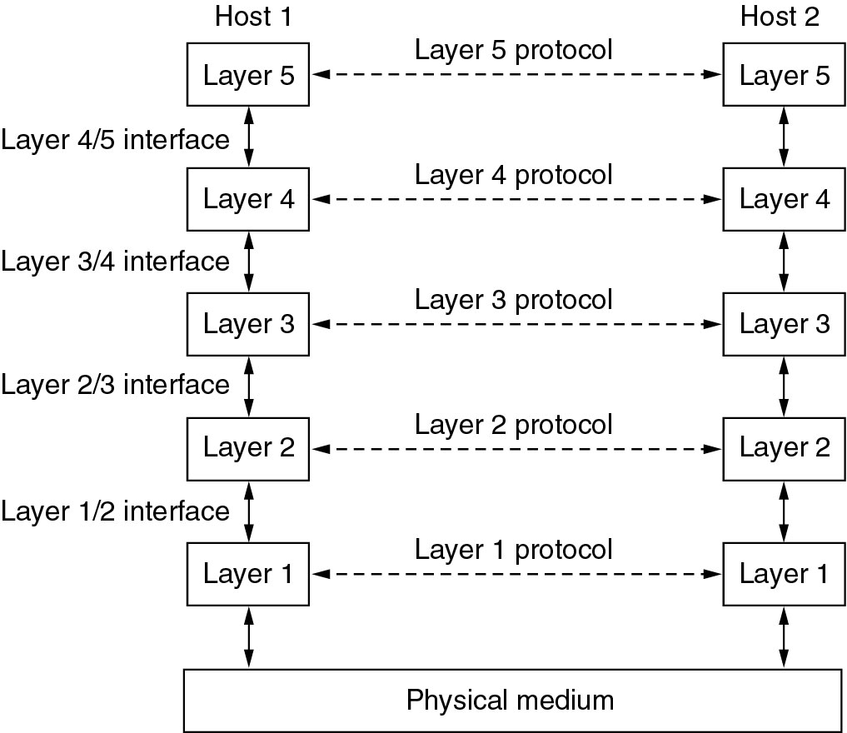
The layering Principle

Slide 9
Between each pair of adjacent layers there is an interface.
A set of layers and protocols is called a network architecture.
A list of protocols used by a certain system , one protocol per layer, is called a protocol stack.

Slide 10
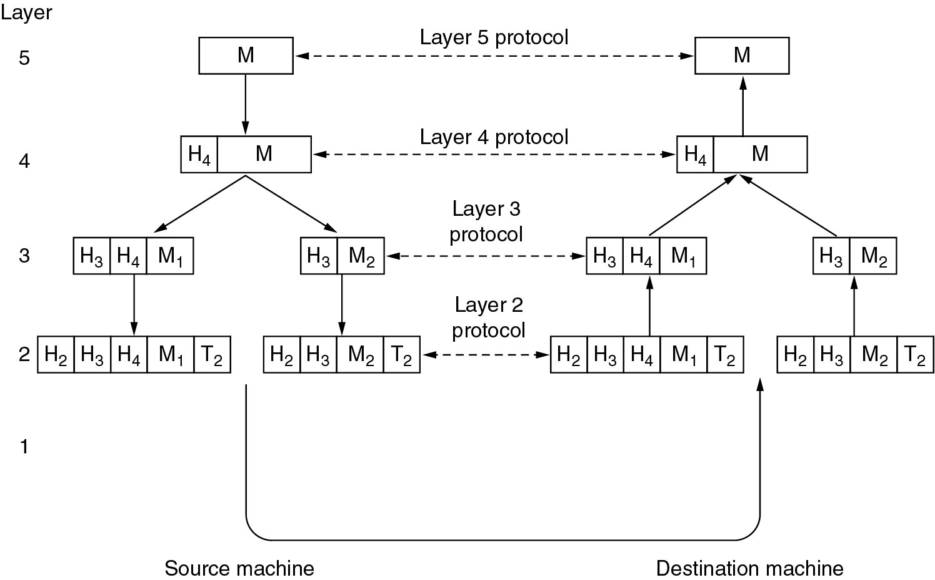
The layering Principle

Slide 11
Design Issues for the Layers
Addressing – each layer needs a mechanism for identifying senders and receivers.
The rules of data transfer – simplex, half-duplex, full duplex
Error Control – error-correction and error-detection
Flow Control - The communication channels must preserve the order of messages sent on them – disassembling, transmitting, and then reassembling.
Multiplexing – inconvenient or expensive to set up a connection for each pair of communication process.
Routing – multiple paths between source and destination, a route must be chosen

Slide 12
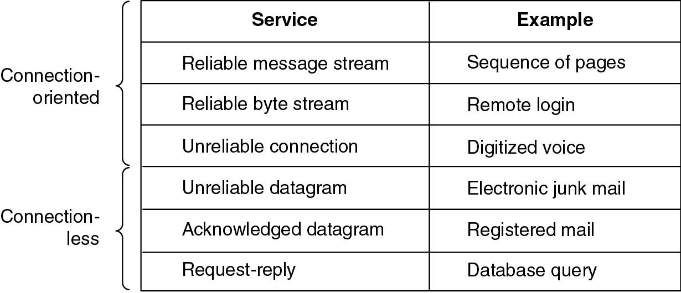
Connection-Oriented vs. Connectionless

Slide 13
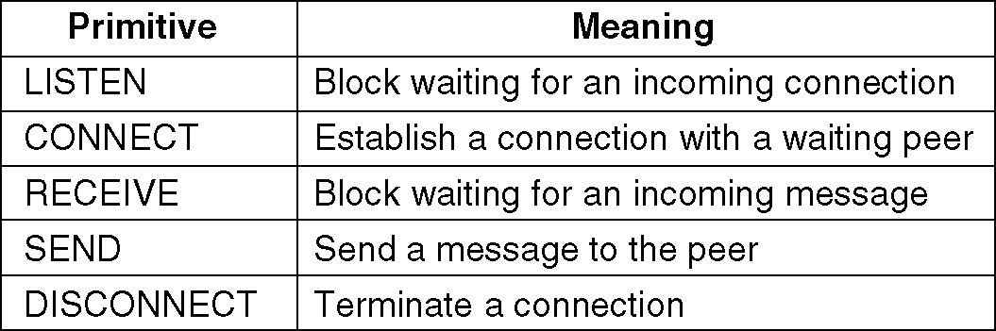
Service Primitives
A service is formally specified by a set of primitives (basic operations) available to a user or other entity to access the service.
Example: five service primitives for implementing a simple connection-oriented service.
Notes:
Another example with html

Slide 14
Services to Protocols Relationship
The relationship between a service and a protocol.
A service is a set of primitives(operations)that a layer provides to the layer above it
A protocol is a set of rules governing the format and meaning of the frames, packets, or messages that are exchanged by the peer entities within the layer

Slide 15
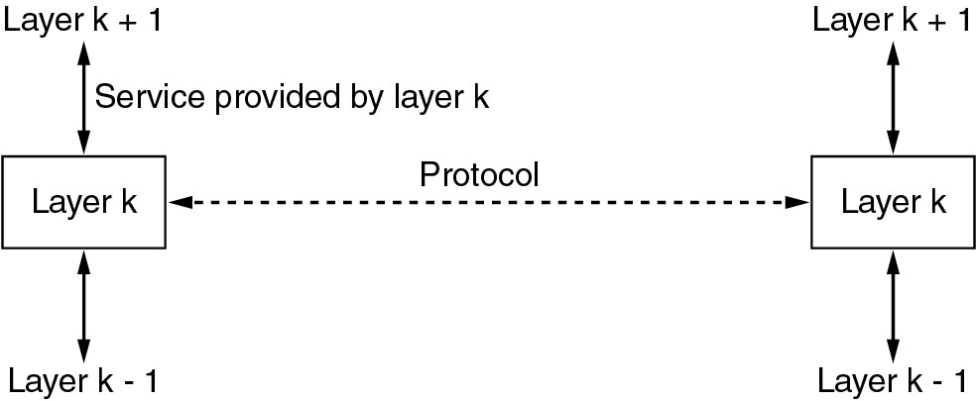
The relationship of Service

Slide 16
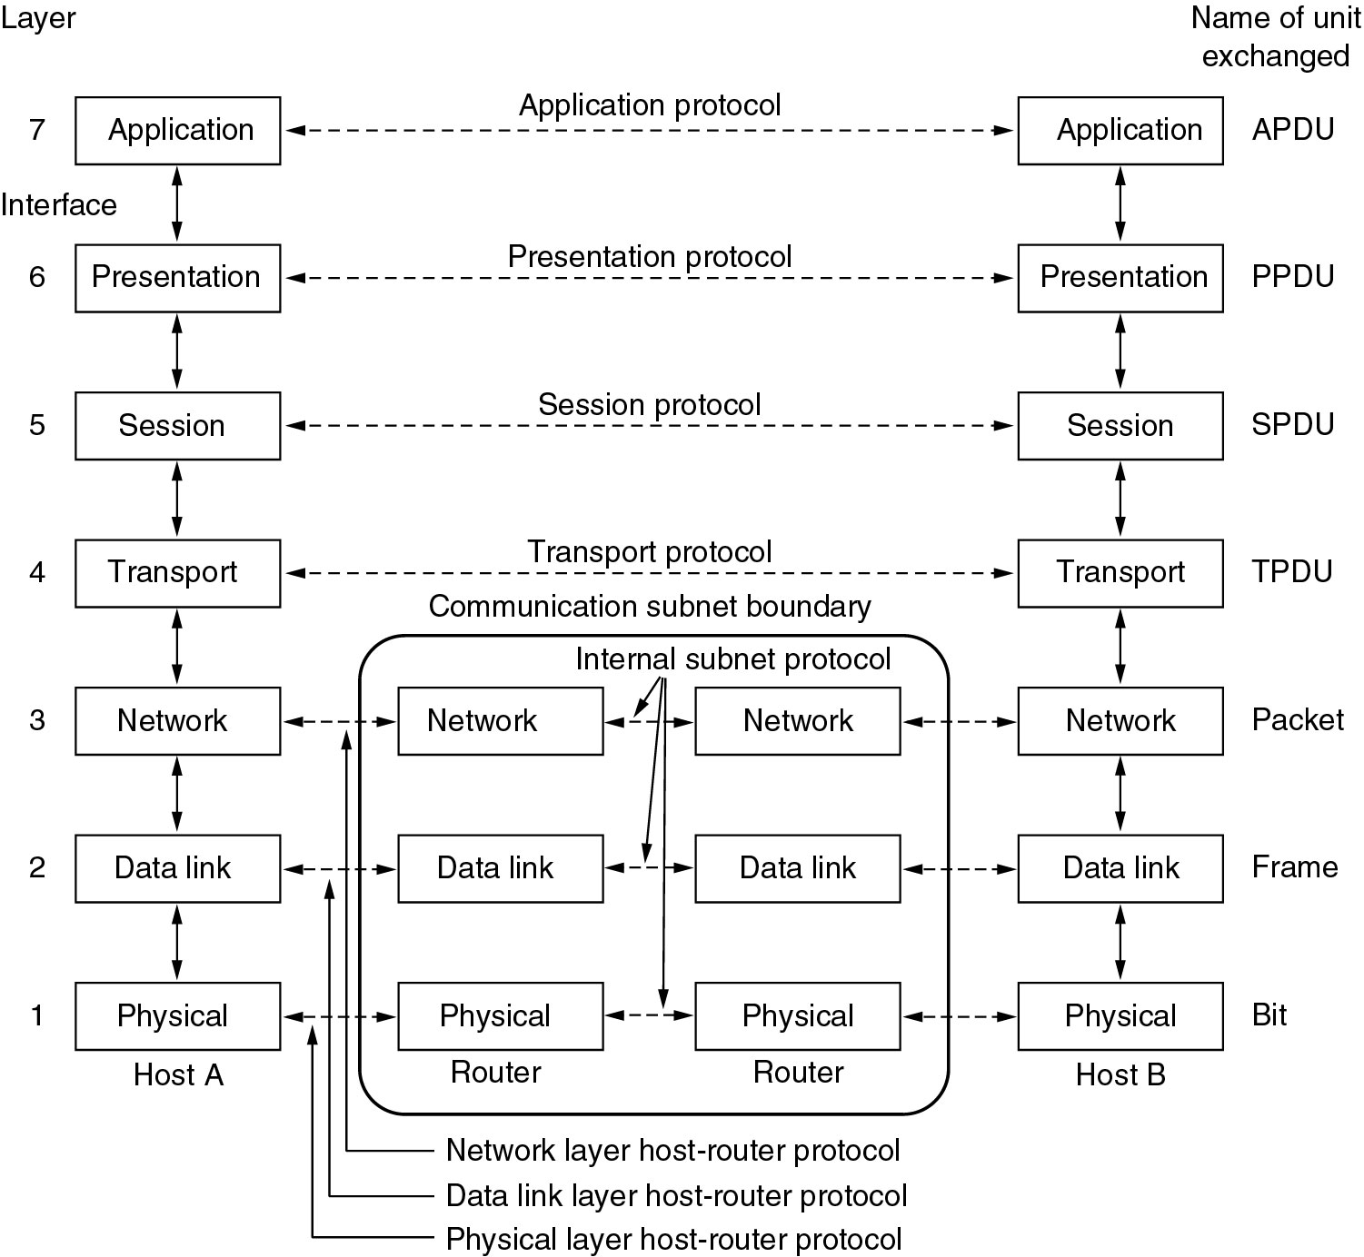
The OSI Reference Model

Slide 17
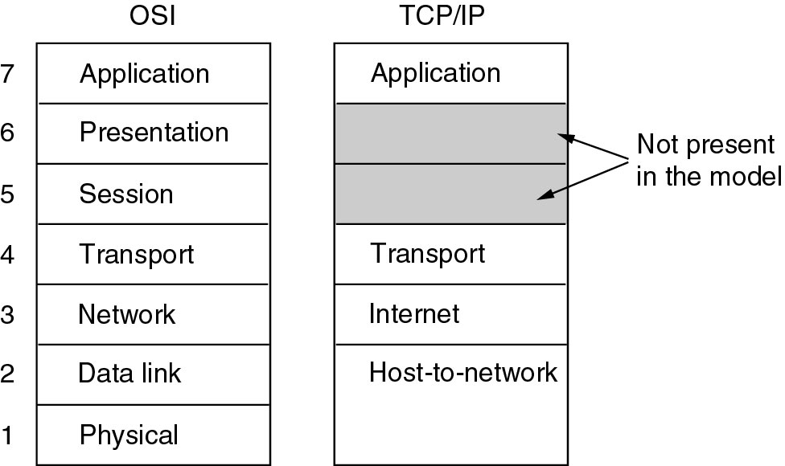
The TCP/IP Reference Model

Slide 18
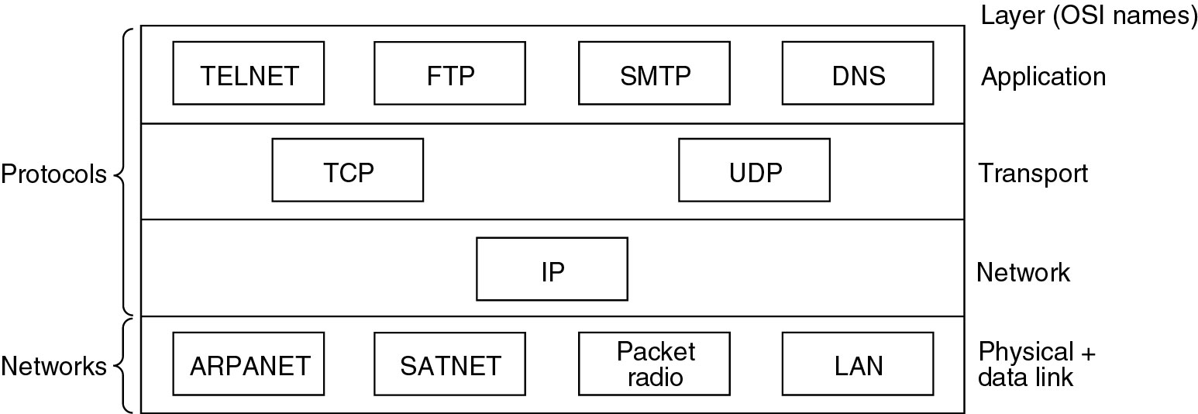
The TCP/IP Reference Model
Protocols and networks in the TCP/IP model initially.

Slide 19
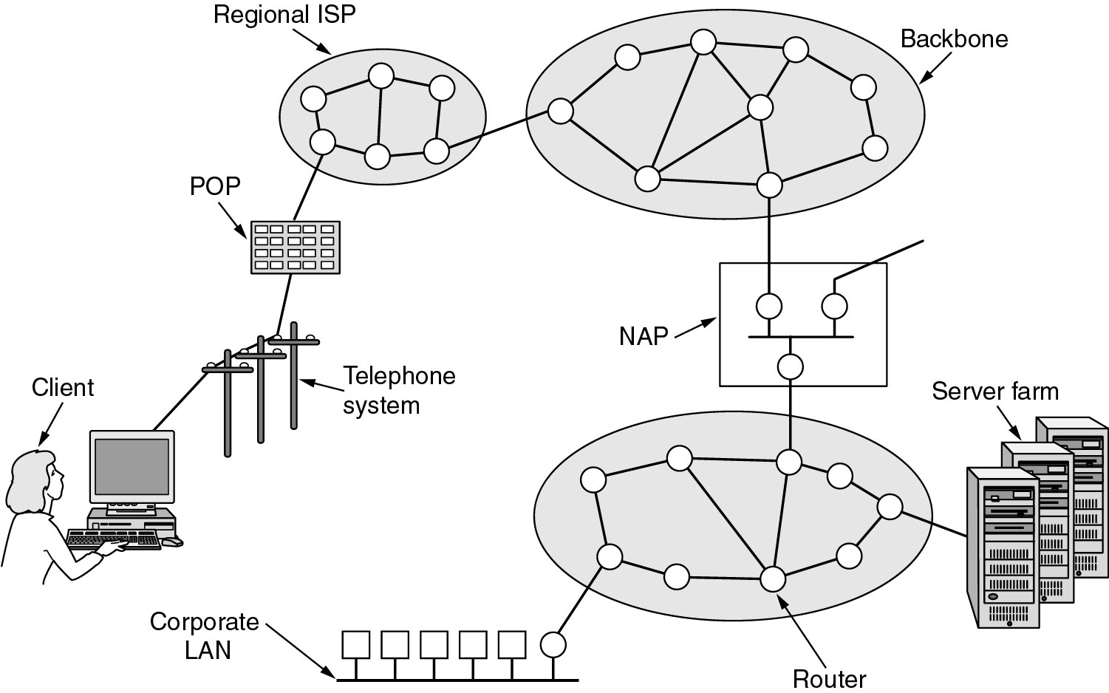
The TCP/IP Reference Model
Overview of the Internet.
Notes:
Add a logical view

