Slide 1
Topology

Slide 2
Network Topology
Topology
  Logical layout of wires and equipment
A network configuration is also called a network topology.
A network topology is the shape or the physical connectivity of the network. i.e. it defines how the nodes of a network are connected.
Three major goals when establishing the topology of a network:
  provide maximum possible reliability to assure proper receipt of all traffic -Alternate routing
  Route the traffic across the least cost path within the network between the sending and receiving Data Terminating Equipments ( DTEs)
  Give the end user the best possible response time and throughput.

Slide 3
Network Topology: Physical & Logical
A network is defined by a physical topology and a logical topology.
Physical topology defines how the nodes of the network are physically connected i.e. the configuration of cables, computers and other peripherals.
Logical topology - dedicated connections between certain selected source-destination pairs using the underlying physical topology.
  In order to have an efficient system, the logical topology should be chosen such that either the average hop distance or the packet delay or the maximum flow on any link must be minimal.
  Another important issue to select the logical topology is the simplicity of the routing.

Slide 4
The nodes in a network can have following two relationships:
Peer to Peer: In this relationship, all the devices in the network have equal status in sharing the link. e.g. Ring & Mesh topology.
Primary-Secondary: In this, one device controls the traffic and all other devices transmit through primary device. e.g. Star topology.

Slide 5
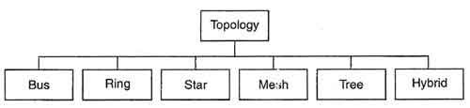
Taxonomy

Slide 6
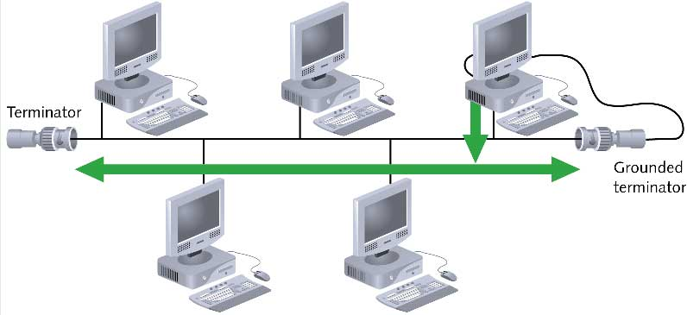
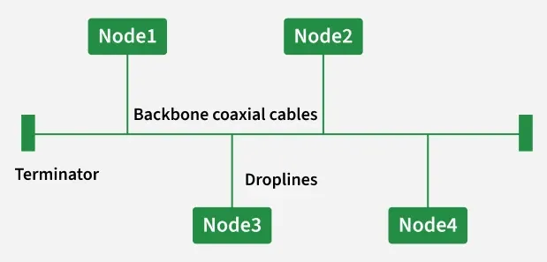
Bus

Slide 7
Linear Bus topology
A linear bus topology consists of a main run of cable with a terminator at each end.
All servers, workstations and peripherals are connected to the linear cable.
Single cable connects all network nodes without intervening connectivity devices
  Terminators at the end of the cable stop signals and prevent the signal from reflecting back to the sender (signal bounce).
  This topology is useful in LANs. It does not rely on central host.

Slide 8
Devices share responsibility for getting data from one point to another.
When a station sends a message, it is broadcast down on the cable in both directions. All stations on the cable constantly monitor for messages meant to them. When a station detects a message meant for it, it reads the message from the cable and the other stations will ignore it.
Since all stations are sharing the same cable, some form of control is needed to make sure which station will transmit when, otherwise there will be a collision.

Slide 9
Advantages:
Easy to setup
Small amount of wire
This network can still function if one of the computers malfunctions, easy to wire, quick response, less expensive
Works well for small networks
Relatively inexpensive to implement
Disadvantages:
Slow
Easy to crash
Not very scalable
Difficult to troubleshoot, not fault-tolerant - bad connection to the cable can short it and bring down the entire network
Collision occurs when two nodes send messages simultaneously. Management costs can be high
Potential for congestion with network traffic

Slide 10
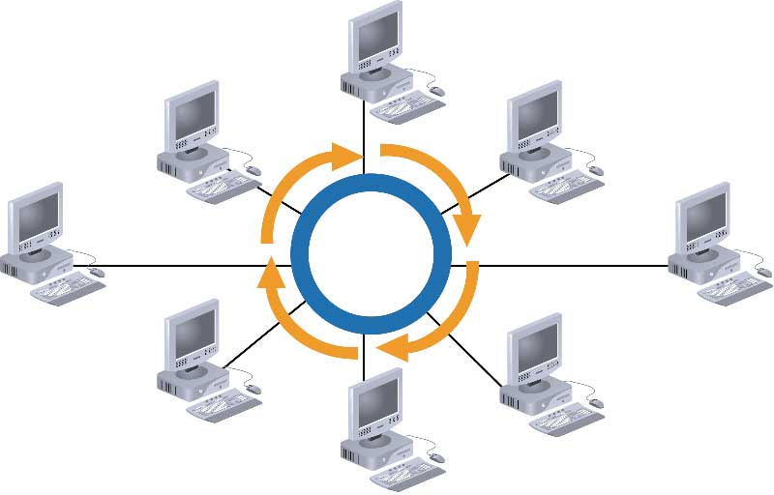
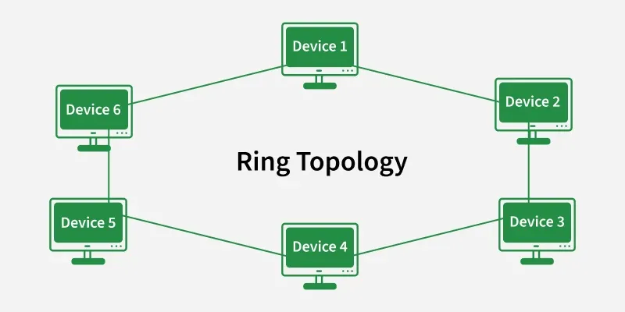
Ring

Slide 11
Ring topology
A ring network is one where all workstations and other devices are connected in a continuous loop. There is no central server. Each node is connected to the two nearest nodes so the entire network forms a circle.
Each node transmits data. The transmitted signal is regenerated at each node.
It is a shared-access network and it has the capability of broadcasting messages.
It needs some form of access control to determine which node will transmit when.
  One method for passing data on ring networks is token passing.

Slide 12
There are two kinds of ring topologies:
Single Ring: In single ring network, a single cable is shared by all the devices and data travel only in one direction. Each device waits for its turn and then transmits. When the data reaches its destination, another device can transmit.
Dual Ring: This topology uses two rings to send the data, each in different direction. Thus allowing more packets to be sent over the network.

Slide 13
Advantages of Ring Topology
This topology is useful in LANs. It does not rely on central host.
The most important advantage of this network is its point-to-point connections. Easier to manage; The structure of this network is very simple and it is very easy to insert and delete any number of nodes. Easily scalable and highly modular.
Enables reliable communication, Easier to locate a defective node or cable problem, this network can still function even if one of the computers malfunctions. Fault isolation and recovery are much simpler
Well-suited for transmitting signals over long distances on a LAN
Handles high-volume network traffic

Slide 14
Disadvantages of Ring Topology
Expensive
Requires more cable and network equipment at the start
Not used as widely as bus topology
  Fewer equipment options
  Fewer options for expansion to high-speed communication
It offers only two alternate routes and thereby it can manage only a single fault.
Another important drawback of ring network is its large diameter.
If diameter of a network is high, the number of edges involved in each communication will also be very high resulting in high signal attenuation and network blocking probability.

Slide 15
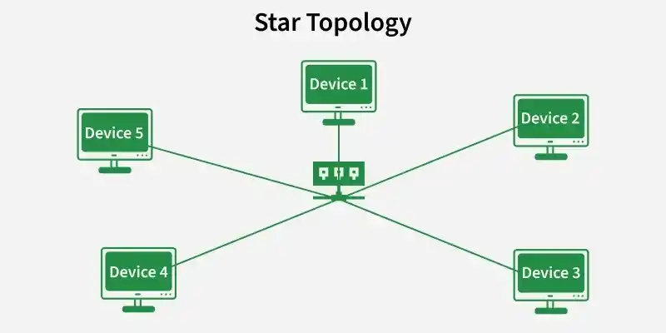
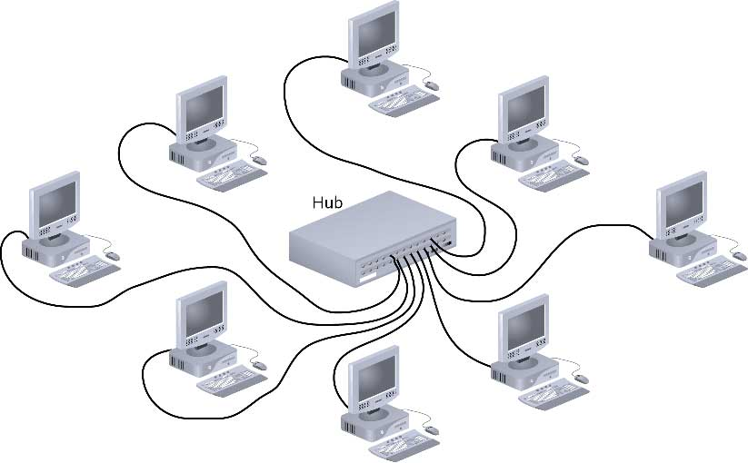
Star

Slide 16
This topology is useful for applications where processing must be centralized and some can be performed locally.
In star network, each station is connected via a point-to-point link to a central point.
This central point is called hub, multi port repeater, or concentrator.
The central point may be “passive”, “active”, or “intelligent”.
  A passive hub simply connects the arms of a star, no signal regeneration is performed.
  An active hub is like a passive hub, except that it regenerates signals.
  Intelligent hubs not only regenerate signals but also perform activities such as intelligent path selection and network management.

Slide 17
Any single cable connects only two devices
  Cabling problems affect two nodes at most
Requires more cabling than ring or bus networks
  More fault-tolerant
Easily moved, isolated, or interconnected with other networks
  Scalable
Supports max of 1024 addressable nodes on logical network

Slide 18
Advantages
Since all information in a star network goes through a central point, stars are easy to troubleshoot.
Good option for modern networks
Low startup costs
Easy to manage
Offers opportunities for expansion
Most popular topology in use; wide variety of equipment available

Slide 19
Disadvantages
Hub is a single point of failure all communication pass through the central one.
Requires more cable than the bus

Slide 20
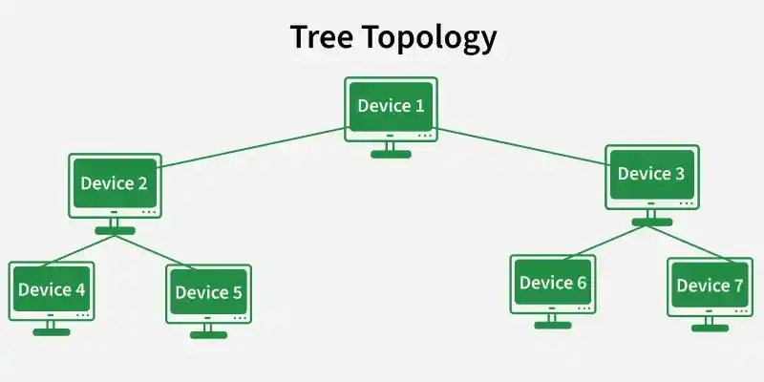
A Hub/Tree Network
Hub
End node
Hub
Hub
Hub
Hub

Slide 21
A tree or hybrid topology combines characteristics of linear bus and star and/or ring topologies.
It consists of groups of star-configured workstations connected to a linear bus backbone cable
In hub or tree network, the wires that are used to connect different nodes are collapsed into a central unit, called hub.
Hub does not perform switching function.
It consists of repeaters that retransmitted all the signals from nodes to all other nodes in the same way.

Slide 22
Advantages
Supported by several hardware and software venders.
It allows more devices to be attached to a single central hub and can therefore increases the distance a signal can travel between devices.
It allows the network to isolate and prioritize communication from different computers i.e. the computers attached to one secondary hub can be given priority over the computers attached to another secondary hub.

Slide 23
Disadvantages
The multipoint nature of tree topology gives rise to several problems.
Overall length of each segment is limited by the type of cabling used. If the backbone line breaks, the entire segment goes down. More difficult to configure and wire than other topologies. It has higher cabling cost in setting up a tree structure.
The access control is fairly difficult to determine the time slot for each node.
Another problem with multipoint is signal balancing.
When two device exchange data over a link, the signal strength of the transmitter should be adjusted. If it is low, after attenuation, it might not meet the minimum signal strength requirement of the transmitter and minimum signal to noise ratio. If it is very high, it can overload the circuitry of the transmitter resulting in harmonics and other spurious signals.

Slide 24
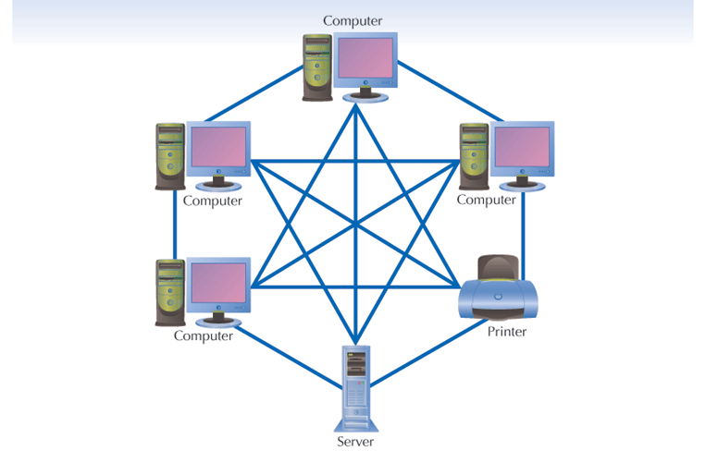
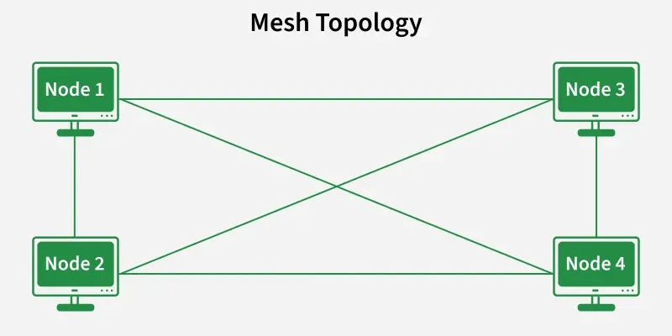
Mesh Topology

Slide 25
Mesh Topology
The mesh network topology uses redundant connections between the node on the network, applying a fault tolerance strategy.
Each node included in the network connected to the rest of the node,

Slide 26
Advantages of Mesh Topology
It is robust as the failure of one node does not collapse the entire system. If one link fails, the entire system continues to work.
There is no traffic congestion problem as dedicated links are being used.
Dedicated links ensure faster transmission without any delay.
Dedicated links also ensure data privacy and security.
Point to point links makes fault identification and isolation easier.

Slide 27
Disadvantages of Mesh Topology
Mesh networks are more expensive
difficult to install than other types of network topologies Connecting each device to every other device in the network makes installation and reconfiguration difficult due to the large number of connections they require.
It has high cabling cost as n (n-l)/2 links are required to connect n nodes.

Slide 28
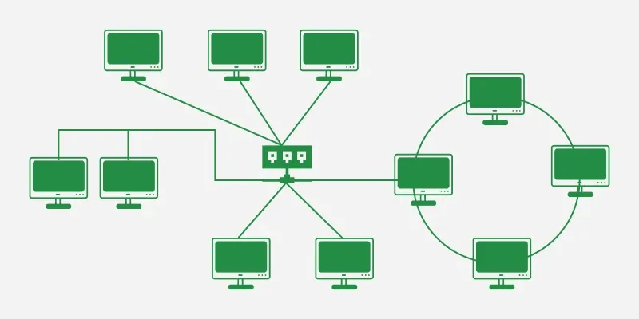
Hybrid Physical Topologies

Slide 29
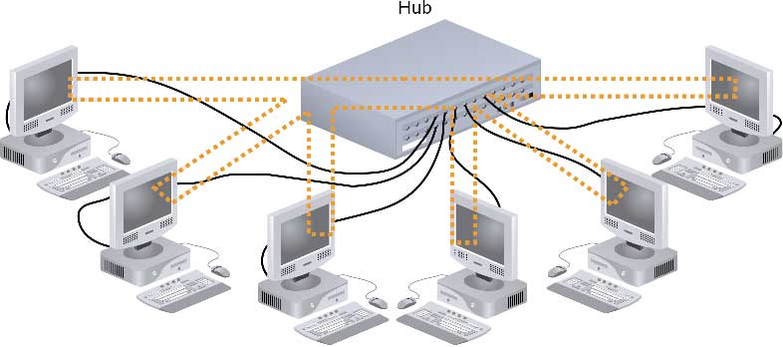
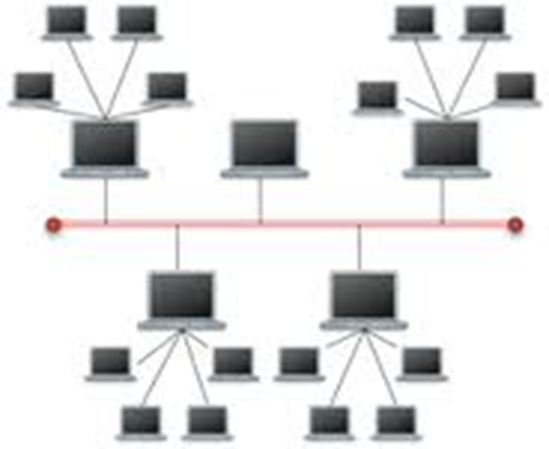
Star-Wired Ring

Slide 30
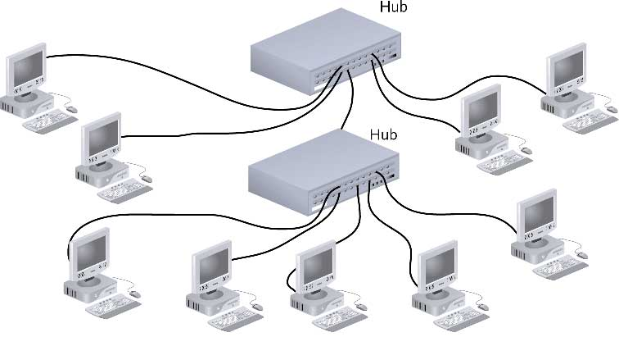
Star-Wired Bus

